Slide 1
USER’S GUIDE BUDGET MANAGEMENT
PLEASE READ INSTRUCTIONS BEFORE LOGGING INTO THE SYSTEM
Questions may be addressed to your Division Budget Administrator

Slide 2
TABLE OF CONTENTS
I. Logging into the Colleague …………………………………………………..……. Page 1
II Navigation Tips ……………………………………………………………….…….… Page 2
Colleague Toolbar Icons ………………………………………………….…..…. Page 2
III Accessing Budget Management ……………………………..……….…….. Page 3
1. Select CF, Colleague Financials …………………………….…………….….…. Page 4
2. Open Budget Management ……………………………………..…….……... Page 4
3. Move to RWLI, Budget Responsibility Worksheet Line …….……. Page 5
4. RWLI, Budget ID LookUp …………………………………………….…….…... Page 6
5. Budget Responsibility Resolution ………………………………….…….…. Page 7
6. Adjustment to Dollar Amounts ………………………………..……….…… Page 8
7. BNJS – Budget Justification Notes/Scenarios …………………….…… Page 9-10
8. Save and Complete Process ……………………………………………....…. Page 11
IV Logging Out of Colleague …………………………………………………..…. Page 12
V Report Instructions and Example……………………………………………... Page 13
1. Select CF, BU, BWR & ODWP - Officer Budget Detail Worksheet. Page 14
2. Processing and Printing Instructions……………………………………..…. Page 14-21

Slide 3
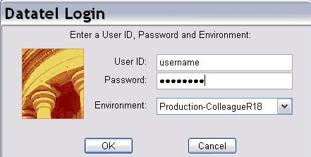
I Logging into Colleague
Select the Datatel Icon from your desktop or from the Start menu. Enter your username and password as illustrated. Select OK or enter.

Slide 4
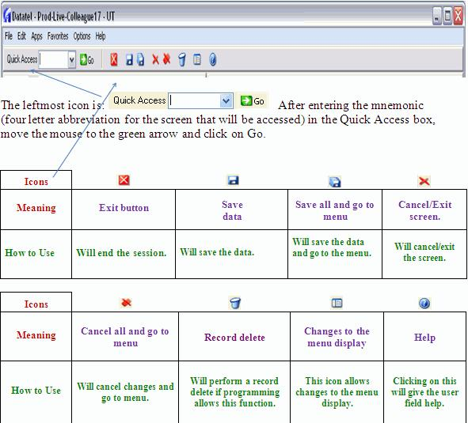
II Navigation Tips in Colleague
Colleague Toolbar Icons

Slide 5
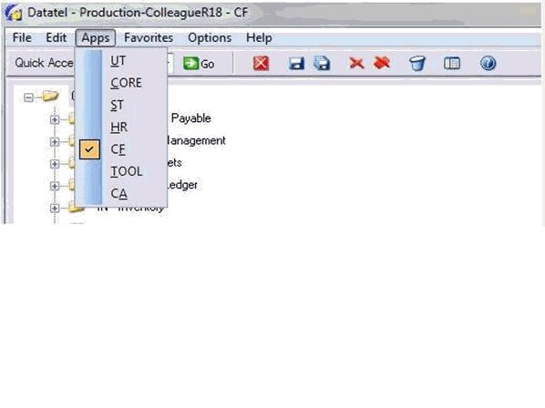
III Accessing Budget Management
1. From the APPS Menu, select CF, Colleague Financials.

Slide 6
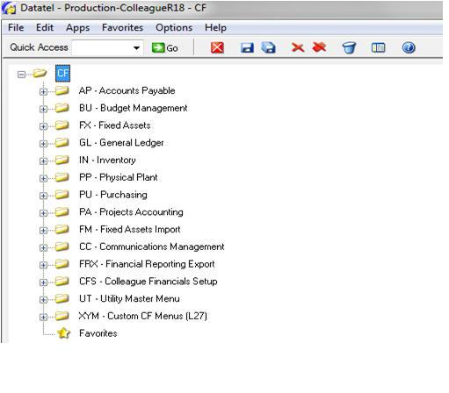
2. Next, from the CF menu, open BU, Budget Management

Slide 7
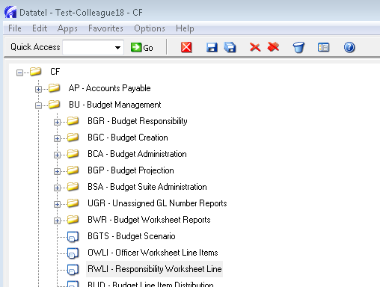
3. From the Budget Management Menu, open RWLI – Responsibility Worksheet Line.

Slide 8
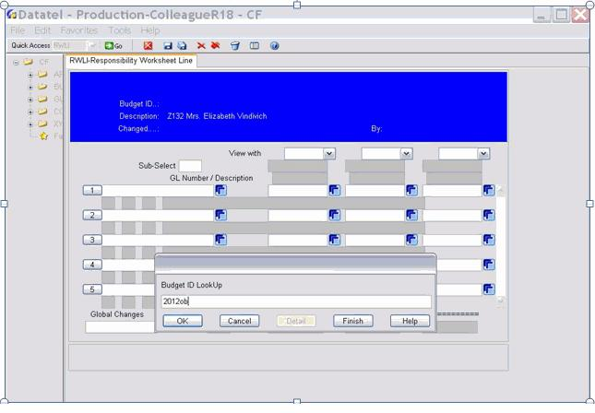
4. On RWLI, go to the Budget ID LookUp and type 2012ob then select OK or enter.

Slide 9
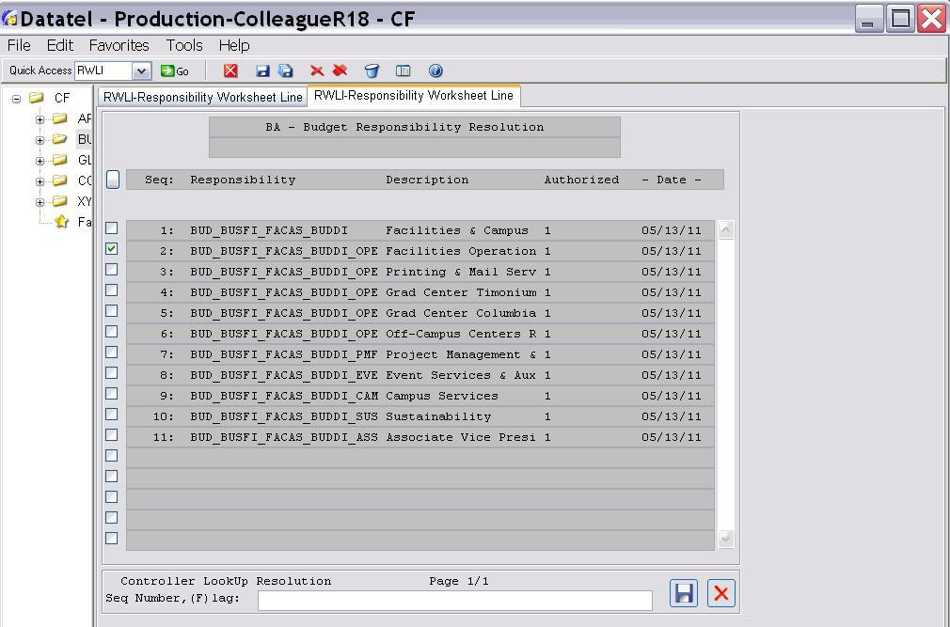
5. Check box of budget to review, then select the Save icon.

Slide 10
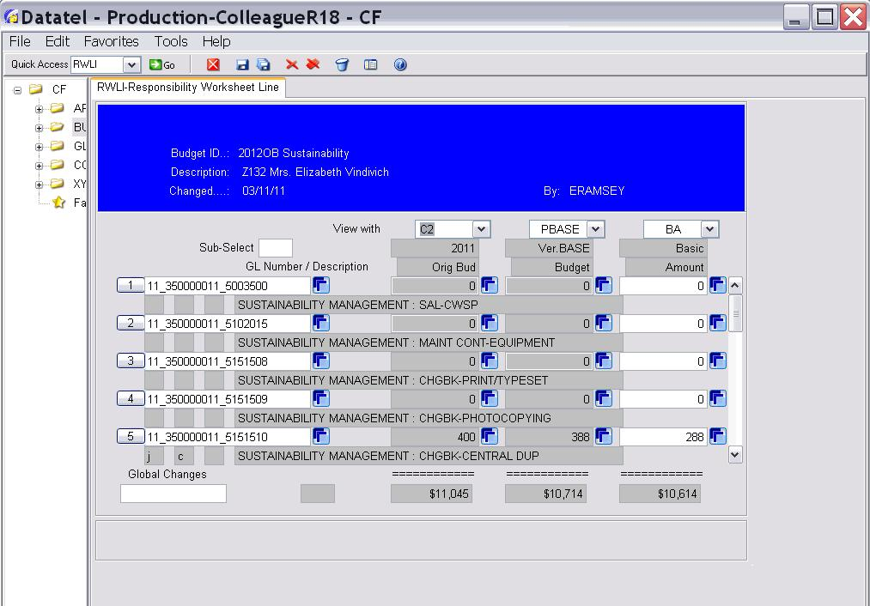
6. Adjustment to Dollar Amounts.
If the budget has more than one line, you can slide the bar up/down to the right of the dollar amounts. This enables you to see all lines in the budget.
C2 column represents the FY11 budget as originally allocated.
PBASE represents the FY12 budget assumption.
BA column is where your requests are made.

Slide 11
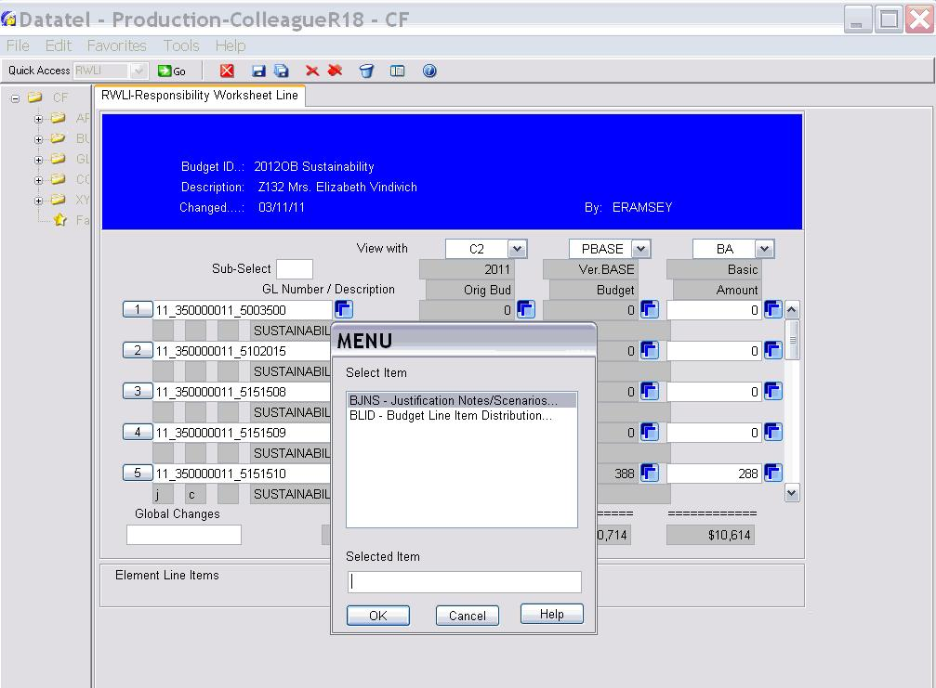
7. BJNS – Budget Justification Notes/Scenarios
Where total request in BA exceeds PBASE total, justification must be provided. Click on box to the right of dollar amounts in BA column. Highlight BJNS and click OK.
BJNS results on next page.

Slide 12
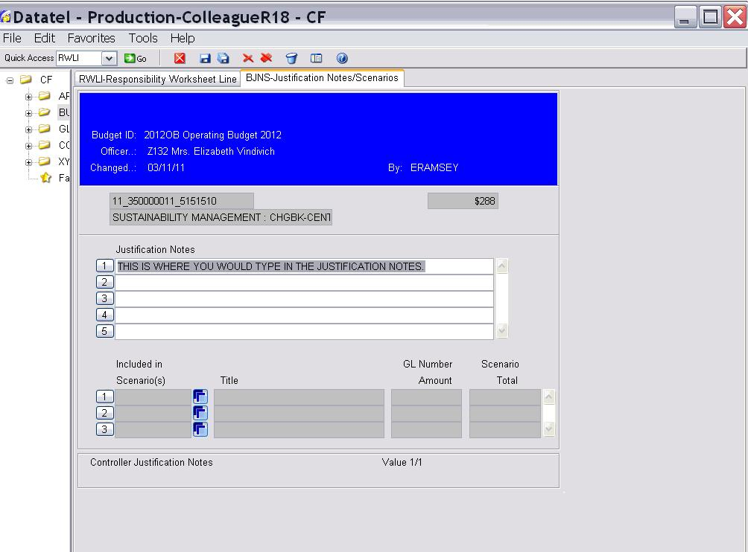
Type justification here.
Upon completion of justification, select the Save icon. This will take you back to the RWLI worksheet.

Slide 13
8. Save and Complete Process.
If a change is necessary or you find an error, select the Cancel icon and repeat appropriate Steps 4-8.
Once you are satisfied with the allocations in the BA Column, select the Save All icon. This will take you out of the adjustment screen and back to the beginning.
If you have more than one budget, repeat Steps from #1, select another budget, and follow through to Step 8.

Slide 14
IV Logging out of Colleague
To exit system, select either Icon to close.

Slide 15
If you would like to run reports on individual budgets (like the example below), please use instructions on the following pages.
If you want to run a report of individual budgets, follow these instructions.

Slide 16
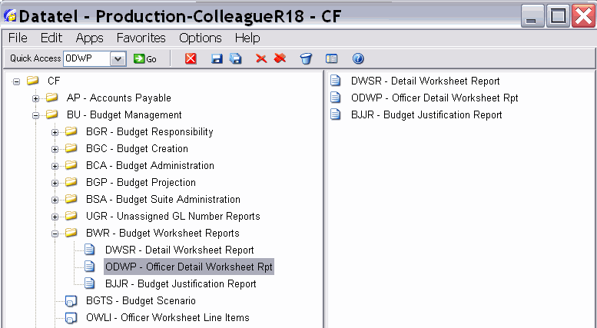
Login in to Colleague. Go to CF, BU then BWR and double click on ODWP.
Step 1

Slide 17
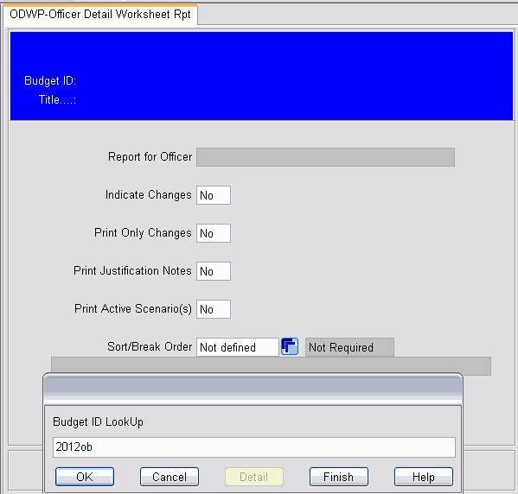
Step 2
Type in current budget 2012ob then select OK or hit enter.

Slide 18
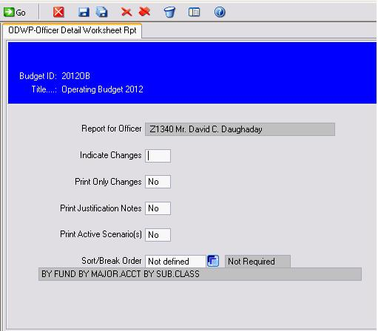
Step 3
Click on the blue box next to Not Defined.

Slide 19
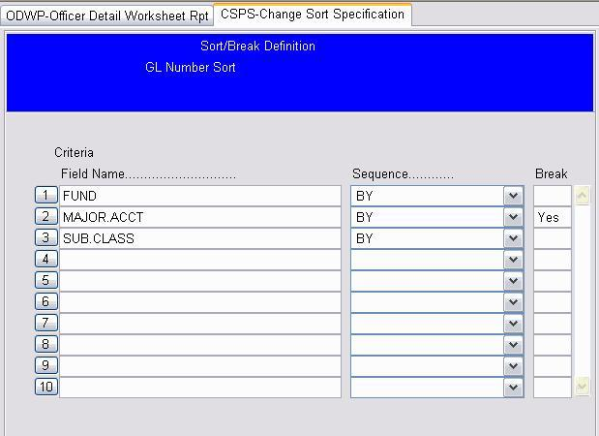
Save
Step 4
Type Yes then select the save icon.

Slide 20
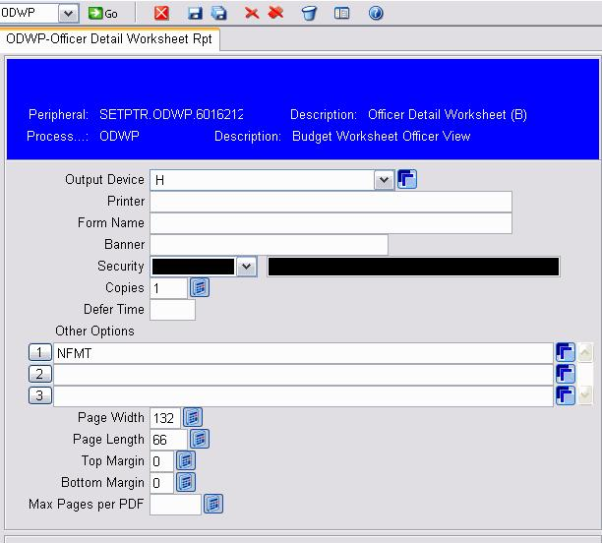
Save
Step 5
Change the P to an H (for Hold) then select the save icon.

Slide 21
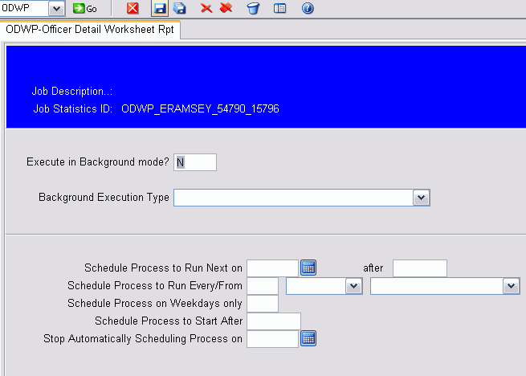
Save
Step 6
This screen will display. Select the save icon.

Slide 22
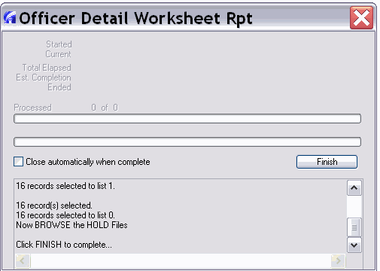
Step 7
Click on Finish when process is complete.

Slide 23
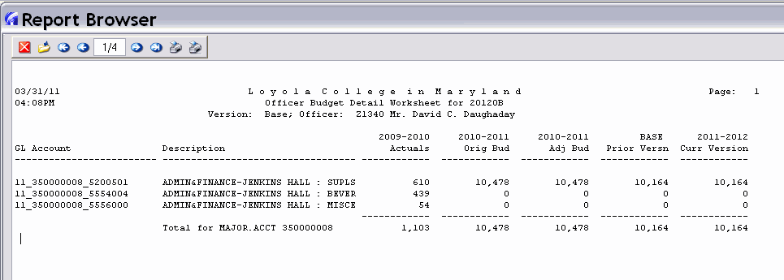
Step 8 This is the result page from Step 7.
Click the close icon to take you to the main menu.
Use the back arrow to move back.
Use the right arrow to move forward.
Use the print icon to print the reports to local printer.
Indicates there are 4 pages to this report.

