Slide 1
LOYOLA University Maryland
Sociology Department
Loyola Ready

Slide 2
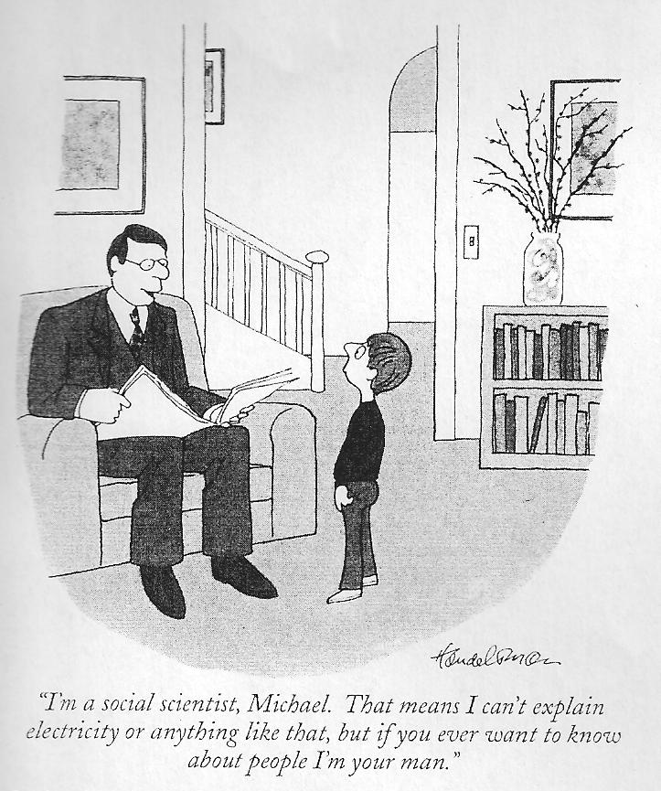
What is Sociology?
Sociology applies systematic research approaches to study human beings in their social contexts in order to explain behavior.

Slide 3
What is Sociology?
Sociology is the study of relationships between people as they participate in interactions in groups ranging in size and intimacy, from dyads to families, organizations, communities, nations, and even globally.

Slide 4
What is Sociology?
Sociology is an “imagination,” a way of seeing, a way of “connecting biography to history.” -- C. Wright Mills

Slide 5
What is sociology?
“The fascination of sociology lies in the fact that its perspective makes us see in a new light the very world in which we have lived all our lives... It can be said that the first wisdom of sociology is this--things are not what they seem.”
-Peter Berger

Slide 6
Why Sociology?
The most important problems of the 21st century will be social. How can we:
Avoid war and promote lasting peace?
Fight poverty and crime?
Advance democracy?
Minimize environmental destruction?
Advance civil and human rights?
Sociologists will be on the forefront in the search for answers

Slide 7
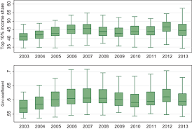
Why sociology?
It’s a terrific Interdisciplinary or Double Major combined with:
Biology
Psychology
Political Science
Languages
Global Studies
Communication
History
Writing
Speech Pathology
Statistics

Slide 8
Why study sociology?
Sociology is now a significant part of the MCAT - Studying sociology is important for students interested in medical fields.

Slide 9
What can I do with a BA in Sociology?
Sociology majors pursue employment in many differing fields! Such as …
Social research
Teaching
Policy analysis & development
Legal Practice
Attorneys & paralegals
Law enforcement
Federal, state, and local
Non-profit and for-profit management
Public relations
Human relations
Direct client services
Social work & healthcare

Slide 10
What can I do with a Bachelor’s Degree in Sociology?
Pursue graduate studies in a variety of fields!
Sociology MA or PhD
Public Policy
Public Health
Criminology
Education
Peace and Conflict Resolution Studies
Gender Studies
Ethnic Studies
Law
Social Work

Slide 11
The Loyola University Advantage
Loyola sociology graduates are ready! They have an advantage competing with other liberal arts students who directly enter the job market – they understand social factors, know how to design, research, and collect data, and have experience in a work setting.

Slide 12
Sociology Faculty
Dr. Amanda Konradi, Department Chair and Associate Professor
Deviance, criminal justice, gender, rare disease
Dr. Joshua Hendrick, Associate Professor
Religion; development, social movements; Turkey
Dr. H. Lovell Smith, Assistant Professor
Sociology of education, urban populations, and race
Dr. Michelle I. Gawerc, Associate Professor
Sociology of peace, war, and social conflict; social movements; Israel-Palestine
Dr. Nicole A. Shoenberger, Associate Professor
Criminal justice, deviance, criminological theory, delinquency, and research methods

Slide 13
Sociology Faculty (Cont.)
Dr. Christopher Turner, Lecturer
Medical sociology, mental health, qualitative methods
William Sheppard, MA, Affiliate Instructor
Ethnicity, race, and religion in history archaeology; cultural anthropology
Dr. Nicole Rosen, Affiliate Instructor
Gender and sexuality, criminology, global inequalities, quantitative methodology

Slide 14
Loyola Sociology curriculum: your introduction to the field
SC 100 Introduction to Sociology: The fundamentals of sociological inquiry, including the history of the discipline, primary theories, and methods.

Slide 15
Loyola sociology curriculum Beyond the introduction
Two 200-level courses introduce specific substantive areas of sociology.
Four 300- or 400-level courses provide in-depth exploration of topics.
A research methods course provides a systematic introduction to the basic skills of sociological analysis.
A theory course introduces students to classical, modern, and contemporary theories.
A junior/senior seminar works toward synthesis.
An applied skills elective* allows students to develop skills complementing sociological research and inquiry.
A capstone experience helps students develop career-relevant skills (in a practicum) or perform and present in a public forum intensive independent research (in a research capstone*).
*New requirement starting AY23/24

Slide 16
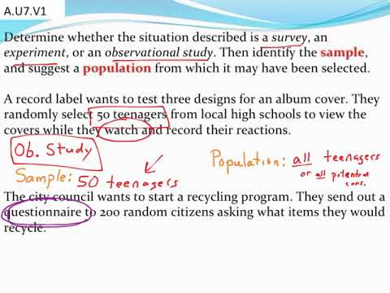
Research Methods & Applied Skills
SC 342: An introduction to the logic, ethics, and techniques of social research.
Students choose from a wide variety of courses in other departments to develop applied skills
Electives in:
Business
Communications
Computer Science
Writing

Slide 17
Theory and practice
Functionalism
Symbolic interactionalism
Sociological theory: An overview of classical, modern, and contemporary theories
Marxian theory
Postmodern theory
Globalization theory
Feminist theory
and others!

Slide 18
Electives - U.S. Focused
SC 201
SC 202
SC 204
SC 205
SC 206
SC 207
SC 210
SC 214
SC 221
SC 233
SC 260
SC 276
Self and Society
Social Power and Social Change
The Family
Education in U.S. Society
Health and Society
Social Problems
Introduction to Gender and Sexuality Studies
Introduction to Social Work
Sociology of Race, Class, and Gender
Juvenile Delinquency
Introduction to Criminal Justice
Human Health and the Environment

Slide 19
Electives - U.S. Focused
SC 332
SC 334
SC 360
SC 361
SC 365
SC 366
SC 368
SC 369
SC 371
The Sociology of Crime and Criminals
Sociology of Policing
Critical Analysis of Criminal Justice Outcomes
Social Inequality
Neighborhood and Community in Urban America
Sociology of Sexuality
Masculinities
Mining the Gap: Determinants of Educational Outcomes
Sociology of Serial and Mass Murder
SC 309
SC 331
Child Welfare
Deviance and Social Control

Slide 20
Electives - International
Social Conflict
Sociology of Health, Illness, and Medicine
Sociology of Human Rights
Sociology of Development
Israel-Palestine: Conflict Narratives, Media Framing, and Peace-Building
Social Movements and Social Protest
Islam and Politics
SC 339
SC 364
SC 373
SC 374
SC 376
SC 377
SC 378
SC 203
SC 209
SC 324
Globalization and Society
Cultural Anthropology
Sociology of Religion

Slide 21
Topical Elective Seminars for Juniors and Seniors
SC 420
SC 424
SC 430
SC 435
SC 440
SC 441
Social Construction of Opportunity
Privilege and Inequality in Education
Gender and Justice
Forensic Sociology
Global Sociology
Conflict and Reconciliation in Divided Societies

Slide 22
Study Abroad expands your understanding of society! We encourage it!
Experience everything Loyola has to offer!
Almost all programs serve Sociology.
Here are some highlights!
Copenhagen, Denmark
Study tours and field study visits included in academics
Leuven, Belgium
Designed for Humanities and Social Sciences
Bangkok, Thailand
Designed for all majors
Copenhagen
Leuven
Bangkok

Slide 23
Sociology offers an internship each spring. Students benefit in many ways.
Gain experience related to future employment
Establish a track record of work habits and attitudes
Develop professional skills and competence in areas including agency research, practice intervention, policy formation and development, etc.
Determine how well- suited you are in terms of skill and personality to particular kinds of work
Integrate sociological theory and analysis with practical experience accrued in a concrete work setting
Discuss professional issues and concerns that are not covered in other courses
Funds are available to assist students with transportation.

Slide 24
Students secure placements in a range of areas
Law and Criminal Justice
Social Work and Client Advocacy
Human Resources, Development, and Public Relations
Social Media
Education Counseling and Children/Youth
Recreation & Sport
Preventing Gendered Violence

Slide 25
Loyola Sociology faculty support student research
Sociology faculty offer:
Independent studies for students to explore new areas of literature.
Research credits for students to design and implement studies.
An opportunity for students to participate in faculty projects.

Slide 26
Student Research
Sociology students present their research and compete for cash prizes at the Loyola Undergraduate Student Research & Scholarship Colloquium.
The Eastern Sociological Society (ESS) sponsors a four-day Annual Meeting in the early spring. Loyola sociology students submit posters.
(Photo: At ESS, Joe Kropff ‘14 presents, while Dominic Walker ‘13 looks on.)

Slide 27
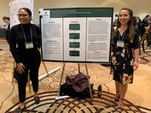
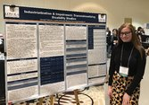
Eastern Sociological Society 2020 Loyola Sociology student presenters
Hector Trujillo
Cierra Thurmond & Amanda Debold
Hannah Tubman

Slide 28
Loyola Sociology Club: Annual events
Open to all students!
Resume Workshop
Sociology faculty work with majors and minors to develop resumes that sell their unique skills.
Holiday Dinner
Career Night
Loyola Sociology alumni in various professions (law, teaching, social work, business, etc.) share their career trajectories and tips for success.

Slide 29
Our most talented students are invited to join Alpha Kappa Delta
AKD is an international sociology society dedicated to promoting, facilitating, and recognizing academic scholarship.
.
Benefits of activated membership:
Recognition at graduation (AKD members wear teal honor cords).
A free one-year subscription to Sociological Inquiry.
Funds to travel to sociology conferences to present research.
Student paper competitions.
Requirements:
Junior or Senior Sociology Major/Minor
Completed 4+ Sociology Courses
Overall GPA of 3.3 and Sociology GPA of 3.0

Slide 30
We are ready for you! Come join our program.
Contact Information
Sociology Department Beatty Hall 238-A Loyola University Maryland 4501 N. Charles St. Baltimore, MD 21210
Phone: 410-617-2742
Email: sociology@loyola.edu

