Slide 1
Common Mistakes on Tax Forms:
Missing signature.
Missing or incorrect social security number.
Any information that is knowingly false.
Contradictory withholding status
For example often students claim “exempt”, but also indicate a number of additional tax they want withheld (instructs us to withhold taxes).
Disclaimer: The material contained herein on the following slides is for informational purposes only and does not constitute tax advice.

Slide 2
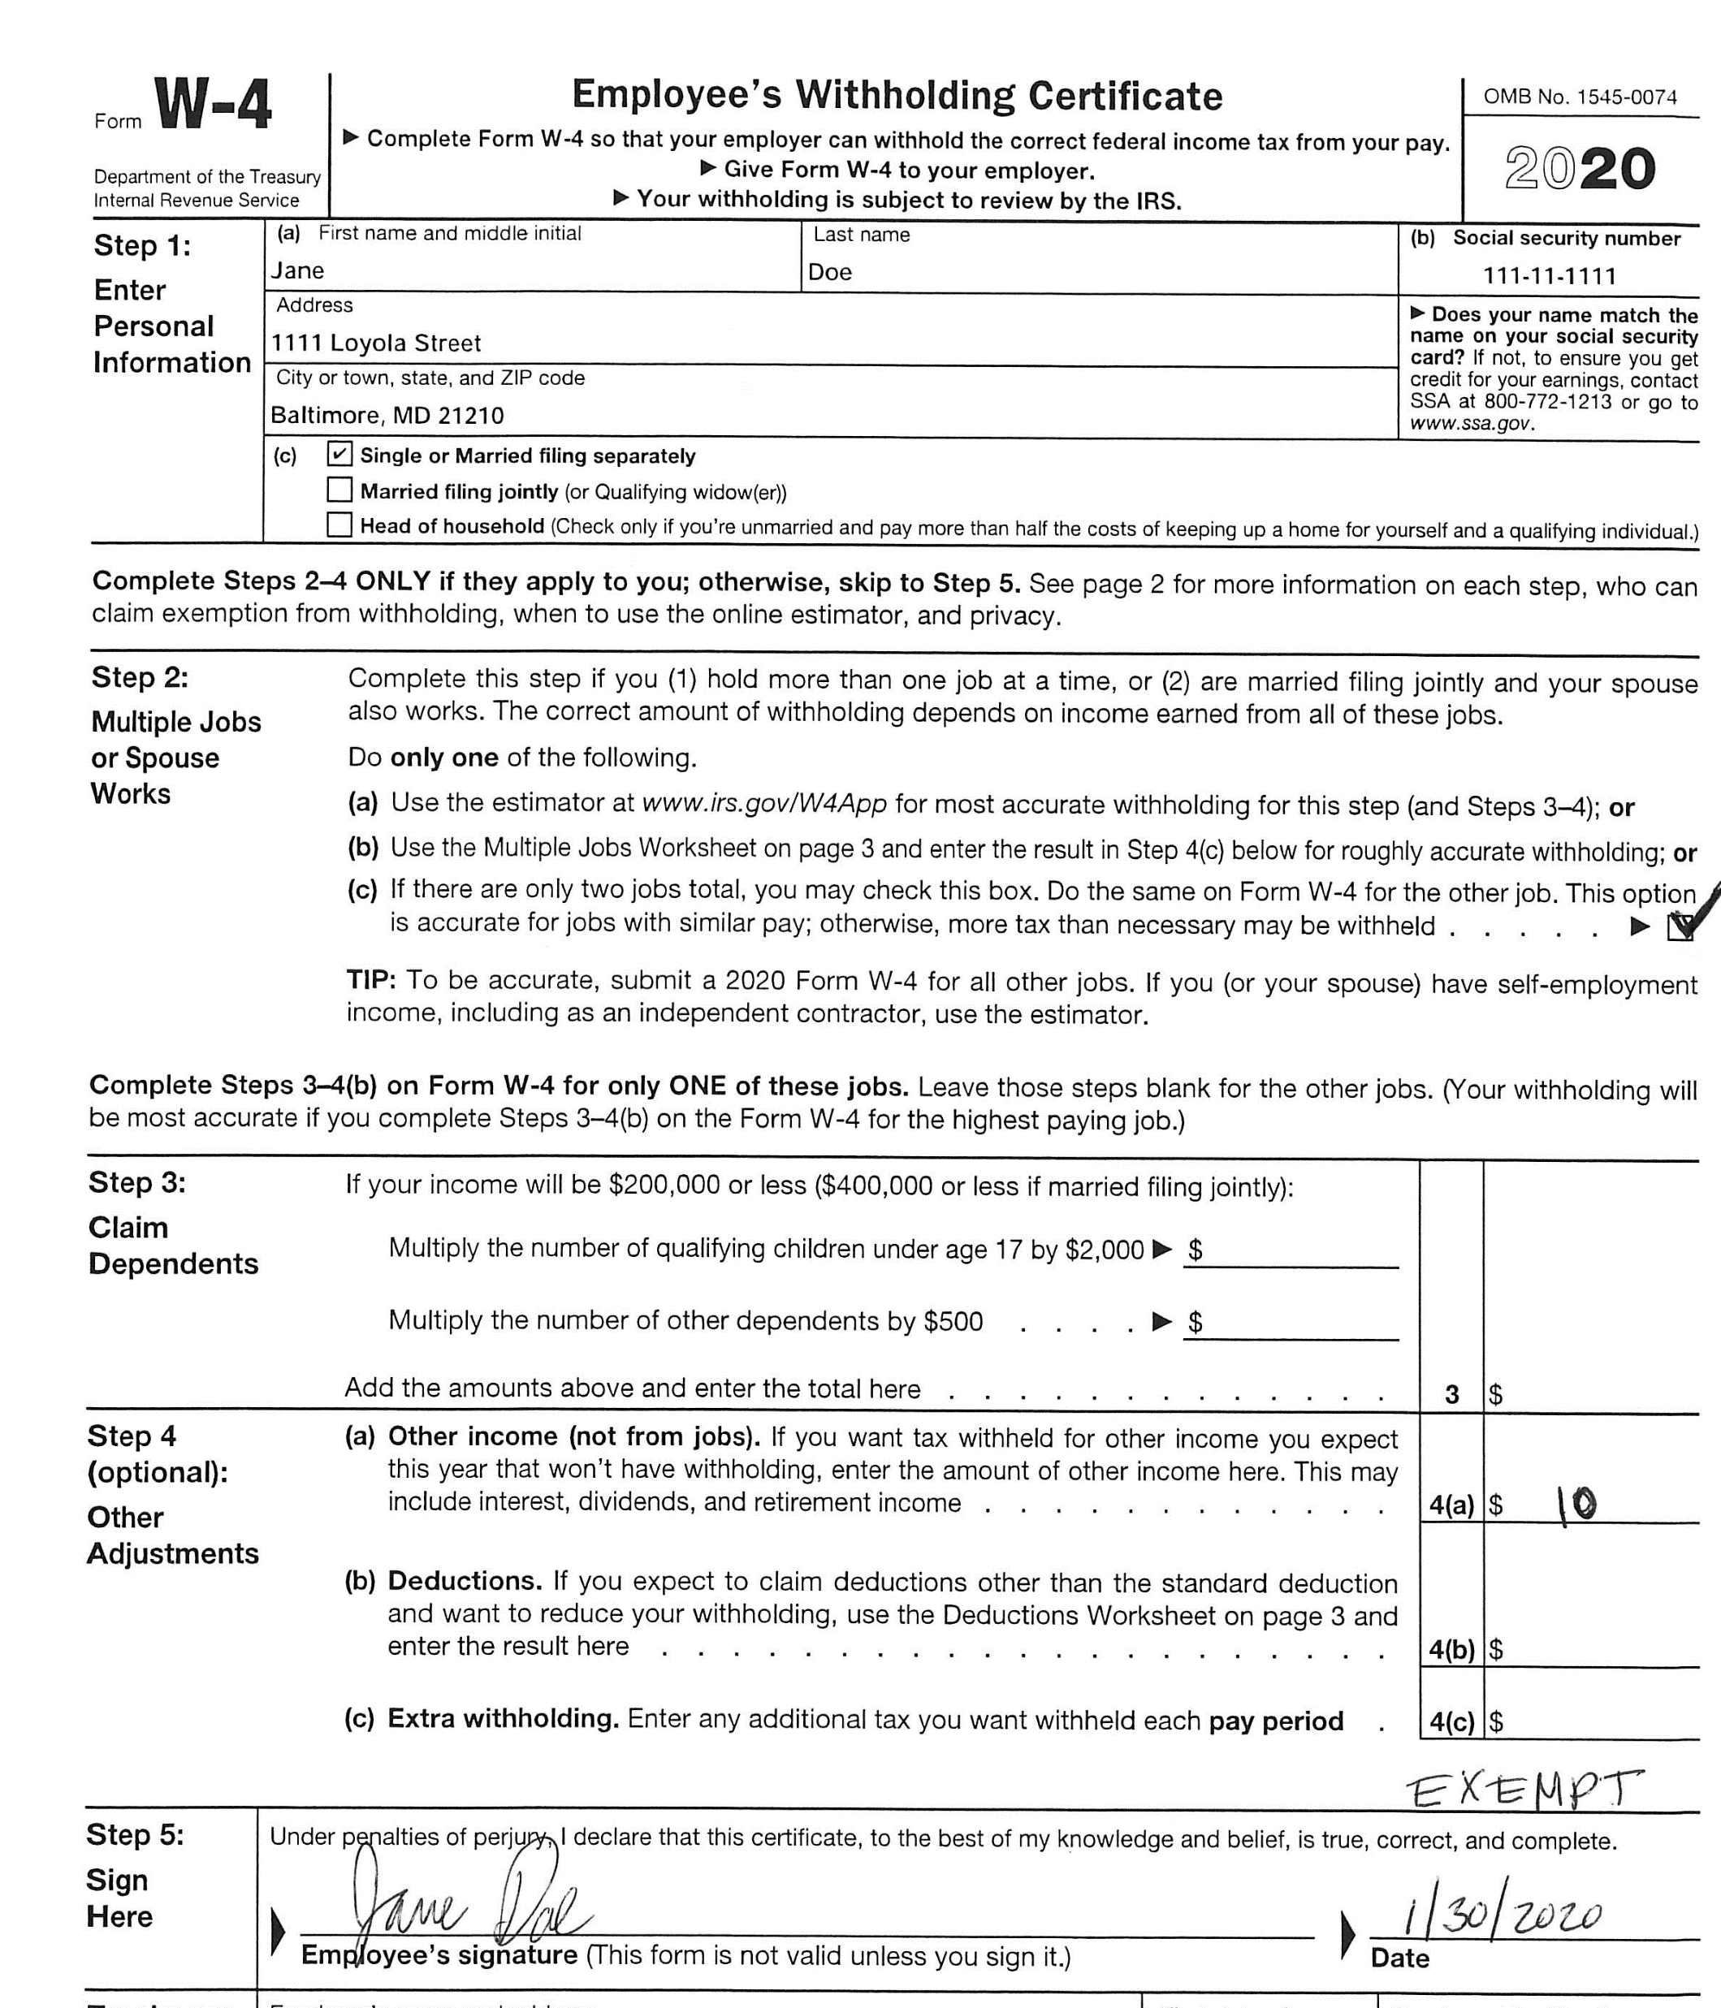
Example of INVALID W-4 2020 Form
This is not acceptable to turn into HR because there is a conflict. When claiming exempt, nothing else should be entered on any lines.

Slide 3
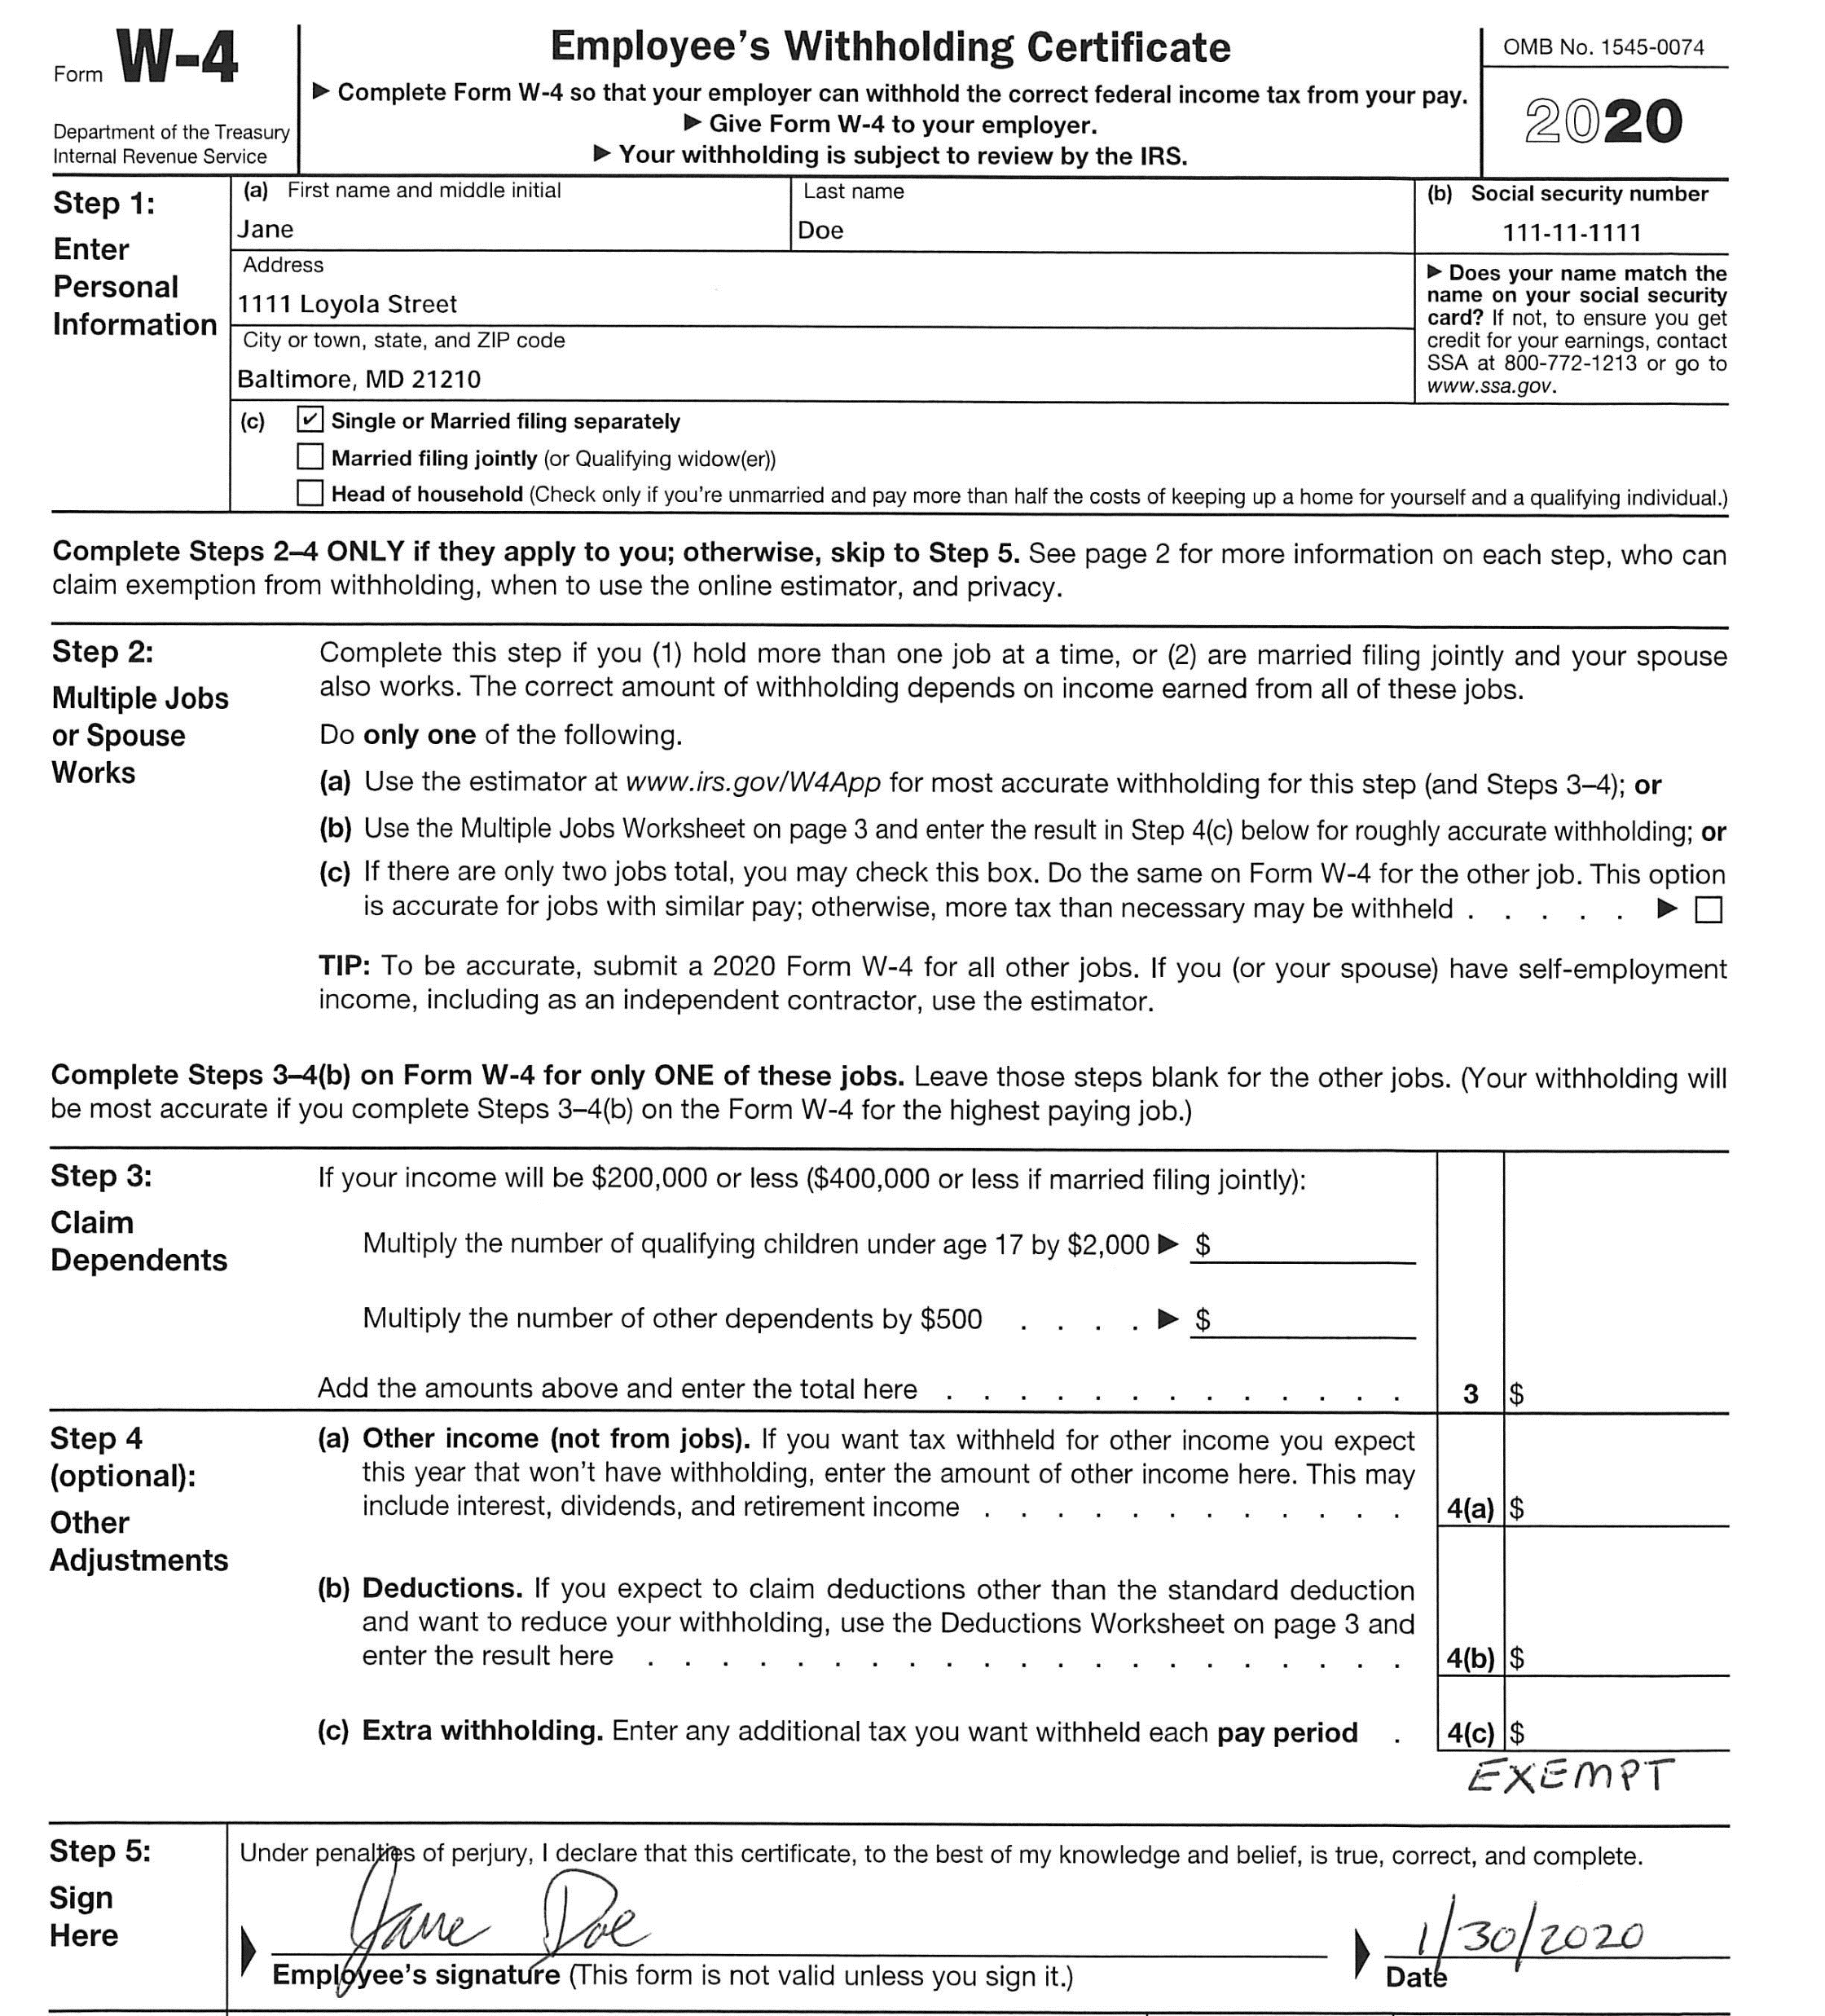
Example of VALID W-4 2020 Form
With EXEMPT

Slide 4
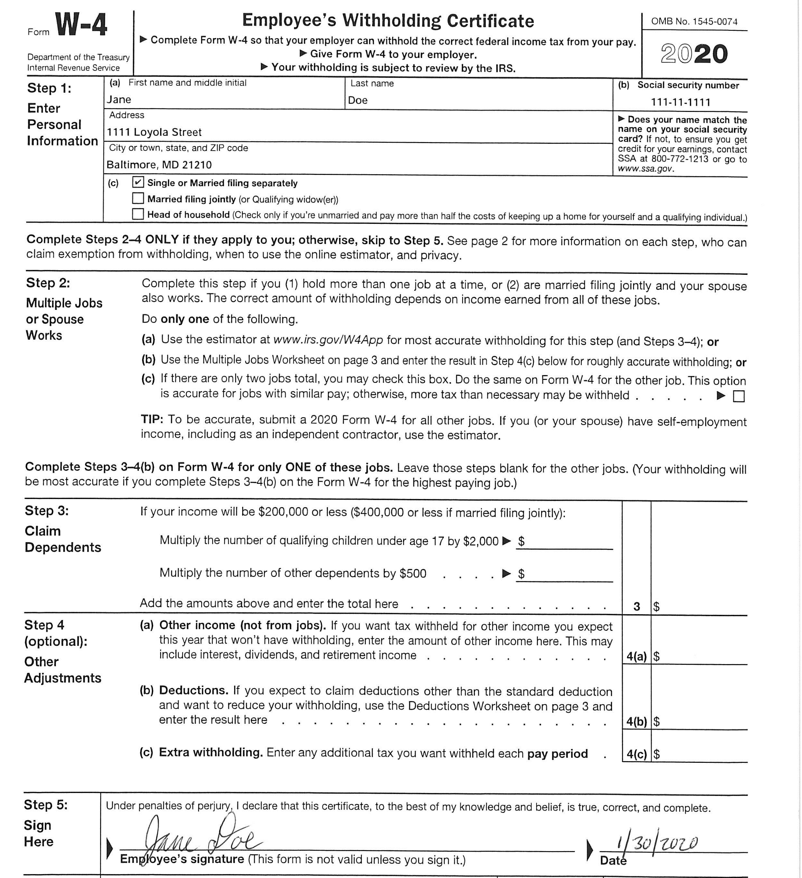
Example of VALID W-4 2020 Form
When someone claims single and the rest is blank, this will result in the most taxes taken out.

Slide 5
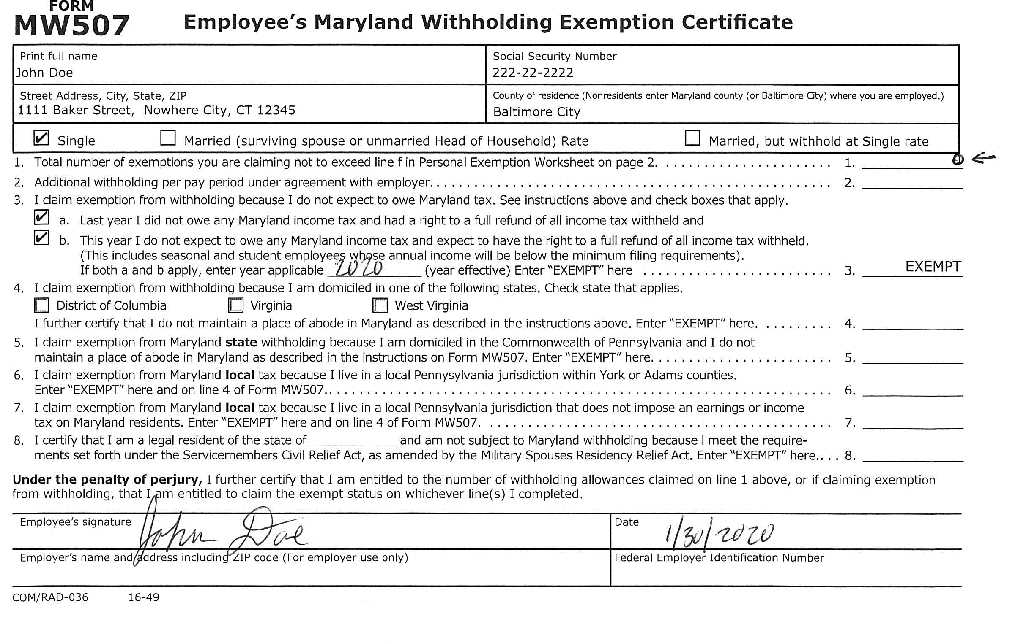
Example of INVALID MW507 Form
When claiming EXEMPT, all other lines should be blank.

Slide 6
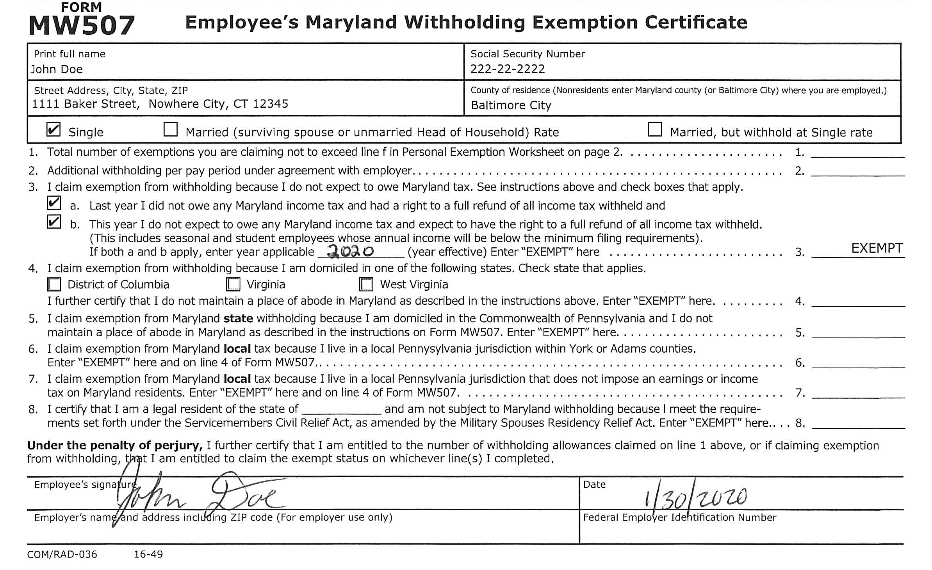
Example of VALID MW507 Form
With EXEMPT

Slide 7
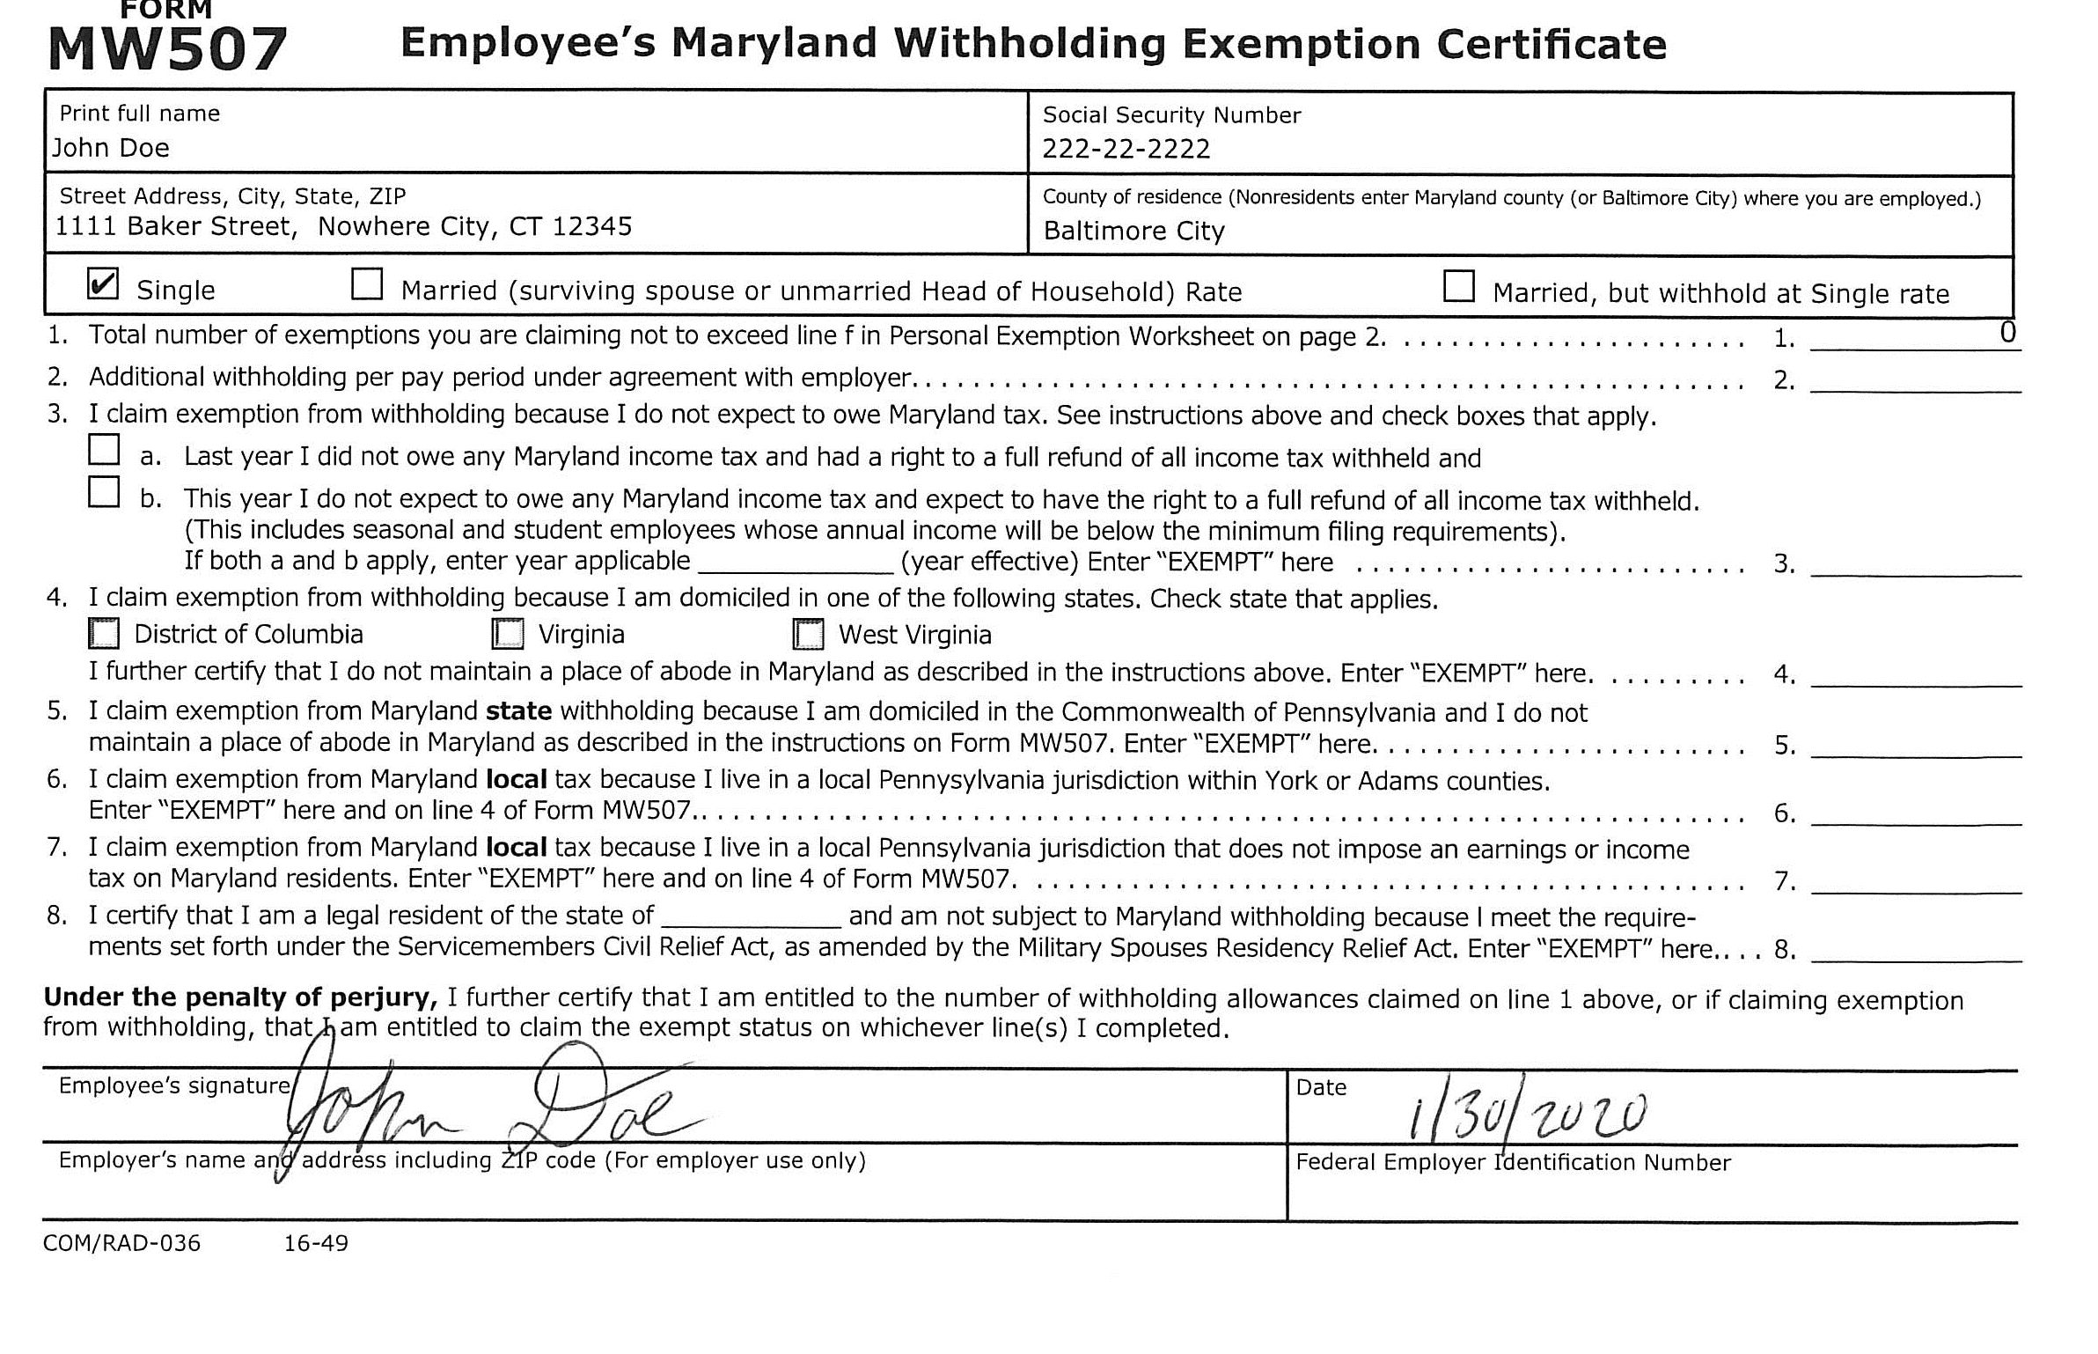
Example of VALID MW507 Form
With exemptions

