Slide 1
Innovation & Entrepreneurship at Loyola University Maryland
The Latest on the Simon Center for
Innovation & Entrepreneurship
and the Innovation & Entrepreneurship Minor
- Spring 2024 -

Slide 2
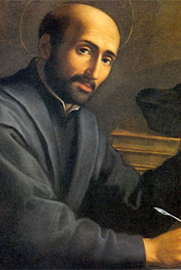
Saint Ignatius was an innovator
Go forth and set the world on fire!
- St. Ignatius
Notes:
Innovation is not new to Loyola—CI&E is not a departure
Started the Jesuit order, sent missionaries all over the world, founded schools
CI&E spirit of innovation & entrepreneurship inspired by Loyola’s social justice mission (not necc. Silicon Valley)

Slide 3
Baltimore is a great place for entrepreneurs to live and work
Notes:
Entrepreneurship is transforming Baltimore, and Loyola is a part of that movement through the CI&E
https://vimeo.com/user10242217/review/466221951/bc6f95d3a7

Slide 4
Simon Center for Innovation & Entrepreneurship

Slide 5
Transforming lives through… Learning
Innovation & Entrepreneurship Minor
Core Courses:
Creative Mindset (BA205)
Social Entrepreneurship (MG451)
Applied Angel Investing (BA495)
New Venture Creation (BA401)
Experiential Learning
Tech Treks
Expert Panels
Contact Jon Weinstein, Entrepreneur-in-Residence for more info!

Slide 6
***NEXT CLASS OFFERED FALL 2024***
https://www.loyola.edu/department/center-innovation-entrepreneurship/angels

Slide 7
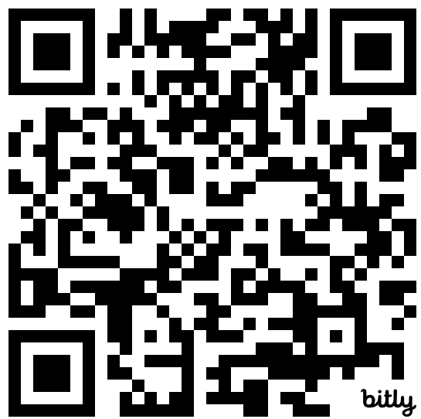
Transforming lives through… Action
Baltipreneur Accelerator Program
Demo Day on March 19
Applications open Fall 2024
Entrepreneur Camp (E-Camp) for Baltimore High School Students – Inaugural event on March 28, 2024
Loyola Angels Fund
Apply this semester for Fall 2024
Mentoring & Coaching for Entrepreneurs
Available to Students, Faculty, Staff, Administration, & Baltimore Community
Contact Wendy Bolger in you’re interested in joining the next cohort
Faculty, staff, and administers can click here (or scan code to the right) to register your interest in mentoring or coaching future Baltipreneurs

Slide 8
Inaugural Entrepreneur Camp (E-Camp) Program
Interactive& engaging 1-day program for Baltimore City high school students
Partnership with Baltimore-based Equity Project Foundation, a part of the Epic Arts Universe
On campus event with workshops, panels, and team-based activities that foster creativity and entrepreneurship
Students will:
Increase their awareness and understanding of entrepreneurship and Baltimore’s entrepreneurial ecosystem and resources.
Be able to identify their own strengths and opportunities for entrepreneurship and innovation.
Establish relationships with other students and local entrepreneurs Forge a connection with Loyola University Maryland.

Slide 9
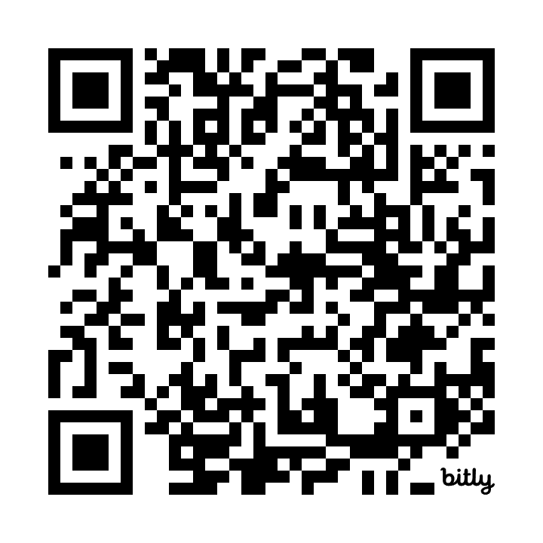
Transforming lives through… Engagement
Loyola Consulting Group
Contact Alexa Junikiewicz for more info
SCI&E Steering Committee
Open Events on Feb 9, Apr 19
Apply this semester for AY24-25
Student Made & Freshmeet U
Support for Student Organizations
Intentional Living Communities
Complete our survey to connect to our network of entrepreneurs & innovators
bit.ly/innovator-survey

Slide 10
Promoting Student Entrepreneurs & Their Businesses
Student-Made provides an effective and entirely student-run platform for entrepreneurial students to reach supporters on their campus and in the University’s network.
The Simon Center for Innovation & Entrepreneurship is launching the Loyola University Maryland Store in Fall 2024.
This spring, SCI&E will be recruiting students to service in leadership roles to build and operate the Loyola store. The Center is working to offer students in these roles academic credit through an internship. Contact Jennifer Sullivan at the Center for more info!
Freshmeet U. is a platform designed to meet the needs of freelance Creatives.
Users engage with FreshmeetU to develop a viable plan for their future; mentoring and teaching Creative everything they need to know from, Accounting to Zoom, how to start and maintain their freelance company.
The Simon Center for Innovation & Entrepreneurship & the Rizzo Career Center are collaborating with FreshmeetU to make the platform available to interested student.
Contact the Center for more info and learn more at freshmeetu.com.

Slide 11
Join the Simon Center’s Entrepreneurs & Innovators Network
CLICK HERE if you have an idea, side-hustle, or start-up business to join our network and access our resources and assistance.
CLICK HERE to express your interest in volunteering with the Center as a mentor or coach for innovators and entrepreneurs in our network.

Slide 12
Student Outcomes

Slide 13
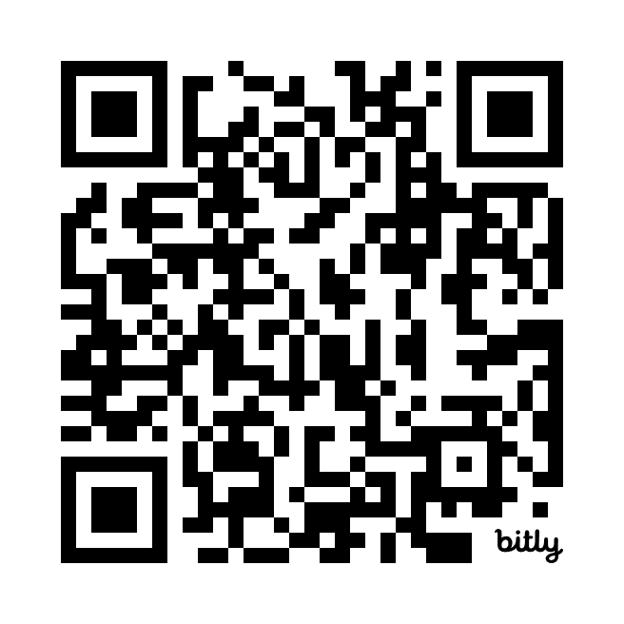
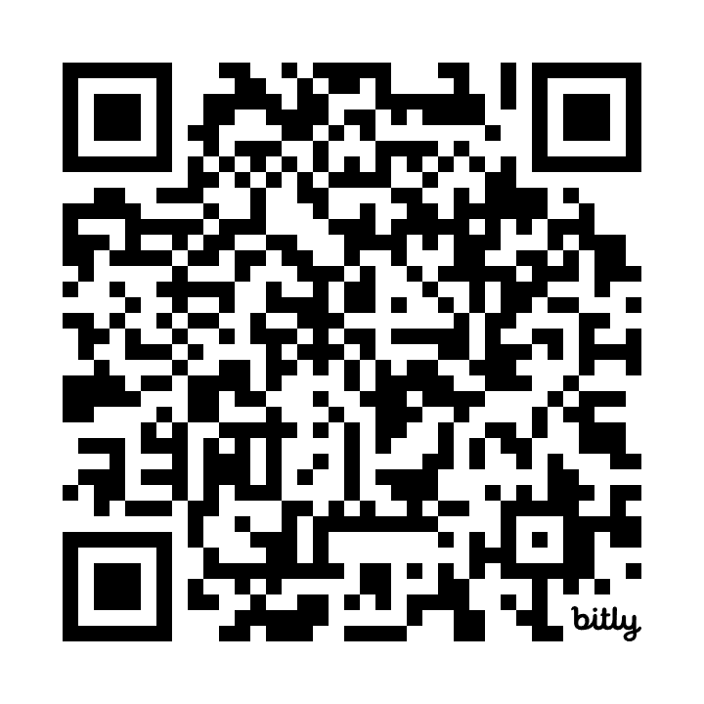
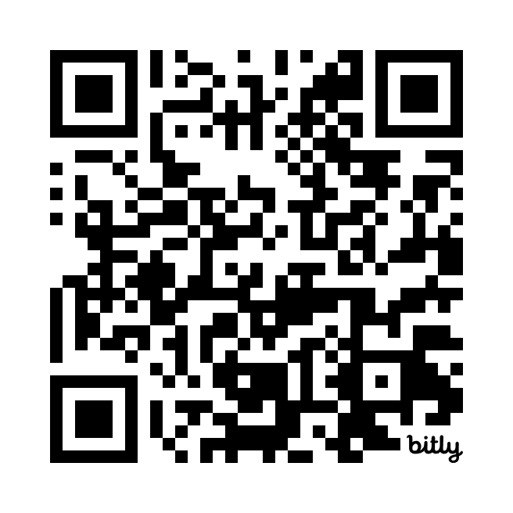
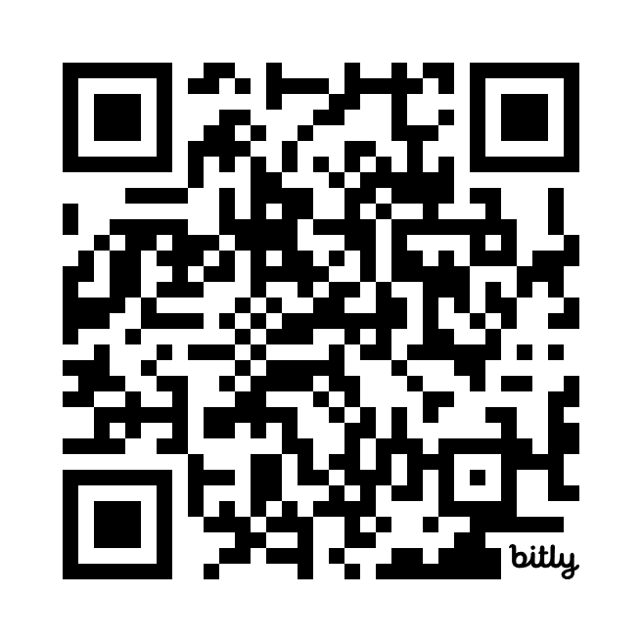
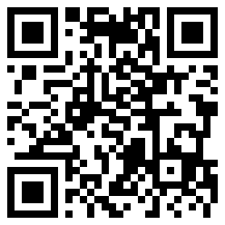
Crack the (QR) Code!
SCI&E Website
I&E Minor
Book a Meeting
with Wendy or Jon
Newsletter Subscribe
Join us on
The Bridge
Innovator Survey

Slide 14
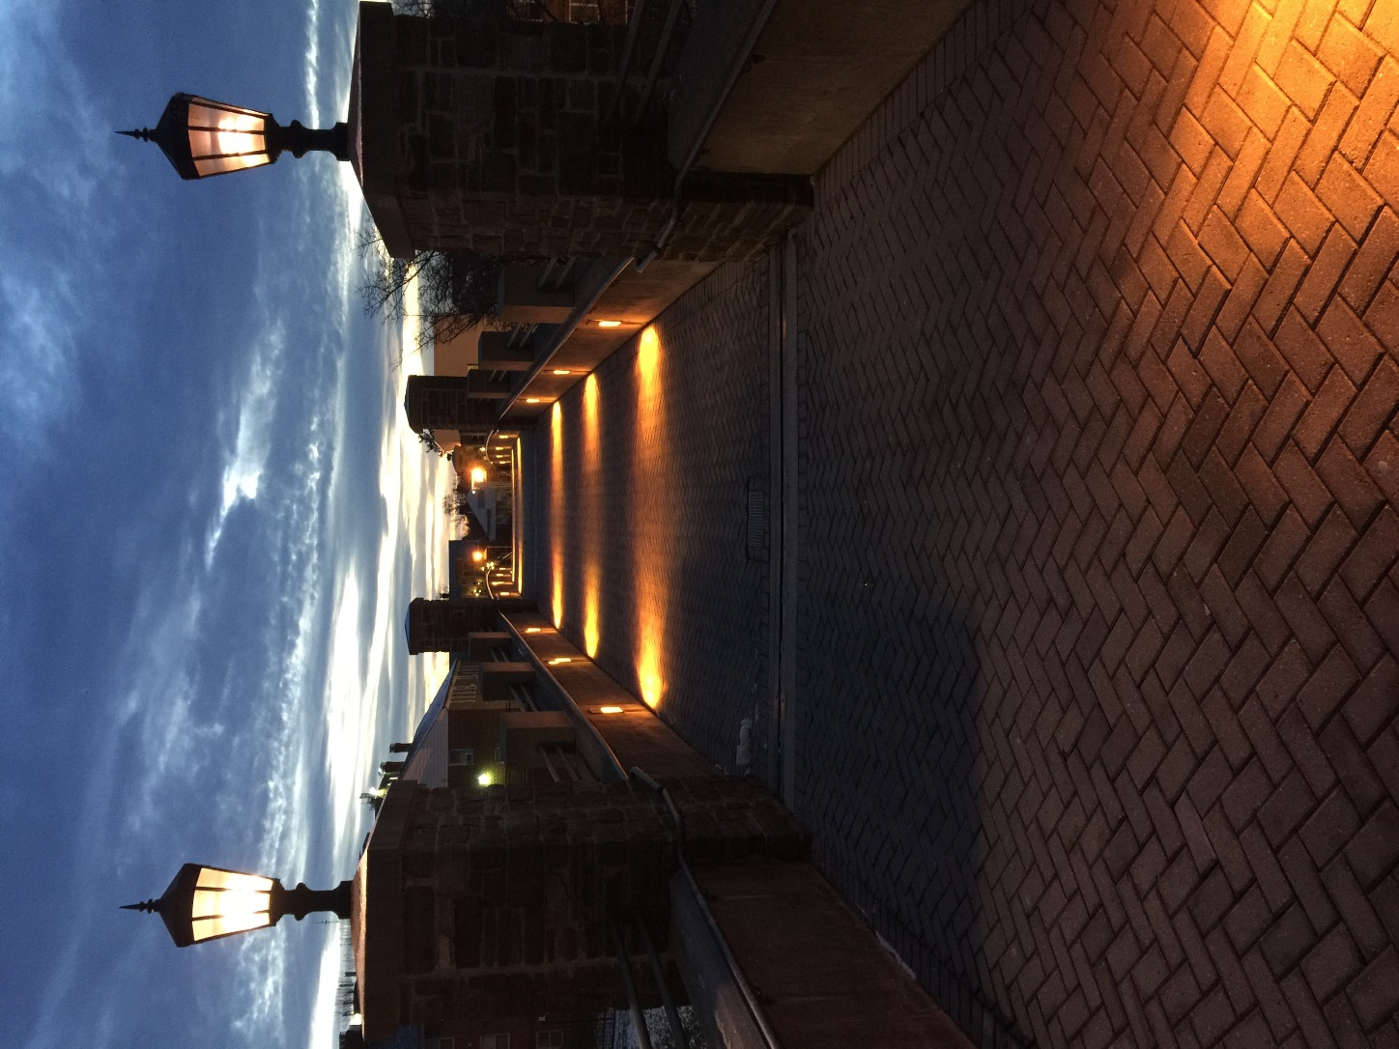
Stay Engaged & Informed!
Find us on the web: https://www.loyola.edu/innovation
Join us on the Bridge: https://bridge.loyola.edu/cie/club_signup
Sign up for Newsletter: https://www.loyola.edu/department/center-innovation-entrepreneurship/about/newsletter
Follow us on Instagram & X:
@LoyolaInnovates
Contact us:
Wendy Bolger, webolger@loyola.edu
Jon Weinstein, jweinstein1@loyola.edu

