Slide 1
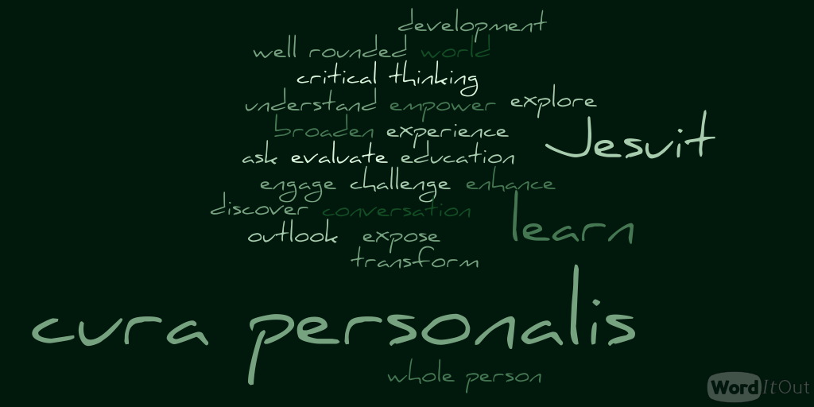
The Liberal arts core
at Loyola University Maryland

Slide 2
What is the Liberal arts core?
A liberal arts education requires students to take courses in the:
    Humanities
    Social sciences
    Mathematical sciences
    Natural sciences
Jesuit ideology of “Cura Personalis”
    Development of the whole person
    Well-rounded individuals
    Loyola students take 15 core courses in the liberal arts, plus the diversity-justice requirements

Slide 3
The Core at a Glance
Effective Writing (WR 100)
Encountering the Past (HS 100)
The Art of Reading (EN 101)
Choice of 200-level History OR 200-level English
World or Classical Language (Intermediate II Level)
Social Sciences (2)
Fine Arts
Math
Natural Science
Math/Natural Science/Computer
Intro to Philosophy (PL 201)
Theology Matters (TH 201)
Choice of 202-299 Philosophy OR 202-299 Theology
Ethics
2 Diversity and Justice courses

Slide 4
EFFECTIVE WRITING
WR 100 (3 CR.)
Students should take this course during their first year at Loyola
Preparation for university-level writing in all Loyola courses
Students develop a full writing process – planning, drafting, revising, and editing – as they learn how to compose the critical research essay

Slide 5
HISTORY
Students take one 100-level history course:
HS 100: Encountering the Past
Students can choose to take a 200-level history OR a 200-level English.

Slide 6
literature
Students take one 100-level English literature course:
    EN 101 The Art of Reading
Students can choose to take a 200-level history OR a 200-level English.

Slide 7
World/Classical language
Students must reach the Intermediate II level (104) of a world or classical language to fulfill the core
This may take students anywhere from one to four semesters depending upon the placement test score
Students who place higher than the 104 level on Loyola’s language placement exam may be exempt from the language core requirement, pending confirmation from Loyola’s Modern Language department after a proctored, on-site placement exam. Those students will need to complete 1 additional free elective in lieu of the language core.
World and classical languages offered at Loyola:
    Spanish French
    Greek Chinese
    Italian Latin
    German Arabic

Slide 8
SOCIAL SCIENCE
Students take two social science courses
Social science courses include 100-level courses in psychology, sociology, political science, and economics
In some majors, students take specific social science courses to fulfill the core:
    Business Majors, Accounting, and Econ – EC102 & EC103
    Education – ED205 & one additional social science core
    Forensic Studies – PY101 & SC100
    Global Studies – EC102 & EC103
    Political Science – PS101 & PS102
    Psychology – PY101 & one 200-level PY
    Sociology – SC100 & SC201

Slide 9
Fine arts
Students take one fine arts course selected from:
    AH109: Non-Western Art
    AH110: Survey of Art – Paleolithic to Gothic
    AH111: Survey of Art – Renaissance to Modern
    DR250: Intro to Theatre History
    DR251: Experience of Theatre
    DR252: Intro to Theatrical Production
    MU201: Music Fundamentals
    MU 202: Class Piano
    MU203: The Art of Listening
    MU204: Western Musical Traditions
    PT270: Digital Photography
    SA224: Two-Dimensional Design
    SA227: 3-D Design in Art and Engineering
Be careful! Only the specific courses listed above fulfill the core requirement in fine arts

Slide 10
Mathematics & Statistics
Students take one course in mathematics or statistics to fulfill the core requirement: MA109 MA113, MA 115, MA117, MA118, MA151, MA251, ST110, ST210, or ST265
Students are placed into a math course based on their math placement test results
MA005 is a 1-credit course designed to help students with MA109 course material
In some majors, students take specific math courses to fulfill the core

Slide 11
Math core requirement by major
Business, Account., Econ.– MA151 or MA251
Biology – MA251, MA252, ST210, or ST265
Chemistry – MA251
Computer Science – MA251
Data Science – MA251
Elementary Education – ST110 or ST210
Engineering – MA251
Forensic Studies – ST110 or ST210 or ST265
Global Studies – ST110 or ST210
Mathematics, Statistics – MA251
Physics – MA251
Psychology – ST110, ST210, or ST265
Sociology – ST110, ST210, or ST265
Speech Language Pathology – ST110 or ST210

Slide 12
Natural science
Students take one course in a natural science to fulfill the core requirement
Natural sciences:
    Biology
    Chemistry
    Physics
    In some majors, students take specific natural science courses to fulfill the core

Slide 13
Natural science core requirement by major
Biology – BL150/BL151
Chemistry – CH101/CH105
Computer Science (BS) – PH201/PH291
Elementary Education – PH116
Engineering – PH201/PH291
Forensic Studies – BL150/BL151
Mathematics & Statistics – BL150/BL151, BL201/BL202, PH201/PH291, or CH101
Physics – PH201/PH291
Psychology – BL105 or BL152/153
Speech Language Pathology – 1 course in Biology

Slide 14
Math/natural science/computer science
Students may choose to take another math course, another natural science course, a computer studies course, EC220, or EG101 to fulfill this requirement
In some majors, this core requirement is fulfilled by taking a specific course:
    Business Admin., Accounting, Econ.– EC220
    Biology – BL152/BL153
    Chemistry – CH102/CH106
    Computer Science (BA) – CS151
    Computer Science (BS) – PH202/PH292
    Data Science – CS151
    Elementary Education – PH117
    Engineering – EG101
    Forensic Studies – BL152/BL153
    Math/Statistics – MA252
    Physics – PH202/PH292
    Speech Language Pathology – 1 course in Chemistry or Physics

Slide 15
PHILOSOPHY
Students take PL201: Foundations of Philosophy.
Students can choose to take a 202-299 philosophy OR a 202-299 theology.
PL201 provides a foundation for the study of philosophy with regard to its historical beginnings and central themes
The 200-level philosophy courses allow students to focus on a particular philosophical perspective (i.e. love, art, education, humanity and divinity, culture, etc.)

Slide 16
theology
Students take TH201: Theology Matters
Students can choose to take a 202-299 philosophy OR a 202-299 theology.
TH201 provides an introduction to Jewish and Christian scripture
The 200-level theology courses allow students to focus on a particular area (i.e. scripture, history, or culture)

Slide 17
ethics
The ethics core requirement is fulfilled by an ethics course in either philosophy (PL301-319) or theology (TH301-319)
The ethics core must be completed in the opposite area than the 202-299 philosophy/theology core.
  If a student takes a philosophy course from 202-299, they must complete the ethics core in theology (TH300-319).
  If a student takes a theology course from TH202-299, they must complete the ethics core in philosophy (PL300-319).

Slide 18
Diversity and Justice
Students take two designated diversity and justice core, major or elective courses to fulfill this requirement
Diversity and justice courses focus on:
    Global awareness
    Justice awareness
    Domestic diversity awareness
Diversity and justice courses can be found for each specific semester in Self Service under “Course Types,” then “Diversity-Justice”
Students who plan well should be able to find diversity and justice requirements within a core or major course
The diversity and justice requirements must be completed at Loyola

Slide 19

Questions?
Please contact the Academic Advising and Support Center (AASC) at Loyola University Maryland with any questions concerning the liberal arts core curriculum:
Telephone: 410-617-5050
Email: aasc@loyola.edu
Location: Maryland Hall, Room 138

