Slide 1
MAKE THE MOST OF YOUR COLLEGE LIFE
James David
PNC Branch Manager
Roland Park Branch
AND YOUR MONEY
STUDENT BANKING FROM PNC BANK
©2021 The PNC Financial Services Group, Inc. All rights reserved. PNC Bank, National Association. Member FDIC

Slide 2
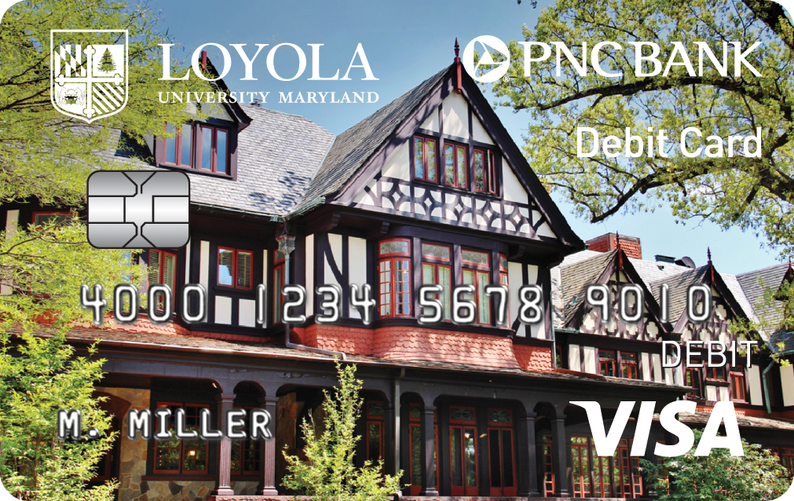
+
VIRTUAL WALLET STUDENT® Designed to meet the unique needs of students
CONVENIENT BRANCH NEAR CAMPUS Located at 5119 Roland Ave., Baltimore, MD for all of your banking needs
CAMPUS PNC ATMs 2 PNC ATMs on campus where PNC customers can access their money fee free — find the one nearest you at pnc.com/loyolamd
PNC BANK – LOYOLA UNIVERSITY VISA® DEBIT CARD Customed-designed to show your school pride
PNC BANK
©2021 The PNC Financial Services Group, Inc. All rights reserved. PNC Bank, National Association. Member FDIC

Slide 3
Between classes, activities, studying and events, who has time to stay on top of their finances? With Virtual Wallet Student, you do.
A CHECKING ACCOUNT THAT FITS
A STUDENT’S LIFE.
THREE ACCOUNTS IN ONE Spend: for primary checking. Reserve: for short-term savings like books. Growth: for long-term savings like a new car.
NO MONTHLY FEE Avoid the monthly service fee for the first 6 years after opening your account.¹
MONEY MANAGEMENT TOOLS Set Budgets, track your spending and schedule payments with easy-to-use digital tools.
COURTESY OVERDRAFT FEE REFUND Get one courtesy fee refund of any Overdraft Item or Returned Item fee associated with your first overdraft event that occurs within 6 years of the date of account opening.⁶
FREE WIRE TRANSFERS Get one free incoming domestic or international wire transfer per statement period.
VIRTUAL WALLET STUDENT®
©2021 The PNC Financial Services Group, Inc. All rights reserved. PNC Bank, National Association. Member FDIC

Slide 4
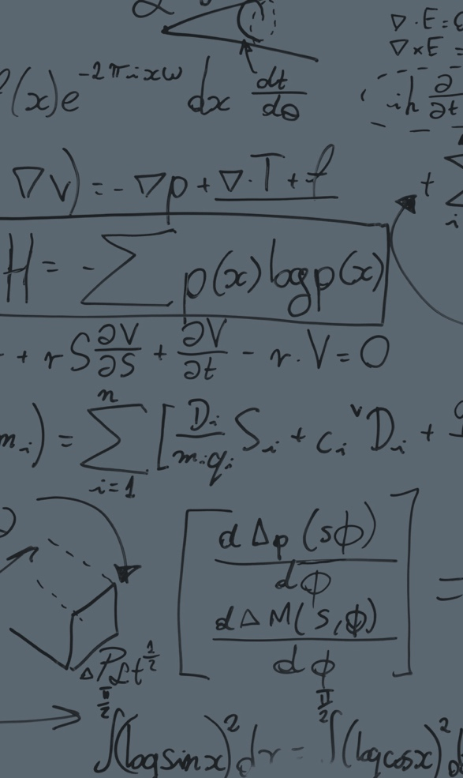
Everyone can have a low cash moment. We believe how you handle overdrafts should be in your control, not just your bank’s.
EXTRA TIME You'll have at least 24 hours to bring your available Spend account balance³ to at least $0 before you're charged overdraft fees.
PAYMENT CONTROL Now you can choose to pay or return certain transactions⁴ when you're overdrawn.
INTELLIGENT ALERTS Set up alerts so that if your Spend account balance gets too low, you'll be notified that you can take action⁵ .
INTRODUCING LOW CASH MODE
SM
Download the PNC Mobile app² to use Low Cash ModeSM.
©2021 The PNC Financial Services Group, Inc. All rights reserved. PNC Bank, National Association. Member FDIC

Slide 5
TO HELP YOU TAKE CONTROL AND BANK HOW, WHERE AND WHEN
ONLINE & MOBILE BANKING Do your banking how and when you want to.²
ZELLE® With Zelle® and PNC, sending money is easy. With just an email address or a U.S. mobile phone number, you can send money to people you know and trust, regardless of where they bank in the U.S.⁷
MOBILE DEPOSIT Use your smartphone camera to deposit checks into your PNC account.²
PNC MOBILE BANKING APP Easy-to-use digital tools help you budget, track and manage your money.²
EMAIL AND TEXT ALERTS Notices include an option to alert family or friends when balances are low.⁸
DIGITAL TOOLS
YOU CHOOSE.
©2021 The PNC Financial Services Group, Inc. All rights reserved. PNC Bank, National Association. Member FDIC
5

Slide 6
BANKING FOR
INTERNATIONAL
STUDENTS
Being far from home has its challenges. Finding the products, services and assistance for meeting your banking needs won’t be one of them.
COST-EFFECTIVE WIRE TRANSFERS Receive one incoming wire transfer per statement period into your Virtual Wallet Student Spend account at no charge.
SPEAKING YOUR LANGUAGE Our services to non-English-speaking customers include ATMs with an array of language options and customer service interpretation in more than 240 languages.
MAKING IT EASIER TO MAKE YOUR WAY IN A NEW CULTURE.
VISIT pnc.com/internationalstudents to find the information you need to open a U.S. banking account, understand the essentials, learn about your finances and more.
©2021 The PNC Financial Services Group, Inc. All rights reserved. PNC Bank, National Association. Member FDIC

Slide 7
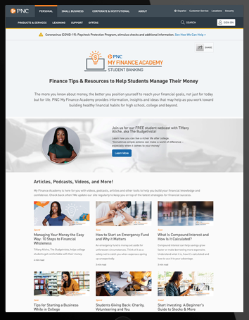
PNC MY FINANCE ACADEMY
My Finance Academy provides information and real-world insights for everyday financial challenges.
From helping you to understanding financial basics to showing you how to make the most of your money, PNC is here to guide you along the way with My Finance Academy’s library of educational resources, including articles, podcasts, webinars and more!
Taking small steps today can help make a big impact on your lifelong financial success.
PNC.COM/MYFINANCEACADEMY
©2021 The PNC Financial Services Group, Inc. All rights reserved. PNC Bank, National Association. Member FDIC

Slide 8
IT’S EASY TO APPLY FOR AN ACCOUNT.
With your Social Security number and a valid photo ID, you can apply for your PNC account by:
READY FOR THE
Call the Roland Park branch at 410-235-6300 to see if you are eligible to have a digital application emailed to you.
Email branch manager James David at james.david@pnc.com
Scheduling an in-person or virtual appointment at a nearby or on campus PNC Branch at pnc.com/locator.
Visiting pnc.com/loyolamd
NEXT STEP?
©2021 The PNC Financial Services Group, Inc. All rights reserved. PNC Bank, National Association. Member FDIC

Slide 9
WE’RE COMMITTED TO COLLEGE
1 Virtual Wallet Student has no minimum balance requirement or monthly service charge for active students for six years from the date of account opening. You may be asked to provide proof of active enrollment in a qualifying educational institution. At the end of the six years, your account will be converted to Virtual Wallet and subject to the Virtual Wallet Features and Fees in effect at that time. If you transfer this account to a different product or account type during the first six years, you will forfeit the benefits of the Virtual Wallet Student account and will not be able to transfer back to the Virtual Wallet Student account.
2 PNC does not charge a fee for Mobile Banking. However, third-party message and data rates may apply. These include fees your wireless carrier may charge you for data usage and text messaging services. Check with your wireless carrier for details regarding your specific wireless plan and any data usage or text messaging charges that may apply. Also, a supported mobile device is needed to use the Mobile Banking app. Eligible PNC Bank account and PNC Bank Online Banking required. Certain other restrictions apply. See the mobile banking terms and conditions in the PNC Online Banking Service Agreement.
3 In order to avoid overdraft fees, you must bring the available balance in your Account to at least $0 before your Extra Time expires. If you make a deposit, the time it takes for your deposit to be reflected in your available balance and for those funds to become available to you will vary based on the deposit type and time. Depending on your deposit type or your deposit time, your deposit may not be available before your Extra Time period expires, and you may incur overdraft fees. See your Funds Availability policy for more information. Overdrawing an account, maintaining a negative available balance for any period of time, and returning transactions as unpaid may have other consequences, including account closure or negative impacts to your ability to obtain financial services including loans, deposit accounts, and other services at PNC and other institutions.
4 Payment Control applies to check transactions, or payments made using your PNC Bank routing and checking account numbers (ACH transactions). Debit card transactions do not qualify for Payment Control when your account balance becomes negative. When you choose to return an Item that has been presented to PNC for payment, we will return the Item to the payee’s bank for insufficient funds, and the payee will not receive payment from PNC. You may still have an obligation to pay the payee for goods, services or other products. PNC is not responsible for satisfying any obligations between you and the payee or any other party with respect to an Item you decide to return. Before choosing to return an Item, you should consider rules the payee may have or actions the payee may take on late/returned payments. Overdrawing an account, maintaining a negative available balance for any period of time, and returning transactions as unpaid may have other consequences, including account closure or negative impacts to your ability to obtain financial services including loans, deposit accounts, and other services at PNC and other institutions.
Low Cash Mode is a service mark of The PNC Financial Services Group, Inc.
5 PNC Alerts are free to customers. However, third party message and data rates may apply. These include fees your wireless carrier may charge you for data usage and text messaging services. Check with your wireless carrier for details regarding your specific wireless plan and any data usage or text messaging charges that may apply.
6 You may not make more than a total of six (6) transfers each statement cycle from a savings or money market account to other accounts (including transfers to another account for overdraft protection) or to third parties by check, through point-of-sale purchase transactions or similar debit card transactions, by pre-authorized or automatic agreements, telephone, online or similar order payable to a third person. See your account agreement for more information. Other limits may apply to your account. Excessive transactions may result in your Savings or Money Market account being changed to a Standard Checking account, which will be subject to the features and fees as described in the Consumer Schedule of Service Charges and Fees in effect at that time. We reserve the right to suspend enforcement of these transaction limitations, at our discretion.
7 Zelle should only be used to send or receive money with people you know and trust. Before using Zelle to send money, you should confirm the recipient’s email address or U.S. mobile phone number. Neither PNC nor Zelle offers a protection program for authorized payments made with Zelle. Zelle is available to almost anyone with a bank account in the U.S. Transactions typically occur in minutes between enrolled users. If the recipient has not enrolled, the payment will expire after 14 calendar days. See the PNC Zelle Terms of Use for additional terms and conditions. Use of Zelle is subject to and conditional upon adherence to the terms and conditions of the PNC Zelle Terms of Use.
8 Your wireless carrier may charge you standard text message rates.
[Visa is a registered trademark of Visa International Service Association and used under license.]
Zelle and the Zelle-related marks are wholly owned by Early Warning Services, LLC and are used herein under license.
Low Cash Mode is a service mark of The PNC Financial Services Group, Inc.
Virtual Wallet Student is a registered trademark of The PNC Financial Services Group, Inc.
©2021 The PNC Financial Services Group, Inc. All rights reserved. PNC Bank, National Association. Member FDIC

