Slide 1


Ghana, Africa Global Business Tour
By: Dr. Robbie Bishop - Monroe, CPA, CFE
October 8, 2025
RBishop-Monroe@Loyola.edu

Slide 2
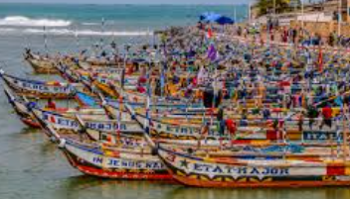
Agenda
Reflection questions
Why is This Important? Or Why Ghana?
The Global Study Tour Overview
Course Information
Sample Itinerary
Budget
Contributions
2

Slide 3
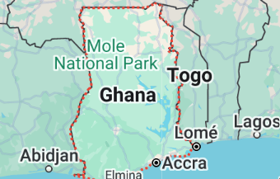
Reflection Questions
1. Why is experiential learning valuable?
2. What are some benefits of a global study tour?
3. Can success be measured? How?
3

Slide 4
Reflection Questions
1. Why is experiential learning valuable?
“Experiential learning is crucial for students because it fosters deeper understanding, enhances skills, and improves motivation by engaging students in real-world activities and encouraging reflection, leading to better retention and application of knowledge. ”
4

Slide 5
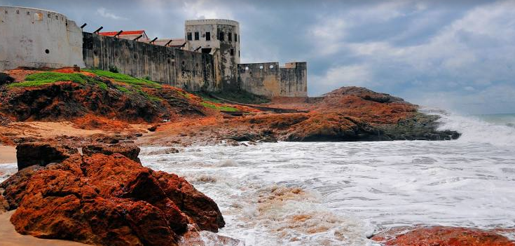
Reflection Questions
2. What are some benefits of a global study tour?
Enhanced Understanding and Retention
Development of Essential Skills (communication, collaboration, critical thinking, problem-solving)
Increased Motivation and Engagement
Reflective Practice
5

Slide 6
Reflection Questions
3. Can success be measured? How?
Completion of assignments
Reflections
Team presentations
Case analysis
Survey
6

Slide 7
Why is This Important? Or Why Ghana
Jesuit Catholic Mission Connection
Major accounting firms & global businesses
International business experience - Cultural Exchange
The population is 34,800,860 (World Meters, 2025)
Historical sites (UNESCO World Heritage Site)
Environmental Justice, Sustainability, and Ethics
7

Slide 8

Support
Students
Professor(s)
School of Business
International Program Office
Overall University
8

Slide 9

Our Partner
Hilltop has coordinated international travel for multiple universities
Website
https://hilltopglobalgroup.com/
Video https://vimeo.com/manage/videos/1009903690
Will you be next to experience travel with Hilltop Global???
9

Slide 10

Global Study Tour Overview
Content - Accounting, finance & cultural
Course - Global Business Tour
Timing - Monday, May 18, 2026 - Tuesday, May 26, 2026
Trip length - 9 days
Credits - 3 credits
Professors - Two faculty members
10

Slide 11
Course Information
Sample Schedule of Sessions and Assignments
Date | Topic | Homework Due at 11:59 pm
Pre Session 1 - Friday, March 20, 2026, 3:00 p.m. - 7:00 p.m. | Course introduction, Logistics, and Financial Boot Camp | Assign Groups Reflection 1 (Session 1 - 200 points), due Friday, March 20, 2026 (First Session)
11

Slide 12
Course Information
Sample Schedule of Sessions and Assignments
Date | Topic | Homework Due at 11:59 pm
Session 1 - Friday, April 10, 2026, 3:00 p.m. - 5:00 p.m. | The Overview Course Introduction, Country overview, and Guest speaker. | Assign Groups Reflection 1 (Session 1 - 200 points), due Friday, April 10, 2026
Session 2 - Friday, April 17, 2026, 3:00 p.m. - 5:00 p.m. | Environmental Justice, Sustainability, and Ethics | Case Analysis and Presentation I (Session 2 - 125 points) due Friday, April 17, 2026
Session 3 - Friday, May 8, 2026, 3:00 p.m. - 5:00 p.m. | Foreign Currency and Accounting Guest speaker - Ghana | Case Analysis and Presentation II (Session 3 - 125 points) due Friday, May 8, 2026
Travel dates Monday, May 18, 2026 to Tuesday, May 26, 2026 (subject to change) | The Study Tour (Experiential Learning activities, including site visits) Daily reflection journal maintenance for students | Study Tour On-site presentations and briefings (100 points) Study Tour Journal and Reflection (Session 4 - 250 points) due Friday, May 22, 2026
Session 4 - Thursday, May 28, 2026, 3:00 p.m. - 5:00 p.m. | The final reflection and summary Final Group Presentations (study tour) | Final Group Presentation - Study Tour (Session 4 - 200 points) - due Wednesday, May 27, 2026
12

Slide 13

Course Information
Class Format & Expectations:
This three-credit course has two components: a) lecture component b) experiential component. The course was developed around a 9-day trip to Africa where the topics and concepts will be discussed via site visits at companies that operate in Ghana. Every student is expected to complete a series of reading, research, and writing assignments and actively participate in discussions and site visits.
13

Slide 14
Course Information
Main Course Objectives
Gain an understanding of how cultural, geographic and historical factors impact the business environment.
Provide students with a basic knowledge of how international financial markets work.
Provide students with an understanding of exchange rates and why currency values fluctuate.
Explore methods used to manage risk in the global markets.
Discuss general accounting issues associated with operating in different countries with different currencies.
Analyze the financial statements of multinational companies.
Support student learning through site visits to cultural sites and various businesses.
Explore ethics, environmental justice, and sustainability practices in the Country.
Become familiar with accounting for foreign currency transactions and translation.
Become familiar with the similarities and differences between International Financial Reporting Standards (IFRS) and U.S. Generally Accepted Accounting Principles (GAAP).
Explore cultural practices within the Country.
Cultivate critical thinking, leadership, and communication skills.
14

Slide 15
Course Information
Learning Aims:
Intellectual Excellence
Critical Understanding: Thinking, Reading, and Analyzing
Leadership
Faith and Mission
Promotion of Justice
Diversity
Wellness
15

Slide 16
Course Information
Grading Distribution
Evaluation Criteria | Points | Percent
Writing Assignments (50%):
Reflection 1 (Session 1 - 200 points) | 200 | 20%
Study Tour Journal and Reflection (Session 4 - 250 points) | 250 | 25%
Assignments (50%):
Class Presentations and Cases Case Analysis and Presentation I (Session 2 - 125 points) Case Analysis and Presentation II (Session 3 - 125 points) Final Presentation(s) Study Tour Site group presentations (Site Visits - 100 points) Live Case - Study Tour (Session 4 - 200 points) | 250 300 | 25% 30%
Total | 1000 | 100%
16

Slide 17
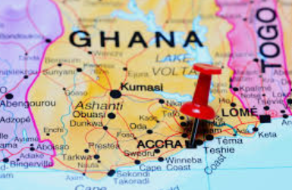
Sample Itinerary
DAY | ACTIVITY
Day 1 | Travel, Arrival, Welcome, Briefing, Lunch, City Tour, and Opening Dinner
Day 2 | History, Culture, and Social Justice Lecture, Tour, local resident cultural education, and dinner
Day 3 | Breakfast, Company visits, sustainability company, lunch and dinner
Day 4 | Breakfast, Cape Coast, Assin Manso Ancestral Slave River, Jesuit meeting, and dinner
17

Slide 18
Sample Itinerary
DAY | ACTIVITY
Day 5 | Breakfast, Cape Coast Castle, Lunch, Kakum National Park, and Dinner
Day 6 | Breakfast, local business tour, lunch, and dinner
Day 7 | Breakfast, community service project, lunch, reflection, and hotel
Day 8 | Breakfast, cultural center, market, lunch, final reflection, and dinner
Day 9 | Hotel check out and departure
18

Slide 19
Who should apply?
Students who:
Rising Sophomores and higher with good academic standing of at least a 2.5 GPA
Accounting Elective
International Business Elective
Possible other subject area Electives
19

Slide 20
Application Process
Apply online starting from early November 2026 through 11:59pm on February 1, 2026.
Deposit due Friday, February 1, 2026
Talk to Dr. Robbie Bishop-Monroe about the course connection Rbishop-Monroe@Loyola.edu
20

Slide 21
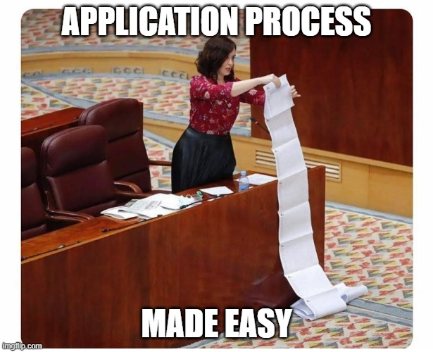
Application Process
Dr. Robbie will provide a link for a Microsoft forms. Students will also submit information to the Office of International Programs (OIP)
This program has a maximum capacity of 20 participants
Students outside this major are welcome to apply as well! All majors are welcome.
21

Slide 22


Next Steps
1. Visit https://www.loyola.edu/department/international-programs/locations/summer.html
2. Passport - Students in this program must have a passport that does not expire
before July 11, 2026.!
3. Attend an information session on your program or a meeting with your Program
Director.
4. Submit your application electronically to the Office of International Programs using our
online application portal before the deadline indicated below.
5. Application deadline: February 1, 2026, 11:59 EST.
6. Pay deposit
7. Register for Summer course AC 320-01 (Accounting 320- Z1)
8. Payment deadlines (subject to change):
Deposit-February 27, 2026= $500
Payment 1-March 13, 2026= $1,250
Payment 2-April 3, 2026= $1,250
Payment 3-April 24, 2026= $1,250
22
Notes:
Can measure through certain ratios

Slide 23
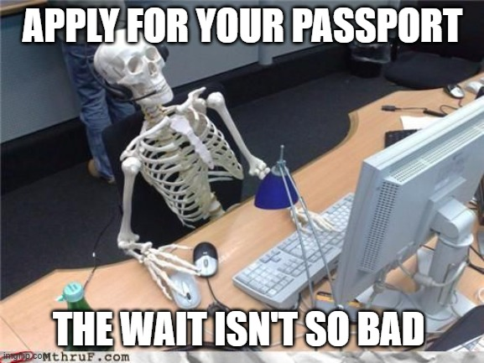
Passports
The US state department is currently quoting passport processing times of 4-6 weeks for routine processing ($130, plus $35 acceptance fee) and 2-3 weeks for expedited processing (additional fee of $60). All students must have valid passports by February 1, 2026.
Visit the US State Department website for more information on how to apply for a passport
23

Slide 24
Program Fees
$4,250 per student paid directly to Loyola University
Hotel accommodations (Double occupancy)
Entrance & activity fees
Private transportation during the program
Local guides for duration of the program
Group meals
*Does not include flights
*Solo room request incur additional fees
*Does not include passport, visa, and immunization fees
* Additional amounts for incidentals
24

Slide 25
Accepted Student Requirements
Participate in all workshops and pre-departure meetings.
Remain in good academic and disciplinary standing. Conduct violations may result in dismissal from the program and student liability for any un-recoverable costs paid on their behalf.
Transcripts will be evaluated in January 2026
25

Slide 26
Scholarships
Go Fund Me
https://fundforeducationabroad.org/
Transfer Scholarships
26

Slide 27
FAQs
Q. What are the different types of housing available during the program?
A. Students will share a double occupancy hotel room during the program.
Q. How would this program impact my courses?
A. This program is over the Summer break; there are some sessions held before you travel to prepare you for the international educational and business experience.
Q. Are there any costs we should expect that are not covered by the program fee?
A. Students will be responsible for the cost of passports, visas, and immunizations, in addition to any personal spending money for shopping or free-time activities.
Q. Are there any prerequisites to be considered for this program?
A. Students who will be taking the course should have all prerequisites completed prior to Spring ‘26 semester. A 2.5 grade point average is required in January 2026, all majors
Q. Will this itinerary change at all?
A. Hilltop Global reserves the flexibility to make changes to an itinerary if necessary. In the case of removing an activity, alternate activities will be substituted.
27

Slide 28


Questions
28

Slide 29
Bonus
29

Slide 30
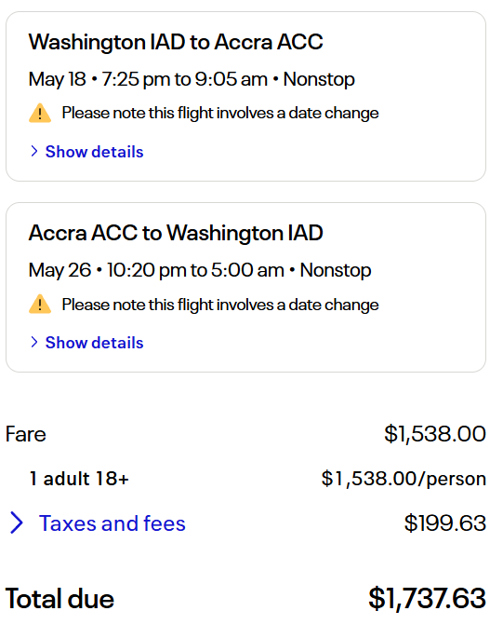
Flights - United Airlines
30

