Slide 1
Sexual Misconduct Hearing Panel Training- Spring 2024
Marian Aden (she/her)
Director of Student Conduct
David Tiscione (he/him)
Director of Title IX, Compliance, and Assessment
MORE THAN READY.
LOYOLA READY.

Slide 2
Overview of training
Policy update
Policy and Process Reminders
Update on Regs Timeline
Sanctioning Guide
Case Study
Notes:
Dave- We’re going to start by reviewing the behaviors prohibited by our Sexual and Gender-Based misconduct policy.
These policies apply to all members of our community- employees and students. They also apply to behaviors that occur on or off campus, in person or online, and abroad or in the united states- essentially anytime someone is a student or employee.
These are the definitions we are required to use by the federal government from the Violence Against Women Act. They are reviewed in detail on the Title IX website, community standards, and Everfi course. But to make sure we are using common language today, let’s do a brief review of the meaning of these policies-
Sexual assault and the 4 categories under it can be defined as non-consensual sexual intercourse or contact, which includes categories of people who can’t consent because of their age or familial status.
Dating and domestic violence is violence or threat of violence between individuals who are dating, hooking up, going steady, exclusive- what was it Melissa a situationship? whatever phrase you use to describe people in a relationship. When there is violence or harm occurring, that could fall under dating or domestic violence.
And stalking is more than just someone saying “I’m totes stalking my bffs instagram”. Stalking is 2 or more behaviors directed at someone that makes them fear for their safety or the safety of others.

Slide 3
Policy updates
Sexual assault is defined as any sexual act directed against another person, without consent of the complainant, including instances where the complainant is incapable of giving consent. Sexual assault includes penetration, no matter how slight, of the vagina or anus with any body part or object, or oral penetration by a sex organ of another person, without the consent of the complainant. This definition includes any gender of the complainant or respondent.
Fondling is another form of sexual assault which is defined as the touching of the private body parts, including but not limited to breasts, buttocks, or groin of another person, for the purpose of sexual gratification, without the consent of the complainant, including instances where the complainant is incapable of giving consent because of their age or because of their temporary or permanent mental incapacity. (This would include someone (person A) making another person (person B) touch their (person A) private body parts sexually without their (person B) consent.)

Slide 4
Policy updates
Incest is also a form of sexual assault when defined as non-forcible sexual intercourse occurs between persons who are related to each other within the degrees wherein marriage is prohibited by law.
Added the following sanction: 29. Removal from Employment- A student found responsible for a Sexual and Gender-Based Misconduct policy may be removed from their on-campus employment, if appropriate.

Slide 5
Policy Review
Sexual Harassment defined as conduct on the basis of sex which may include such behavior as unwelcome sexual advances, requests, and other verbal, written, or electronic communications or physical conduct of a sexual nature when
an employee of the University conditions the provision of an aid, benefit, or service of the University on an individual’s participation in the unwelcome sexual conduct; or
unwelcome conduct determined by a reasonable person to be so severe, pervasive, and objectively offensive that it effectively denies a person equal access to the University’s education program or activity.

Slide 6
Policy Review
Fondling is defined as the touching of the private body parts, including but not limited to breasts, buttocks, or groin of another person, for the purpose of sexual gratification, without the consent of the complainant, including instances where the complainant is incapable of giving consent because of their age or because of their temporary or permanent mental incapacity.
This would include someone (person A) making another person (person B) touch their (person A) private body parts sexually without their (person B) consent.

Slide 7
Policy Review
Statutory Rape is defined as non-forcible sexual intercourse with a person who is under the statutory age of consent which is 16 years of age in the state of Maryland (which means the victim must be under 16); however, 14- and 15-year-olds may consent if the offender is less than four years older than the victim.

Slide 8
Policy Review
Dating Violence encompasses a wide range of behaviors including sexual assault, physical abuse and other forms of violence committed by a person who is or has been in a social relationship of a romantic or intimate nature with the complainant. The existence of such a relationship shall be determined based on the complainant’s statement and with consideration of the length of the relationship, the type of relationship, and the frequency of interaction between the persons involved in the relationship. For the purposes of this definition, dating violence includes, but is not limited to, sexual or physical abuse or the threat of such abuse. Dating violence does not include acts covered under the definition of domestic violence.

Slide 9
Policy Review
Domestic Violence encompasses a wide range of behaviors including sexual assault, physical abuse and other forms of violence committed by a current or former spouse or intimate partner of the complainant; by a person with whom the complainant shares a child in common; by a person who is cohabitating with or has cohabitated with, the complainant as a spouse or intimate partner; by a person similarly situated to a spouse of the complainant, or by any other person against an adult or youth complainant protected from those acts by domestic or family violence laws of Maryland.

Slide 10
Policy Review
Violence under dating violence and domestic violence includes but is not limited to:
the use or attempted use of physical abuse or sexual abuse
a pattern of any other coercive behavior committed, enabled, or solicited to gain or maintain power and control over a victim
  including verbal, psychological, economic, or technological abuse.
Economic abuse means behavior that is coercive, deceptive, or unreasonably controls or restrains a person’s ability to acquire, use, or maintain economic resources to which they are entitled, including using coercion, fraud, or manipulation to restrict a person’s access to money, assets, credit, or financial information; unfairly use a person’s personal economic resources, including money, assets, and credit, for one’s own advantage; or exert undue influence over a person’s financial and economic behavior or decisions, including forcing default on joint or other financial obligations, exploiting powers of attorney, guardianship, or conservatorship, or failing or neglecting to act in the best interests of a person to whom one has a fiduciary duty. Technological Abuse means an act or pattern of behavior that is intended to harm, threaten, intimidate, control, stalk, harass, impersonate, exploit, extort, or monitor, except as otherwise permitted by law, another person, that occurs using any form of technology, including but not limited to: internet enabled devices, online spaces and platforms, computers, mobile devices, cameras and imaging programs, apps, location tracking devices, or communication technologies, or any other emerging technologies.

Slide 11
Policy Review
Economic abuse means behavior that is coercive, deceptive, or unreasonably controls or restrains a person’s ability to acquire, use, or maintain economic resources to which they are entitled, including using coercion, fraud, or manipulation to restrict a person’s access to money, assets, credit, or financial information; unfairly use a person’s personal economic resources, including money, assets, and credit, for one’s own advantage; or exert undue influence over a person’s financial and economic behavior or decisions, including forcing default on joint or other financial obligations, exploiting powers of attorney, guardianship, or conservatorship, or failing or neglecting to act in the best interests of a person to whom one has a fiduciary duty.
Technological Abuse means an act or pattern of behavior that is intended to harm, threaten, intimidate, control, stalk, harass, impersonate, exploit, extort, or monitor, except as otherwise permitted by law, another person, that occurs using any form of technology, including but not limited to: internet enabled devices, online spaces and platforms, computers, mobile devices, cameras and imaging programs, apps, location tracking devices, or communication technologies, or any other emerging technologies.

Slide 12
Policy Review
Stalking is defined as engaging in a course of conduct directed at a specific person that would cause a reasonable person to fear for the person’s safety or the safety of others or suffer substantial emotional distress. A course of conduct means two or more acts, including, but not limited to, acts in which the stalker directly, indirectly, or through third parties, by any action, method, device, or means, follows, monitors, observes, surveils, threatens, or communicates to or about a person, or interferes with a person’s property. A reasonable person means a reasonable person under similar circumstances and with similar identities to the complainant. Substantial emotional distress means significant mental suffering or anguish that may but does not necessarily require medical or other professional treatment or counseling.

Slide 13
Policy Review (Non Title IX)
Harassment under this section means unwelcome verbal, written or physical conduct based on sex, sexual orientation and/or gender identity, that has the purpose or effect of unreasonably interfering with an individual's work or education (including living conditions) or that creates an intimidating, hostile or offensive environment.
Student Quid Pro Quo Sexual harassment is a form of harassment that consists of unwelcome sexual advances, requests for sexual favors, or other verbal, written, or physical conduct of a sexual nature when a student of the University conditions the provision of an aid, benefit, or service of the University on an individual’s participation in the unwelcome sexual conduct.

Slide 14
Policy Review (Non Title IX)
Sexual exploitation means taking non-consensual or abusive sexual advantage of another person for one’s own advantage or benefit or for the advantage or benefit of anyone other than the person being exploited. Examples include but are not limited to non-consensual photography, video-, or audio- recording of sexual images or activity, distributing images of sexual activity without consent, allowing others to observe a consensual sexual act without the prior knowledge or consent of all involved parties, and voyeurism.

Slide 15
Update on regs timeline
Have been delayed multiple times
Will likely be released by July with implementation in August
Training in August

Slide 16
ATIXa Sanction Guide

Slide 17
THINGS TO consider
Mitigating, Aggravating, and Compounding Factors
Severity and Egregiousness
Cumulative Violations
Prior Conduct History
Precedent
Complainant request/ Respondent acceptance of responsibility

Slide 18
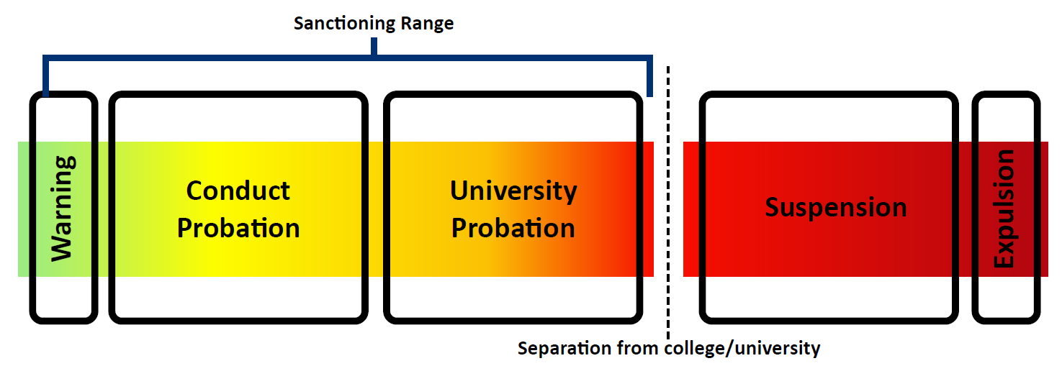
Sexual Harassment (SPOO)- Guide

Slide 19
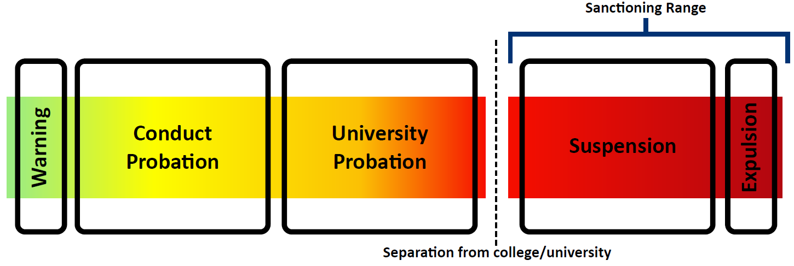
Sexual Assault- Guide

Slide 20
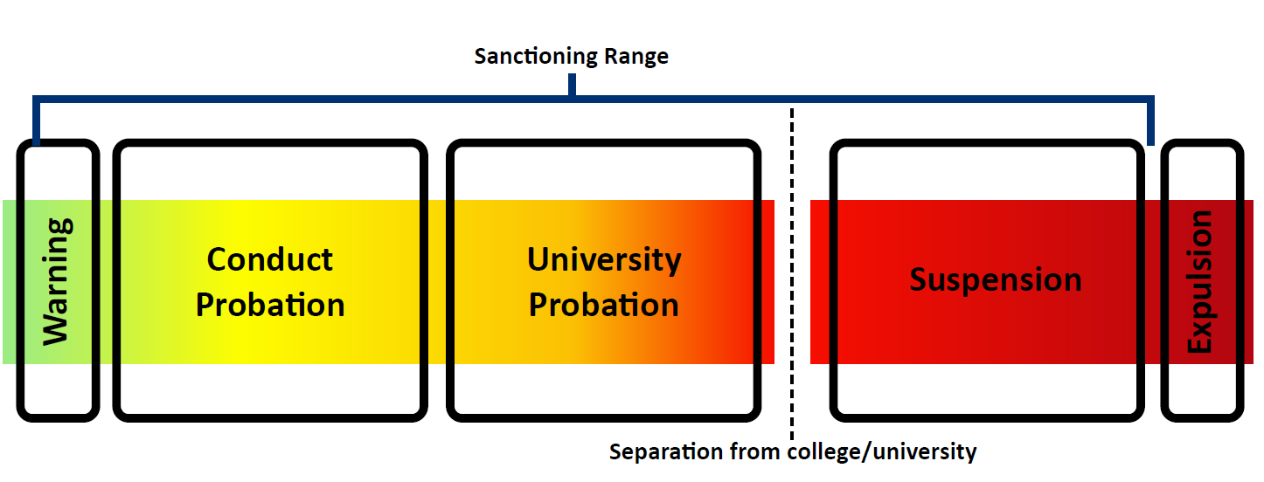
Fondling- Guide

Slide 21
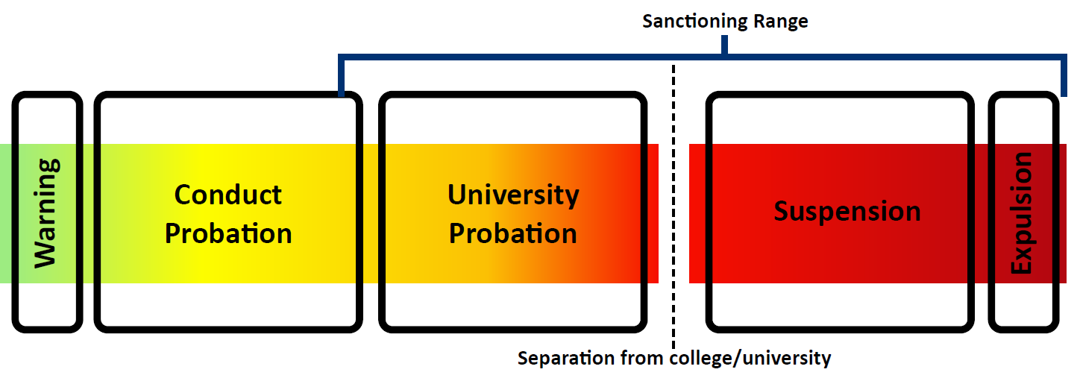
Dating & Domestic Violence- Guide

Slide 22
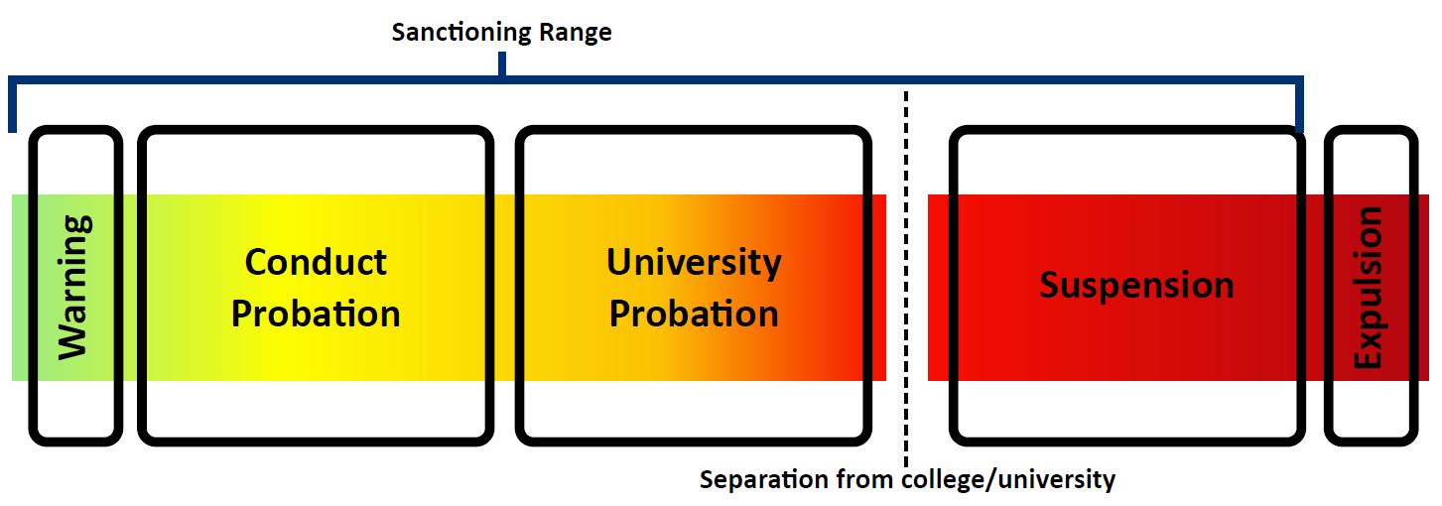
Stalking- Guide

Slide 23
Incapacitation

Slide 24
Incapacitation Review
Incapacitation is a state where someone cannot make rational, reasonable decisions because they lack the capacity to give knowing consent (e.g., to understand the “who, what, when, where, why or how” of their sexual interaction). While incapacitation may result from the use of alcohol and/or drugs, incapacitation is a state beyond drunkenness or intoxication. Incapacitation may also exist because of a physical, mental, or developmental disability. The question of incapacitation will be examined objectively from the perspective of the respondent i.e., whether a reasonable, sober person in place of the respondent should have known the condition of the complainant based on the apparent indications of incapacitation, which may include, but are not limited to, acting confused or incoherent, difficulty walking or speaking, and vomiting.

Slide 25
Jalen and Yameeka- Case Study

Slide 26
What are Statements or actions that could indicate incapacitation?

Slide 27
Where can Evidence of Incapacitation come from?

Slide 28
What questions would you ask to assess incapacitation?

Slide 29
Questions

