Slide 1
Do Parent-Engagement Workshops and Informational Sessions Help Parents Feel More Connected to Their Child’s Education? By Lily Enchin M.Ed Candidate
M.Ed Montessori Education
Loyola University Maryland

Slide 2
Background
Parental involvement and engagement at school is an issue of constant importance for young children. Parental involvement can include activities ranging from an investment in one’s child’s education as well as the ways in which parents are engaged with their children's teachers and larger school community, from participation in school events, communication with classroom teachers, as well as attending parent-teacher conferences. This connection is critical for optimal social, emotional, and cognitive development for children three and under. According to the National Parent Teacher Association, student achievement in school can most accurately be predicted by the extent to which a family becomes involved in the child’s school life, while creating a home environment that encourages learning (National PTA, 2000). Establishing positive parent-teacher partnerships as soon as a child begins school, sets the stage for on-going parent involvement, engagement, as well as learning support in the home for the school years to come.

Slide 3
background
Parent engagement that fosters open communication between families and teachers creates consistent expectations and circumstances for children. Consistency between the school and home environments is important for our youngest learners, and this is best achieved when parents and teachers develop a healthy relationship to support the child. Research by Galindo and Sheldon (2012) examined the relationship between parent involvement in education and children’s academic and social-emotional development concluding that there are no greater learning environments than the home and school. According to Galindo and Sheldon (2012), when children are being supported in their home environment, the common themes from school are translated to the home setting more easily. While this home-school partnership ought to be a foundation of all early childhood programs, this particular action research project was conducted in a Montessori school with the parents of children enrolled in the Toddler program for children aged 18 months-3 years.

Slide 4
What is Montessori education?
Montessori education is a child-centered, individualized approach to education that relies on special, self-correcting materials and a purposefully crafted space known as a prepared environment that offers opportunities for independence. This pedagogy was developed over a century ago by Dr. Maria Montessori, an activist, medical doctor, anthropologist, and educator who founded her method of education by working with children with developmental disabilities. Dr. Montessori’s experience working with children with exceptionalities was so successful that these children, believed at that time to be incapable of such profound development, achieved the same results on state exams as neurotypical children and thus, the Montessori method was born. Dr. Montessori stated that understanding the needs of the child and offering the appropriate scaffolding and support to meet those needs was the underlying aim of her method (Montessori, 2017).
Notes:
Consider talking about:
Planes of development
Education and peace

Slide 5
, “﻿on every teacher and every parent, I urge not great instruction, but humility and simplicity in dealing with small children. Their lives are fresh, without rivalry or external ambitions, it takes so little to make them happy, to let them work in their own way towards the normal development of the men and women they will be” (Montessori, 2017, p. 18).

Slide 6
Objective
With the knowledge that the home-school partnership is impactful for young children, this action research study sought to understand whether Montessori philosophy was understood by families and looked at the effect of adding more parent Montessori education workshops to the school calendar at Hilltop Montessori School in Vermont, something I believe is critical to creating a bridge between home and school. It is the role of educators to work to support the whole child by supporting the whole family, thus bridging the gap between the home and school.
Notes:
Consider talking about:
Infant and toddler programs
Preschool and kindergarten
Elementary classrooms
Middle and high school

Slide 7
Research questions
This investigation of parent involvement was based on the following questions:
1. Do parents want to learn more about Montessori education and will providing this information help them feel more connected to their child's school life?
2. If parents are given the opportunity to learn more about Montessori education for toddlers and best practices used in the classroom, will they then feel empowered in their own parenting practices?
These initial questions led me a much larger question: Do parent-engagement opportunities help parents feel more connected to their child’s education?

Slide 8
participants
After obtaining approval from the IRB, I sent out Informed Consent Forms to my community of parents. I have 10 children in my class and 20 parents. 14 parents (7 mothers and 7 fathers) agreed to participate in my research.

Slide 9
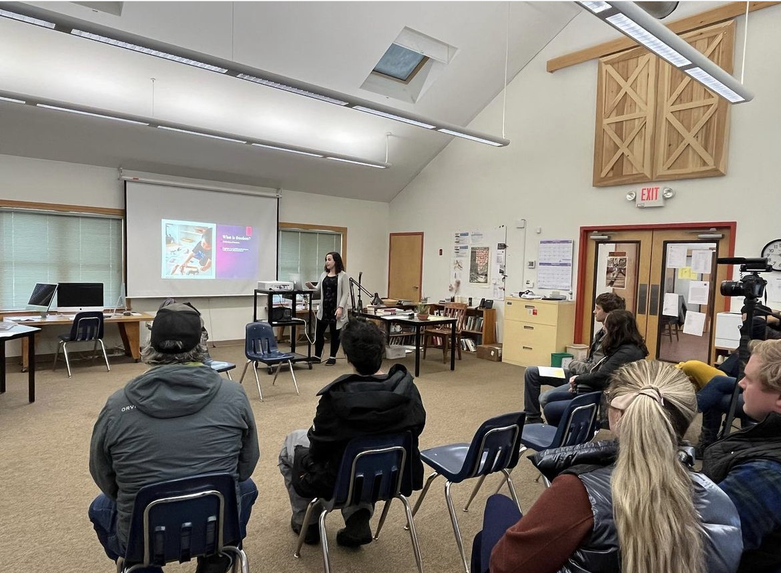
Parent workshops

Slide 10
Data collection
Data was collected through the following data collection methods:
Surveys (using a pre- and post- format)
Interviews
Reflective Logs

Slide 11
Data Analysis
I used thematic analysis to identify themes that emerged in the open-ended survey questions and interview discussions. Identified themes included:
The importance of the home-school partnership
A desire to observe the toddler classroom in action
The effectiveness of parent workshops
I used descriptive statistics to explain and track changes in the survey data from the pre- to post-surveys, understanding how parent attitudes, perceptions, and knowledge of Montessori education changed over the course of my study.

Slide 12
Findings

Slide 14
A collection of quotes from respondents
“I attended your training on toilet learning and I thought that was very helpful. You gave all the parents suggestions that they could follow what you’re doing at school. You offered very specific ways of helping them feel comfortable and I thought that was very good”.
“I find myself changing my own behavior because of what I learned which, I guess, is kind of the point of those. So, in that way, it was quite effective. I certainly plan to go to more of them”

Slide 15
Feedback from families on future Montessori parent learning
“Photos are great, but an occasional video would offer a clearer window into how kids are interacting with the class projects and with each other”.
““I think an open house of what activities or projects she is learning I will really look forward to attending to see more of what is happening in the classroom”.
“A document summarizing all the works available so we can see what our child gravitates toward and what works he avoids”.

Slide 16
Limitations
Small sample size
Parent participation in the research study itself dropped off significantly from the start of the study to its conclusion and potential future action research may look at how to keep parent participation strong in school events throughout the entire academic year

Slide 17
Action plan
The results of the data collected during this research will help guide my future practice with parent education: I plan to have a yearly series with 5 parent talks scheduled throughout the academic year emphasizing aspects of the Toddler curriculum, the materials in the classroom, and observation as a practice.
I plan to change a pane of glass on my classroom door to a one-way mirror so parents can observe the classroom in action without disrupting the daily schedule

Slide 18
References
Montessori, M. (2017). Maria Montessori Speaks to Parents: A Selection of Articles.
National PTA. 2000. Building successful partnerships: A guide for developing parent and family involvement programs. National Education Service, 11–12.

