Slide 1
MORE THAN READY.
LOYOLA READY.

Slide 2
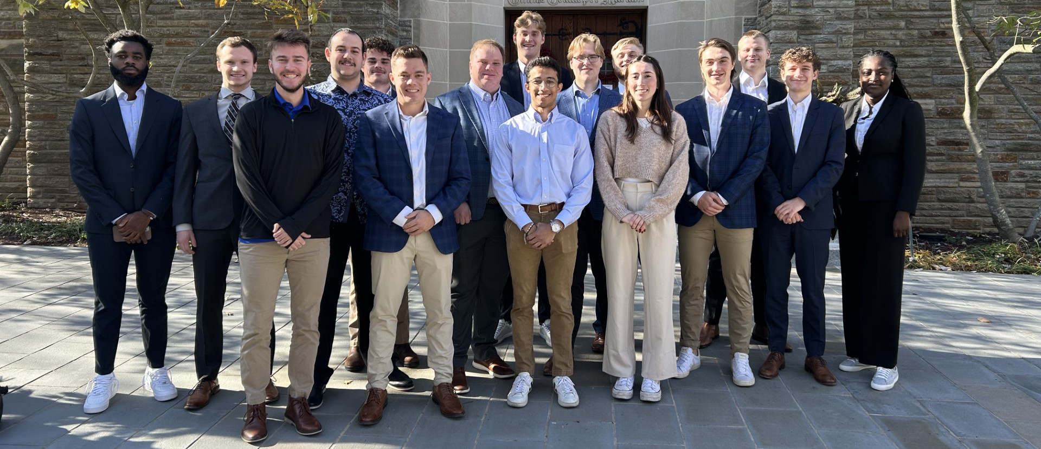

Fall 2023 SAP Report

Slide 3
TABLE OF CONTENTS
Overview
Economic Conditions
Sector Summaries
Portfolio Strategy & Composition
  Growth
  Value
  Dividend
Risk Analysis
Performance Review
Student Bios

Slide 4
Overview

Slide 5
BACKGROUND
The Sellinger Applied Portfolio Fund, known as the "SAP Fund," is a student-managed initiative at Loyola University designed to offer hands-on experience in portfolio management. The SAP Fund receives annual funding of up to $500,000 from the University, contributing to the University's endowment. The fund operates on an annual cycle, with all investments liquidated at the end of each course. Students, as a class, actively engage in decision-making processes related to stock selection and trading, gaining practical insights into portfolio management processes such as valuation, diversification, optimization, and risk management.
SAP Fund
Managed by 15 students
September 19, 2023 → December 13, 2023
Beginning assets: $508,135 → Ending Assets $533,465 (increase of $25,330).
S&P 500 ETF Return: 4.52%
SAP Fund Return: 4.98%

Slide 6
INVESTMENT STRATEGIES
Investment Strategies
Investment Philosophy
Diversification across sectors
Asset strategy
  Not more than 10% will be invested in any one stock
  Not more than 25% will be invested in a single index
  Not more than 30% will be invested in a single sector
Three Investment Strategies
  Growth → Value → Dividend
U.S. exchange listed stocks, including ADRs
Unleveraged ETFs, including stock index ETFs and commodity ETFs
Only investment grade securities
Process for SAP Fund
Research
- Finding undervalued stocks
- sector overviews
Team Pitches
- Stock recommendation
- Current events
Investment Voting
- Class votes on stock recommendations

Slide 7
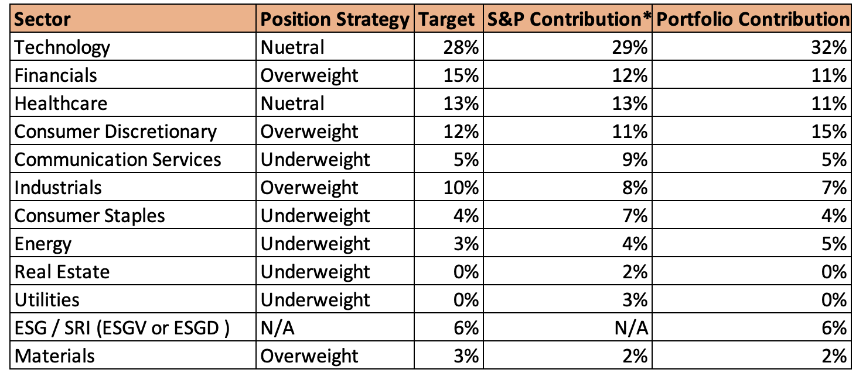
SECTOR WEIGHTS

Slide 8
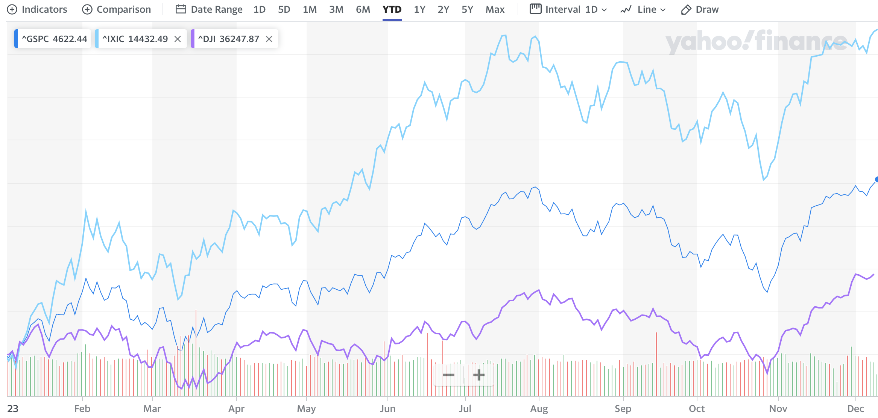
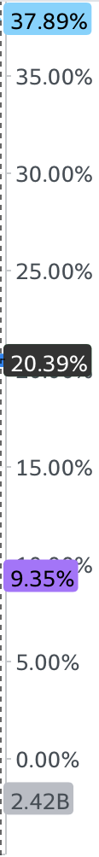
MAJOR INDICES PERFORMANCE

Slide 9
Economic Conditions

Slide 10
ECONOMIC FACTORS
Federal Reserve Policy
The market are influenced by the economic factors such as the federal reserve policy, unemployment, inflation, global events, technology and innovation.
Stock analysis and portfolio management decisions considered economic conditions
Unemployment
Inflation
Sellinger Applied Portfolio
Technology and Innovation
Global Events

Slide 11
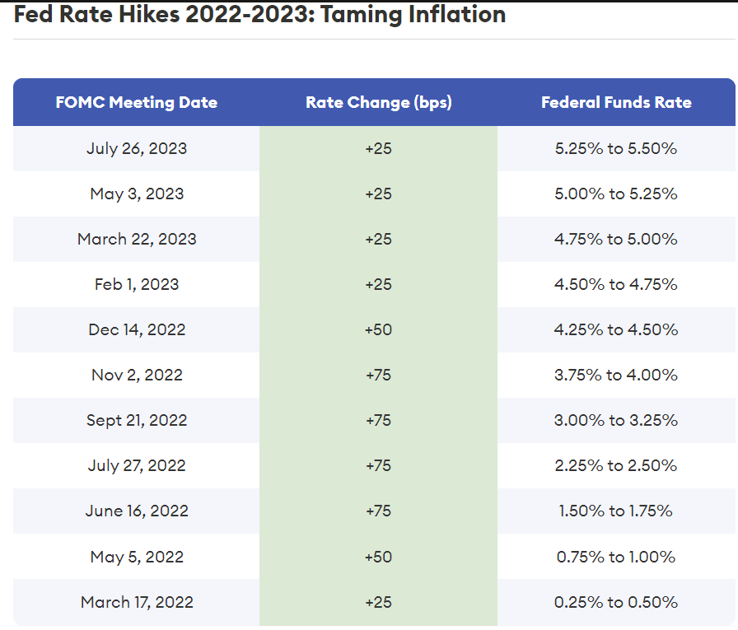
Interest RATE
FED RATE HIKES
In response to rising inflation since March 2022, the Federal Reserve has been implementing rate hikes, with increments as high as 75 basis points. In June 2022, it experienced the highest one-year increase of 9.1%.
The Federal Reserve adjusts the federal funds target rate range in response to what’s happening in the economy. The Fed raises interest rates when inflation is high and cuts rates when the economy looks weak (high unemployment).
Source : Forbes

Slide 12
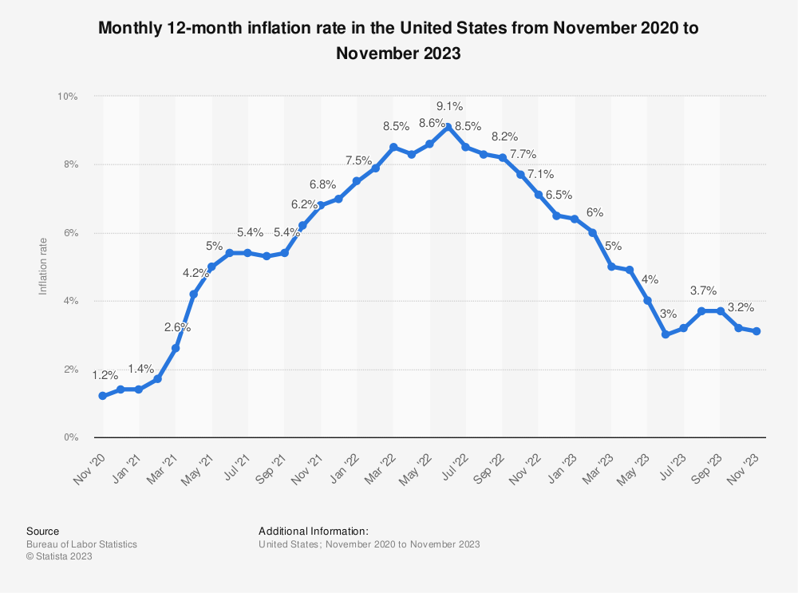
INFLATION
Inflation remains persistently above the Fed’s 2% target.
US Inflation Rate is at 3.2% compared 8.20% last year.
Inflation rates influence purchasing power. High inflation can erode real returns on investments and impact consumer spending.

Slide 13
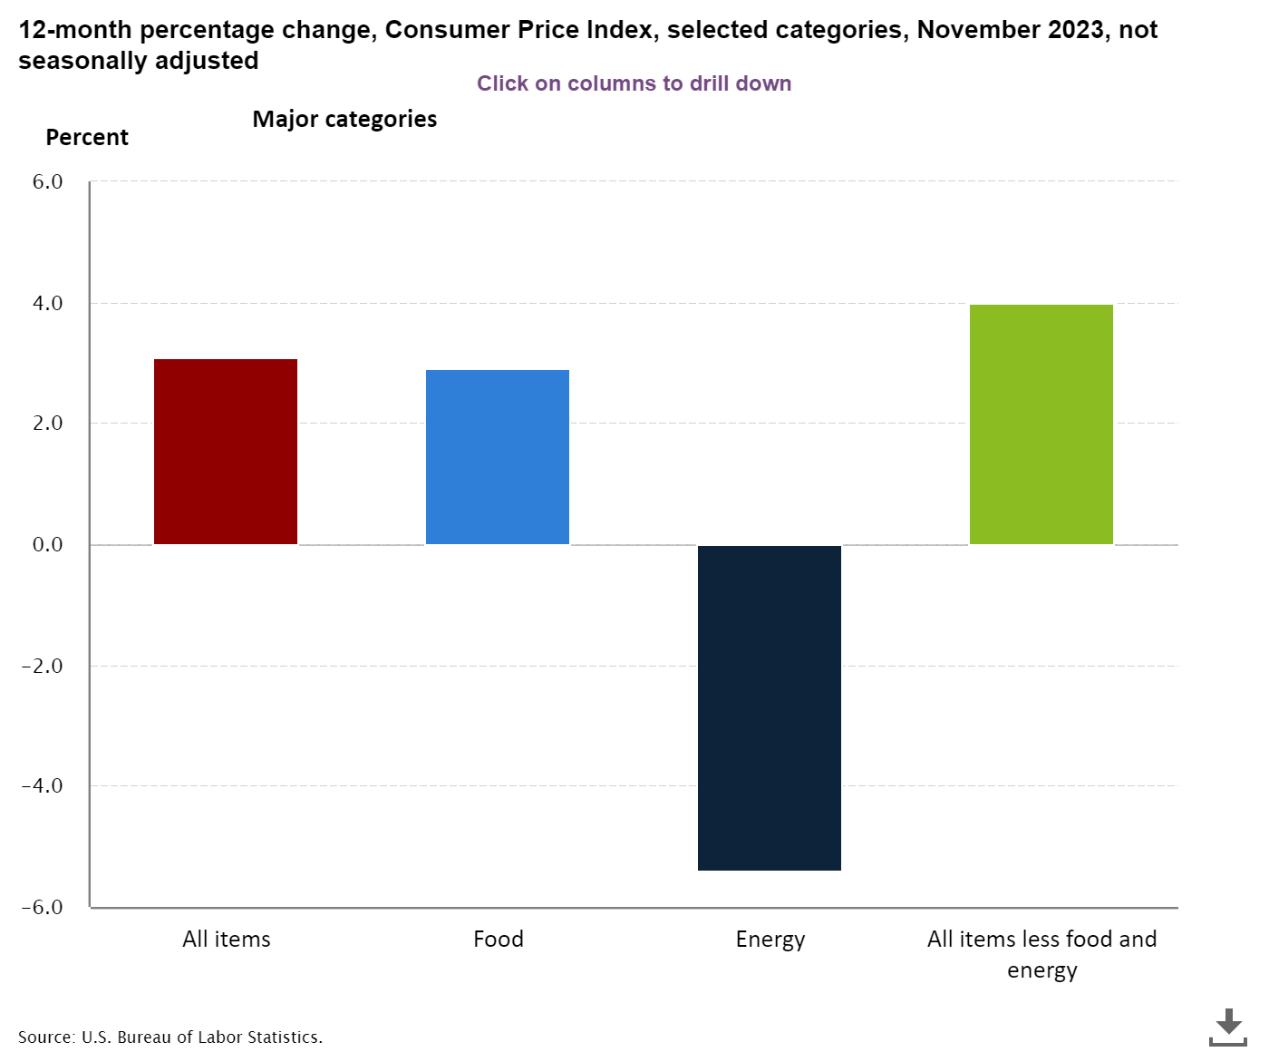
CONSUMER PRICE INDEX
The Consumer Price Index for All Urban Consumers (CPI-U) increased by 0.1 percent in November, following no change in October, with a 3.1 percent rise over the last 12 months.
In November, the energy index declined by 2.3 percent due to a 6.0-percent drop in the gasoline index, while the food index increased by 0.2 percent. The all-items index rose 3.1 percent over the 12 months ending November, slightly lower than the 3.2-percent increase for the 12 months ending October.
CPI is a crucial indicator for gauging inflationary pressures, aiding in the adjustment of investment strategies to preserve real returns and navigate potential impacts on stock values in response to changing economic conditions.

Slide 14
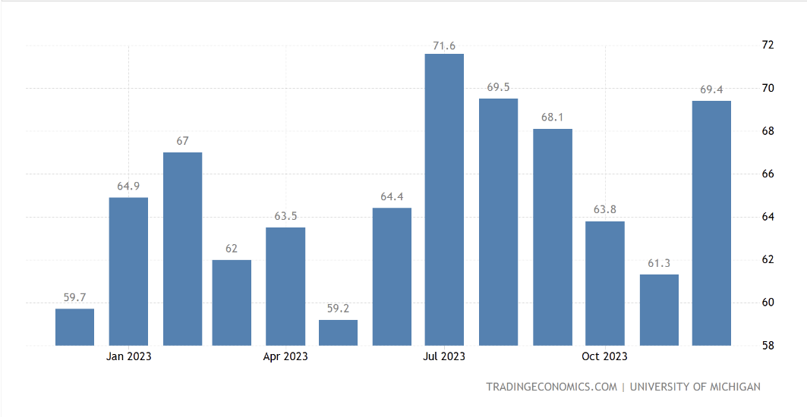
CONSUMER CONFIDENCE
December 2023's US consumer sentiment, as per the University of Michigan, surged to 69.4, surpassing expectations (62.0) and reaching its highest level since August. Fueled by positive shifts in expected inflation, the anticipation for the upcoming year dropped to 3.1%, the lowest since March 2021. Current economic conditions rose to 74.0, and consumer expectations surged to 66.4. Despite a 39% increase from the June 2022 low, sentiment remains below pre-pandemic levels.
A higher than expected reading should be taken as positive/bullish for the USD, while a lower than expected reading should be taken as negative/bearish for the USD.

Slide 15
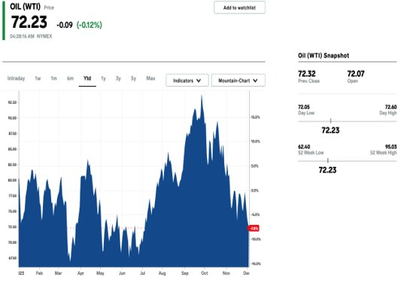
OIL PRICES
The oil price hit a year-to-date high of $95 per barrel.​
The increased demand for oil stemmed from supply cuts by OPEC, particularly Saudi Arabia's daily cut of 1 million barrels, and China's heightened demand upon reopening its economy.​
Recently, OPEC pledged an additional 2.2 million barrel cut for the first quarter of next year in response to weakening oil demand.

Slide 16

ISREAL-HAMAS WAR
On October 7, 2023, Hamas-led incursions and rocket barrages from the Gaza Strip targeted Israel, leading to widespread casualties and inciting the 2023 Israel-Hamas war.​
The assaults resulted in a devastating toll, with approximately 859 Israeli civilians, around 349 soldiers and policemen killed, and nearly 250 civilians and soldiers taken hostage by Hamas fighters.​
The attack was condemned by numerous nations as an act of terrorism, while differing opinions arose regarding the underlying causes, with some attributing blame to the Israeli occupation of Palestinian territories.​

Slide 17

STUDENT LOANS
Despite the Supreme Court blocking President Biden's $400 billion plan to cancel $20,000 in federal student loan debt for 43 million borrowers, the administration successfully erased $127 billion in education debt for 3.6 million borrowers​
The Biden administration utilized existing relief programs to expedite debt relief. By adjusting rules and temporarily waiving requirements, such as the Public Service Loan Forgiveness and Income-Driven Repayment plans, they facilitated debt elimination.​
The resumption of loan repayments in November 2023 is expected to limit consumer spending, potentially exacerbating inflationary pressures.​
​

Slide 18
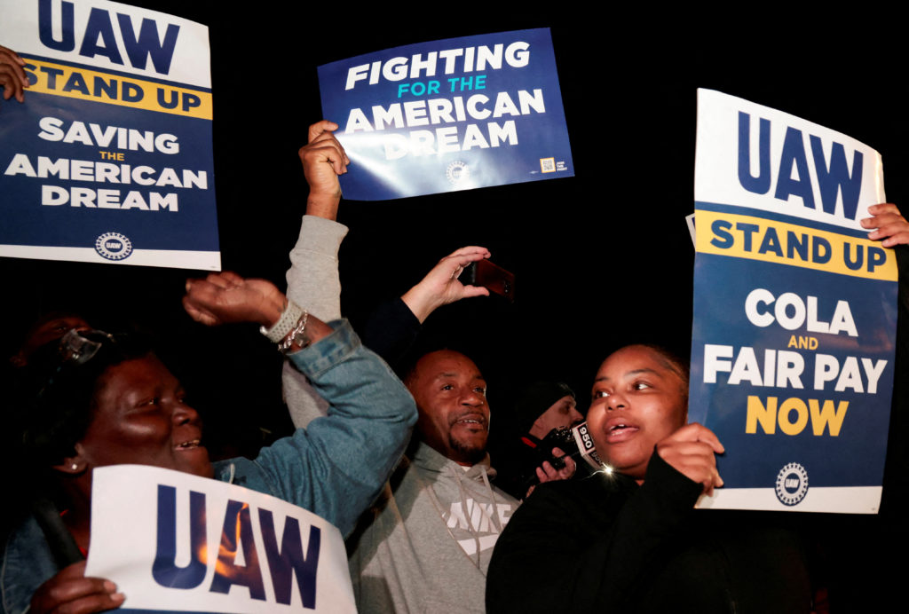
LABOR TENSIONS RISE
Labor tensions in several US industries have come to a head in 2023, resulting in many large-scale strikes.
Worker unrest has been fueled by a rise in inflation as well as inequities stemming from the pandemic.
Strikes included autoworkers at the Detroit Three, the American Actors Union, Hollywood hotel workers, and various healthcare worker organizations.
The UAW strike involved workers from Ford Motor Company, General Motors, and Stellantis

Slide 19


AI & MACHINE LEARNING
AI and Machine learning continue to have a widespread effect on economic conditions in the United States and globally.
New business models and industries have emerged such as autonomous vehicles and smart infrastructure.
Companies and countries continue to compete and invest heavily in AI, hoping to gain advantages in various market spaces.
OpenAI made market headlines when it got rid of and then subsequently re-instated CEO Sam Altman

Slide 20
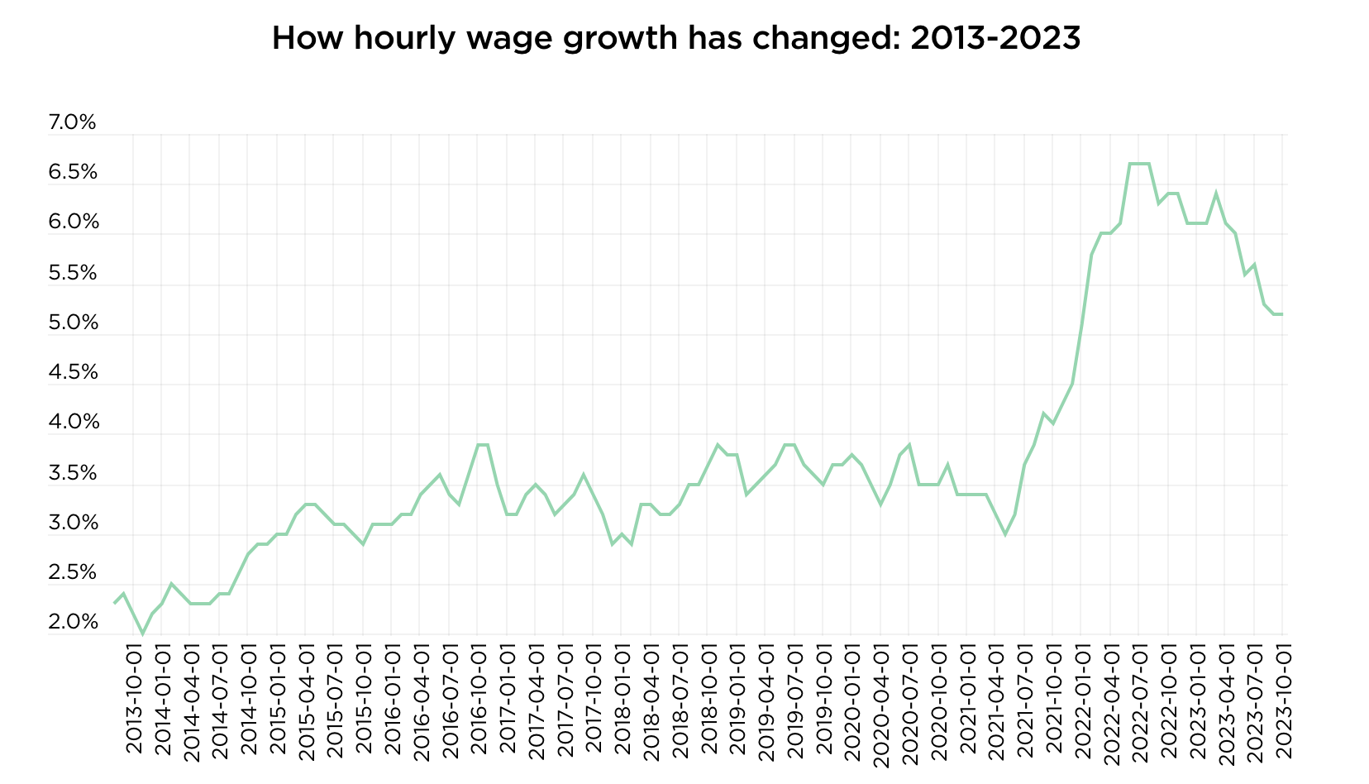
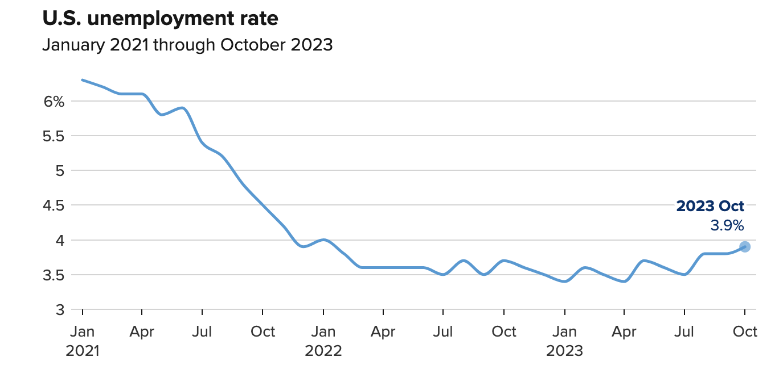
UNEMPLOYMENT
The job market has continued to show signs of cooling, as the 150,000 jobs added in October were significantly under the 260,000 jobs added on average per month in 2023.
Many experts have seen the drop-off as a slowdown into sustainable growth, and not a reason for worry.
Wage growth has also begun to cool as recent labor trends have led to workers and jobseekers losing considerable leverage in the job market.
Most are still optimistic as the job market has showed resiliency in the face of economic headwinds before.

Slide 21
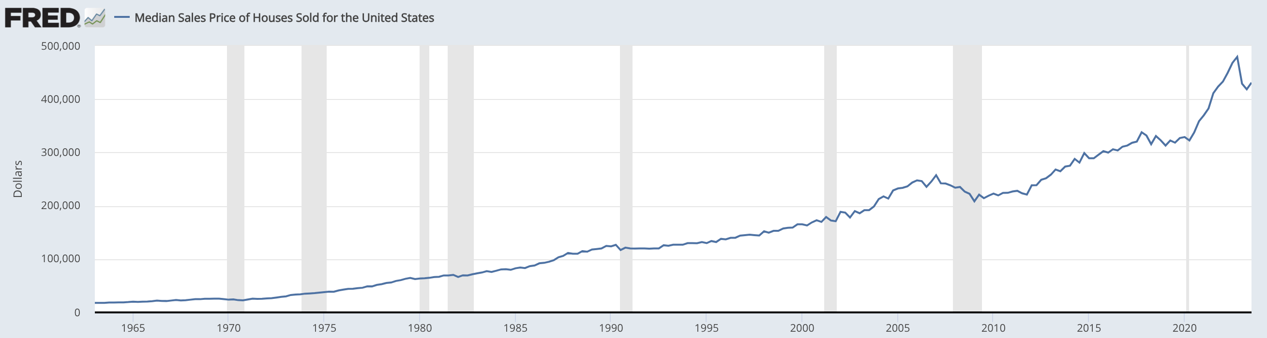

HOUSING MARKET
The housing market has experienced sky-high prices amid high mortgage rates and a drop in stock putting many the goals of many homebuyers out of reach.
In 2023, mortgage rates peaked at 7.79% and median home prices surged above $400,000.
Mortgage rates have begun to fall amid the Federal Reserve seeming to be done with a 20-month long rate hiking campaign.
A low inventory does not seem to be subsiding anytime soon and will continue to put upward pressure on housing prices.

Slide 22
Sector summaries

Slide 23
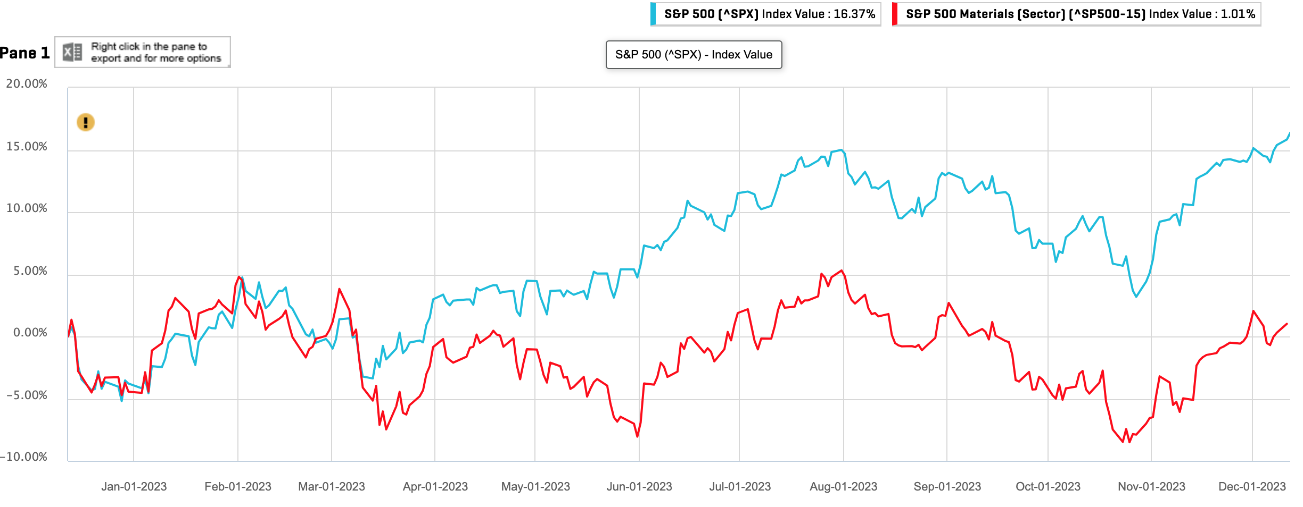
MATERIALS
The materials sector includes companies in industries such as metals and mining, chemicals, construction materials, and packaging, providing essential raw materials for various industries.
Factors to be Considered for Fall 2023:
(-) High cost of borrowing
(-) Supply chain disruptions
(+) Reshoring and nearshoring
Portfolio Contributions
Name | Abbreviation
Nutrien | NTR
Sector | Initial Position Strategy | Final Position Strategy | Target | S&P Contribution | Portfolio Contribution | YTD Performance
Materials | Overweight | Neutral | 3% | 2.40% | 2.05% | 5.71%

Slide 24
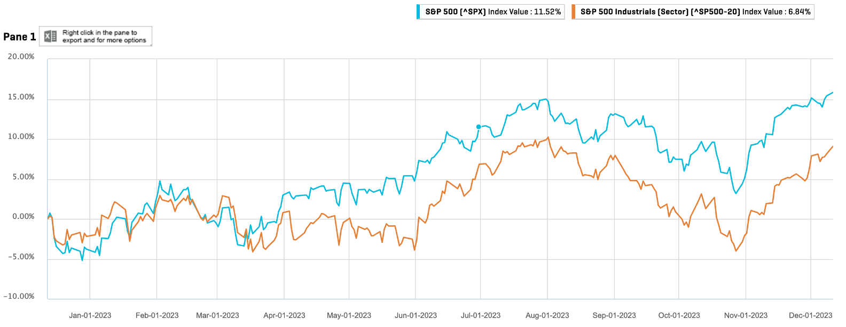
INDUSTRIALS
The industrials sector includes companies involved in the production of goods used in construction and manufacturing. It encompasses a wide range of industries, such as aerospace and defense, industrial machinery, tools, lumber production, construction, cement and metal fabrication, waste management, and others.
Factors to be Considered for Fall 2023:
(-) High interest rates making debt expensive for Capex heavy businesses limiting growth
(+) Increased infrastructure spending
(+) Reshoring and supply chain diversification influenced by U.S. attempting to divest from China
Portfolio Contributions
Name | Abbreviation
FedEx Corperation | FDX
Industrials Select Sector Fund | XLI
Sector | Initial Position Strategy | Final Position Strategy | Target | S&P Contribution | Portfolio Contribution | YTD Performance
Industrials | Overweight | Underweight | 9.50% | 8.30% | 7.43% | 11.53%

Slide 25
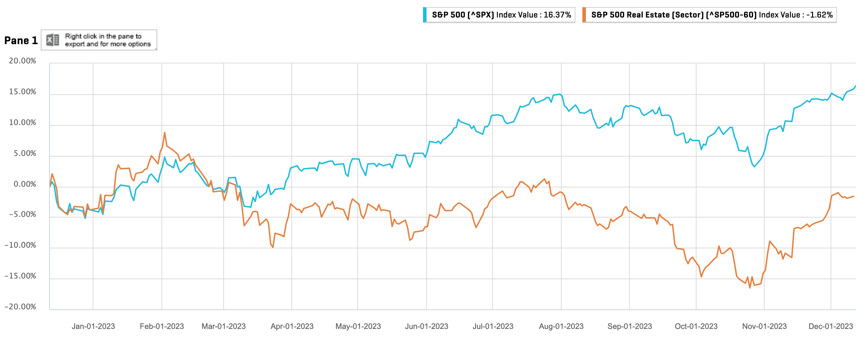
REAL ESTATE
The real estate sector is comprised of companies involved in real estate ownership, development, and management. This includes real estate investment trusts (REITs), real estate management and development companies, and firms providing related services.
Factors to be Considered for Fall 2023:
(-) High borrowing cost slowing development
(-) Mortgage rates at highest level in decades
(-) Office space demand has not recovered from pandemic with continuation of work from home
Sector | Initial Position Strategy | Final Position Strategy | Target | S&P Contribution | Portfolio Contribution | YTD Performance
Real Estate | Underweight | Underweight | 0% | 2.40% | 0% | 2.32%

Slide 26
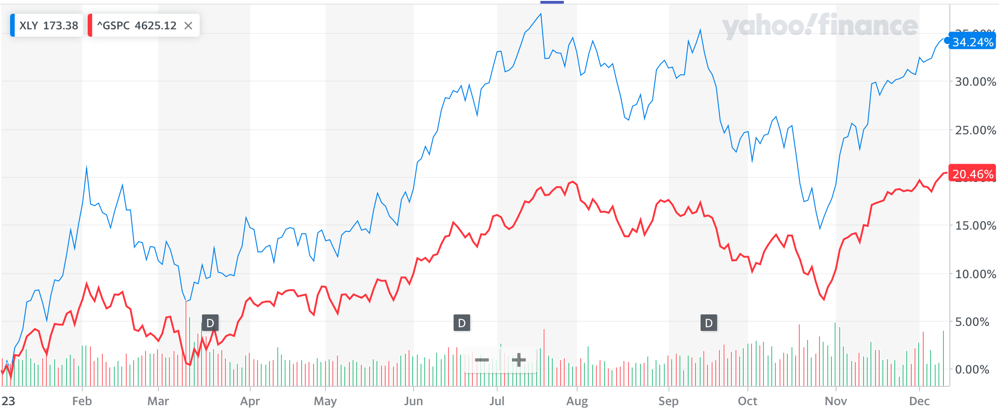
CONSUMER DISCRETIONARY
Consumer discretionary sector consists of businesses that sell non-essential goods and services. These are items that consumers can usually live without and do not need in their day-to-day lives.
Factors to Consider – Fall 2023
(-)High interest rates
(+) Cooling inflation from is previous highs
(+) Holiday season spending
Portfolio Contributions
Name | Abbreviation
TEXAS ROADHOUSE, INC. | TXRH
COSTCO WHOLESALE CORPORATION | COST
FIVE BELOW, INC. | FIVE
TOLL BROTHERS, INC. | TOL
Sector | Initial Position Strategy | Final Position Strategy | Target | S&P Contribution | Portfolio Contribution | YTD Performance
Consumer Discretionary | Overweight | Overweight | 12% | 10.75% | 14.80% | 34.24%

Slide 27
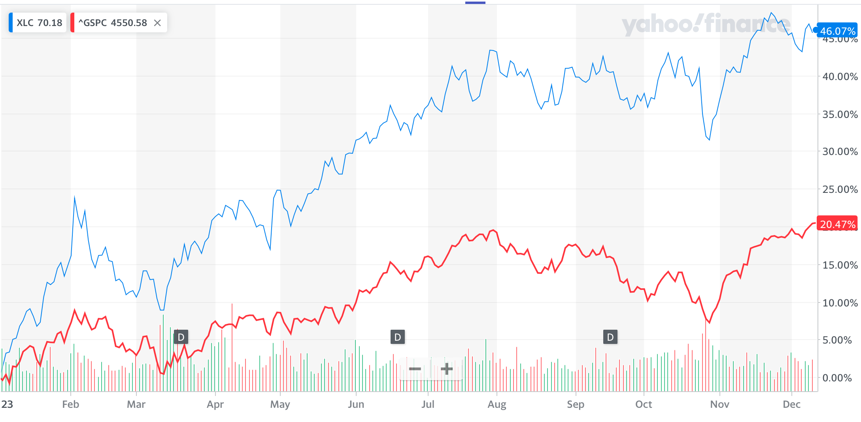
COMMUNICATIONS
The Communication Services sector consists of companies using fixed-line networks or providing wireless access and services. This also includes companies that provide advertising and marketing services, as well as interactive media and content.
Factors to Consider – Fall 2023
(-) High interest rates
(-) Data privacy laws
(+) Increased use of AI allowing services to increase performance
Portfolio Contribution
Name | Abbreviation
Sel Sector:Comm Svc SPDR | XLC
Meta Platforms, Inc. | META
Portfolio Contributions
Sector | Initial Position Strategy | Final Position Strategy | Target | S&P Contribution | Portfolio Contribution | YTD Performance
Communications Services | Underweight | Underweight | 5% | 8.69% | 4.97% | 46.07%

Slide 28
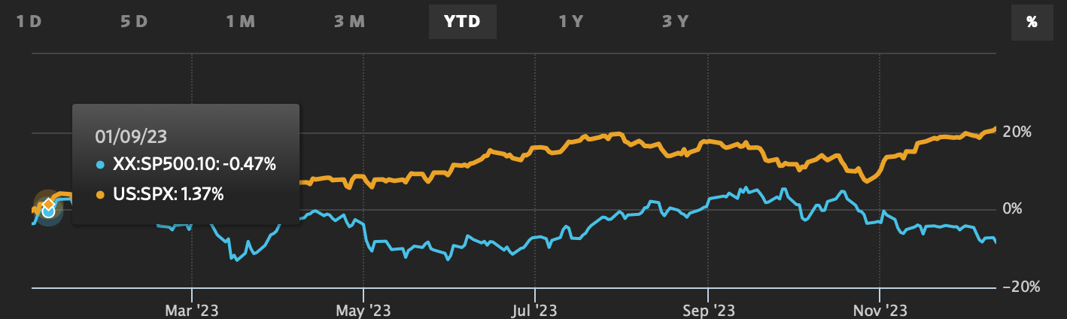
ENERGY
The energy sector consists of companies in the oil, gas, utility, nuclear energy, energy equipment, and clean energy industries. Energy helps fuel operations for industrial growth. It covers companies involved in production and distribution of any form of energy (renewable or nonrenewable). It covers companies that supply nuclear energy used globally for bombs, space, and medical treatments
Factors to Consider – Fall 2023
(-)Increased US oil production
(+) increased OPEC cuts
(+) War in the Middle East
Portfolio Contributions
Name | Abbreviations
Energy Select Sector SPDR ETF | XLE
Sector | Initial Position Strategy | Final Position Strategy | Target | S&P Contribution | Portfolio Contribution | YTD Performance
Energy | Underweight | Underweight | 2.5% | 4.28% | 4.51% | -.87%

Slide 29
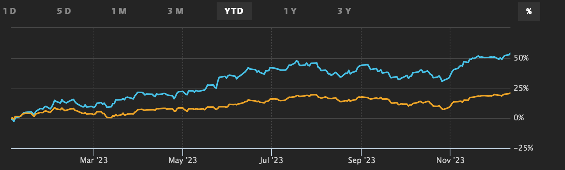
TECHNOLOGY
The technology sector is comprised of businesses that revolve around the selling of goods and services in electronic, software, computers, artificial intelligence, and other industries related to information technology. The 3 main industries in the technology sector are: software and services, semiconductor and semiconductor equipment, and technology hardware and equipment
Factors to Consider – Fall 2023
(-)Chip bottlenecks
(+) AI hype
(+) Cloud computing boom
Portfolio Contributions
Name |  | Abbreviations
Nvidia Corp |  | NVDA
Microsoft |  | MSFT
Sony Group Corp |  | Sony
Adyen NV |  | ADYEN
Qualcomm |  | QCOM
PayPal Holdings Inc |  | PYPL
Technology Select Sector SPDR etf |  | XLK
Sector | Initial Position Strategy | Final Position Strategy | Target | S&P Contribution | Portfolio Contribution | YTD Performance
Technology | Underweight | Overweight | 28% | 28.78% | 31.98% | 6.73%

Slide 30
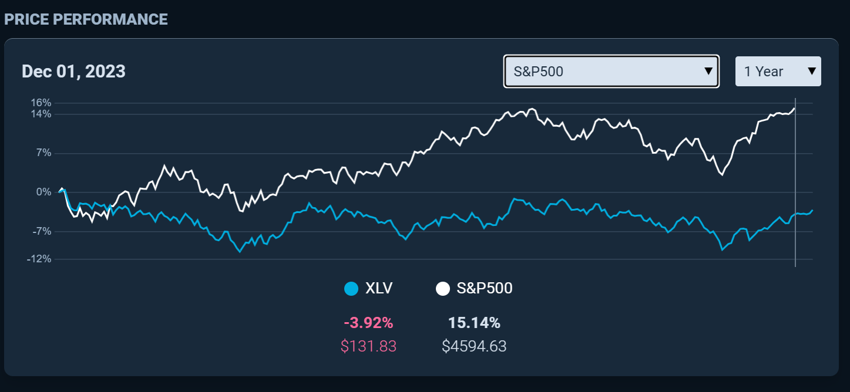
HEALTHCARE
The Health Care sector comprises of businesses that provide medical
offerings, medical equipment manufacturers, medical drugs, or treatment of care to patients in hospitals, facilities, or doctor’s offices.
Factors to be Considered for Fall 2023:
(-) Vaccine rate had been decreasing as less people get boosters
(+) AI developments and increase in patient engagement can drive growth in the healthcare industry.
Portfolio Contributions
Name | Abbreviation
Health Care Select Sector SPDR | XLV
Spok Holdings Inc | SPOK
Vertex Pharmaceuticals Inc | VRTX
CVS Health Corp (*Sold out*) | CVS
Sector | Initial Position Strategy | Final Position Strategy | Target | S&P Contribution* | Portfolio Contribution | YTD Performance
Health Care | Neutral | Neutral | 13.00% | 13.30% | 11.53% | -1.71%

Slide 31
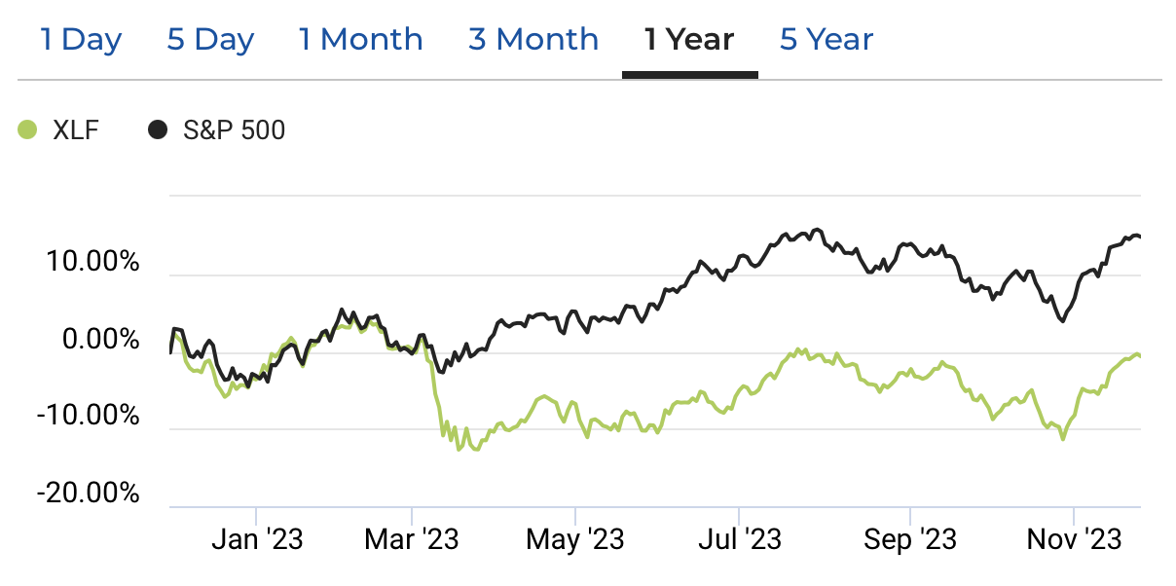
FINANCIALS
The financial sector is a section of the economy made up of firms and institutions that provide financial services to commercial and retail customers. This sector comprises a broad range of industries including banks, investment companies, insurance companies, and real estate firms.
Factors to Consider – Fall 2023
(-) “Higher for longer” interest rates
(-) Stronger constraints on central bank interventions in financial markets
(-) Global Geopolitics
(-) Student Loan Payments Resume
(-) Treasury Yields hit a high
Portfolio Contributions
Name | Abbreviation
Financials Select Sector SPDR Fund | XLF
JPMorgan Chase & Co. | JPM
PayPal Holdings Inc. | PYPL
Sector | Initial Position Strategy | Final Position Strategy | Target | S&P 500 Contribution | Portfolio Contribution | YTD Performance
Financials | Overweight | Underweight | 15.00% | 12.76% | 11.40% | -4.13%

Slide 32
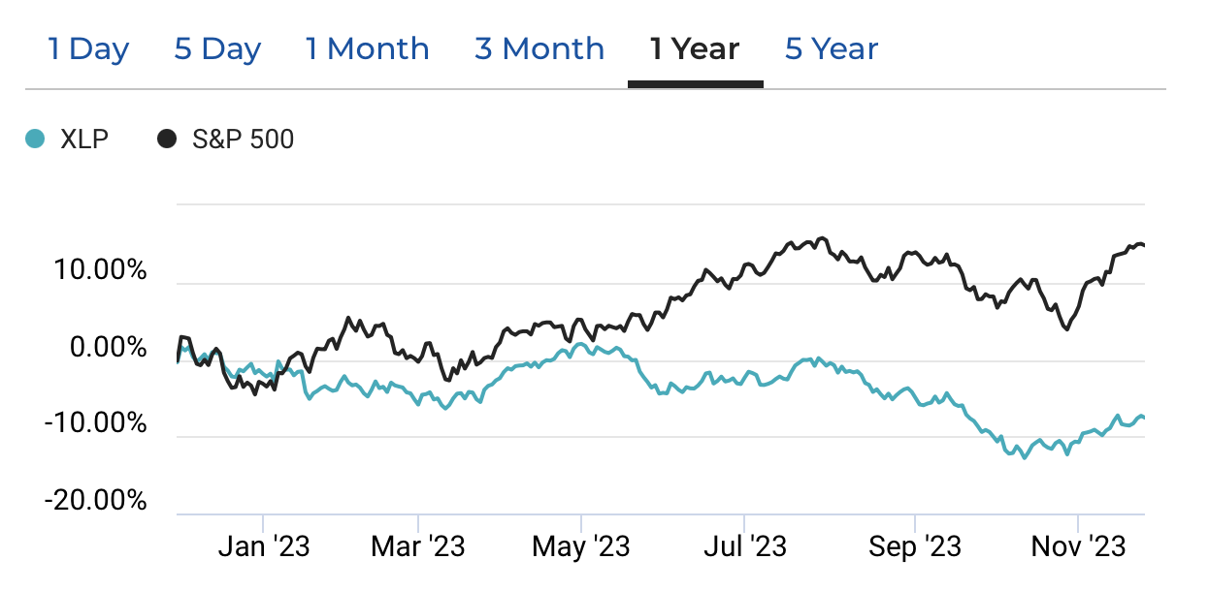
CONSUMER STAPLES
Consumer staples refers to companies that create products considered essential by consumers. This category includes things like foods and beverages, household goods, and hygiene products. These goods are those products that people are unable—or unwilling—to cut out of their budgets regardless of their financial situation.
Factors to Consider – Fall 2023
(-)”Higher for longer” interest rates
(-) Diminished consumer confidence
(-) Student Loan payments resume
(-) Treasury Yields at a high
Portfolio Contributions
Name | Abbreviation
Consumer Staples Sector SPDR Fund | XLP
Sector | Initial Position Strategy | Final Position Strategy | Target | S&P 500 Contribution | Portfolio Contribution | YTD Performance
Consumer Staple | Underweight | Underweight | 4.00% | 6.32% | 4.02% | -7.30%

Slide 33
Investment strategy

Slide 34
GROWTH STRATEGY
Buy Criteria for Growth Strategy Stocks:
Expect stock to perform better than Industry
Revenue growth > Industry Average + forecasted continued growth
Strong Earnings ~ 5 years of CAGR
ROE ≥ 15% and > Industry Average
PEG ≤ 1.2 and < Industry Average
Debt / Equity < 1.5 (or Acceptable Interest Coverage Ratio when D/E >1.0)
Report Beta (less than 1.5 preferred)
Stocks Selected
Costco Wholesale Corp. (COST)
Meta Platforms, Inc. (META)
Microsoft Corp. (MSFT)
Nvidia Corp. (NVDA)
Qualcomm, Inc. (QCOM)
Vertex Pharmaceuticals, Inc. (VRTX)
UnitedHealth Group (UNH)
Texas Roadhouse (TXRH)

Slide 35

COSTCO WHOLESALE
Ticker: COST
Purchase Date: 10/24/2023
Shares: 35
Cost: $551.46
Overview:
Costco is the third largest retailer in the world, and the world’s largest retailer of beef, organic foods, rotisserie chicken, and wine
Costco operates 591 warehouses in the US, and 861 in total globally
Costco prides itself on low prices, bulk buying, a membership model
Why:
In an economic environment where the health of consumer spending is in question Costco looked to be an outlier, providing essential goods in a sector that typically relies on discretionary spending.
Costco’s business model of one way in one way out shopping, plus IDs for all customers inherently prevents consumer theft which has been a focal issue for other consumer discretionary stores recently.
Consumer sentiment towards Costco seems to be at an all-time high giving Costco’s current and future competitors a massive barrier of entry.

Slide 36

META PLATFORMS
Ticker: $META
Purchase Date: 10/04/2023
Shares: 65
Cost: $304.07
Overview:
Meta is the world’s largest online social network with over 3.8 billion monthly active users across its various products
Meta is the lleading stock in the Communication Services sector
Advertising represents more than 90% of the firm’s total revenue, with more than 45% coming from the U.S. and Canada and over 20% from Europe
Why:
Continued Benefit from the AI Hype
Marked Improvements in VR/AR
Significant Reduction in Operating Expenses and CapEx, boosting profits

Slide 37

VERTEX
Ticker: VRTX
Purchase Date: 9/25/2023
Shares: 45
Cost: $400.00
Overview:
Focuses on the discovery and development of small-molecule drugs for treating serious diseases.
Primary offerings include Kalydeco(2012) and Trikafta (2019) for cystic fibrosis.
Diversifying its pipeline through gene-editing therapies, non-opioid treatments for pain, and inhibitors for kidney diseases.
    sickle-cell disease, small-molecule inhibitors targeting acute and chronic pain, as well as cancer treatments
The company is also exploring cell therapies for a potential cure for type 1 diabetes.
The company is also in partnership with Moderna & CRISPR Therapeutics to conduct a clinical studies for acute pain diseases & rare genetic disorders.
Vertex Pharmaceuticals has experienced strong revenue growth from their success in therapies and treatments provided to patients. The company is outperforming the S&P 500 and is one of the most leading Biotech stocks within the healthcare sector.
Why:
With Vertex being undervalued at the time and their income statement/balance sheet/cashflow statements indicate strong growth for the company. We believe Vertex Pharmaceuticals would be a great investment for our SAP fund.

Slide 38

NVIDIA
Ticker: NVDA
Purchase Date: 10/12/2023
Shares: 45
Cost: $444.44
Overview:
NVIDIA is known for developing integrated circuits, which are used in everything from electronic game consoles to person computers (PCs)
The company is a leading manufacturer of high-end graphics processing units (GPUs).
They outsource the making of the chips to a Taiwan Semiconductor company
$1 Trillion valuation → fifth most valuable U.S. company behind Apple, Microsoft, Alphabet and Amazon
Known for its chips used in videogames → pivoted to the data center market over the last few years
The data center chip business accounted for more than 50% of the company's revenue in the financial year ended Jan. 29.
Why:
With Nvidia stock performance showing a consistently growing trend from both a short/long term outlook, the company significantly outperforming the S&P 500, and doing exceedingly well in the Tech/AI sector compared to other companies. We believe Nvidia Inc would be a great investment for our SAP fund.

Slide 39

UNITEDHEALTH GROUP
Ticker: UNH
Purchase Date: 11/16/2023
Shares: 37
Cost: $270.27
Overview:
Two distinct and complementary businesses working to help build a modern, high-performing health system through improved access, affordability, outcomes and experiences.
Optum combines clinical expertise, technology and data to empower people, partners and providers with the guidance and tools they need to achieve better health.
UnitedHealth Group offers a full range of health benefits, enabling affordable coverage, simplifying the health care experience and delivering access to high-quality care.
The company works with governments, employers and providers to serve 149 million people and share a vision of a value-based system of care that provides compassionate and equitable care.
Optum Health delivers patient centered care at a lower total cost to consumers.
Optum Insight connects the health care system with trusted services to make clinical, administrative, and financial processes simpler and more efficient.
Optum Rx integrates pharmacy, medical, and behavioral care through full spectrum services
Why:
With UnitedHealth developing a solid reputation for affordable coverage and delivering high quality care in the healthcare industry. The stock being fairly valued while much news/awareness is consistently surrounding the company. And their earnings report being expected to release on January 16 2024 with overall positive sentiment. We believe UnitedHealth Group Inc would be a great investment for our SAP fund.

Slide 40

TEXAS ROADHOUSE
Ticker: TXRH
Purchase Date: 10/04/23
Shares: 200
Cost: $96.40
Overview:
Texas Roadhouse operates in the casual dining restaurant industry, with a focus on serving hand-cut steaks, ribs, and other American cuisine in a Western-themed setting.
Why:
Texas Roadhouse has seen its stock decline by 10% in the past 6 months, but a closer look at its financials reveals a more positive picture. The (ROE) for them is 27%, while the industry average is 18%. Analysts predict a future ROE of 30%. Overall, Texas Roadhouse's performance appears strong, with reinvestment in the business leading to impressive earnings growth and a positive outlook for the future.

Slide 41

QUALCOMM
Ticker: QCOM
Purchase Date: 11/14/2023
Shares: 120
Cost: $126.82
Overview:
Qualcomm is a leading American semiconductor and telecommunications known for its Snapdragon processors
In Q4 2023 QCOM had a revenue 8.631 billion of which $5.5 billion for handsets, $1.2 billion from the Internet of Things (IoT), and $535 million from Automotives.
Why:
Qualcomm announced the Snapdragon X Elite, a system-on-a-chip (SoC) with a custom Arm architecture designed specifically for laptop PCs. We believe that this could be a massive catalyst for growth if it is adopted as the new status quo.
Apple extended its deal with Qualcomm for iPhone chips until 2026 showing Qualcomm’s chips are still at the cutting edge.
Qualcomm continues to successfully pursue the automotive industry as they recently partnered with BMW for all vehicles.

Slide 42

MICROSOFT
Ticker: MSFT
Purchase Date: 09/26/2023
Shares: 35
Cost: $317.30
Overview:
Microsoft is a technology company which creates the platforms and tools, powered by artificial intelligence (“AI”). cloud-based solutions that provide customers with software, services, platforms, and content, and we provide solution support and consulting services
Microsoft holds a prominent position as the world's leading computer software vendor.
The company's software, including the Office suite, is widely used across various industries
Why:
Wide moat rating arising from switching costs, network effects, and cost advantages
AI is still on the rise, and it is not too late to get in
Over the past 10 years has outperformed S&P 500
Azure, a major profit generator for Microsoft, continues to experience growth, with a 30% increase in the 2023 fiscal year.

Slide 43
VALUE STRATEGY
Buy Criteria for Value Strategy Stocks:
Price/Sales < Industry average
Price/Book Value < Industry average
Dividends > Industry Average
Positive Free Cash Flow
Report Beta (less than 1.5 preferred)
Stocks Selected
Five Below, Inc (FIVE)
JPMorgan Chase & Co. (JPM)
Nutrien Ltd. (NTR)
PayPal Holdings, Inc.
Sony Group Corp. (SONY)
Toll Brothers, Inc. (TOL)
Fedex Corp. (FDX)
CVS Health, Inc. (CVS)

Slide 44

CVS
Ticker: CVS
Purchase Date: 10/18/2023
Shares: 141.2
Cost: $70.82
Overview:
CVS is a prominent and influential presence in the American healthcare and pharmacy sector, renowned for its comprehensive service offerings.
The company provides an extensive array of services that include convenient walk-in clinics, specialized pharmacy services, and advanced infusion therapy solutions.
CVS Retail Pharmacy operates in over 9,000 stores, handles prescription medications, provides over the counter products as well as wellness products, they have services to help patients manage their medications, and provide vaccinations such as COVID or the flu.
​Infusion Therapy to administer medication directly into the patient's bloodstream. This is offered in a clinical setting as well as the patients home.
Aetna Services is one of the leading health insurance providers that CVS acquired to make healthcare and insurance more accessible, affordable, and convenient for consumers.
Most of the the company’s revenue is from pharmacy benefit management (PBM) solutions which are middlemen between insurance companies, pharmacies, and drug manufacturers to introduce plans and offerings tailored toward the individuals needs.
Why:
With CVS beating their EPS estimate 100% of the time over the past 12 months compared to the whole healthcare sector at about 59% of the time and developing a solid reputation and brand name as one of the largest pharmacy chains in the U.S where thousands of patients go and fill their prescriptions.​ We believe that CVS Health would be a great investment for our SAP fund.

Slide 45

SONY
Ticker: $SONY
Purchase Date: 10/31/2023
Shares: 240
Cost: $82.88
Overview:
Sony Group designs, develops, produces, and sells electronic equipment, instruments, and devices for consumer, professional and industrial markets across the globe
Sony offers products in additional sectors including software, gaming, peripherals
Why:
Oversold due to Hollywood strike headwinds
Poised for record PS5 sales
PlayStation Ecosystem evolution: tens of millions of monthly users for Sony’s most profitable segment

Slide 46

Toll Brothers
Ticker: $TOL
Purchase Date: 11/23/2023
Shares: 230
Cost: $85.42
Overview:
Toll Brothers specializes in designing, constructing, and selling luxury homes in major U.S. metropolitan areas
Toll Brothers also develops luxury apartment communities and high-end student housing
The Firm attained over $10.25B in 2022 and has consistently raised guidance throughout 2023
Why:
The stock was oversold due to perceived macro headwinds
Continually raised guidance, potential for big earnings win
Speculative home building as a category is booming

Slide 47
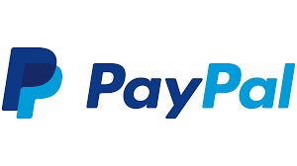
PAYPAL
Ticker: PYPL
Purchase Date: 11/08/23
Shares: 370
Cost: $53.73
Overview:
PayPal, a major American fintech company, powers a global online payment system used by over 435 million users and merchants. Handling 22.3 billion transactions totaling $1.36 trillion in 2022, it's known for its security and innovations like the popular Buy Now, Pay Later (BNPL) program, driving increased checkout volume and transaction value.
Why:
When compared to its peers in the fintech world Paypal is signifyingly undervalued and over the past year has not been trading at a multiple anywhere near in line with its internal future growth aspirations.
Paypals recent management overhaul that includes young, successful, and product focused leadership including a new CEO, CIO, and CFO has already proven to be beneficial to the bottom line performed of the stock given their past Q3

Slide 48

FEDEX
Ticker: FDX
Purchase Date: 10/24/23
Shares: 80
Cost: $241.52
Overview:
FedEx is a global logistics and transportation company with a wide-ranging portfolio of services that play a critical role in connecting businesses and individuals across the world. FedEx's extensive network and innovative solutions make it a prominent player in the logistics and delivery industry.
Why:
FedEx Ground which is their US segment is one of the only areas which had revenue growth this past quarter and we believe revenues will continue to grow headed into the holiday season
As communicated in their most recent earnings call cost cutting initiatives have been a large part of their strategy this year with programs like DRIVE, One FedEx, and Network 2.0

Slide 49

FIVE BELOW
Ticker: FIVE
Purchase Date: 10/31/2023
Shares: 90
Cost: 174.26
Overview:
Discounted retailer selling items mostly 5 dollars and below
Operates through segments: leisure, fashion and home, and party and snack
Why:
Bargain stores tend to thrive in a pessimistic market environment, as they are the more affordable alternative.
Revenue has seen an increase to $90 million compared to the previous year.
The gross profit margin has improved from 34.2% to 34.9%
Five Below has held up better than its peers in the retail sector, bouncing sharply off its lows and seeing much less relative downside in Q3

Slide 50
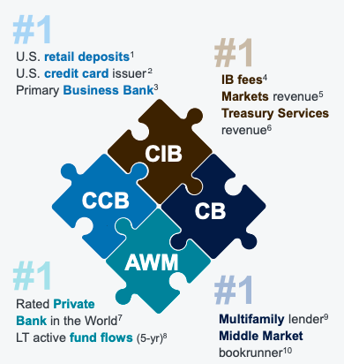

JPMORGAN CHASE
Ticker: JPM
Purchase Date: 10/10/2023
Shares: 135
Cost: $145.76
Overview:
JPM is global financial services firm and leader in investment banking, financial services for consumers and small businesses, commercial banking, financial transaction processing and asset management
Led by CEO, Jamie Dimon, JPM has $3.9 trillion in assets and operates in over 100 countries with more than 308,669 employees worldwide.
Why:
Roughly 1 in 4 Americans (80mil people + 5.7mil businesses) have a Chase account, and we believe JPM’s access to this data gives them a large competitive advantage, especially considering the current economic uncertainty.
JPM has continued to show its value as it has achieved high levels of excellence in virtually all parts of their business, as shown in the diagram to the right:

Slide 51

NUTRIEN
Ticker: NTR
Purchase Date: 9/20/23
Shares: 160
Cost: $63.68
Overview:
Nutrien is an agriculture input producer and distributor. They produce and distribute potash, nitrogen, and phosphate products for agricultural, industrial and feed customers worldwide. Nutrien is the world’s largest provider of crop inputs and services.
Why:
Nutriens stock performance has mimicked the aggregate equities market over the past 5 years (5Y beta of .99) and we expect this trend to continue
Nutrien has a large cost advantage due to the location of its mines and its economies of scale, this has allowed the company to stay profitable in times of demand downturn while also using profits to acquire smaller retail businesses and create a stronger digital presence to inorganically increase demand, this retail creates half of their gross profit and is has steady cash flow

Slide 52
DIVIDEND STRATEGY
Buy Criteria for Dividend Strategy Stocks:
Dividend Yield ≥ SPDR S&P Dividend ETF
Quick Ratio ≥ Industry Average
Positive total cash dividends paid annually
Positive total cash from investing activities
Positive total cash from operating activities
Constant dividend
Historical and potential dividend growth
Report Beta (Less than 1.5 preferred)
Stocks Selected
Spok Holdings, Inc. (SPOK)

Slide 53

SPOK HOLDINGS
Ticker: SPOK
Purchase Date: 10/17/2023
Shares: 1,0000
Cost: $14.92
Overview:
Spok Holdings engages in the provision of communication solutions around the world mostly in healthcare.
Develops and markets enterprise-wide systems for healthcare firms, which helps them to automate and standardize clinical communications.
Provides call center operations, clinical alerting and notifications, one-way advanced and two-way wireless messaging services, mobile communications and public safety solutions
Why:
Largest wireless paging network in the country with 800,000+ units
Stable re-occurring wireless and software maintenance with opportunities to grow total revenue
No debt, $30.9 billion cash balance, significant deferred tax assets, funding 85% + of dividend from free cash flow, substantial dividend yield

Slide 54
Risk analysis

Slide 55
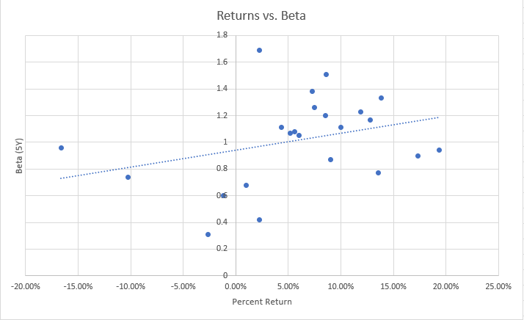
BETA
Beta of SAP:1.038
Beta of S&P 500: 1.000
Highest Beta in the SAP Fund: NVIDIA Corporation (NVDA)
Highest Beta of ETF: Technology Select Sector SPDR Fund (XLV)

Slide 56
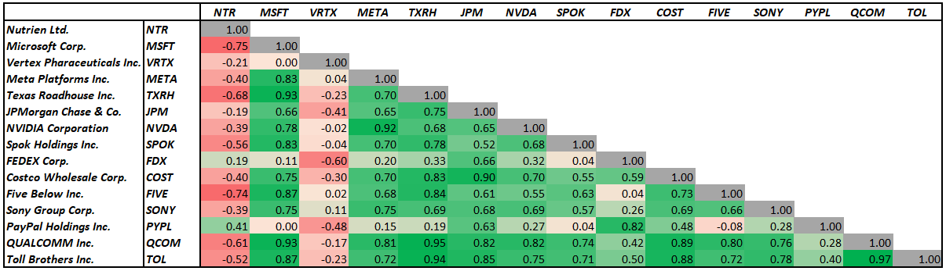
CORRELATION MATRIX
Based on historical prices for the period of 9/19/23 - 12/8/23

Slide 57
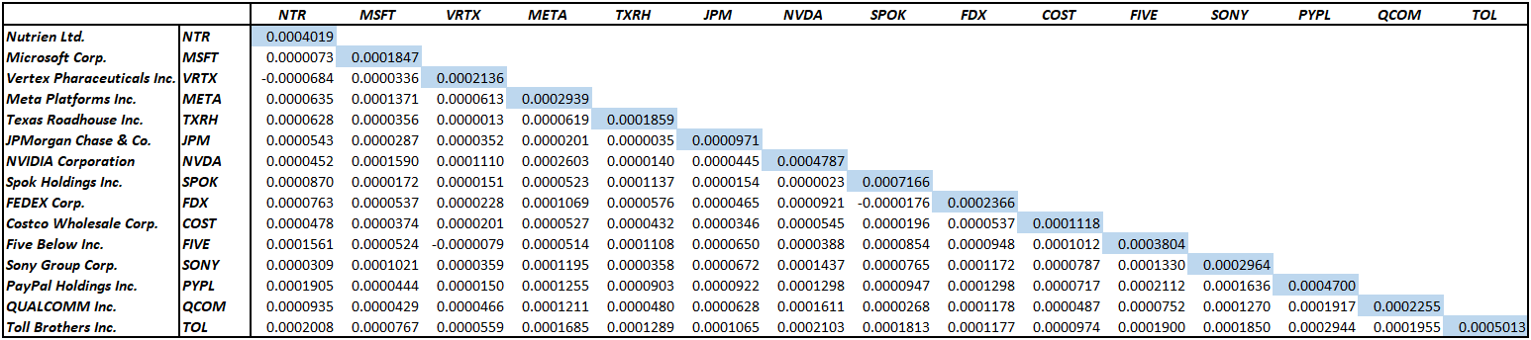
COVARIANCE MATRIX
Based on daily returns for the period of 9/19/23 - 12/8/23

Slide 58
Performance review

Slide 59
PERFORMANCE REVIEW
This performance review will analyze the portfolio for the Fall Session of 2023
This section will detail the following:
  Performance against the index
  Overview of the best and worst performers
This review will analyze data from 9/19/2023 through 12/11/2023
Active Management began with recommendations and trade execution on 9/20/2023

Slide 60
PORTFOLIO CONTRBUTIONS

Slide 61
OVERALL RETURN ANALYSIS
Top overall performers were highly concentrated in technology and consumer discretionary
All ETFs finished positive except Consumer Staples and Energy
  The class decided to avoid allocation to Real Estate and Utilities
Limited cases of underperformance at the single stock level

Slide 62



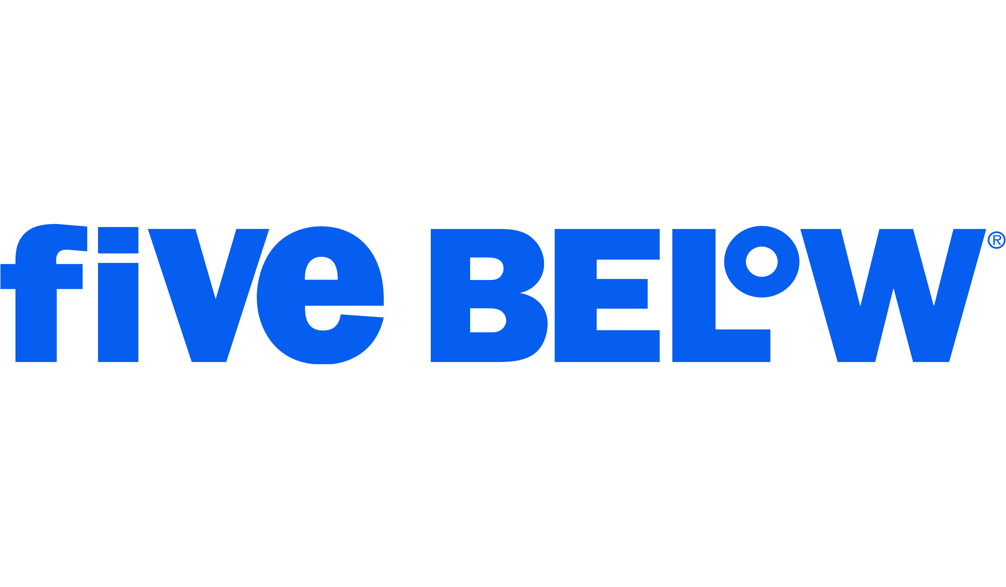


Reflects total return from Acquisition through 12/8/23
BEST RETURNS FALL 2023
+17.94%
9/29-12/8
+17.76%
10/4-12/8
+12.71%
10/24-12/8
+11.80%
10/31-12/8
+10.76%
10/24-12/8
+9.43%
10/4-12/8

Slide 63


Reflects total return from Acquisition through 12/8/23
WORST RETURNS FALL 2023
-14.50%
9/20-12/8
-1.01%
10/17-12/8

Slide 64
Industry Headwinds lead to Nutrien Losses
BIGGEST LOSS
Profit and Revenue miss in the third quarter, and downward revenue guidance adjustments scare investors
Nutrien as a fertilizer company is adversely affected by global supply conditions. With shipments from Russia and Belarus freeing up after the Ukraine invasion, potash prices have been falling.
Lower demand for fertilizer due to high prices have kept farmers waiting to buy.
Continued global conflicts in the Middle East and between Russia and Ukraine increase fertilizer industry volatility.
Potential US legislation is being introduced targeting the anticompetitive nature of the fertilizer industry in the US.

Slide 65
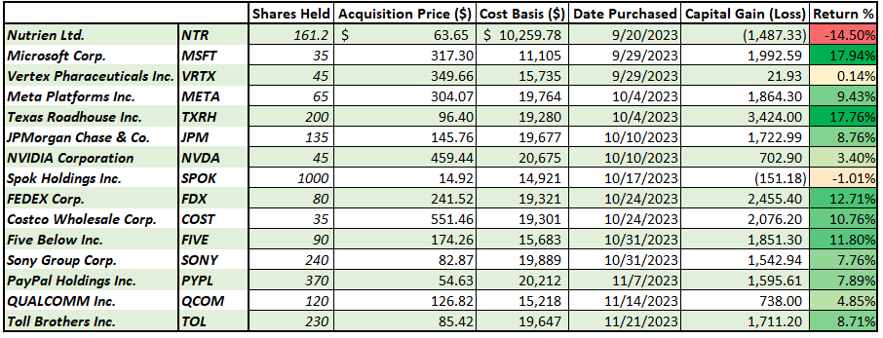
INDIVIDUAL RETURNS
Reflects returns for the purchase date until 12/8/23

Slide 66
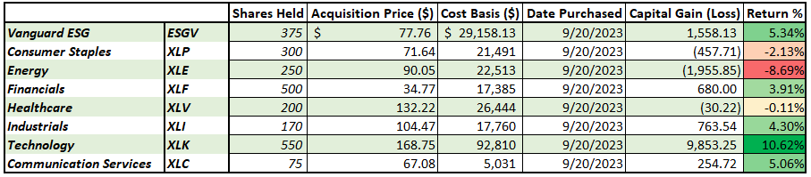
ETF PERFOMANCE
Reflects returns for the period of 9/20/23 - 12/8/23, for ETFs that were not sold during the management period

Slide 67
ETF PERFOMANCE

Slide 68
CONCLUSIONS
Investments were primarily based on Growth and Value Strategies, and therefore time dependent resulting in limited gains over the short run.
Many of the portfolio’s top performers benefited greatly from two market trends
  Continued artificial intelligence speculation
  Strong consumer discretionary spending
Short time horizon makes overall conclusions from analysis difficult
Only one holding is meaningfully in the red, purchased despite significant industry headwinds

Slide 69
Student Bios

Slide 70

Nicholas firestine
Nick is a fourth-year undergraduate from Maryland, pursuing a Bachelor of Science with majors in Finance and Accounting. He is the president of the Accounting Honors Society, Beta Alpha Psi and a Sellinger Scholar. Upon graduation, Nick will be working as an Investment Banking Analyst on the M&A team at Oppenheimer & Co. in New York City. In his free time, Nick enjoys to fish, play poker, and surf.

Slide 71
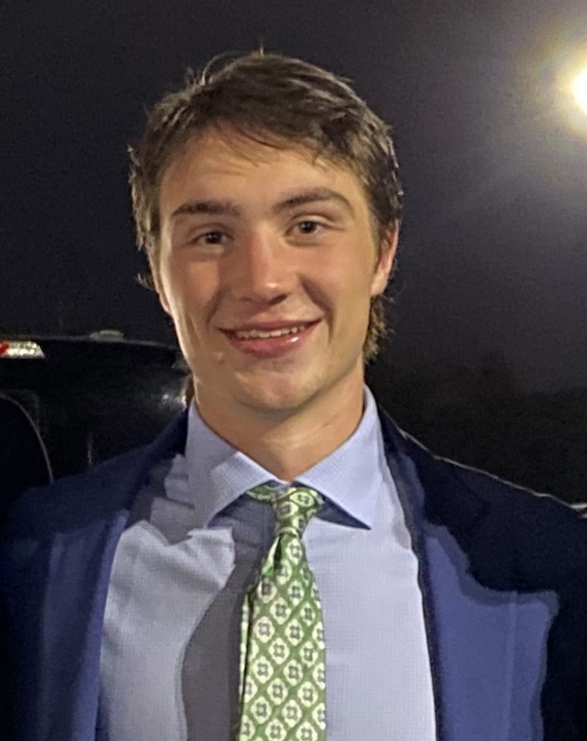
Max McGillicuddy
Max McGillicuddy is a fourth-year undergraduate from Connecticut, pursuing a Bachelor of Science with a concentration in Finance and a minor in Innovation and Entrepreneurship. He is also a member of the Loyola Men's Lacrosse team. Upon graduation, Max will be working as a financial analyst at IBM in New York. In his free time, Max loves to spend time with family and friends, as well as travel.
.

Slide 72
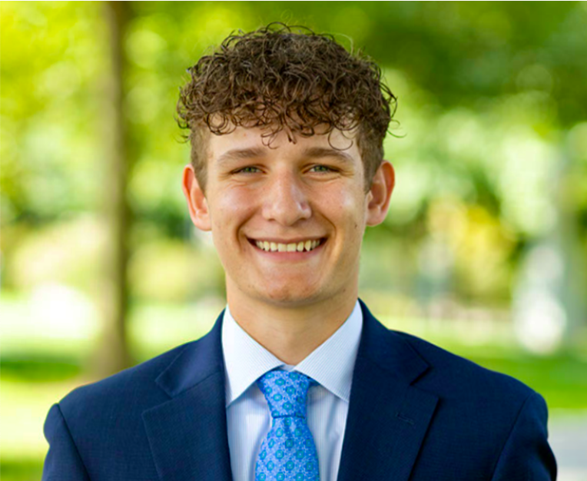

Joe Crema
Joe is a fourth-year undergraduate from Amityville, New York, pursuing a B.S. in Finance with a minor in Marketing. He is a member of Financial Management Association, Investment Club, and Advocates for Inclusion. Upon graduation, Joe will be joining JP Morgan Private Bank as an analyst. In his free time, Joe works closely with the special needs community, as he is the co-founder of Challenger Athletics Soccer, a 501c3 charity with the goal of providing learning and physically disabled children with the opportunity to play soccer.

Slide 73
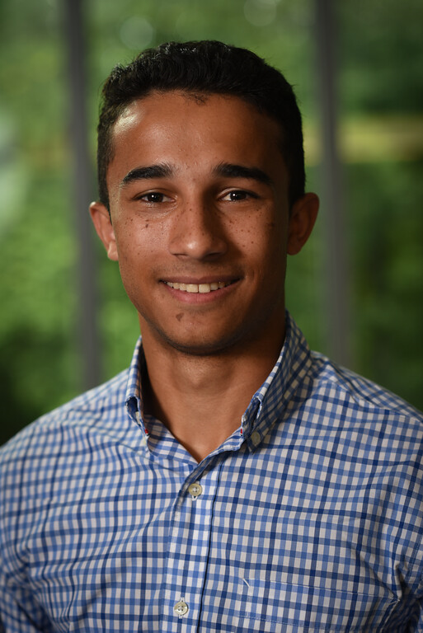
John Regan
John is a fourth-year undergraduate from New Jersey, pursing two bachelor’s degrees in Finance and Information Systems. He is a member of the Investment Banking club, Sellinger Scholars Board, and Club eSports . Upon graduation, John will be moving to Charlotte, NC and joining Wells Fargo as an analyst in their Supra Sovereign Agency debt origination team. In his free time, he enjoys poker, skiing, and cooking

Slide 74

Alex Grahor
Alex is a fourth-year undergraduate from Pittsburgh, pursuing a Bachelor of Science in Finance and Information Systems and Data Analytics, and minoring in Mathematics. He has been a member of the Men’s Swim team for the past four years and is involved on campus as the treasurer of Loyola’s Knights of Columbus council and a volunteer at the campus chapel. Upon graduation from Loyola, Alex will be joining SMBC, where he previously interned. In his free time, Alex enjoys playing guitar, biking, and fishing.

Slide 75
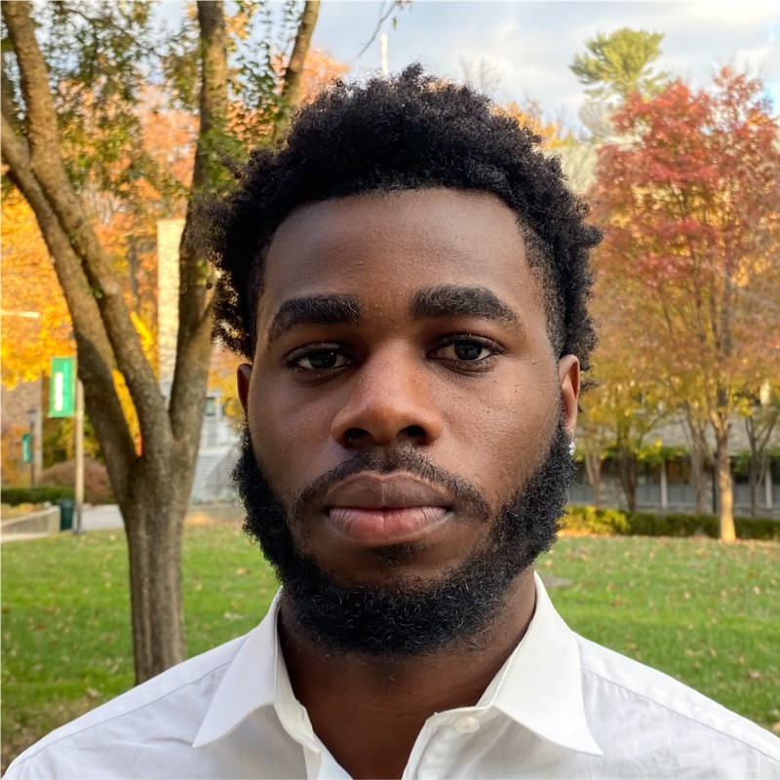
Adesina (Tjaay) Adetunji
Adetunji Adesina is a senior undergraduate student from Providence, Rhode Island, pursuing a Bachelor of Science with a Double Major in Finance and International Business. He is involved in Sellinger Scholars, Financial Management Association, and the Office of Loyola Residence Life. Upon graduation, Adetunji plans to join Bank of America in the Summer of 2024. In his free time, he enjoys watching crime documentaries, playing video games, and spending time with family.

Slide 76

Cameron wallace
Cam is a fourth-year undergraduate from Wilmington, Delaware pursing a BS in Finance and Leadership & Organizational Effectiveness. At Loyola, he works Gameday Operations for the Athletics department, is a member of Financial Management Association, Club Soccer, and Male Practice Player for both the D1 Women’s Basketball and Soccer teams. Upon graduation, Cam will be returning to JPMorgan Chase & Co. In his free time, he enjoys spending time with friends, watching sports, and staying active.

Slide 77
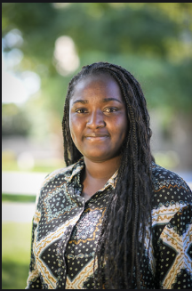
Zainab Oladejo
Zainab Oladejo is a fourth-year undergraduate from Harford Maryland, pursing a Bachelors with a concentration in Finance and a double minor in Accounting, Information System and Data Analytics. She is involved in FMA, ALANA, WIB and peer conduct board. Upon graduation, Zainab will be working at Morgan Stanley. In her free time, she likes to hike, travel, spend time with family, and explore new things.

Slide 78

Andrew Schmutter
Andrew is a fourth-year undergraduate from Cranford, NJ, pursing a Bachelor of Science with a concentration in Finance and Information Systems. He is a Member of Student Government Association and has participated in the Investment Club and the Loyola Consulting Group. Upon graduation, Andrew will be working as a Venture Capital Analyst at StepStone Group. In his free time Andrew enjoys hiking and portrait photography

Slide 79

Oliver Davey
Oliver is a fourth-year undergraduate from Westford, MA, pursing a Bachelor of Science degree with a concentration in Finance and Business Sustainability. He is a member of the Men’s Tennis Team, Loyola’s Student-Athlete Advisory Council, and Loyola’s Chapter of the Financial Management Association. Upon graduation, Oliver will be an Analyst at Scotiabank on their Power & Utilities Investment Banking Team. In his free time Oliver enjoys playing golf.
Write to here*

Slide 80
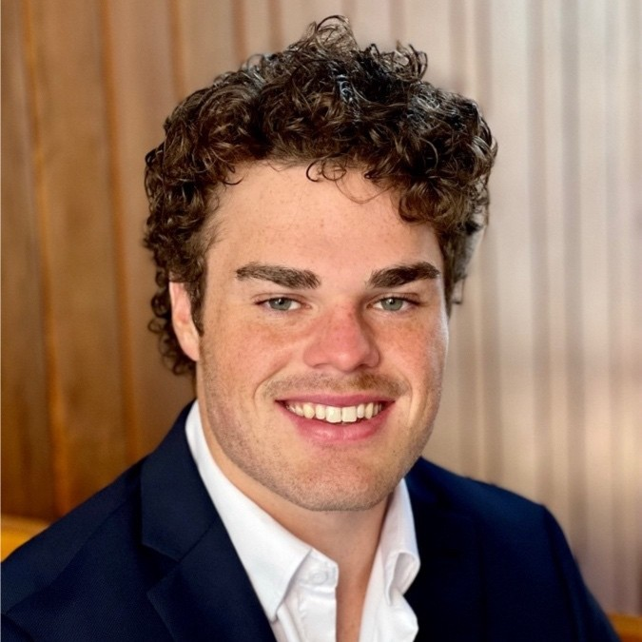
Declan Budnitz
Declan is a fourth-year undergraduate from Baltimore, MD, pursing a Bachelor of Science in Finance. He is a member of Club Lacrosse and sits on the Steering Committee of The Simon Center for Innovation & Entrepreneurship. Upon graduation, Declan will be working as an Analyst at StepStone Group. In his free time, he enjoys practicing Jiu-jitsu and reading.

Slide 81

CAROLIne COTE
Caroline is a fourth-year undergraduate from Long Island, NY, pursing a Bachelor of Science in Finance with a minor in Entrepreneurship. She is a member of Women in Business and Letters to Elders​. In her free time, she enjoys real estate, travel, exercise, and baking​

Slide 82

Richard Clow
Richard Clow is a fourth-year undergraduate from Walpole, MA, pursing a Business degree with a concentration in Finance & Information Systems. He is the President of Investment Club, Greyhound Writer, and Rugby Player. Upon graduation, Richard will be starting as a Financial Representative at Fidelity Investment. In his free time, he enjoys hiking, reading, and doing home improvement projects.

Slide 83

Nolan Walchko
Nolan Walchko is a fourth-year undergraduate from Ellicott City, MD, pursing a Bachelor of Science with a concentration in Finance. He is a Member of the Sellinger-Student Advisory Board. Upon graduation, Nolan plans to be working as a financial advisor and hopes to pass the Series 7 exam. In his free time, he enjoys watching sports and playing video games.

Slide 84

Aidan Harding
Aidan is a fourth-year undergraduate from Fairfield CT, pursing a B.S. with a concentration in Finance. Aidan is a member of the Club Basketball team as well as Chess Club. Upon graduation, Aidan will be pursuing a job in the financial field. In his free time, he enjoys to be on a golf course as well as being with his family.

Slide 85

Christopher Sidrak
Chris Sidrak is a fourth-year undergraduate from Bel air MD, pursing a Bachelors Degree with a concentration in Finance & Information Systems. He is an officer of the Loyola Investment Club and won the 2020-2021 Loyola Intramural Table Tennis award. Upon graduation, Chris will pursue a Full-Time job as a Financial Advisor. In his free time, he enjoys traveling, trying different cuisines, playing table tennis, and spending time with family.

