Slide 2
SELLINGER APPLIED PORTFOLIO FUND
SPRING 2024

Slide 3
Table of Contents
Investment Policy
Market Performance
Economic Conditions
Current Events
Sector Overviews
ETF Performance
Growth Strategy
Value Strategy
Risk Analysis
Performance Review

Slide 4
Investment Policy

Slide 5
Overview of Sellinger Applied Portfolio Fund
Purpose: Provides students with hands-on portfolio management experience.
Activities Involved:
Asset valuation
Constraint setting
Asset allocation
Asset selection
Risk management
Performance evaluation
Fund Allocation:
Annual Investment: Up to $500,000 provided by the University.
Fund Nature: Part of the University’s endowment fund.
Investment Cycle: All investments are liquidated annually at the course end.
Learning Objectives:
Equip students with practical skills in managing a real investment portfolio as part of the university’s endowment.

Slide 6
INVESTMENT PHILOSOPHY
Ethical Considerations
Investments must align with moral and social values.
Guided by the United States Conference of Catholic Bishops' principles of investments.
Allowable Investments
Securities Types:
U.S. exchange-listed stocks, including ADRs (American Depositary Receipts).
Unleveraged ETFs, including:
Stock index ETFs
Commodity ETFs
Only investment-grade securities are permitted.
Unallowable Investments
Exclusions:
“Sin” stocks such as:
Cigarette manufacturers
Alcohol producers
Firearms manufacturers
Companies engaged in gambling activities

Slide 7
INVESTMENT STRATEGIES
Primary Investment Strategy
Focus: Selecting undervalued stocks expected to outperform their industry and the S&P 500 index.
Diversification Strategy
Sector Allocation: Dynamic weighting based on market conditions, aiming for diversification across sectors.
Allocation Limits:
No more than 10% in any one stock.
No more than 20% in a single sector.
No more than 25% in a single index.
Types of Investment Strategies
Growth Investment Strategy: Focus on stocks with potential for high growth.
Value Investment Strategy: Focus on stocks that appear underpriced compared to their intrinsic value.
Dividend Strategy: Focus on stocks offering high dividend yields.

Slide 8
Market Performance

Slide 9
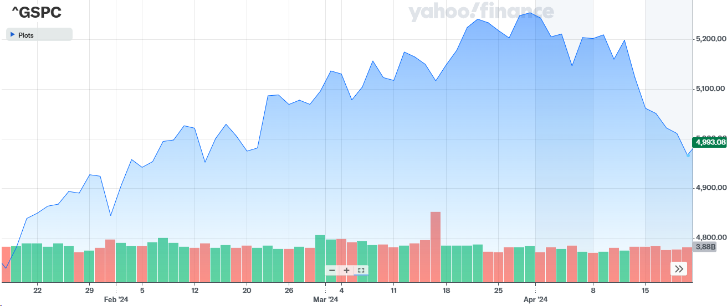
S&P 500 Performance
5 Year | 68.96%
1 Year | 20.28%
6 Month | 17.59%
The S&P 500 had a 4.08% return over the course of the Spring 2024 semester.

Slide 10
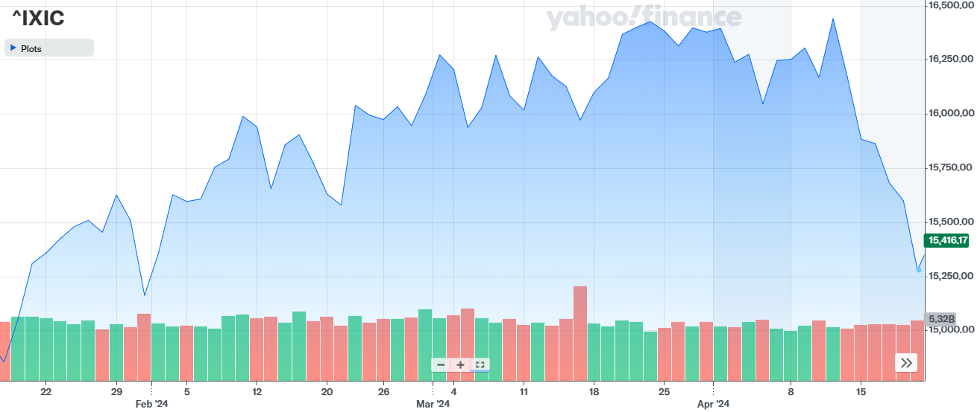
NASDAQ Performance
5 Year | 87.59%
1 Year | 26.72%
6 Month | 17.70%
The Nasdaq had a 2.51% return over the course of the Spring 2024 semester.

Slide 11
Economic Conditions

Slide 12
Federal Reserve Policy
4/19/2024 Effective US Federal Funds Rate | 5.33%
Current Target Range | 5.25%-5.50%

Slide 13
Federal Reserve Actions
Due to high inflation throughout 2022, the Federal Reserve had been steadily enacting rate hikes in increments of .25 to .75 basis points
This was done to combat rising inflation, which reached a high of 9.1% in June 2022
Inflation started to slow down throughout 2023 as the rates were increased by smaller increments
Since late 2023 until now, inflation has been stuck in a range of 3%-3.7%, causing the Federal Reserve to put a hold on lowering rates, as some people question if any rate cuts are possible in 2024
FOMC Meeting Date | Rate Change (bps) | Federal Funds Rate
Mar 20th, 2024 | +0 | 5.25%-5.50%
Jan 31st, 2024 | +0 | 5.25%-5.50%
Dec 13th, 2023 | +0 | 5.25%-5.50%
Nov 1st, 2023 | +0 | 5.25%-5.50%
Sept 20th, 2023 | +0 | 5.25%-5.50%
July 26th, 2023 | +.25 | 5.25%-5.50%
June 14th, 2023 | +0 | 5.00%-5.25%
May 3rd, 2023 | +.25 | 5.00%-5.25%
Mar 22nd, 2023 | +.25 | 4.75%-5.00%

Slide 14
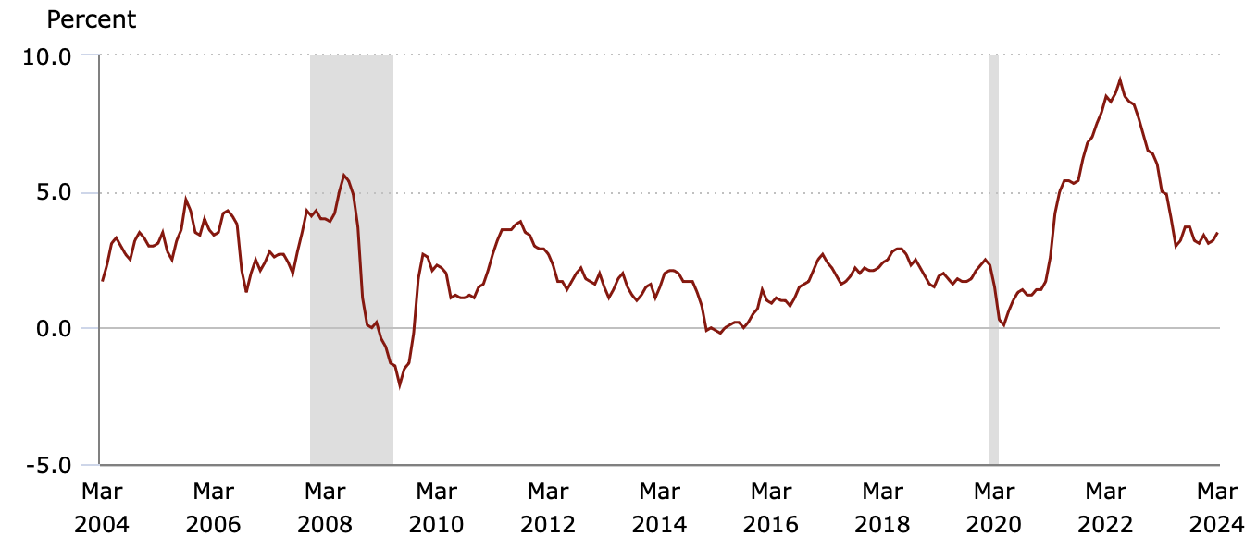
Inflation
The rate hikes from the Federal Reserve have contributed to the decline in inflation
As mentioned, inflation remains sticky, causing a delay in the lowering of rates
This delay has had a negative impact on stocks and the overall market
12 Month CPI | Nov 2023 | Dec 2023 | Jan 2024 | Feb 2024 | Mar 2024
Rate | 3.1% | 3.4% | 3.1% | 3.2% | 3.5%

Slide 15
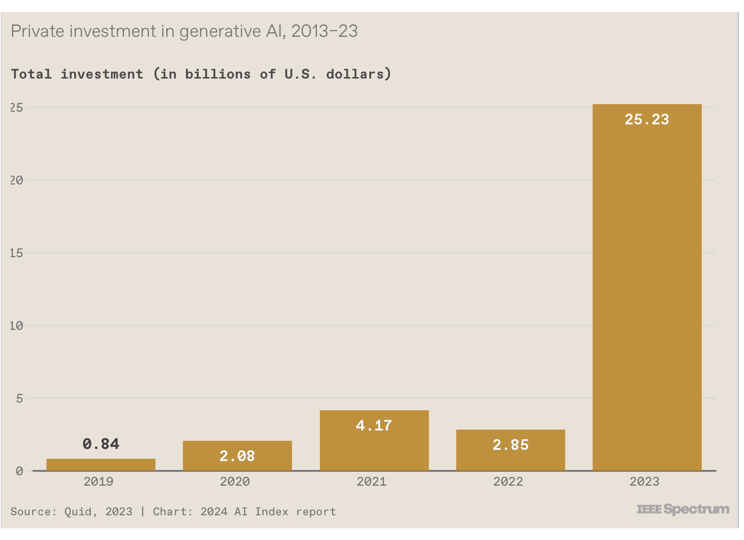
AI rise
AI has not only been a key component in the technology sector but also in the healthcare sector. In the past few months, we have seen a rise in generative AI such as Microsoft's Copilot which began to be used by the public at the beginning of 2024. Due to the popular demand for AI, demand for AI chips also increased which then led to technology stocks such as NVIDIA performing well and showing hopes for greater future success. AI has also been implemented in healthcare such as companies using telemedicine, going from technology that manages customer reports to machines that better take of medical procedures. AI can also be seen used in sectors such as consumer discretionary, with the increase in digital shopping with a more personalized experience for consumers. Soon AI will positively impact all sectors.

Slide 16
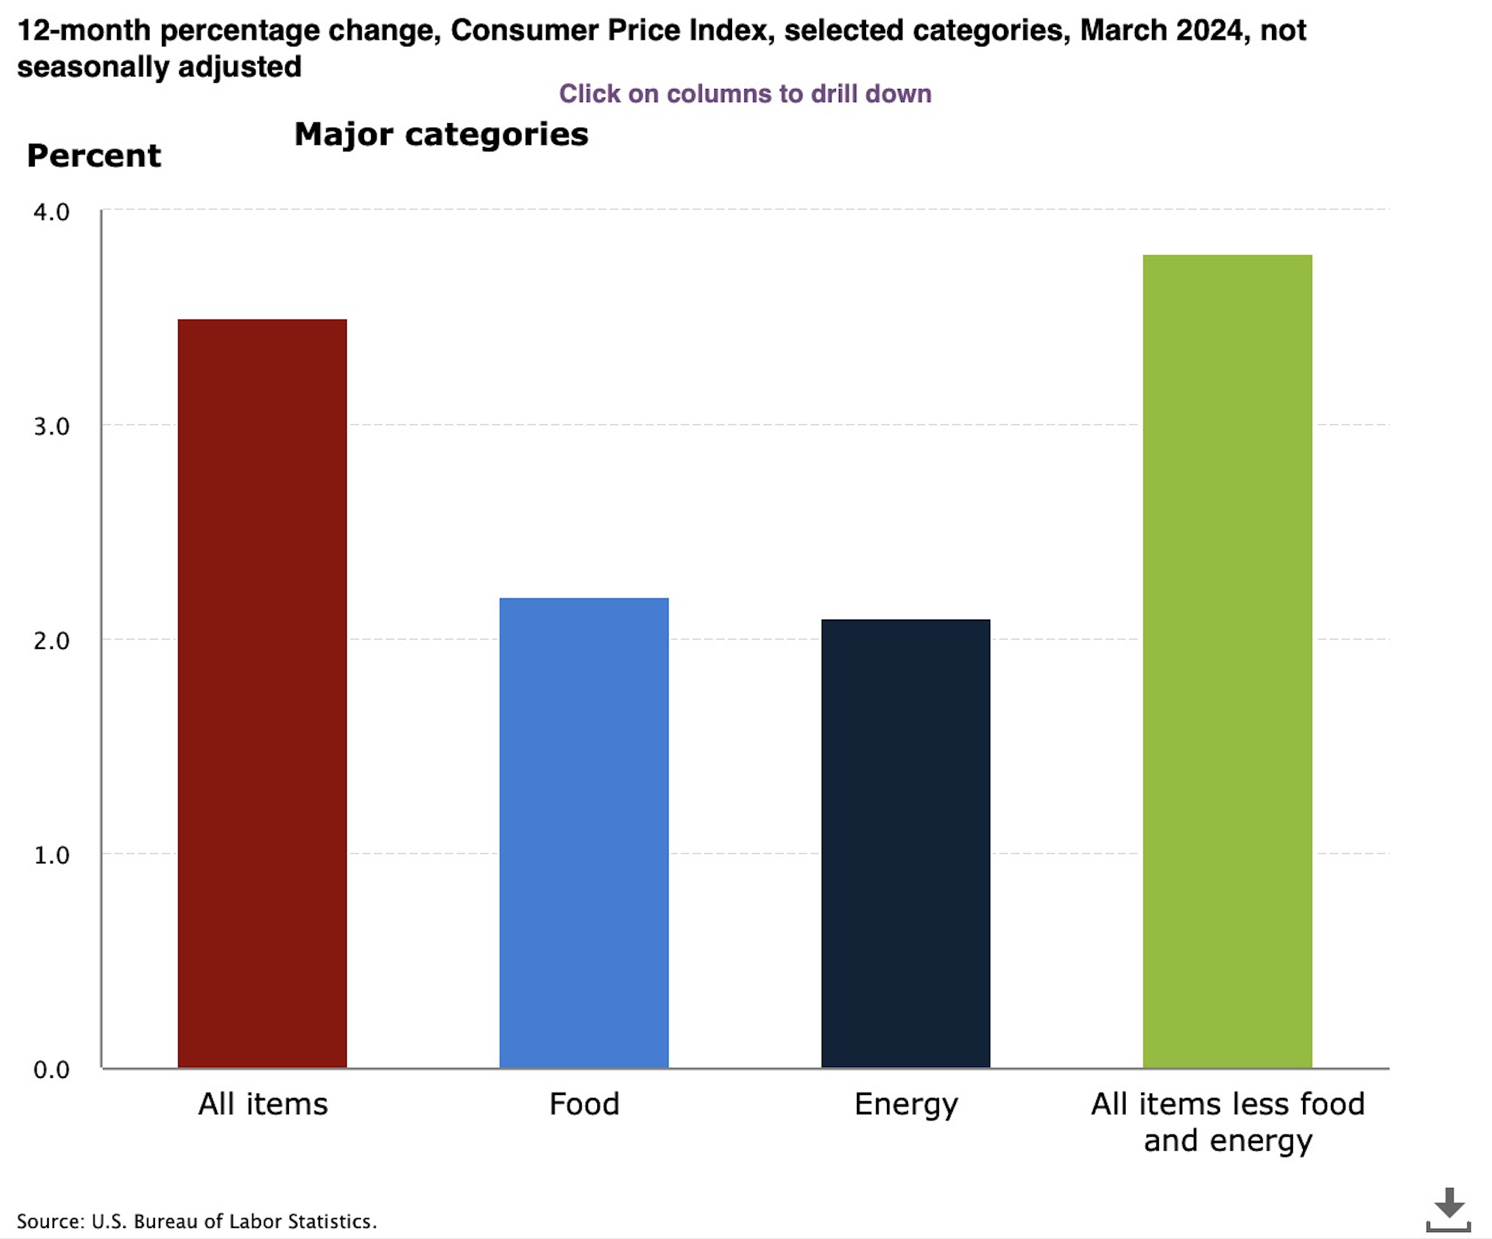
Consumer Price Index
The consumer price index increased 0.4% in March on a seasonally adjusted basis, it was the same increase as it was in February. Over the last 12 months, all items in the index increased 3.5% before seasonal adjustment.
The index for shelter rose in March, as did gasoline. Those two combined contributed of over half of the monthly increase in the index for all items. The energy index rose 1.1 % over the month.
All the indexes that increased in March include shelter, motor vehicle insurance, medical care, apparel, and personal care. The indexes that decreased in March are used cars and trucks, recreation, and new vehicles.

Slide 17
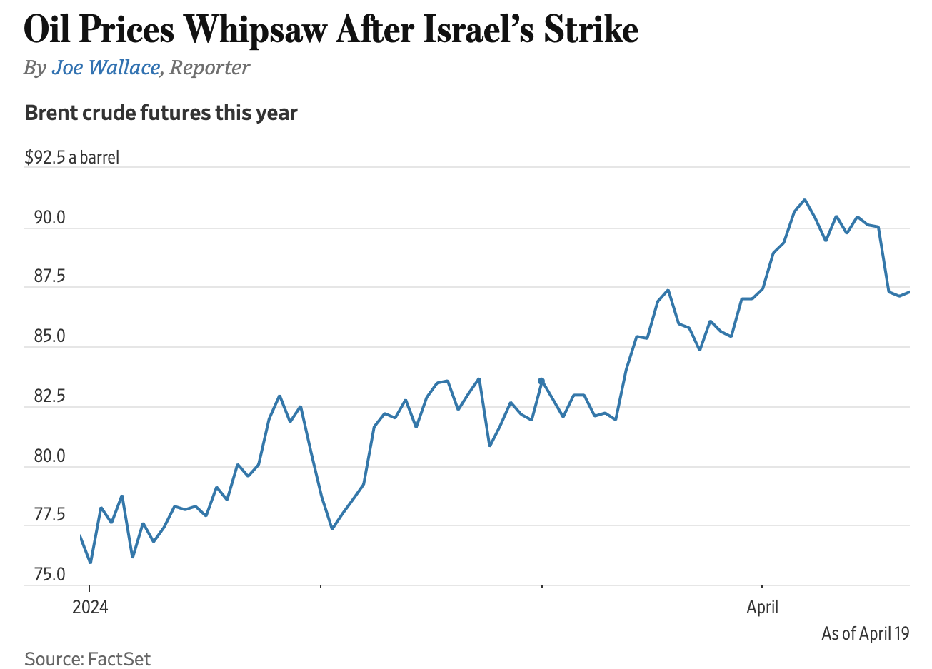
Oil Prices
Crude prices jumped after Israel's retaliatory strike on Iran.
Brent crude futures leapt more than 4% to top $90 a barrel amid concerns of disruptions to Middle Eastern oil supplies. Then it fell below $87 a barrel on Thursday.
Some potential risks
OPEC increases output: they might go for pumping more oil if prices surge.
The U.S. could impose stricter sanctions on Iranian oil exports.

Slide 18
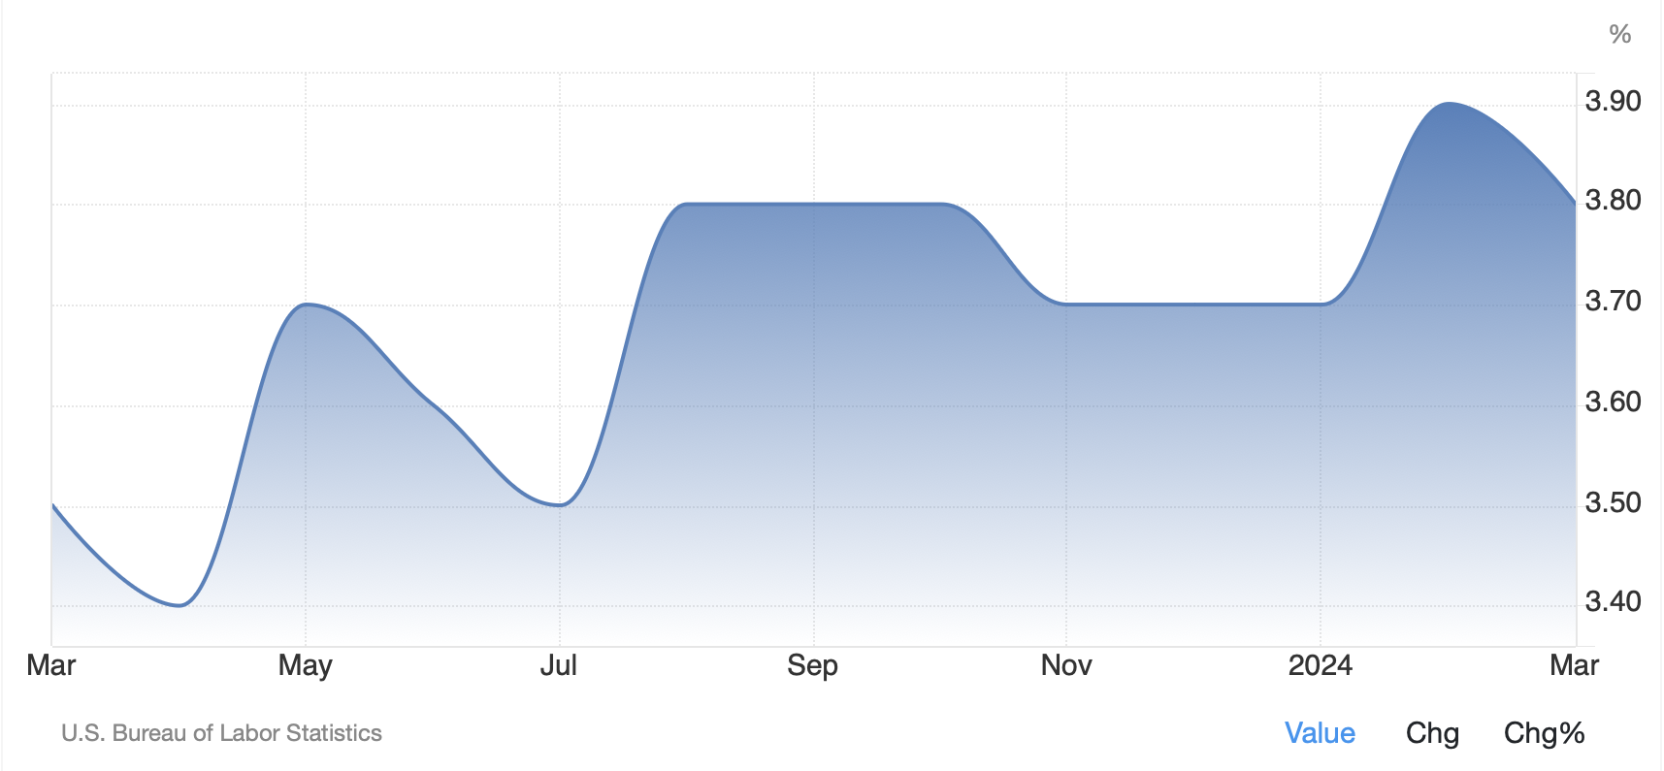
Unemployment
At the beginning of the semester, we saw a rise in jobs which has had a positive impact on consumer-discretionary stocks. Since secure employment was up, consumer confidence also rose. This indicated that demand for discretionary goods and services rose as well. In March 2024, unemployment fell slightly to 3.8% from 3.9% in February. It is forecasted that for April unemployment will fall back to 3.7% such as it was at the beginning of the year.

Slide 19
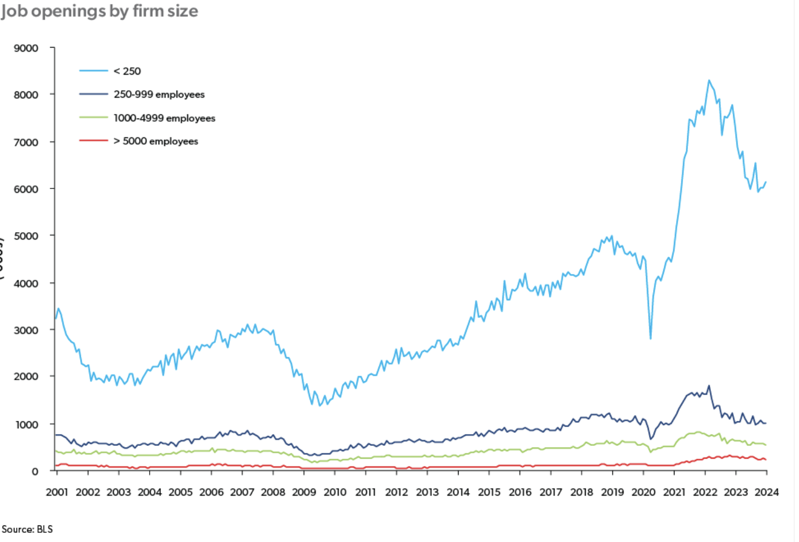
Labor Market
The labor market remains resilient with nonfarm payroll employment increasing by 275,000 in February. Jobs openings remained steady at 8.9 million in January according to the Bureau of Labor Statistics. The ratio of job openings to unemployment changed from 1.42 in December 2023 to 1.45 in January 2024, that indicates that there has been more job openings than unemployed. According to the graph, more smaller firms have job openings compared to larger firms. Post-pandemic, with technology continuing to advance and increase remote work, the growth in small businesses increased the demand for jobs by smaller firms. However, although there is a rise in job openings, owners are struggling to fill those positions.

Slide 20
Cites
https://www.cnbc.com/2024/02/22/existing-home-sales-rose-3percent-in-january-2024.html#:~:text=Inventory%20of%20homes%20for%20sale,for%20the%20month%20of%20January.
https://fred.stlouisfed.org/series/MORTGAGE30US
https://www.washingtonpost.com/business/2024/04/25/gdp-2024-economy-growth/
https://www.wsj.com/economy/central-banking/us-gdp-economy-first-quarter-2024-1675df05
https://www.freddiemac.com/research/forecast/20240320-us-economy-remains-robust

Slide 21
Current Events

Slide 22
Domestic Politics
Legislative Developments:
Cybersecurity Enhancement Act 2024: Mandates new compliance checks for all major tech corporations, potentially affecting over 30,000 businesses across sectors like technology and finance​​.
Medicare Expansion Proposal:
Proposed bill to lower Medicare eligibility to 60 years could extend benefits to an additional 23 million Americans, with estimated costs rising by $200 billion over ten years, raising significant budgetary concerns​​.
Political Landscape:
2024 Presidential Race Dynamics: Polls indicate a split preference with Democratic candidates averaging 45% in approval on healthcare reforms, whereas Republican candidates are capitalizing on economic recovery claims at a 40% approval rate​​.
Key Figures and Movements:
Emerging Leaders: Alexandria Ocasio-Cortez supports the Green New Deal aiming to reduce carbon emissions by 50% within the next decade, while Marco Rubio promotes tax incentives that could decrease small business taxes by up to 20%​​.

Slide 23
International Politics
Trade Agreements and Economic Sanctions:
U.S.-China Trade Talks: Efforts to reduce tariffs from 25% to 15% could potentially boost U.S. exports by $50 billion annually, enhancing sectors like agriculture and manufacturing and positively impacting the U.S. GDP by approximately 0.5%​​.
Sanctions on Iran: Aimed at curbing Iran's nuclear ambitions by significantly cutting its oil exports, these sanctions could increase global oil prices by up to $10 per barrel, affecting global energy costs and economic stability​​.
Global Conflicts and Alliances:
Support for Ukraine: The U.S. has allocated $1.2 billion in military aid to strengthen Ukraine’s defenses against Russian aggression, playing a key role in NATO's Eastern European strategies​​.
Middle East Initiatives: The U.S. is actively involved in peace talks in Syria and has committed $500 million in humanitarian aid to help stabilize the region and support displaced populations​​.
Impact of Global Events on U.S. Politics:
COVID-19 Global Response: Through COVAX, the U.S. has invested over $4 billion to support worldwide vaccine distribution, aiming to enhance global public health and solidify its leadership in international health policy​​.
Climate Change Actions: Rejoining the Paris Agreement, the U.S. plans to cut carbon emissions by 30% by 2030, influencing domestic energy and industrial policies and fostering the growth of renewable energy sectors​​.

Slide 24
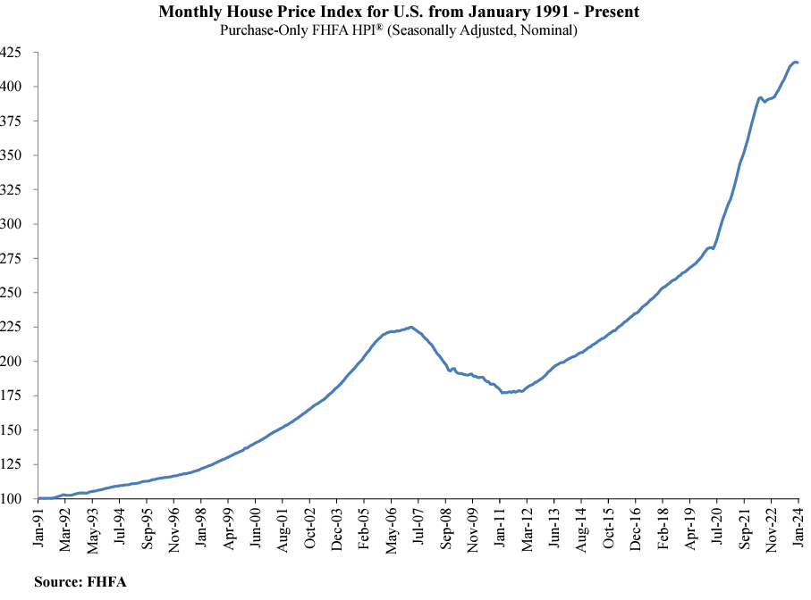
Housing Market
Current Market Dynamics:
Price Fluctuations: In major cities, home prices have risen by an average of 12% over the past year, with places like San Francisco seeing increases of up to 18%​​.
Mortgage Trends:
Current average 30-year mortgage rates stand at approximately 4.5%, a significant rise from 3.75% last year, affecting buyer affordability and market dynamics.
Government and Economic Influences:
Affordable Housing Act Incentives: This proposed legislation includes up to $15 billion in new housing credits aimed at stimulating construction, which could increase housing starts by 10-15% over the next two years​​.

Slide 25
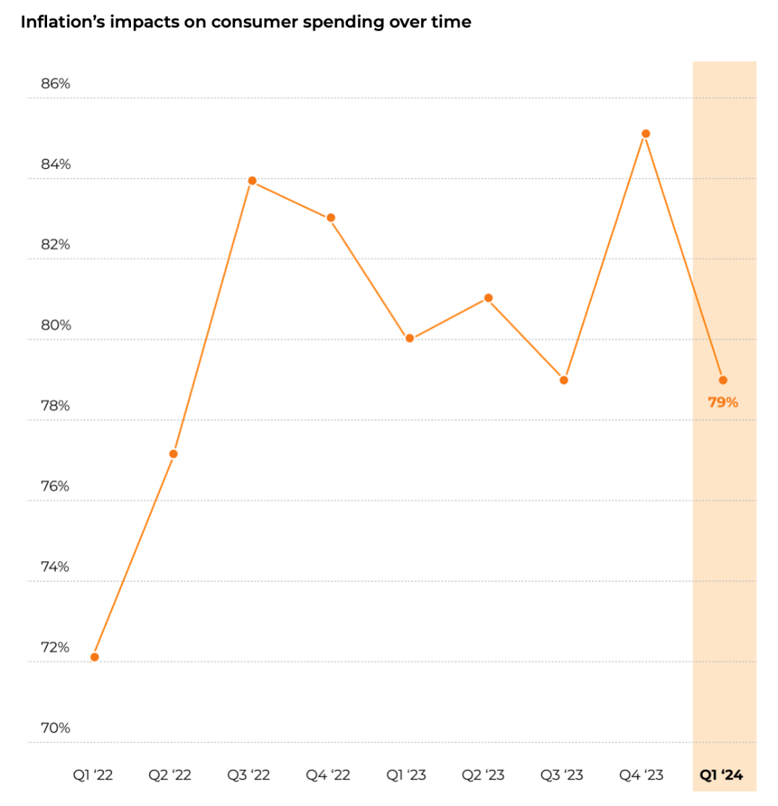
Consumer Spending
Consumer Spending Trends:
Jungle Scout’s Consumer Trends Report for Q1 2024 indicates that cost is the most significant factor driving purchase decisions on Amazon, with more than 70% of consumers looking for products with the lowest price due to persistent concerns about inflation.
The report also highlights the increasing influence of TikTok on ecommerce, with one in three shoppers browsing TikTok Shop at least once a week.
Spending Projections:
Fitch has revised its annual real consumer spending forecast for 2024 upward to 1.3%, reflecting the ongoing willingness and ability of consumers to draw down buffers of excess savings.
Consumer Behavior:
The Bank of America Winter Spending Survey suggests that consumers are planning to pull back a bit in 2024, potentially trimming their spending on meals out and other 'experiences.’
Influence of Technology:
Augmented reality and artificial intelligence are changing the way people shop. On Amazon, the use of the “View in Your Room” tool has led one in three shoppers to make a purchase they would otherwise only make in person.
Notes:
Sources:
https://www.junglescout.com/wp-content/uploads/2024/03/Jungle-Scout-Consumer-Trends-Report-Q1-2024.pdf
https://www.fitchratings.com/research/us-public-finance/us-consumer-spending-likely-moderates-in-2024-labor-market-underpins-resilience-05-02-2024
https://institute.bankofamerica.com/content/dam/bank-of-america-institute/economic-insights/consumer-checkpoint-january-2024.pdf

Slide 26
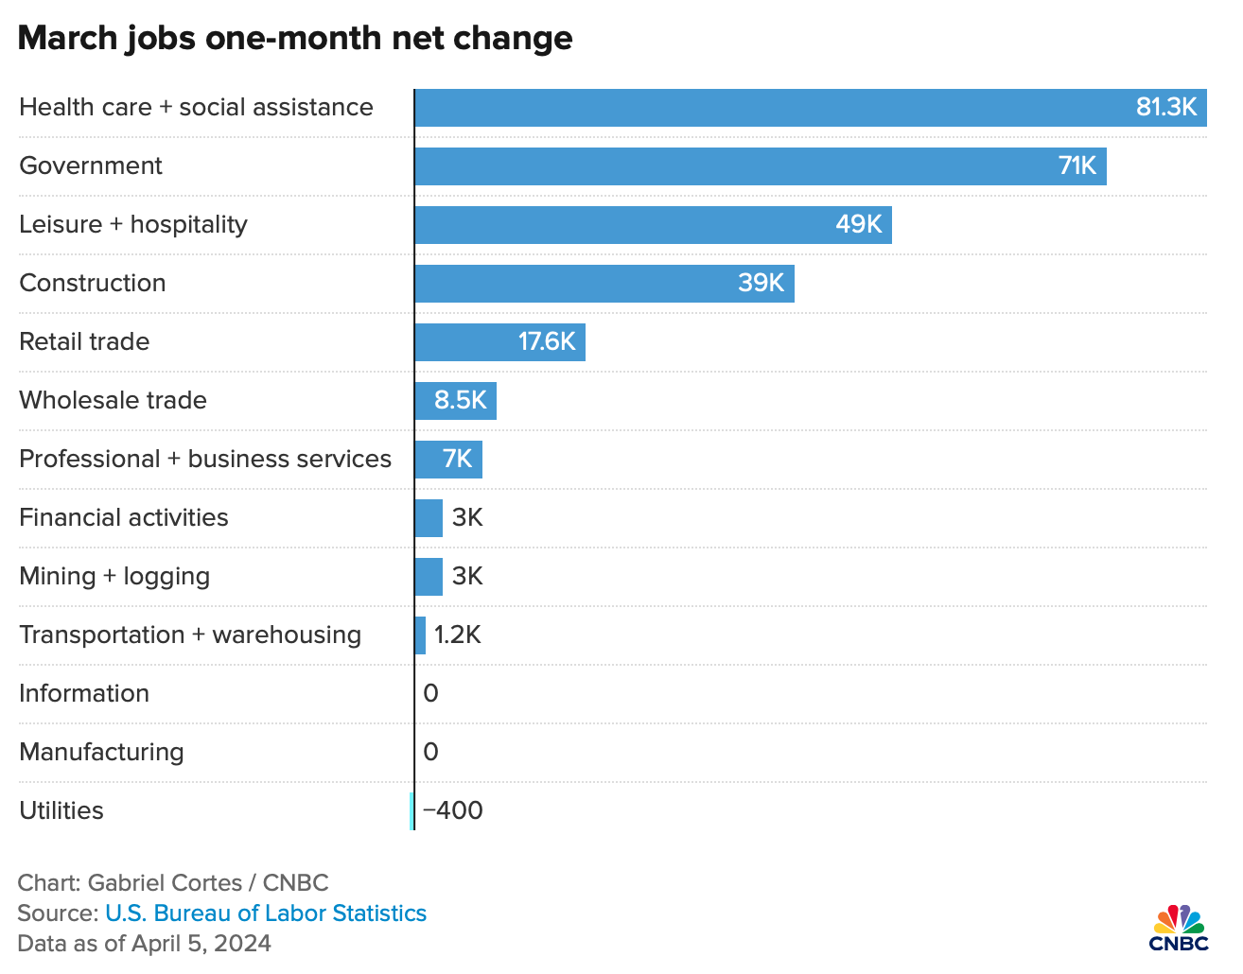
Employment
Job Growth:
The U.S. economy added 303,000 jobs in March 2024, marking an acceleration in the pace of hiring.
The three-month average employment gain reached a 12-month high of 276,000 jobs.
Unemployment Rate:
The overall unemployment rate fell back to 3.8% in March from 3.9% the prior month. However, some forecasts suggest that the unemployment rate could drift higher in 2024 while remaining low in historical context.
On a calendar-year basis, the unemployment rate is expected to edge up from 3.7 percent in 2024 Q1 to 4.0 percent in 2025 Q1.
Industry Breakdown:
Employment gains in health and private education, government, and leisure and hospitality contributed to 208,000 of the total job gains.
Jobs in manufacturing were unchanged, while jobs in mining and logging increased by 3,000.
Labor Market Resilience:
Despite high interest rates and slowing economic indicators, the labor market remains resilient.
Momentum in the job market is starting to wane with slowing payroll growth and modestly rising unemployment.
Notes:
Sources:
https://www.jpmorgan.com/insights/outlook/economic-outlook/jobs-report-march-2024
https://www.bls.gov/news.release/archives/empsit_04052024.pdf
https://www.cnbc.com/2024/04/05/heres-where-the-jobs-are-for-march-2024-in-one-chart-in-one-chart.html

Slide 27
SECTOR OVERVIEW

Slide 28
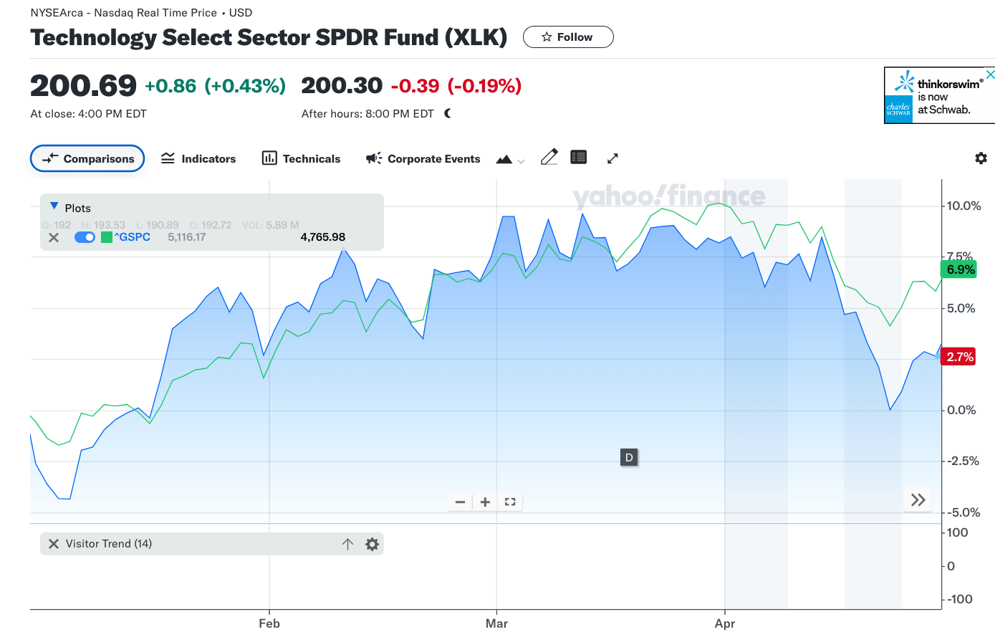
Technology
The technology sector is the category of stocks relating to the research, development, or distribution of technologically based goods and services. This sector is comprised of businesses that sell goods and services in electronics, software, computers, artificial intelligence, and other industries related to information technology (IT).
The XLK ETF is underperforming the S&P 500 over the course of the year. The XLK ETF was actually out preforming the S&P 500 until the middle of last month. It is up 3.8% this year, thanks to great performance by the semiconductor industry, software infrastructure, and the hype around AI. While the ETF underperformed, the stocks held in the SAP fund outperformed the S&P 500 because of earnings beats and positive sentiment regarding expansion in the sector.
Position Strategy | Overweight
SAP Target | 32.05%
S&P Contribution | 28.20%
SAP Contribution | 33.09%

Slide 29
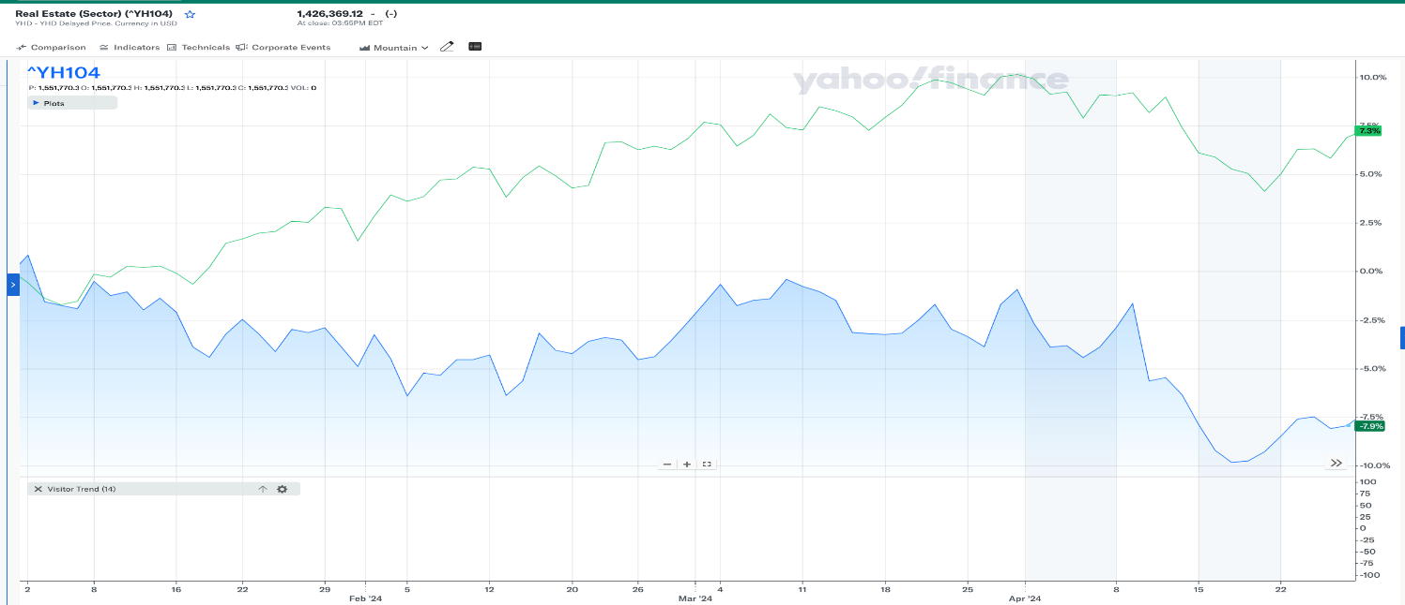
Real Estate
The Real Estate sector is the market for land, homes, and buildings. The main segments of the real estate sector are residential real estate, commercial real estate, and industrial real estate.
The Real Estate Sector has underperformed significantly against the S&P 500 over the course of the year. This is lead by high mortgage rates and high home prices along with a lack of housing supply. While the sector has underperformed significantly, our portfolio does not currently hold any stocks or ETFs in the sector.
Position Strategy | Underweight
SAP Target | 0%
S&P Contribution | 2.40%
SAP Contribution | 0.00%

Slide 30
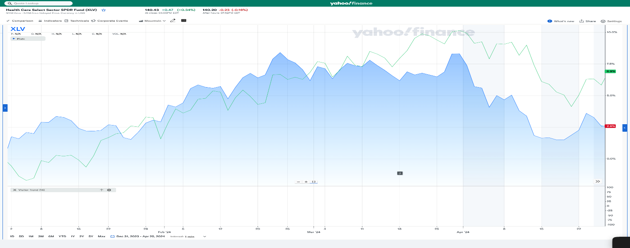
Healthcare
The Healthcare Sector consists of businesses that provide medical services, manufacture medical equipment or drugs, provide medical insurance, or facilitate the provision of healthcare to patients. It includes various stakeholders such as hospitals, clinics, pharmaceutical companies, medical device manufacturers, and insurance providers.
The XLV ETF underperformed the S&P 500 by almost 5%. Solid performance from the drug manufacturer industry as well as the medical distribution industry has made the healthcare sector and ALV ETF have a positive return in 2024. However, the healthcare plans industry, the biotechnology industry, and it being an election year have made the sector and ETF underperform the S&P 500.
Position Strategy | Overweight
SAP Target | 14%
S&P Contribution | 13.10%
SAP Contribution | 11.53%

Slide 31
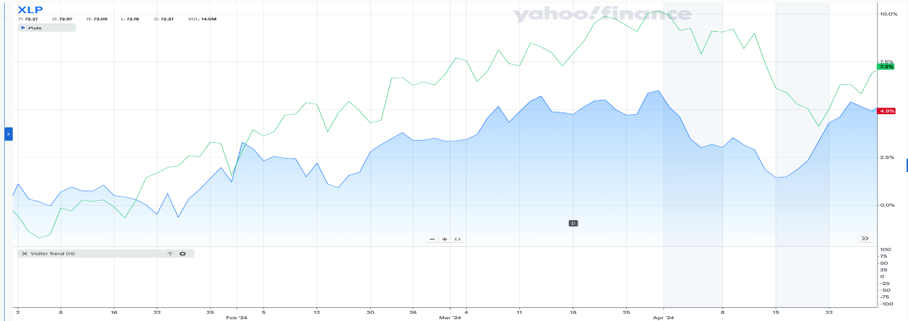
Consumer Staples
The Consumer Staples sector refers to all essential products used by consumers. Consumers will not cut these products out of their life no matter what the financial situation is. This category includes things like foods and beverages, household goods, hygiene products, alcohol and tobacco. Consumer staples are non-cyclical.
The XLP ETF has underperformed the S&P 500 so far this year. The ETF as well as the sector has very low volatility. However, since there is low volatility, there is limited highs for this ETF and sector. Also, since spending is down as a whole, the ETF has underperformed the S&P 500. We took an underweight position strategy for this sector.
Position Strategy | Underweight
SAP Target | 8.60%
S&P Contribution | 6.60%
SAP Contribution | 4.32%

Slide 32
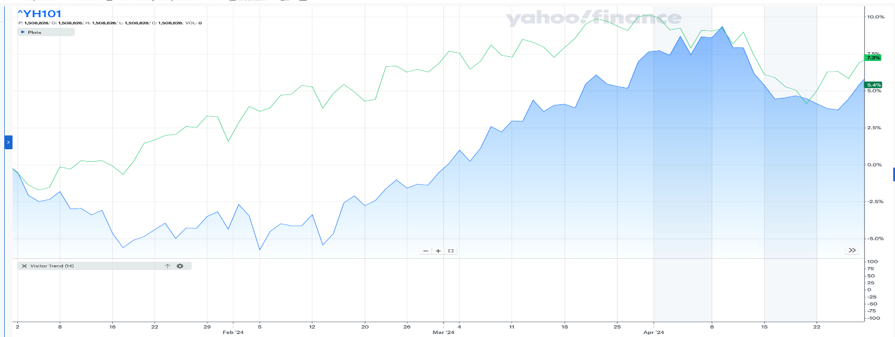
Materials
The Materials sector made up of businesses engaged in the discovery, development, and processing of raw materials. The raw materials they finish are sold for use in nearly all other industry sectors. The performance of the materials sector is influenced by factors such as commodity prices, global demand trends, technological advancements, and environmental regulations.
The Materials sector has underperformed the S&P 500 by about 2% so far this year. It is up 5.4% as of market close on 4/26. While the sector has underperformed slightly, our portfolio does not currently hold any stocks or ETFs in the sector.
Position Strategy | Underweight
SAP Target | 2.40%
S&P Contribution | 2.40%
SAP Contribution | 0%

Slide 33
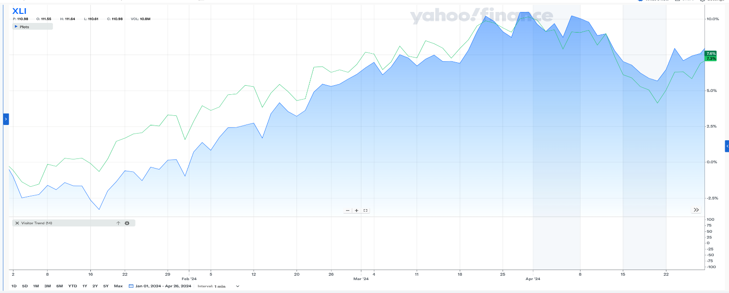
Industrials
The industrials sector encompasses a diverse range of companies involved in manufacturing, construction, engineering, transportation, and other industrial activities. These companies produce goods and provide services essential to infrastructure development, production processes, and logistics
The XLI ETF has outperformed the S&P 500 by a slim margin so far this year after underperforming the S&P 500 in 2023. Our portfolio took an overweight position strategy for this sector. The ETF is up 7.6% so far, which is 0.3% higher than the S&P 500. The growth of the industrial sector is closely tied to the growth of the economy as a whole. Also, advancements in technology, regulatory changes, and companies being more environmentally friendly have had an impact on the ETF and sector as a whole this year.
Position Strategy | Overweight
SAP Target | 10%
S&P Contribution | 8.33%
SAP Contribution | 10.46%

Slide 34
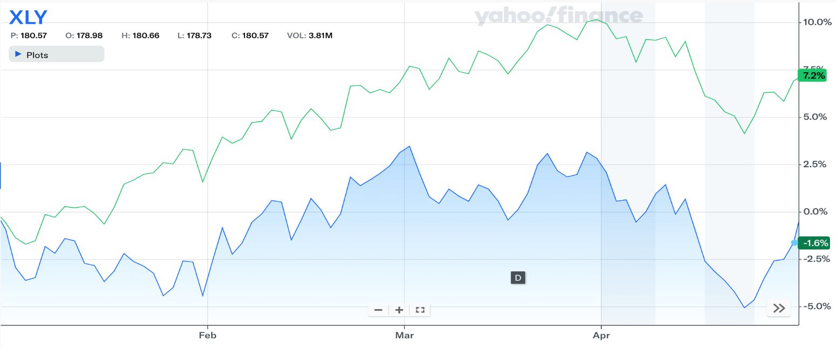
Consumer Discretionary
Companies in the consumer discretionary sector provide goods and services that cater to individuals' wants and preferences, rather than essential needs. This sector encompasses a broad array of offerings, including experiential services like dining out and entertainment, as well as luxury and premium products from renowned brands.
The XLY ETF has underperformed significantly against the S&P 500 over the course of the year. This is lead by rising concerns about inflation and our current interest rate effects on nonessential consumer spending. While the ETF underperformed, the stocks held in the SAP fund outperformed the S&P 500 because of earnings beats and positive sentiment regarding expansions.
Position Strategy | Overweight
SAP Target | 10.60%
S&P Contribution | 10.60%
SAP Contribution | 16.58%

Slide 35
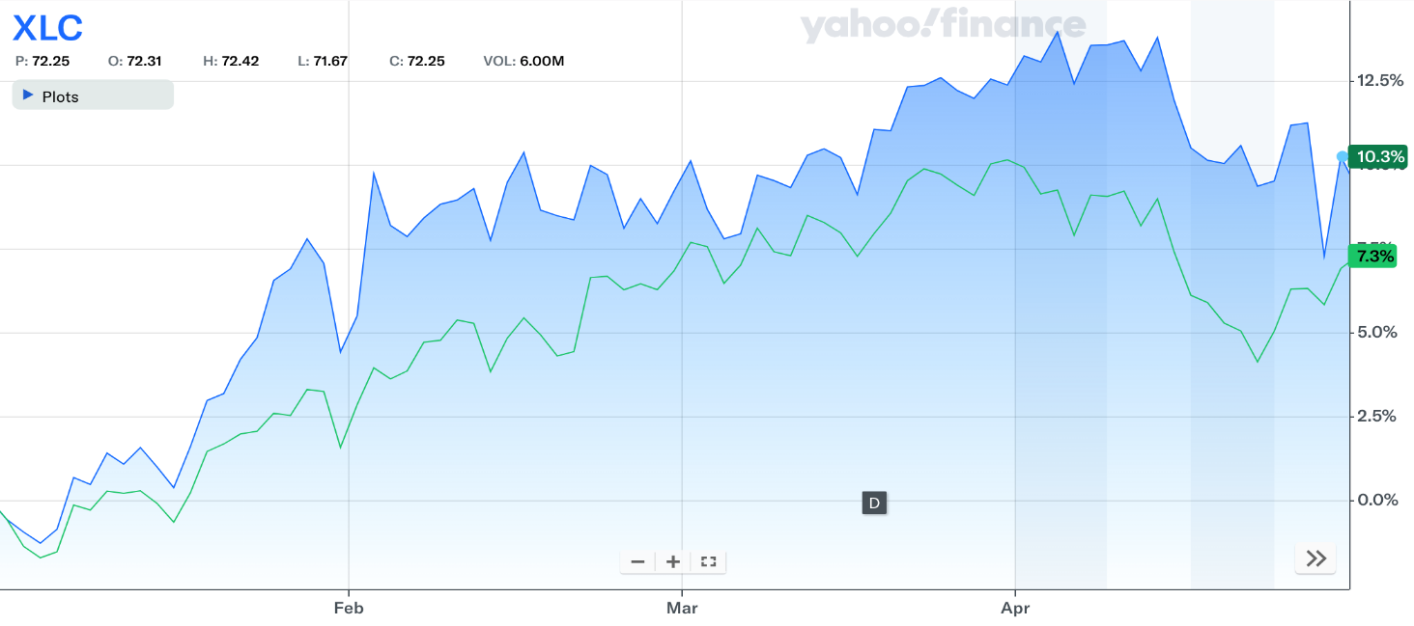
Communication Services
The communication services sector encompasses a broad spectrum of services and technologies that enable people to connect, share information, and communicate with each other. This sector includes traditional communication methods such as cell phone operators and television services but has evolved to incorporate digital platforms like social media, search engines, and other cutting-edge technologies.
The growth in the XLC ETF was spearheaded by the strong performances of Meta and Google, caused by the hype surrounding generative AI and a rebound in revenue in digital advertising.
Position Strategy | Overweight
SAP Target | 10.00%
S&P Contribution | 8.80%
SAP Contribution | 9.07%

Slide 36
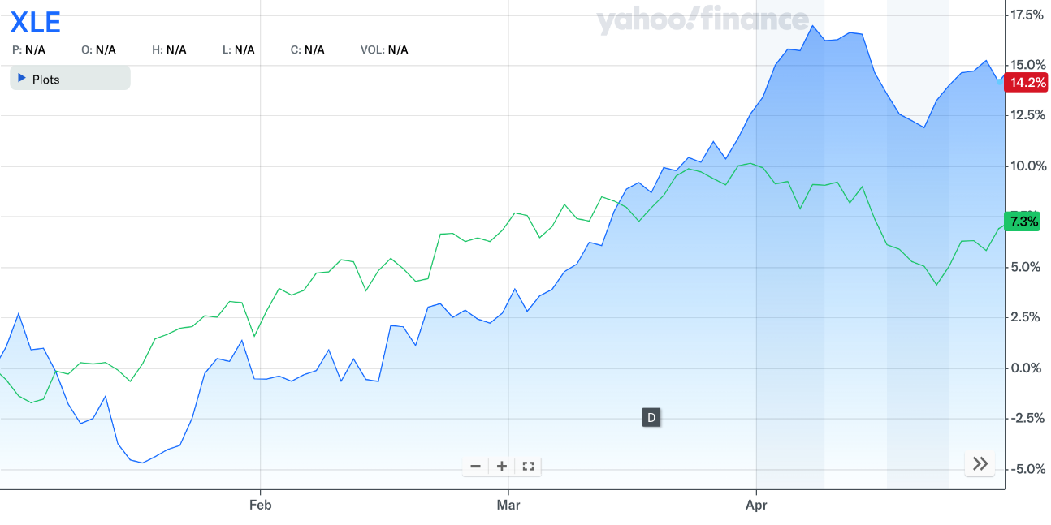
Energy
The energy sector encompasses a diverse range of companies involved in the production, supply, and distribution of various energy sources. These companies can be categorized into oil and gas, coal, nuclear energy, and renewable energy sources, such as hydropower, solar power, wind power, and biofuels.
The XLE ETF underperformed the S&P 500 at the beginning of the year but has since rebounded and passed the index mostly because of the rising concerns surrounding the Israel-Hamas conflict. This concern is caused by the potential for the conflict to broaden into an oil producing region.
Position Strategy | Underweight
SAP Target | 2.08%
S&P Contribution | 4.40%
SAP Contribution | 0.00%

Slide 37
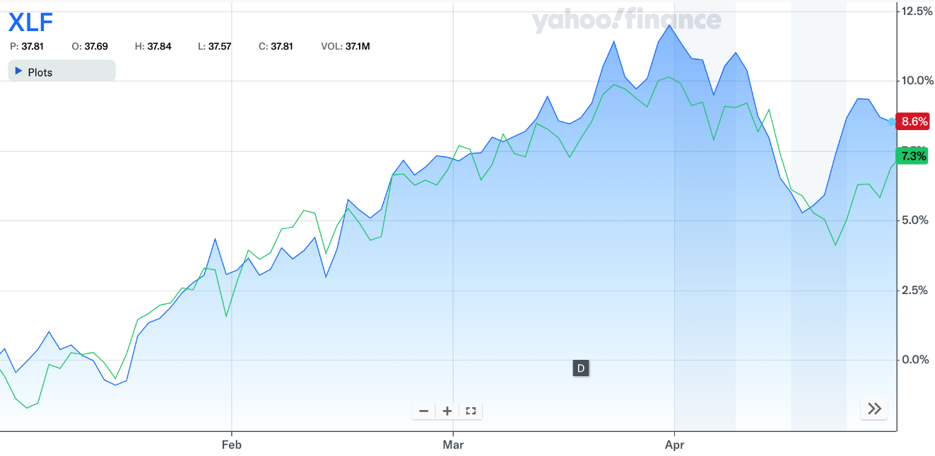
Financials
The financials sector encompasses a diverse range of organizations that offer essential financial services to individuals, businesses, and governments. The sector is comprised of various key players, including banking institutions, credit unions, investment companies, insurance providers, brokerage firms, and regulatory agencies that oversee and govern financial activities.
-The XLF ETF outperformed the S&P 500 by a slim margin, coming off a volatile 2023 where several firms, like Silicon Valley Bank, shut down. In 2024, banks have benefited from higher interest rates, but could be susceptible to higher volatility in the future if a soft-landing isn’t foreseeable.
Position Strategy | Underweight
SAP Target | 9.00%
S&P Contribution | 12.60%
SAP Contribution | 12.38%

Slide 38
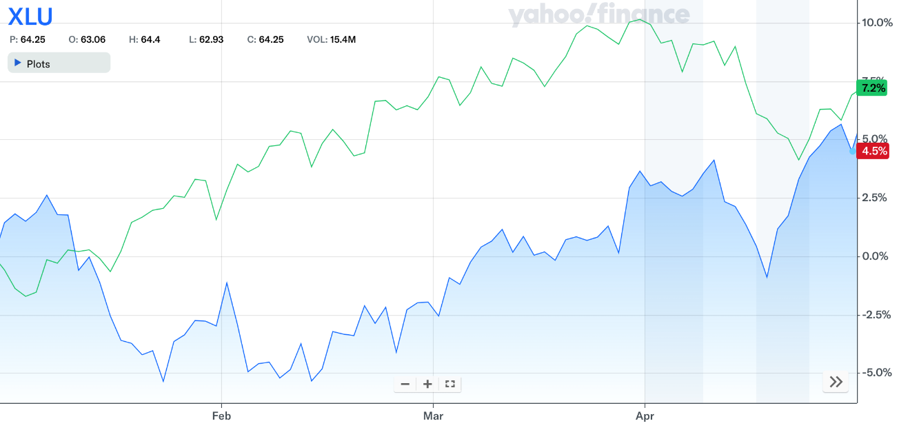
Utilities
The utilities sector is a vital component of the economy. It encompasses companies that deliver indispensable services such as water, electricity, and natural gas. Characterized by its reliability and consistent earnings, because of a steady demand, this sector presents a compelling investment opportunity during times of economic volatility.
The XLU has underperformed when compared to the S&P 500. A core reason for this is our current interest rate environment, high rates can impact profitability because of the significant debt levels used to finance infrastructure projects. In the future, utilities reliable dividend payments and defensive nature could be beneficial if there is increased market volatility.
Position Strategy | Underweight
SAP Target | 0.00%
S&P Contribution | 2.55%
SAP Contribution | 1.98%

Slide 39
ETF PERFORMANCE

Slide 40
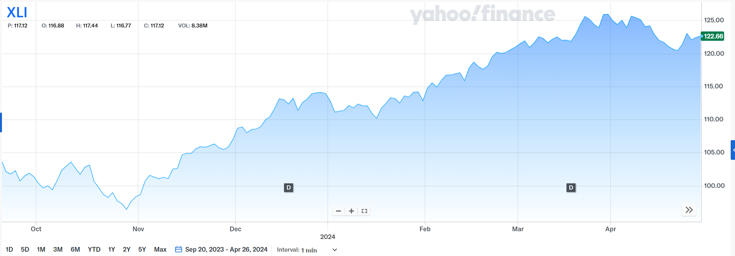
Industrials SPDR (XLI)
Top 10 Holdings (36.05%)
Name | Ticker | % Assets
General Electric Company | GE | 4.92%
Caterpillar Inc. | CAT | 4.80%
Uber Technologies, Inc. | UBER | 4.08%
Union Pacific Corporation | UNP | 3.86%
Honeywell International Inc. | HON | 3.48%
RTX Corporation | RTX | 3.33%
Eaton Corporation plc | ETN | 3.21%
The Boeing Company | BA | 2.85%
United Parcel Service, Inc. | UPS | 2.77%
Deere & Company | DE | 2.75%
Date Purchased | 09/20/2023
Number of Shares Held | 170.93
Acquisition Price | $104.47
Cost Basis | $17,856.82
Market Value (4/26/2024): $121.39 +$16.92 (+16.20%)

Slide 41
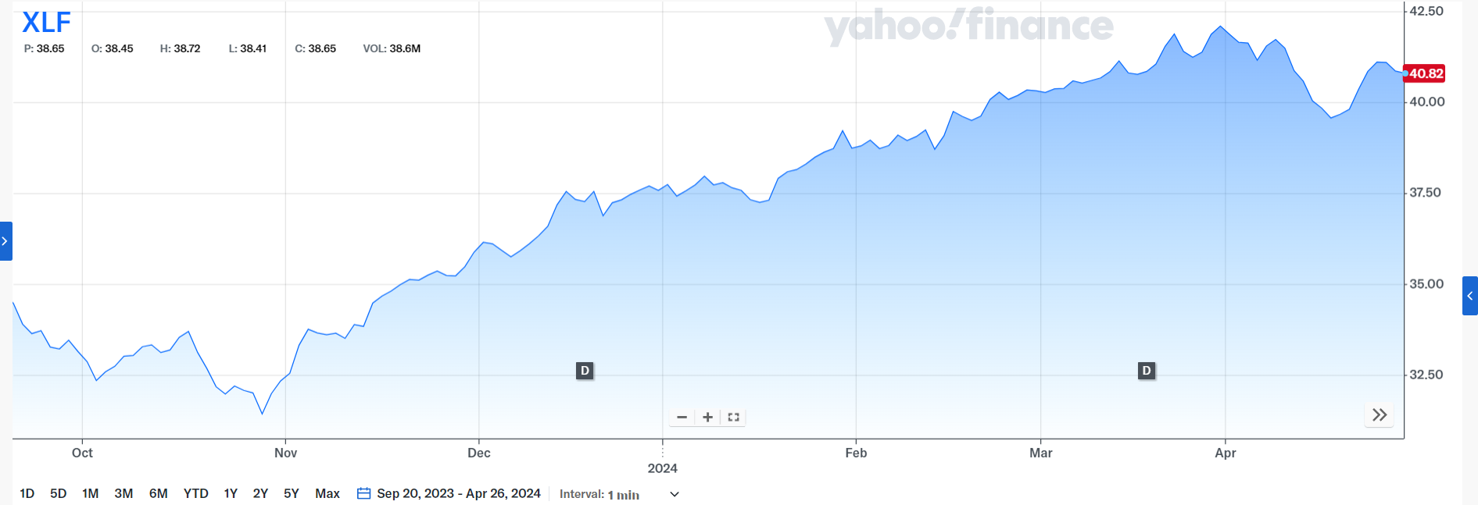
Financials SPDR (XLF)
Top 10 Holdings (54.74%)
Name | Ticker | % Assets
Berkshire Hathaway Inc Class B | BRK.B | 13.18%
JPMorgan Chase & Co | JPM | 9.98%
Visa Inc. | V | 7.6%
Mastercard Incorporated | MA | 6.85%
Bank of America Corporation | BAC | 4.50%
Wells Fargo & Company | WFC | 3.60%
S&P Global Inc. | SPGI | 2.36%
The Goldman Sachs Group, Inc. | GS | 2.35%
American Express Company | AXP | 2.24%
The Progressive Corporation | PGR | 2.09%
Date Purchased | 09/20/2023
Number of Shares Held | 502.47
Acquisition Price | $34.77
Cost Basis | $17,470.88
Market Value (4/26/2024): $40.89 +$6.11 (+17.59%)

Slide 42
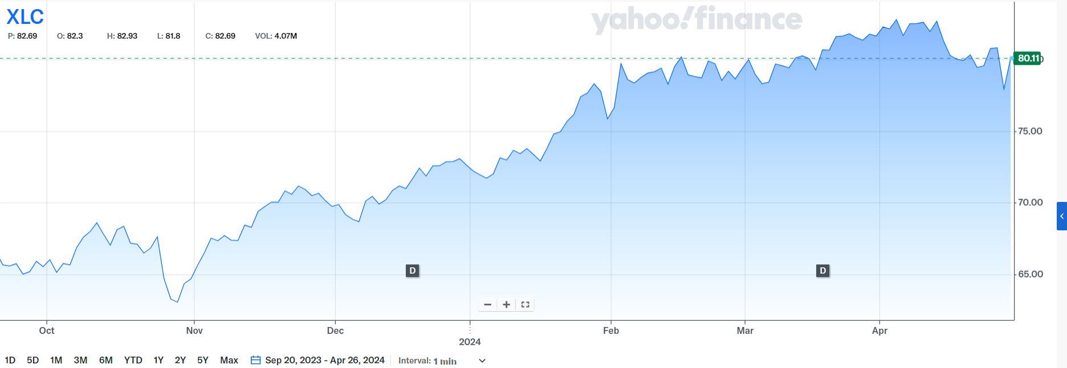
Communications Services SPDR (XLC)
Top 10 Holdings (77.45%)
Name | Ticker | % Assets
Meta Platforms, Inc. | META | 21.34%
Alphabet Inc. | GOOGL | 13.45%
Alphabet Inc. | GOOG | 11.36%
The Walt Disney Company | DIS | 4.83%
Verizon Communications Inc. | VZ | 4.62%
AT&T Inc. | T | 4.45%
Comcast Corporation | CMCSA | 4.43%
Netflix, Inc. | NLFX | 4.37%
T-Mobile US, Inc. | TMUS | 4.33%
Electronic Arts Inc. | EA | 4.27%
Date Purchased | 09/20/2023
Number of Shares Held | 75.18
Acquisition Price | $67.08
Cost Basis | $5,043.36
Market Value (4/26/2024): $79.59 +$12.51 (+18.64%)

Slide 43
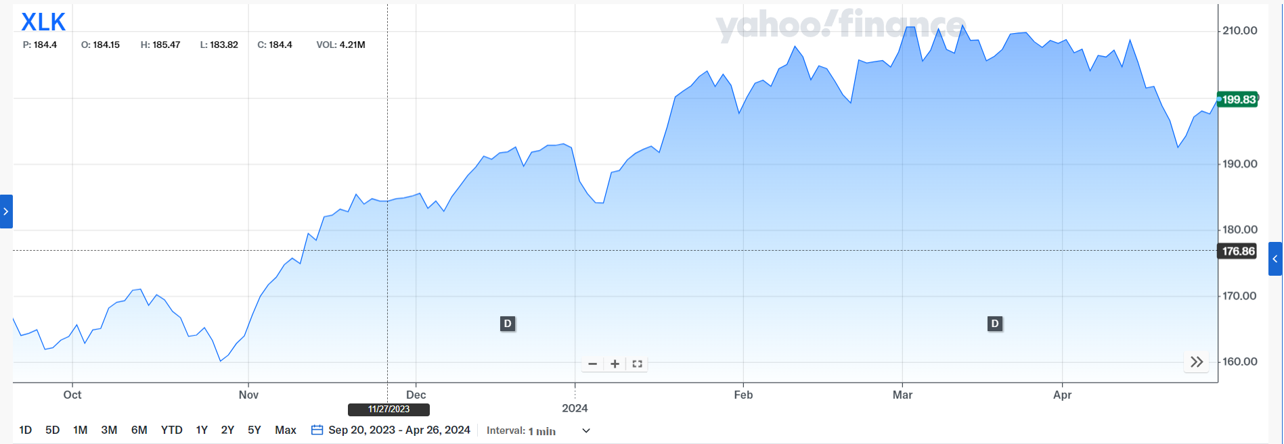
Technology SPDR (XLK)
Top 10 Holdings (54.74%)
Name | Ticker | % Assets
Microsoft Corporation | MSFT | 22.93%
Apple Inc. | APPL | 19.31%
Broadcom Inc. | AVGO | 4.52%
NVIDIA Corporation | NVDA | 4.50%
Advanced Micro Devices, Inc. | AMD | 3.08%
Salesforce, Inc. | CRM | 3.07%
Adobe Inc. | ADBE | 2.41%
Accenture plc | ACN | 2.29%
Cisco Systems, Inc. | CSCO | 2.14%
Oracle Corporation | ORCL | 2.11%
Date Purchased | 09/20/2023
Number of Shares Held | 491.21
Acquisition Price | $168.71
Cost Basis | $82,889.23
Market Value (4/26/2024): $194.26 +$25.52 (+15.12%)

Slide 44
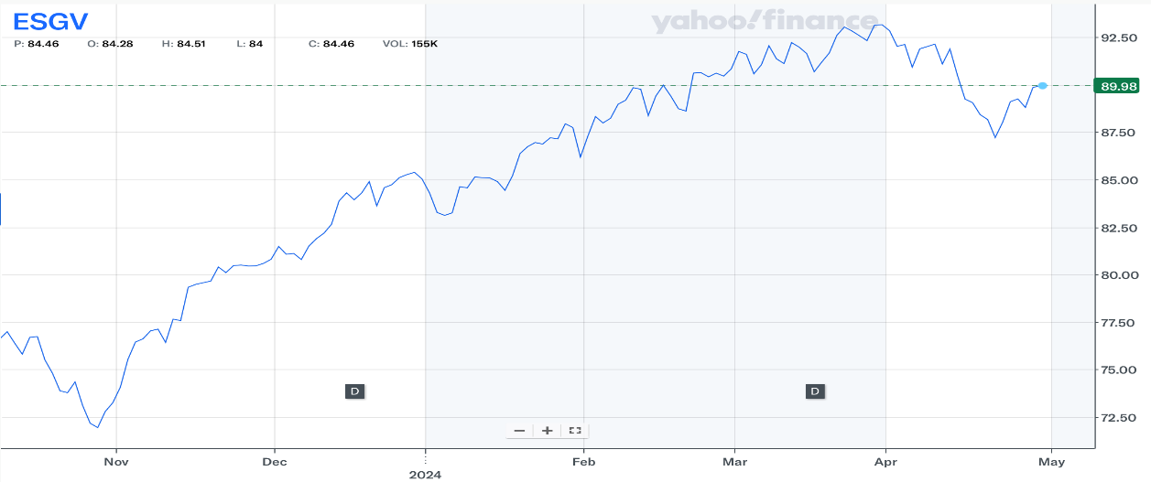
VANGUARD ESG US STOCK (ESGV)
Top 10 Holdings (33.94%)
Name | Ticker | % Assets
Microsoft Corporation | MSFT | 7.42 %
Apple Inc | AAPL | 6.06 %
NVIDIA Corp | NVDA | 5.12 %
Amazon.com Inc | AMZN | 3.97 %
Meta Platforms Inc. | META | 2.41 %
Alphabet Inc – Class A | GOOGL | 2.37 %
Alphabet Inc – Class C | GOOG | 2.28 %
Eli Lilly & Co | LLY | 1.52 %
Broadcom Inc | AVGO | 1.42 %
JPMorgan Chase & Co | JPM | 1.37%
Date Purchased | 09/20/2023
Number of Shares Held | 377.35
Acquisition Price | $77.76
Cost Basis | $29,340.85
Market Value (4/26/2024): $90.13 +$12.93 (+15.93%)

Slide 45
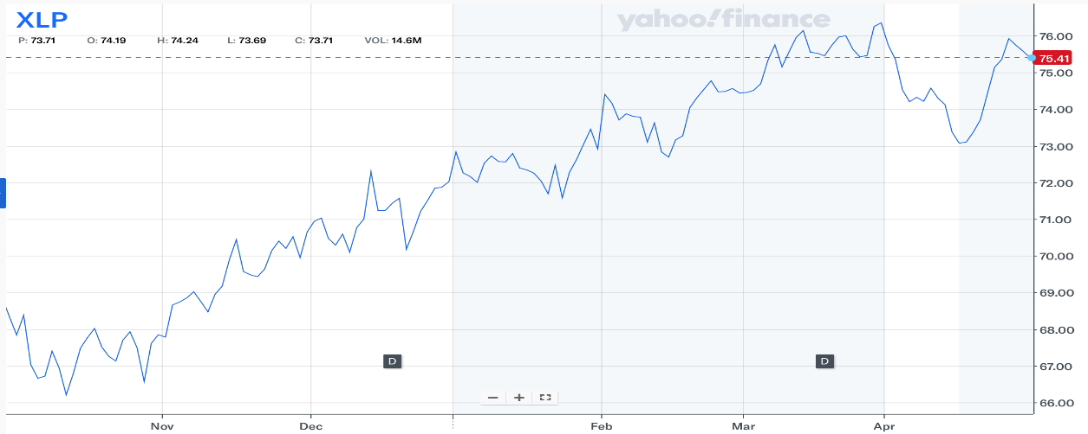
Consumer Staples SPDR (XLP)
Top 10 Holdings (69.70%)
Name | Ticker | % Assets
Procter & Gamble Company | PG | 14.62%
Costco Wholesale Corporation | COST | 12.46%
Walmart Inc. | WMT | 9.92%
Coca-Cola Company | KO | 9.25%
PepsiCo Inc. | PEP | 4.80%
Philip Morris International Inc. | PM | 4.57%
Mondelez International Inc. Class A | MDLZ | 4.15%
Altria Group Inc. | MO | 3.34%
Target Corporation | TGT | 3.32%
Colgate-Palmolive Company | CL | 3.27%
Date Purchased | 09/20/2023
Number of Shares Held | 377.35
Acquisition Price | $71.64
Cost Basis | $21,810.92
Market Value (4/26/2024): $75.47 +$3.83 (+5.35%)

Slide 46
Growth Strategy

Slide 47
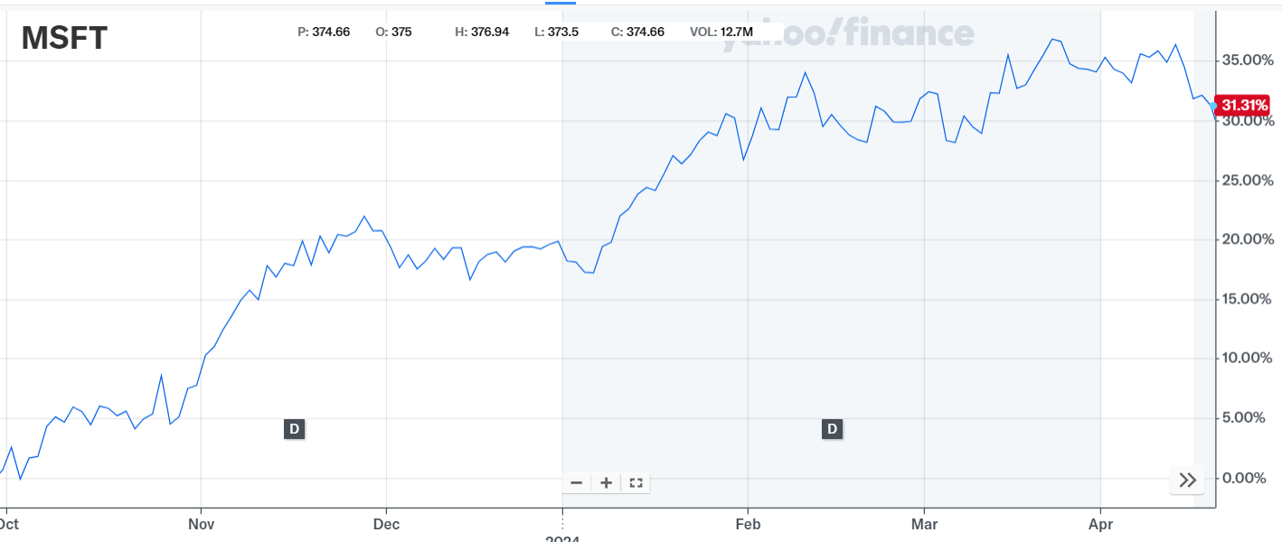
Microsoft corporation
Microsoft is a global technology company that contributes to advancements in software, cloud computing, and digital services.
The company offers a diverse range of products and services including Microsoft 365, Excel, Word, PowerPoint, Azure, Xbox, LinkedIn, and hardware, which cater to both consumer and enterprise markets.
Holds a prominent positions as the world's leading computer software vendor that is used across various industries
Date Acquired | 9/29/2023
Number of Shares | 35.07
Acquisition PPS | $317.30
Cost Basis | $11,127.68
Market Value (4/17/2024): $411.840 -$2.74 (-0.66%)

Slide 48
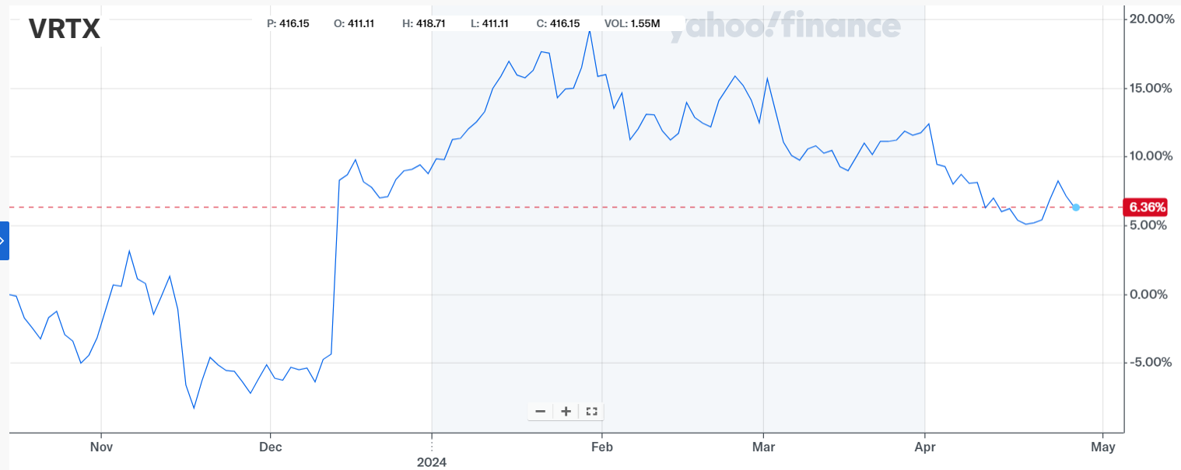
Vertex Pharmaceutical inc.
Vertex Pharmaceuticals is a prominent biotechnology firm that focuses on the discovery and development of small-molecule drugs for treating serious diseases
The primary drugs that they offer include Kalydeco and Trikafta for cystic fibrosis.
They are diversifying their pipeline through gene-editing therapies, non-opioid treatments for pain, and inhibitors for kidney diseases.
Date Acquired | 9/29/2023
Number of Shares | 45
Acquisition PPS | $349.66
Cost Basis | $15,734.82
Market Value (4/17/2024): $393.10 -$1.07 (-0.27%)

Slide 49
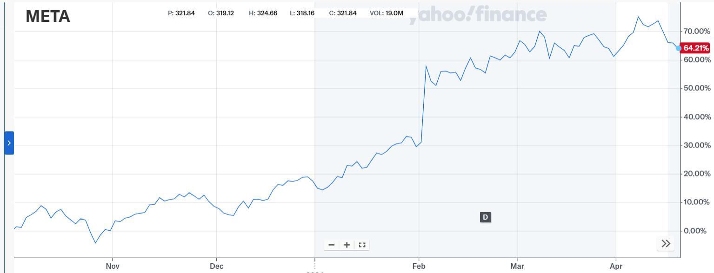
Meta platforms Inc.
Meta is the world's largest online social network, with 3.8 million active monthly users engaging with each other in different ways.
The firm owns Facebook, Instagram, Messenger, WhatsApp, and many features surrounding these apps.
Date Acquired | 10/4/2023
Number of Shares | 65
Acquisition PPS | $304.07
Cost Basis | $19,764.45
Market Value (4/17/2024): $494.17 -$5.59 (-1.12%)

Slide 50
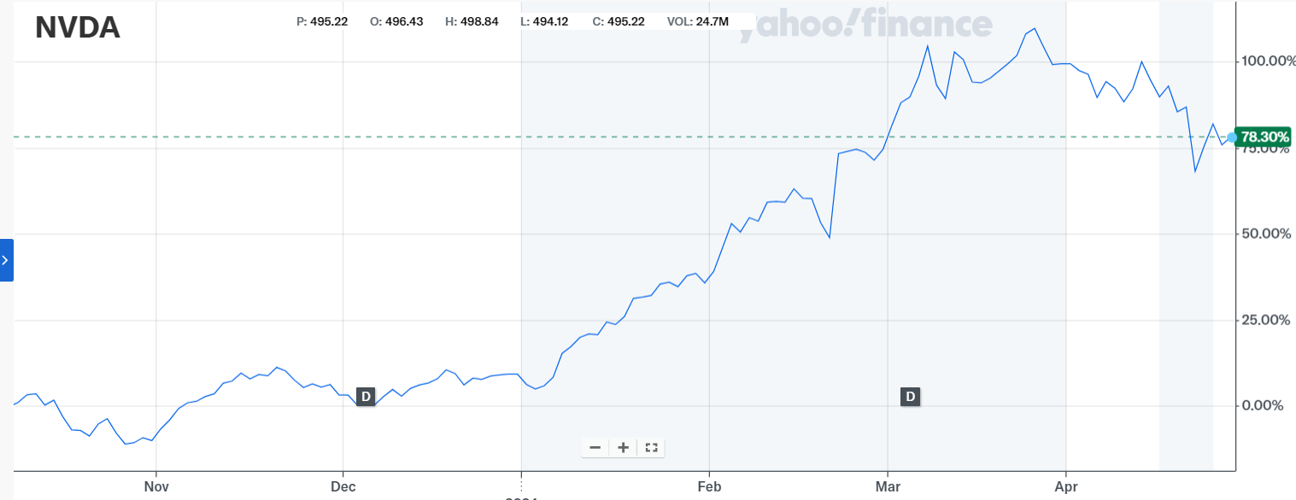
Nvidia corporation
NVIDIA is a technology company known for developing integrated circuits, which are used in everything from electronic game consoles to PCs.
The leading manufacturer of high-end graphics processing units (controls 80% of the market). Large computers that process data and power generative AI run on GPUs.
Date Acquired | 10/10/23 & 1/30/24
Number of Shares | 53
Acquisition PPS | $459.44
Cost Basis | $24,350.32
Market Value (4/17/2024): $840.35 -$33.80 (-3.87%)

Slide 51
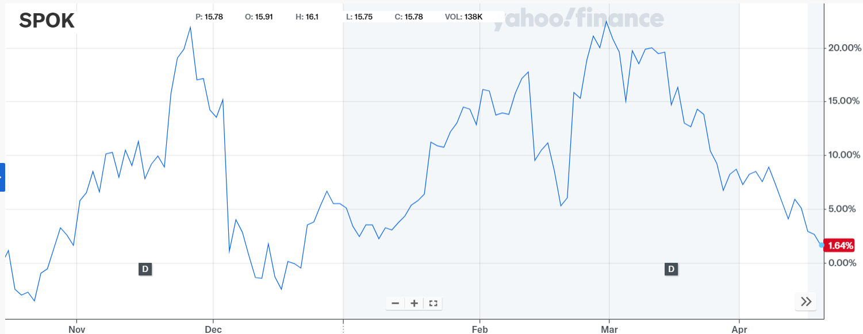
Spok holdings inc.
Spok Holdings engages in the provision of communication solutions around the world.
The company develops and markets enterprise-wide systems for healthcare firms, which helps them to automate and standardize clinical communications.
Provides call center operations, clinical altering and notifications, one-way advanced and two-way wireless messaging services, mobile communications and public safety solutions.
Date Acquired | 10/17/2023
Number of Shares | 1,020.85
Acquisition PPS | $14.92
Cost Basis | $15,232.32
Market Value (4/17/2024): $164.32 -$4.26(-2.53%)

Slide 52
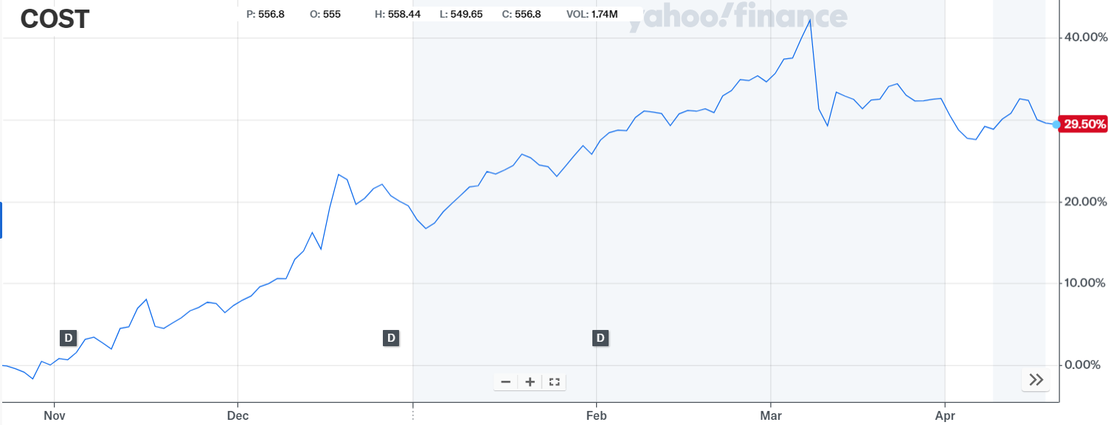
Costco wholesale CORP.
Costco is an American multinational company that operates chain, membership only warehouse clubs. The company is the third largest retailed in the world, and the world's largest retailer of beef, organic foods, rotisserie chicken and wine.
Costco employs 304,000 full-time and part-time employees worldwide, and operates 591 warehouses in the US, and 861 in total globally. They have 124.7 million members.
Date Acquired | 10/24/2023
Number of Shares | 35.89
Acquisition PPS | $551.46
Cost Basis | $19,790.80
Market Value (4/17/2024): $715.19 -$0.78 (-0.11%)

Slide 53
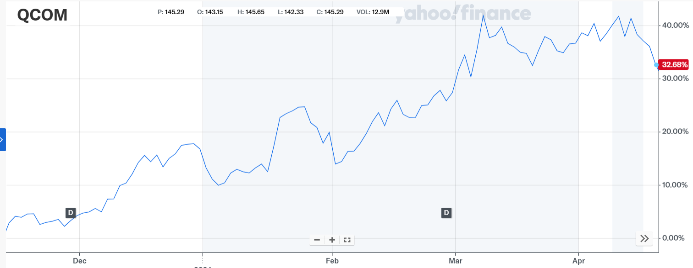
Qualcomm inc.
Qualcomm is leading American semiconductor and telecommunications company in the technology sector that specializes in mobile processors, wireless technologies and is a key player in 5G development.
The company is known for its Snapdragon processors and holds significant patents in mobile tech. They generate revenue through licensing.
Date Acquired | 11/14/2023
Number of Shares | 120.69
Acquisition PPS | $126.82
Cost Basis | $15,305.53
Market Value (4/17/2024): $164.32 -$4.26 (-2.53%)

Slide 54
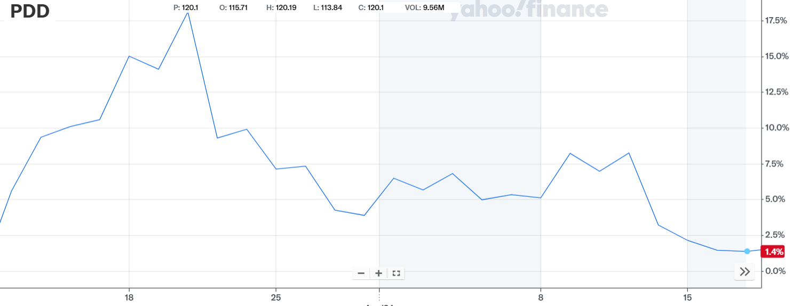
PDD Holdings inc.
PDD Holdings Inc is a multinational commerce group in the internet retail industry that operates Pinduoduo, an e-commerce platform that offers products in various categories, and Temu which is an online marketplace.
They aim to bring more business and people into the digital economy so that local communities and small businesses can benefit from the increased productivity and new opportunities.
Date Acquired | 3/12/2024
Number of Shares | 80.00
Acquisition PPS | $118.31
Cost Basis | $9,464.80
Market Value (4/17/2024): $113.43 -$0.09 (-0.08%)

Slide 55
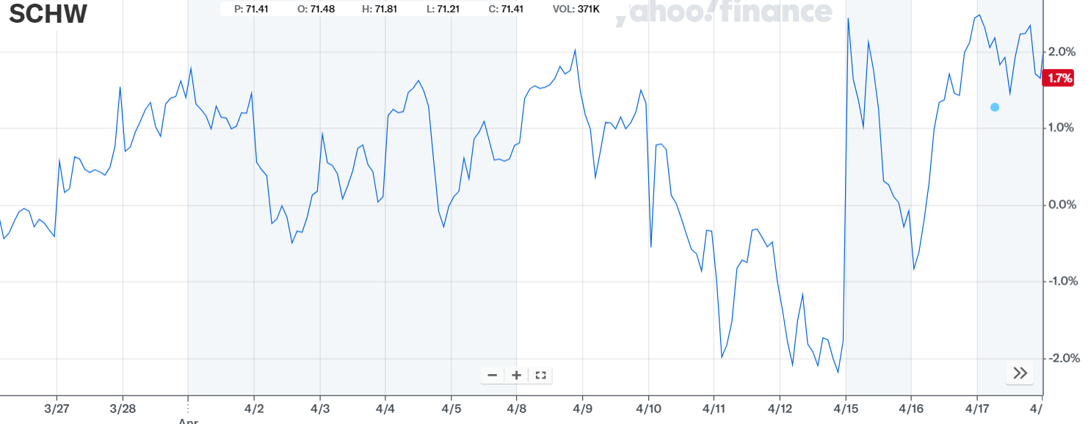
The Charles Schwab Corp
Charles Schwab is a financial services company that offers consulting, wealth management and advisory services in both retail and institutional platforms.
Pioneered discount sales of equity securities.
They have over 380 branches in the United States and the United Kingdom and have $8.5 trillion in client assets, and 34.8 million in active brokerage accounts
Date Acquired | 3/26/2024
Number of Shares | 140.00
Acquisition PPS | $71.30
Cost Basis | $9,982.00
Market Value (4/17/2024): $72.50 -$0.57 (-0.78%)

Slide 56
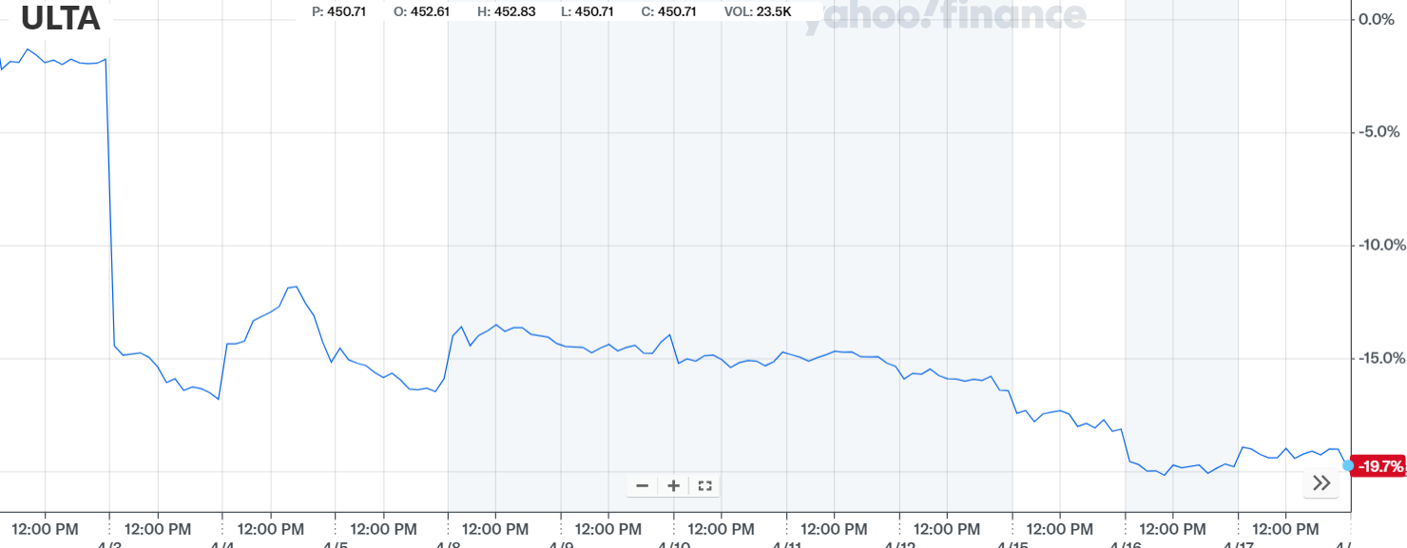
Ulta beauty
Ulta is an American beauty retail chain in the consumer discretionary sector. $21 billion dollar market cap
They offer a wide range of beauty products including cosmetics, fragrances, nail care, bath and body items, haircare products, and beauty tools. Some stores feature a beauty salon
There are 1,385 Ulta stores in all 50 states and over 350 Ulta Target locations
Date Acquired | 4/2/2024
Number of Shares | 32.00
Acquisition PPS | $460.99
Cost Basis | $14,751.68
Market Value (4/17/2024): $424.55 $0.28 (0.09%)

Slide 57
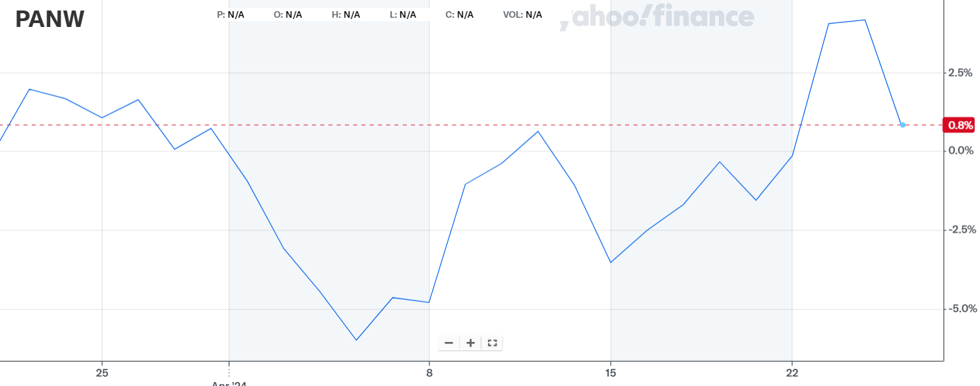
Palo alto networks inc.
An American global cybersecurity leader dedicated to protecting the digital way of life and enabling cyber transformation
Offer products/services such as network and cloud security, endpoint protection and cloud delivered services
Date Acquired | 4/11/2024
Number of Shares | 55.00
Acquisition PPS | $279.00
Cost Basis | $15,345.00
Market Value (4/17/2024): $277.33 $2.31 (0.84%)

Slide 58
Value Strategy

Slide 59
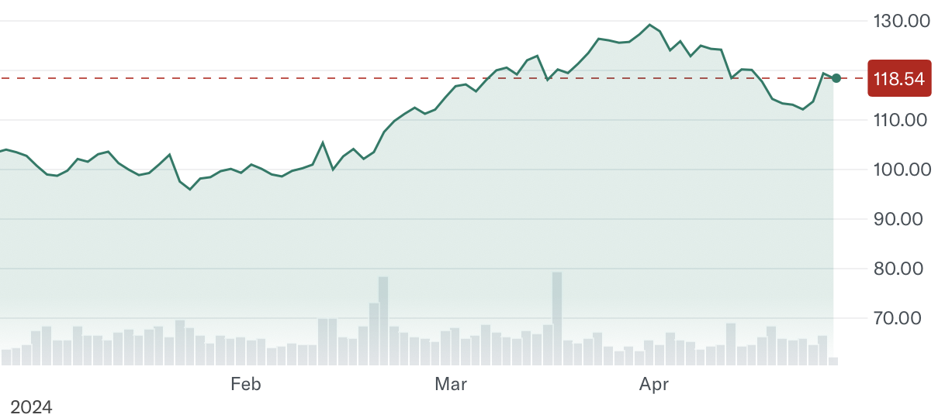
Toll Brothers Inc.
Consumer Staples
Toll Brothers offers a range of home styles including traditional, modern, and contemporary, tailored to the luxury market. Toll Brothers operates across several states, also developing luxury apartment communities and high-end student housing
Existing-home inventory still at historical lows, pushing consumers to buy into new developments
Toll Brothers increased their guidance for Q4 with increased net signed contracts for the quarter.
High demand for housing amidst decade-low existing home supply
Acquisition price: $85.42
Date purchased: 11/21/23
Number of shares: 230.49
Cost basis: $19,668.63

Slide 60
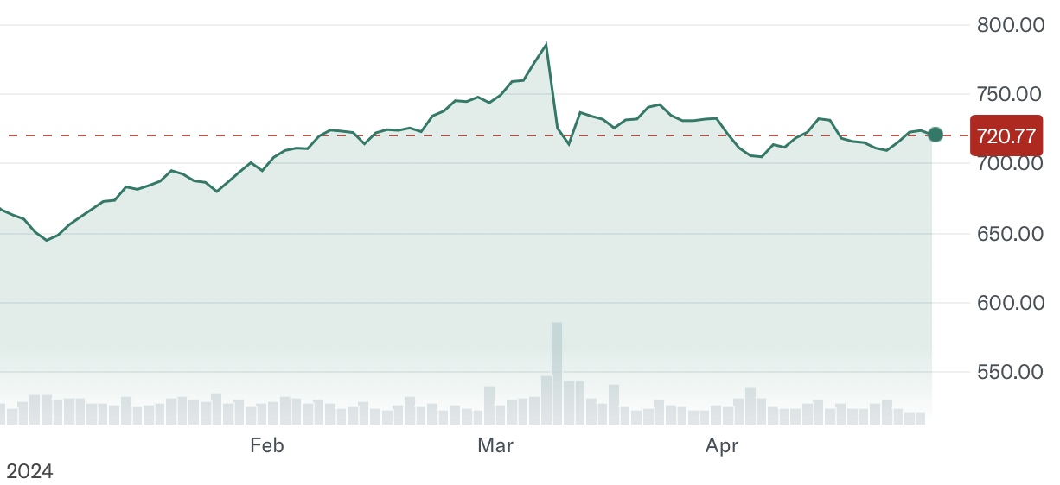
Costco Wholesale Corp.
Consumer Discretionary
Costco is the third largest retailer in the world, and the world’s largest retailer of beef, organic foods, rotisserie chicken, and wine
Costco is continuing to grow their Kirkland Signature brand, which helps to lower supplier costs and give them more control over operations
Costco has grown significantly more then the sector (XLP) YTD (22% vs. -9%) and over the past 5Y (154% vs. 25%)
Growing at a high rate, Costco possesses a strong balance sheet and is primed for future growth
Acquisition price: $551.46
Date purchased: 10/24/23
Number of shares: 35.89
Cost basis: $19,790.80

Slide 61
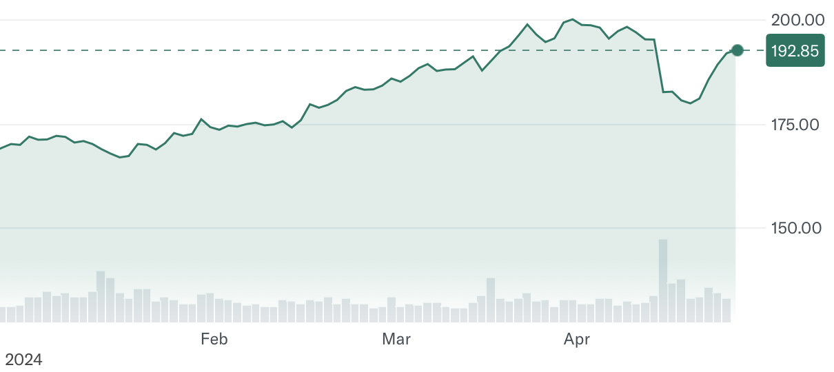
JP Morgan Chase & Co.
Financials
Global financial services firm with assets of $2.6 trillion and operations worldwide.
Has consumer and community banking, corporate and investment banking, commercial banking, and wealth/asset management.
The financials sector is a double-edged sword during periods of high inflation which poses a major growth opportunity
The financials sector has historically performed well year over year and the addition of JPM provides diversity to the portfolio in a sector the portfolio is underweight in
Acquisition price: $145.76
Date purchased: 10/10/23
Number of shares: 135.80
Cost basis: $19,794.4

Slide 62
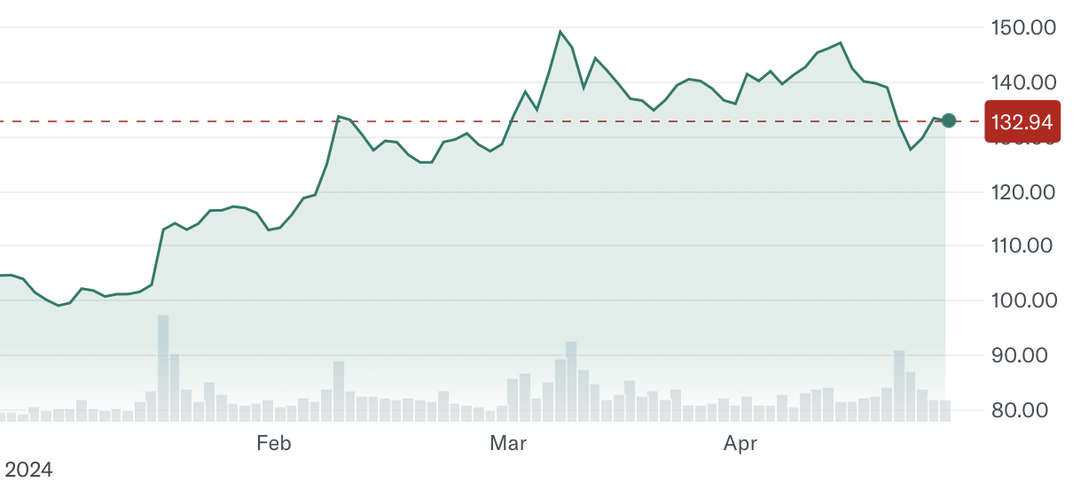
Taiwan Semiconductor Manufacturing Co. LTD
Technology
Taiwan Semiconductor Manufacturing Company Limited is a multinational semiconductor contract manufacturing and design company. It is the world's second most valuable semiconductor company.
TSMC is a global market leader in the manufacturing of semiconductors, with a market share of around 58%. TSMC employs more than 73,000 people and has a well-known cliental base, including Apple, AMD, and Nvidia.
Acquisition price: $135.42
Date purchased: 3/21/24
Number of shares: 80
Cost basis: $10,833.60

Slide 63
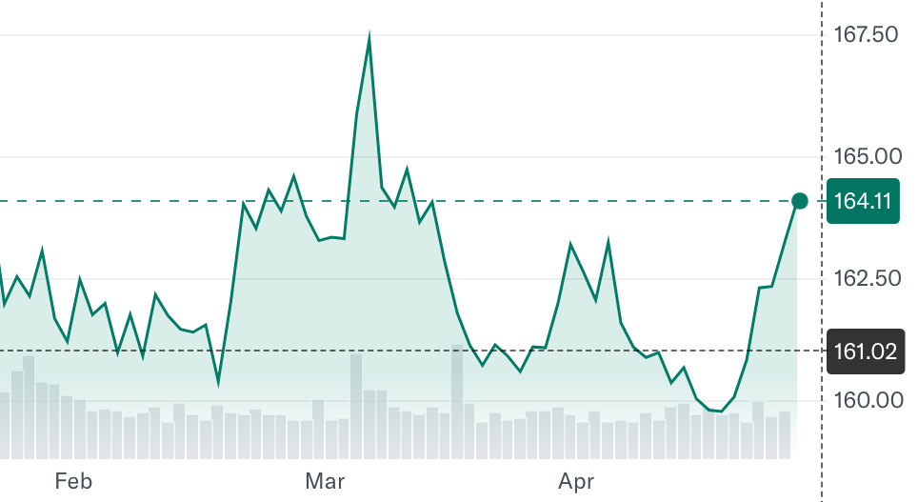
T-Mobile US Inc.
Communication Services
Founded in 1994, its services include voice, messaging, and data for postpaid, prepaid, wholesale, and other customers. Is the leader in 5G across the country for customers.
It is a mobile communications subsidiary of Deutsche Telekom.
Fund was underweighted in communication services when we voted to be overweight
Makes 77% of their revenue from postpaid mobile plans
Undervalued using Perpetuity Growth method & EBITDA Multiple Method
69% upside assuming 2% growth rate
80% of analysts rate it a buy
19 Billion in stock buybacks
Acquisition price: $161.76
Date purchased: 2/12/24
Number of shares: 60.24
Cost basis: $9744.42

Slide 64
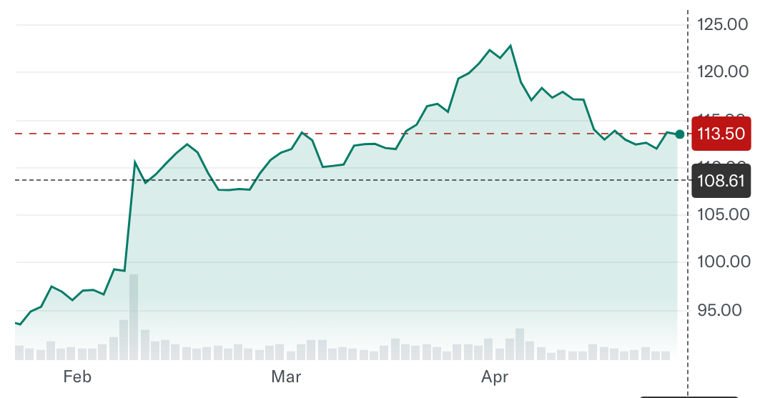
Walt Disney co. (DIS)
Consumer Discretionary
The Walt Disney Company, is a leading diversified international family entertainment and media enterprise that includes three core business segments: Disney Entertainment, ESPN, and Disney Experiences.
Most of its revenue comes from its streaming platforms which generates income from subscription fees and advertising.
We purchased them at this stage with the announcement of their merge with ESPN+ as part of their streaming.
Acquisition of Epic Games
Acquisition price: $108.25
Date purchased: 2/21/24
Number of shares: 100
Cost basis: $10,824.50

Slide 65
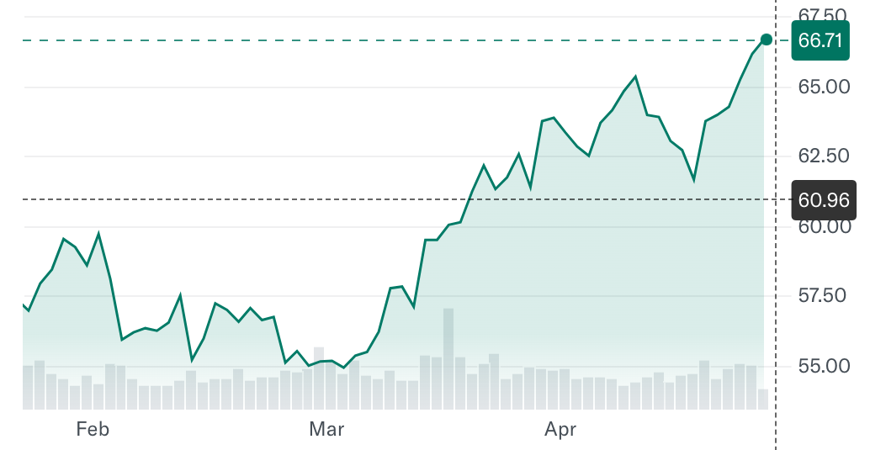
Nextera energy inc.
Utilities
NextEra Energy is a holding company that owns Florida Power & Light Company, the largest electric utility in America. They are a leader in battery storage technology. They are the world’s largest generator of renewable energy from wind and solar.
Most of its revenue . from FP&LC electric sales
Projected growth of the renewable energy sector by 2030
High revenue and EPS growth over the last 3 years.
Undervalued by $13
AI demand and chip factories will cause demand for electricity to soar.
Acquisition price: $60.93
Date purchased: 3/21/24
Number of shares: 160
Cost basis: $9078.00

Slide 66
RISK ANALYSIS

Slide 67
Portfolio Risk analysis: Beta
SAP FUND ​
β 1.09
S&P 500 ​
β 1.00
VS
Highest Betas in SAP Fund
• NIVIDA Corporation (NVDA), Toll Brothers (TOL), and The Walt Disney Company (DIS)
Lowest Betas in SAP Fund
• Spok Holdings (SPOK), Vertex Pharmaceuticals (VRTX), and T-Mobile US, Inc (TMUS)
Risk = Reward
• As a group, we recognize the correlation between increased risk and potential for greater rewards. Therefore, we opted for stocks with betas near the industry average, aiming for performance that either matched or exceeded industry standards

Slide 68
Portfolio Risk Analysis: Beta

Slide 69
Portfolio Risk analysis: Sharpe Ratio
The Sharpe Ratio measures a portfolio’s return adjusted with risk when associated with the market. We assumed the risk-free rate as a 10-year treasury bond (rate averaged between start and end date of the portfolio).
 | SAP Fund | S&P
Risk Free Rate | 4.67% | 4.67%
% Growth | 17.71% | 9.91%
Standard Deviation of Excess Returns | 0.21 | 0.18
Sharpe Ratio | 0.607 | 0.298

Slide 70
Correlation Matrix
Red represents a Weak Correlation between securities
The Correlation Matrix represents the correlation between each security through change in stock price day over day. A well-balanced portfolio would display lower values to illustrate a resilience when the market fluctuates.
Blue represents a Strong Correlation between securities
Weakest: (PDD & NVDA) (TSM & PDD)
Strongest: (NVDA & TSM) (NVDA & QCOM)
Date Range: 1/2/2024 - 4/26/2024
 |  | BAC | ULTA | SCHW | NEE | TSM | PDD | DIS | TMUS | NVDA | TOL | QCOM | FDX | ELV | PANW | COST | SPOK | JPM | META | TXRH | MSFT
BANK OF AMERICA CORPORATION | BAC | 1.00
ULTA BEAUTY, INC. | ULTA | -0.26 | 1.00
THE CHARLES SCHWAB CORPORATION | SCHW | 0.74 | 0.32 | 1.00
NEXTERA ENERGY, INC. | NEE | 0.69 | -0.74 | 0.23 | 1.00
Taiwan Semiconductor Manufacturing Co., Ltd. | TSM | 0.70 | 0.11 | 0.69 | 0.15 | 1.00
PDD Holdings Inc. | PDD | -0.63 | -0.05 | -0.54 | -0.15 | -0.86 | 1.00
THE WALT DISNEY COMPANY | DIS | 0.78 | 0.08 | 0.73 | 0.28 | 0.93 | -0.81 | 1.00
T-MOBILE US, INC. | TMUS | 0.02 | 0.24 | 0.17 | -0.23 | 0.01 | 0.03 | -0.07 | 1.00
NVIDIA CORPORATION | NVDA | 0.77 | 0.13 | 0.75 | 0.22 | 0.96 | -0.85 | 0.93 | 0.03 | 1.00
TOLL BROTHERS, INC. | TOL | 0.88 | 0.02 | 0.84 | 0.45 | 0.83 | -0.71 | 0.86 | 0.12 | 0.91 | 1.00
QUALCOMM INCORPORATED | QCOM | 0.78 | 0.02 | 0.76 | 0.29 | 0.94 | -0.78 | 0.88 | 0.07 | 0.94 | 0.90 | 1.00
FEDEX CORPORATION | FDX | 0.84 | -0.42 | 0.62 | 0.76 | 0.54 | -0.49 | 0.63 | -0.13 | 0.61 | 0.78 | 0.68 | 1.00
ELEVANCE HEALTH, INC. | ELV | 0.76 | -0.07 | 0.50 | 0.38 | 0.71 | -0.66 | 0.80 | -0.02 | 0.74 | 0.67 | 0.61 | 0.47 | 1.00
PALO ALTO NETWORKS, INC. | PANW | -0.69 | 0.21 | -0.50 | -0.56 | -0.43 | 0.42 | -0.46 | -0.19 | -0.52 | -0.74 | -0.58 | -0.64 | -0.39 | 1.00
COSTCO WHOLESALE CORPORATION | COST | 0.42 | 0.43 | 0.55 | -0.24 | 0.81 | -0.70 | 0.74 | 0.23 | 0.82 | 0.61 | 0.69 | 0.16 | 0.62 | -0.19 | 1.00
Spok Holdings, Inc. | SPOK | -0.12 | 0.76 | 0.34 | -0.69 | 0.30 | -0.28 | 0.16 | 0.34 | 0.28 | 0.09 | 0.19 | -0.36 | 0.07 | 0.21 | 0.58 | 1.00
JPMORGAN CHASE & CO. | JPM | 0.92 | 0.02 | 0.88 | 0.45 | 0.84 | -0.71 | 0.90 | 0.07 | 0.90 | 0.96 | 0.88 | 0.76 | 0.75 | -0.66 | 0.63 | 0.12 | 1.00
Meta Platforms, Inc. | META | 0.65 | 0.16 | 0.64 | 0.09 | 0.94 | -0.86 | 0.92 | -0.08 | 0.93 | 0.78 | 0.84 | 0.46 | 0.74 | -0.39 | 0.84 | 0.31 | 0.81 | 1.00
TEXAS ROADHOUSE, INC. | TXRH | 0.80 | 0.09 | 0.70 | 0.27 | 0.90 | -0.80 | 0.93 | 0.10 | 0.94 | 0.87 | 0.86 | 0.57 | 0.87 | -0.57 | 0.80 | 0.22 | 0.90 | 0.90 | 1.00
MICROSOFT CORPORATION | MSFT | 0.53 | 0.18 | 0.68 | 0.07 | 0.85 | -0.74 | 0.81 | -0.22 | 0.84 | 0.68 | 0.79 | 0.50 | 0.55 | -0.18 | 0.72 | 0.36 | 0.72 | 0.85 | 0.73 | 1.00

Slide 71
Covariance Matrix
Red represents an Inverse Correlation between securities
Blue represents a Strong Correlation between securities
The Covariance Matrix assesses the relationship between two vectors (securities). Larger outputs simulate that these investments react similarly when the sample market condition is met..
Weakest: (NEE & NVDA) (TSM & NEE)
Strongest: (NVDA & TSM) (NVDA & META)
Date Range: 1/2/2024 - 4/26/2024
Company Name |  | BAC | ULTA | SCHW | NEE | TSM | PDD | DIS | TMUS | NVDA | TOL | QCOM | FDX | ELV | PANW | COST | SPOK | JPM | META | TXRH | MSFT
BANK OF AMERICA CORPORATION (XNYS:BAC) | BAC | 0.000185
ULTA BEAUTY, INC. (XNAS:ULTA) | ULTA | 0.000024 | 0.000482
THE CHARLES SCHWAB CORPORATION (XNYS:SCHW) | SCHW | 0.000057 | 0.000023 | 0.000041
NEXTERA ENERGY, INC. (XNYS:NEE) | NEE | 0.000091 | 0.000028 | 0.000052 | 0.000240
Taiwan Semiconductor Manufacturing Co., Ltd. (XNYS:TSM) | TSM | (0.000011) | 0.000049 | 0.000032 | (0.000053) | 0.000587
PDD Holdings Inc. (XNAS:PDD) | PDD | 0.000045 | 0.000009 | 0.000029 | 0.000054 | 0.000075 | 0.000729
THE WALT DISNEY COMPANY (XNYS:DIS) | DIS | 0.000028 | 0.000078 | 0.000035 | 0.000031 | 0.000106 | (0.000008) | 0.000325
T-MOBILE US, INC. (XNAS:TMUS) | TMUS | 0.000010 | (0.000007) | 0.000010 | 0.000014 | (0.000017) | (0.000017) | (0.000012) | 0.000031
NVIDIA CORPORATION (XNAS:NVDA) | NVDA | (0.000052) | 0.000107 | 0.000022 | (0.000105) | 0.000419 | 0.000184 | 0.000017 | (0.000025) | 0.001123
TOLL BROTHERS, INC. (XNYS:TOL) | TOL | 0.000106 | 0.000017 | 0.000076 | 0.000093 | 0.000122 | 0.000072 | 0.000034 | 0.000023 | 0.000192 | 0.000383
QUALCOMM INCORPORATED (XNAS:QCOM) | QCOM | 0.000041 | 0.000003 | 0.000042 | (0.000032) | 0.000278 | 0.000120 | 0.000039 | (0.000005) | 0.000269 | 0.000138 | 0.000346
FEDEX CORPORATION (XNYS:FDX) | FDX | 0.000059 | 0.000009 | 0.000034 | 0.000046 | 0.000007 | 0.000076 | 0.000006 | 0.000008 | 0.000058 | 0.000106 | 0.000039 | 0.000197
ELEVANCE HEALTH, INC. (XNYS:ELV) | ELV | 0.000035 | (0.000012) | 0.000012 | 0.000025 | (0.000032) | 0.000010 | 0.000001 | 0.000004 | (0.000024) | 0.000024 | (0.000021) | 0.000020 | 0.000088
PALO ALTO NETWORKS, INC. (XNAS:PANW) | PANW | 0.000049 | 0.000153 | 0.000005 | (0.000060) | 0.000109 | 0.000127 | 0.000123 | (0.000043) | 0.000314 | (0.000042) | 0.000075 | 0.000014 | 0.000007 | 0.001480
COSTCO WHOLESALE CORPORATION (XNAS:COST) | COST | 0.000024 | 0.000057 | 0.000023 | (0.000025) | 0.000124 | 0.000074 | 0.000014 | 0.000001 | 0.000207 | 0.000071 | 0.000080 | 0.000010 | (0.000008) | 0.000110 | 0.000154
Spok Holdings, Inc. (XNAS:SPOK) | SPOK | 0.000054 | (0.000002) | 0.000059 | 0.000058 | 0.000106 | 0.000018 | 0.000057 | 0.000013 | 0.000261 | 0.000203 | 0.000105 | 0.000036 | 0.000021 | 0.000071 | 0.000049 | 0.000424
JPMORGAN CHASE & CO. (XNYS:JPM) | JPM | 0.000102 | 0.000017 | 0.000045 | 0.000048 | 0.000024 | 0.000065 | 0.000033 | 0.000015 | 0.000044 | 0.000090 | 0.000042 | 0.000038 | 0.000024 | (0.000006) | 0.000020 | 0.000065 | 0.000132
Meta Platforms, Inc. (XNAS:META) | META | 0.000041 | 0.000035 | 0.000041 | (0.000033) | 0.000232 | 0.000103 | 0.000025 | (0.000022) | 0.000388 | 0.000117 | 0.000137 | 0.000026 | (0.000033) | 0.000194 | 0.000117 | 0.000126 | 0.000051 | 0.000951
TEXAS ROADHOUSE, INC. (XNAS:TXRH) | TXRH | 0.000031 | 0.000059 | 0.000023 | 0.000016 | 0.000049 | 0.000046 | 0.000043 | 0.000002 | 0.000136 | 0.000046 | (0.000018) | 0.000028 | 0.000045 | 0.000110 | 0.000042 | 0.000060 | 0.000029 | 0.000060 | 0.000259
MICROSOFT CORPORATION (XNAS:MSFT) | MSFT | 0.000010 | 0.000053 | 0.000030 | 0.000013 | 0.000142 | 0.000073 | 0.000027 | (0.000009) | 0.000199 | 0.000077 | 0.000088 | 0.000036 | (0.000006) | 0.000119 | 0.000065 | 0.000086 | 0.000018 | 0.000209 | 0.000035 | 0.000148

Slide 72
Performance Review

Slide 73
PERFORMANCE REVIEW
This performance review will analyze the portfolio for the Spring Session of 2024
This section will detail the following:
Performance against the index.
Overview of the best and worst performing stocks and ETFs.
This review will analyze data from 1/30/2024 through 4/26/2024.
Active Management began with recommendations and trade execution on 1/30/2024.

Slide 74
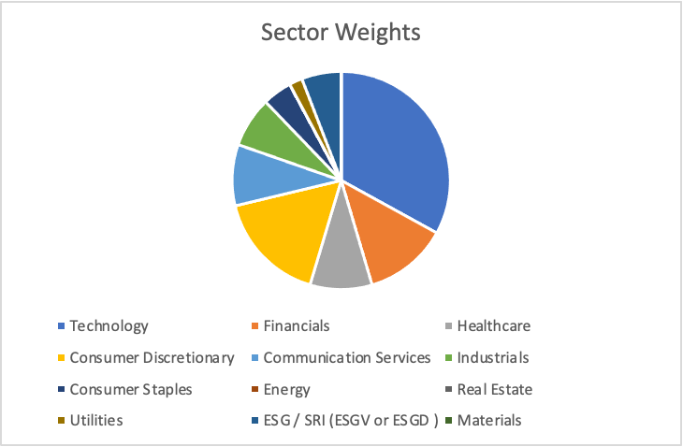
PORTFOLIO CONTRIBUTIONS

Slide 75
OVERALL RETURN ANALYSIS
Top overall performers came from a variety of different sectors, including Technology, Consumer Discretionary, Healthcare, Utilities and Financials.
All ETFs finished positive from the original purchase date (9/20/23) except the Energy ETF (XLE) which was sold at a loss.
The class made the decision not to allocate funds for energy, materials, or real estate stocks.

Slide 76
Reflects total return from Acquisition through 4/26/24
BEST RETURNS Spring 2024
+40.08%
1/30 - 4-26
+9.30%
3/12 - 4/26
+8.40%
14/11 - 4/26
+8.30%
3/19 - 4/26
+5.18%
3/26 - 4/26

Slide 77
Reflects total return from Acquisition through 4/26/24
WORST RETURNS SPRING 2024
-11.84%
4/4 - 4/26

Slide 78
Cooling demand in retail beauty category caused ulta's stock price to plummet
BIGGEST LOSS
Ulta shares fell 15% on Wednesday April 3rd as the CEO Dave Kimbell stated that demand in the beauty category has fell sooner and "bigger than expected" this year
Kimbell added this trend is continuous across price points and product categories in the industry
The market dynamics which caused this slowing in demand can be attributed to rising credit card debt in the country harming consumers spending capacity and geopolitical conflicts
The beauty industry has also become more crowded in the past year as Kohl's announced opening Sephora shops in all their locations.
After the fund added Ulta on April 4th for $460.99, the share price continued to drop on the news and increased economic uncertainty

Slide 79
 | Sellinger Applied Portfolio | S&P 500
Market Value (9/20/24) | $500,000.00 | 4,924.97
Market Value (4/26/24) | $608,354.94 | 5,099.96
Raw Return | 19.26% | 14.81%
Annualized Return | 34.26% | 25.36%

Slide 80
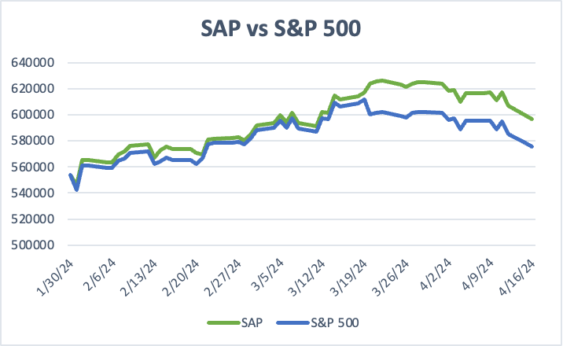

Slide 81
INDIVIDUAL RETURNS

Slide 82
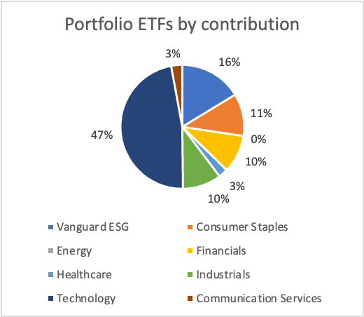
WHOLE YEAR ETF PERFOMANCE
Reflects returns for the period of 9/20/23 - 4/26/24, for the ETFs that were not sold during the management period

Slide 83
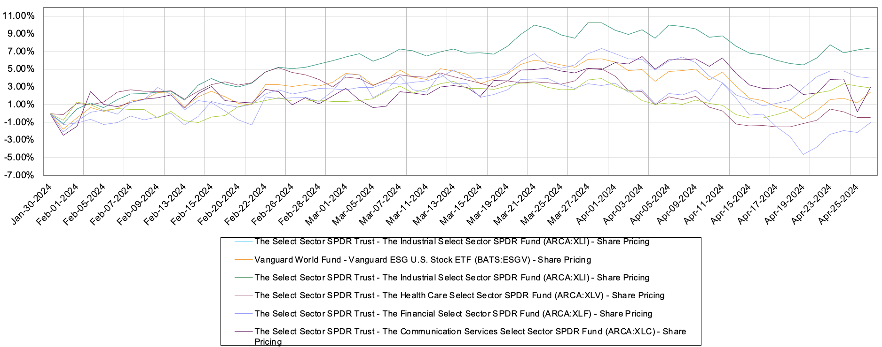
SP24 ETF PERFOMANCE

Slide 84
CONCLUSIONS
Our investments were primarily on stocks selected from the Growth Strategy as we had a shorter time horizon (5 months).
The top overall performer benefited from continued growth speculations around artificial intelligence.
Only one holding is meaningfully in the red due to a statement from the CEO and other economic uncertainty.
ETFs performed well and all finished positive except for the Energy ETF that was sold as a slight loss.
Portfolio beat the S&P 500 by 4.9% from 1/30/24 - 4/26/24

