Slide 1


Sellinger Applied Portfolio
Spring 2022

Slide 2
Executive
Summary
01
02
03
Class
Overview
Economic Outlook
Sector Summaries
04
05
06
Portfolio Strategy and Composition
Risk Analysis
Performance Review
Highlight the biggest takeaways form the class
Current state of the economy and future conditions
Portfolio sector perfromances compared to the benchmark
07
The ones that got away
Covering Growth, Value, and Dividend Strategies
Overall risk sensitivity with high and low risk securities
Overall review of our portfolio’s performance
Overview of securities we missed opportunities on

Slide 3

Class
Overview
01

Slide 4

Class Overview
SAP Fund
The Sellinger Applied Portfolio class is a class designed to give students exposure to practical management of a portfolio.
Students learn topics like asset allocation and valuation, asset selection, risk management and performance evaluation.

Slide 5

Biggest Takeaways and Lessons Learned
“Learning how to screen for securities” – Nick Darcy
“How to pitch securities to a class of diverse mindsets” – Nicklaus Palmesano
“Staying updated on current events in the market and watching how it influences a portfolio” – Melina Connolloy
“How important understanding the basics of a business’s operations are to understanding financial ratios” – Dominik Pajor
“Discussion and group-think is better than individual research”
– Josh Long

Slide 6

Economic Outlook
02
Will Provide a brief overview of the markets and economy during our time with the portfolio and provide some guidance moving forward.

Slide 7
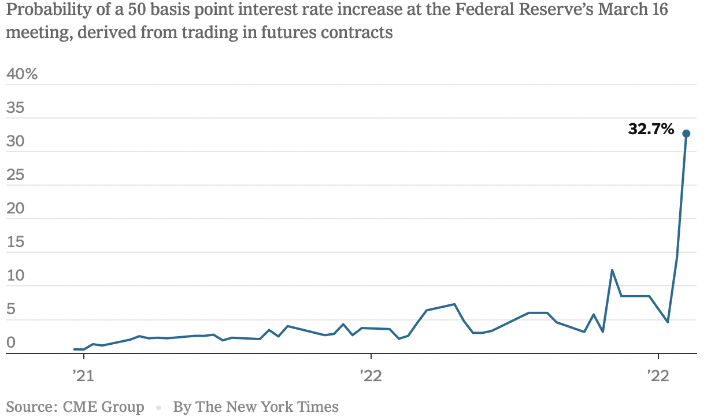
January
January saw the economy recovering and managing through another COVID-19 winter. Supply chain issues became a real factor in January as an increase in infections led to an abundance of delays in the supply chain.
Inflation towards the end of January specifically, began to come on extremely strong. The uncertainty of rising inflation scared investors. Gas and grocery prices began to hike in January and were driving inflation.
Unemployment rates approached a pandemic low of 4%. Overall, January was filled with uncertainty largely due to the pandemic.

Slide 8
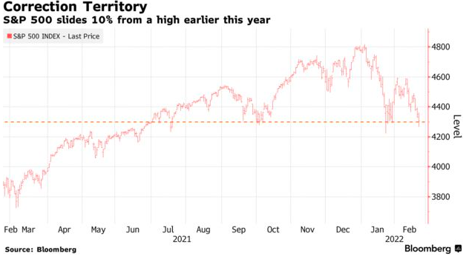
February
Following the technology sell off the economy looked poised for more growth going through the rest of 2022. Unfortunately, February turned out to be an unprecedented month as President Putin of Russia sent nearly 200,000 troops to the border of Ukraine and invaded Ukraine on February 24th
The CPI posted its largest percent increase since January of 1982, at 7.9%.
Consequently, the S&P was unable to post any new closing highs signaling a momentum halt. The S&P ended down 3.14% and the DJIA finished down 3.53%. The United States placed strict sanctions on Russia and the S&P slid 10% from its January highs and entered correction territory

Slide 9
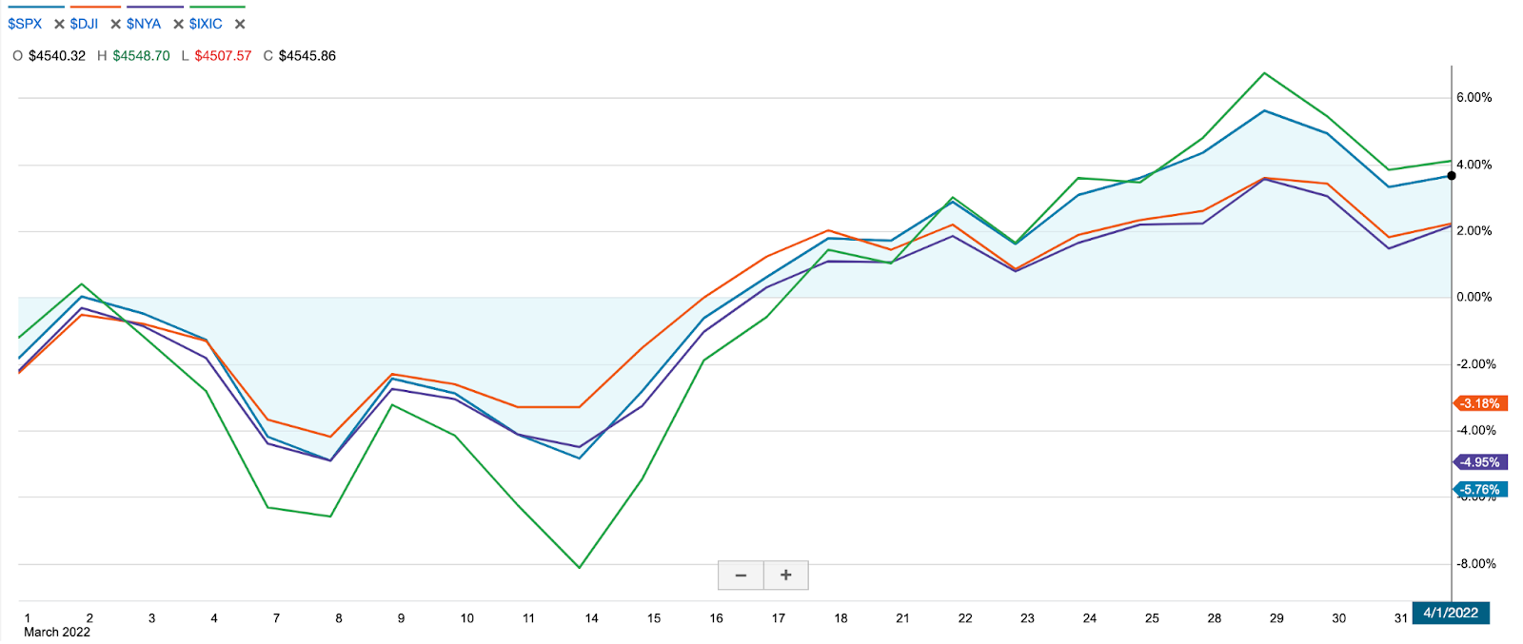
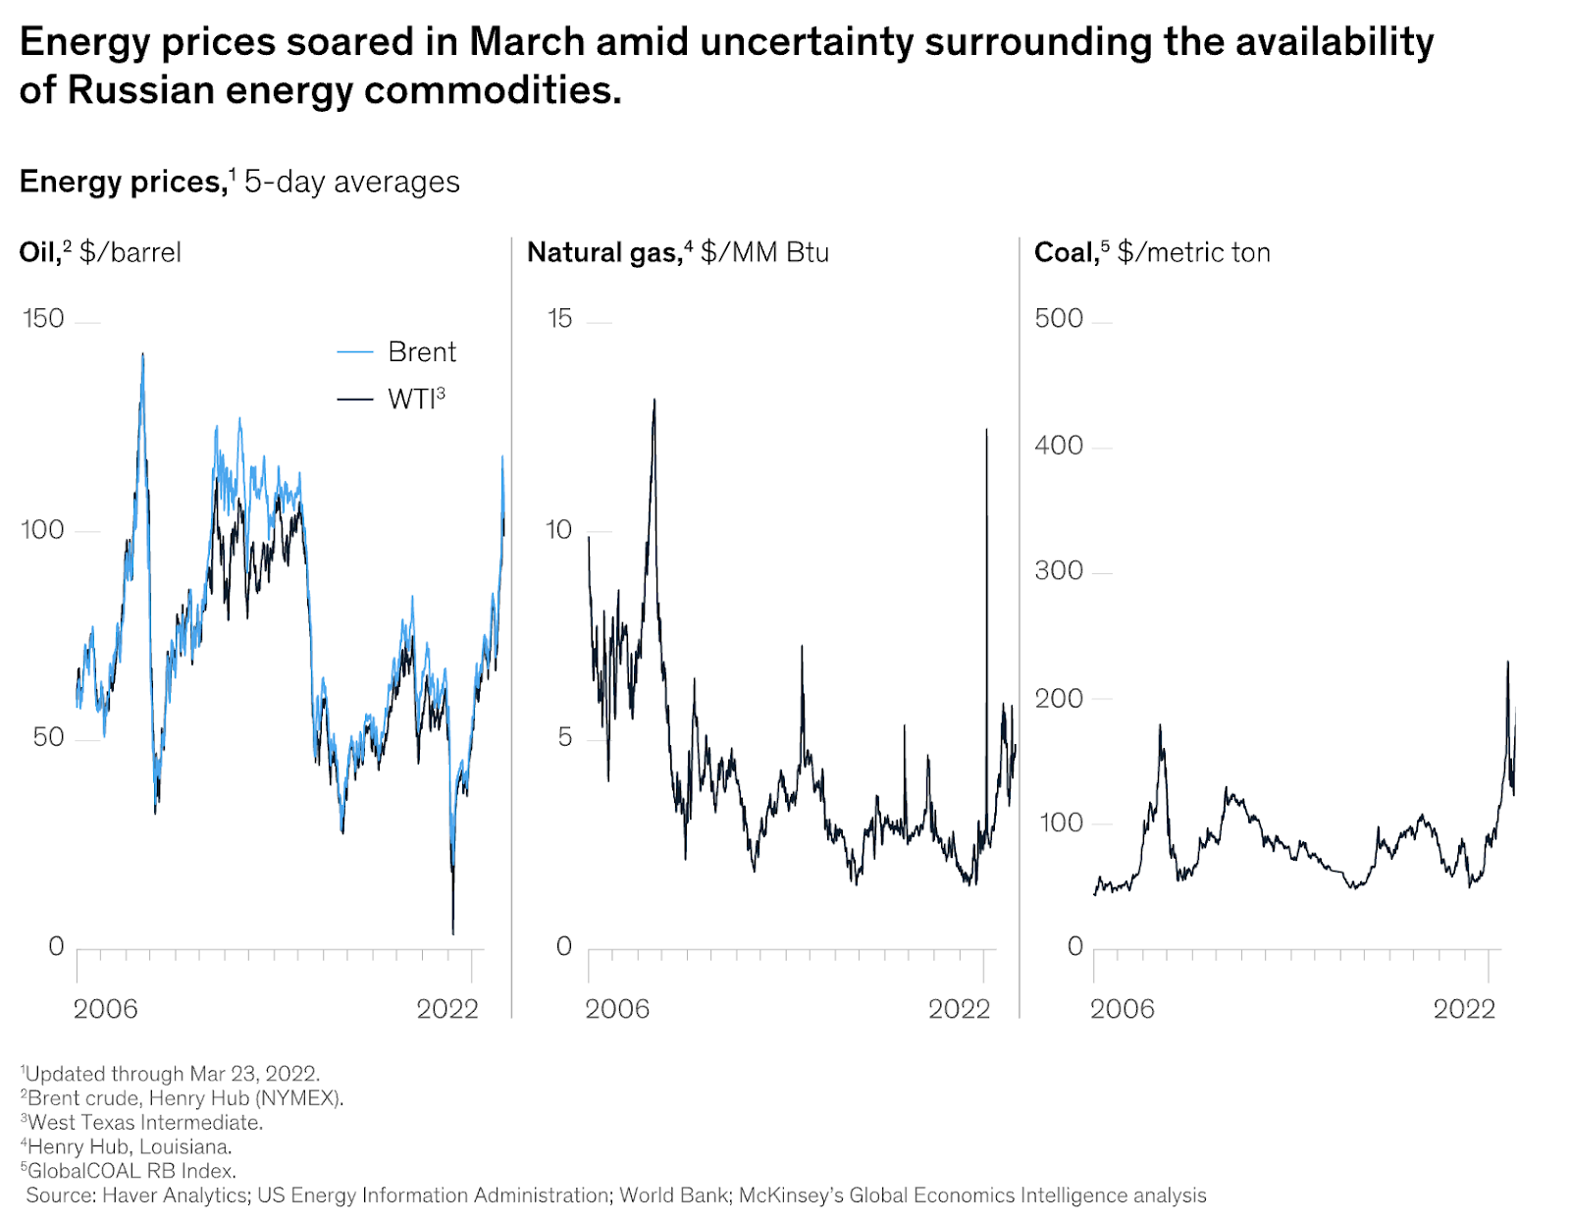
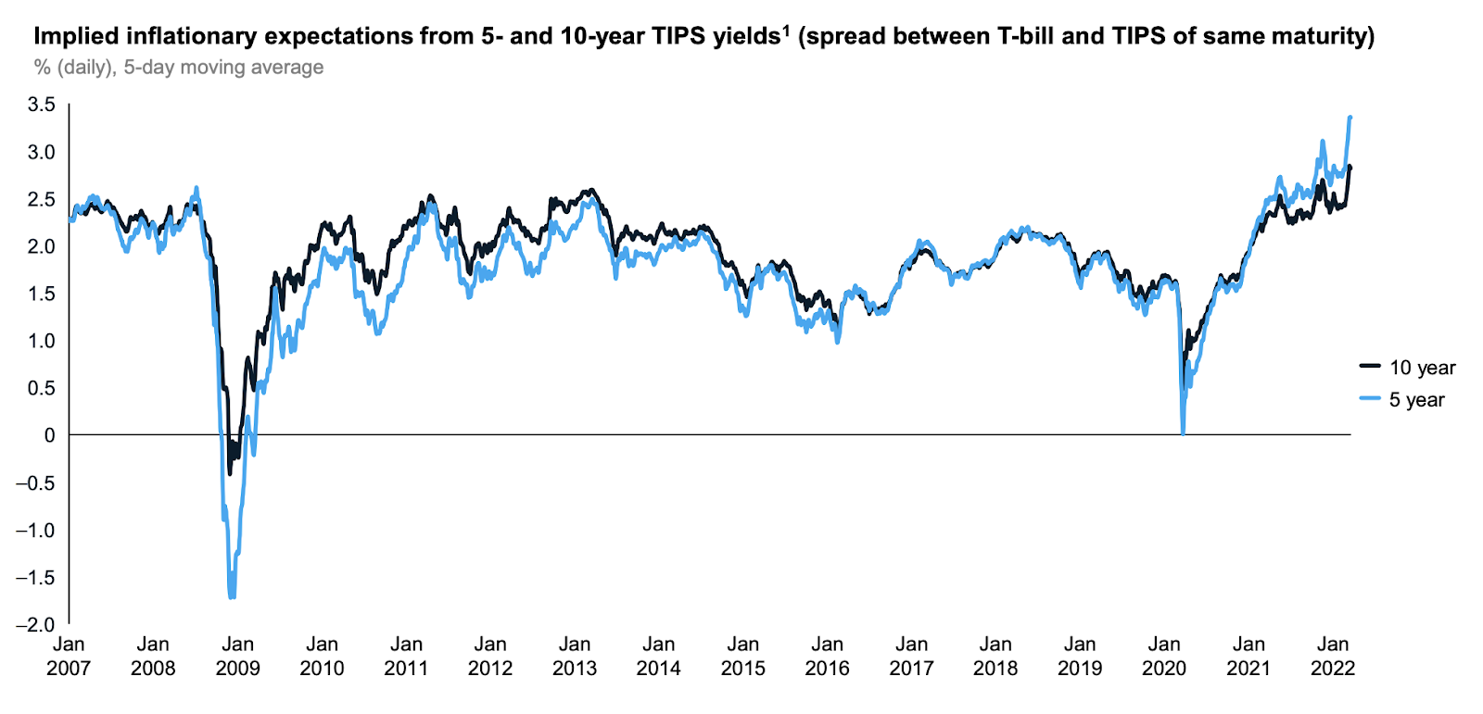
March
March’s economies displayed strong
resilience in the face of several major
macroeconomic headwinds
As a result of the Russia-Ukraine conflict
and sanctions placed on Russian, the
Brent crude price reached above $125 per
barrel, the highest price in a decade.
The CPI for All Urban Consumers rose 1.2% in March and 8.5% for the year. Increases in the indexes for gasoline, shelter, and food were the largest contributors. The gasoline index itself rose 18.3%.
The Federal Reserve made the first of several expected rate hikes, raising the benchmark interest by 25 basis points
March ended with an inverted US 2/10 YR spread, serving as a possible warning signal that a recession is on the horizon.

Slide 10
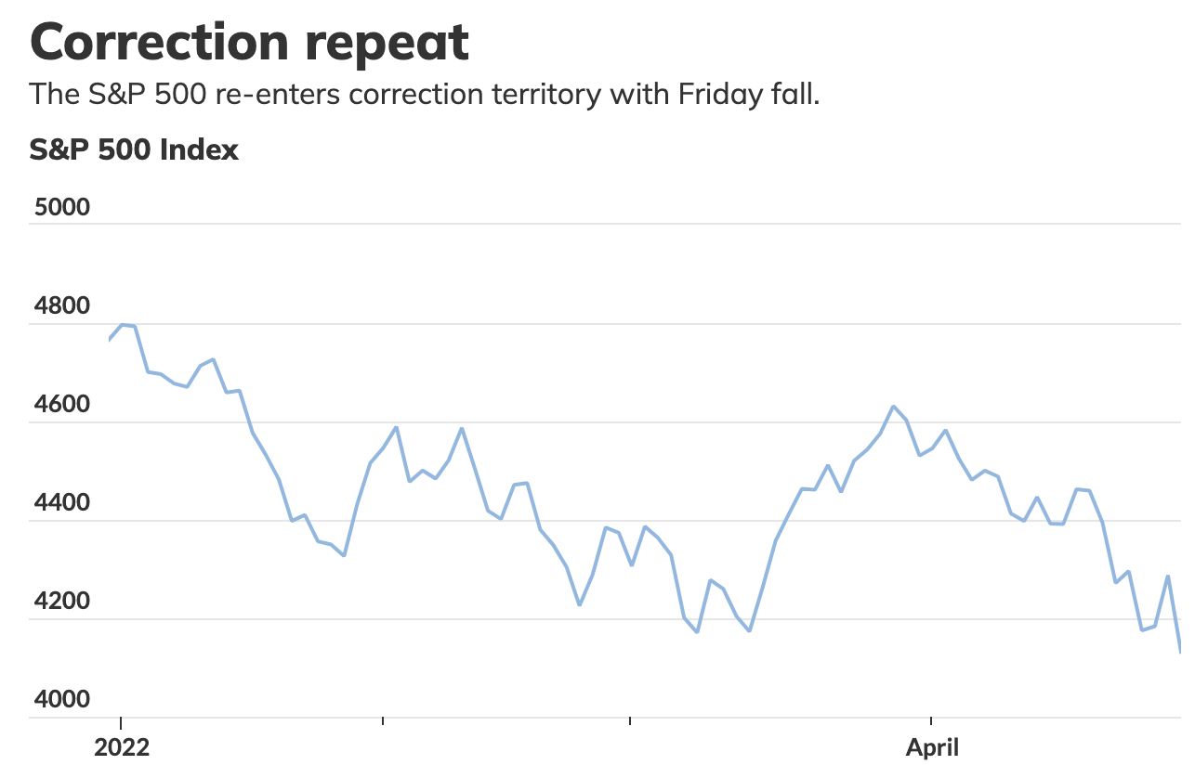
April
The U.S. economy faced declines because of tech companies' mixed results, inflation, and the Federal Reserve’s tightening of monetary policy. The S&P 500 ended April by dropping 10% from its recent peak.
The DJIA went down 4.9%, being the worst performance since 1970, and the Nasdaq Composite went down 12.3%, which was the biggest drop since 2000.
The U.S. bond market had their worst quarter in over forty years and yields on short- to medium-term Treasuries logged their biggest quarterly jumps in decades. Investors fear increasing rates will cause higher costs, a slowdown in spending, and potentially lead to a recession instead of a “soft landing”.

Slide 11
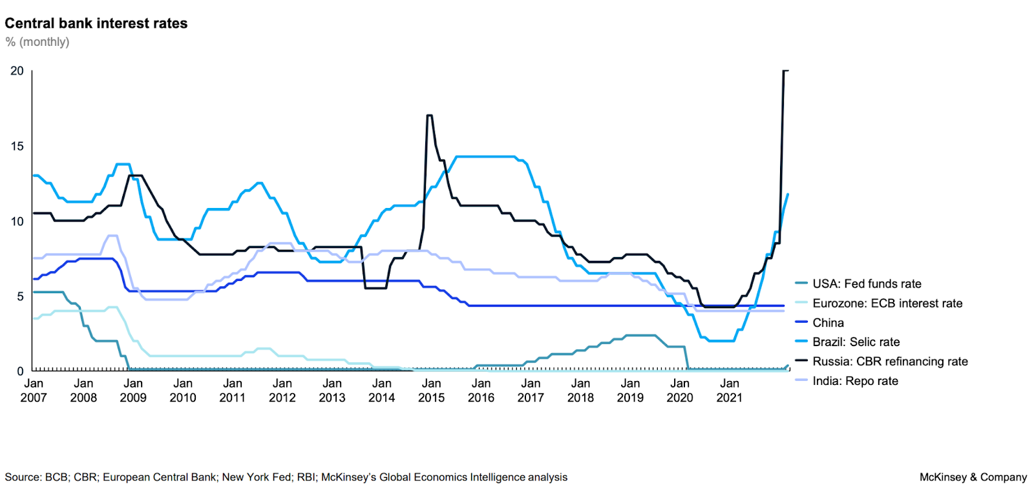
Outlook by Topic:
Federal Fund Rate Hikes
The FOMC will meet six more times throughout the 2022 fiscal year.
The Federal Reserve just announced a 50 basis point increase during its last meeting on May 4.
This raised the target rate from the current 25-50 bp to 75-100 bp. The market expects the federal funds rate to pass 3% by early 2023.

Slide 12
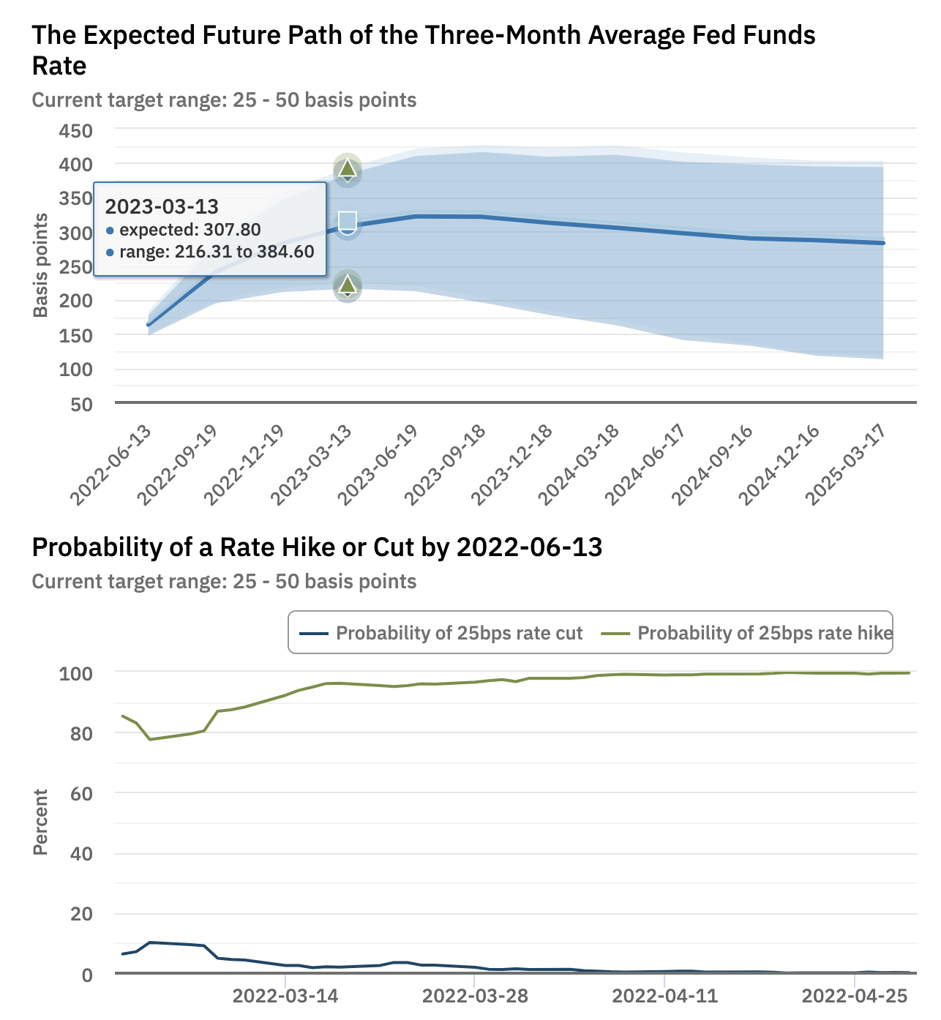
Federal Fund Rate Hike Expectations
The CME FedWatch Tool
Projections As of March 2, 2022:
May: 50 bp increase to a new target range of 70-100 bp
June: 75 bp increase to a new target range of 150-175 bp
July: 50 bp increase to a new target range of 200-225 bp
September: roughly equal odds for a new target range of 225-250 bp or 250-275 bp
November: roughly equal odds for a new target range of 250-275 bp or 275-300 bp
December: roughly equal odds for a new target range of 275-300 bp or 300-325 bp
Anticipates the target range most likely to be 350-375 bp by July 2023.
The Atlanta Fed Market Probability Tracker projections:
May and June: up a cumulative 130 to 163 bp
July through September: up a cumulative 77 to 240 bp
November and December: up a cumulative 43 to 283 bp

Slide 13
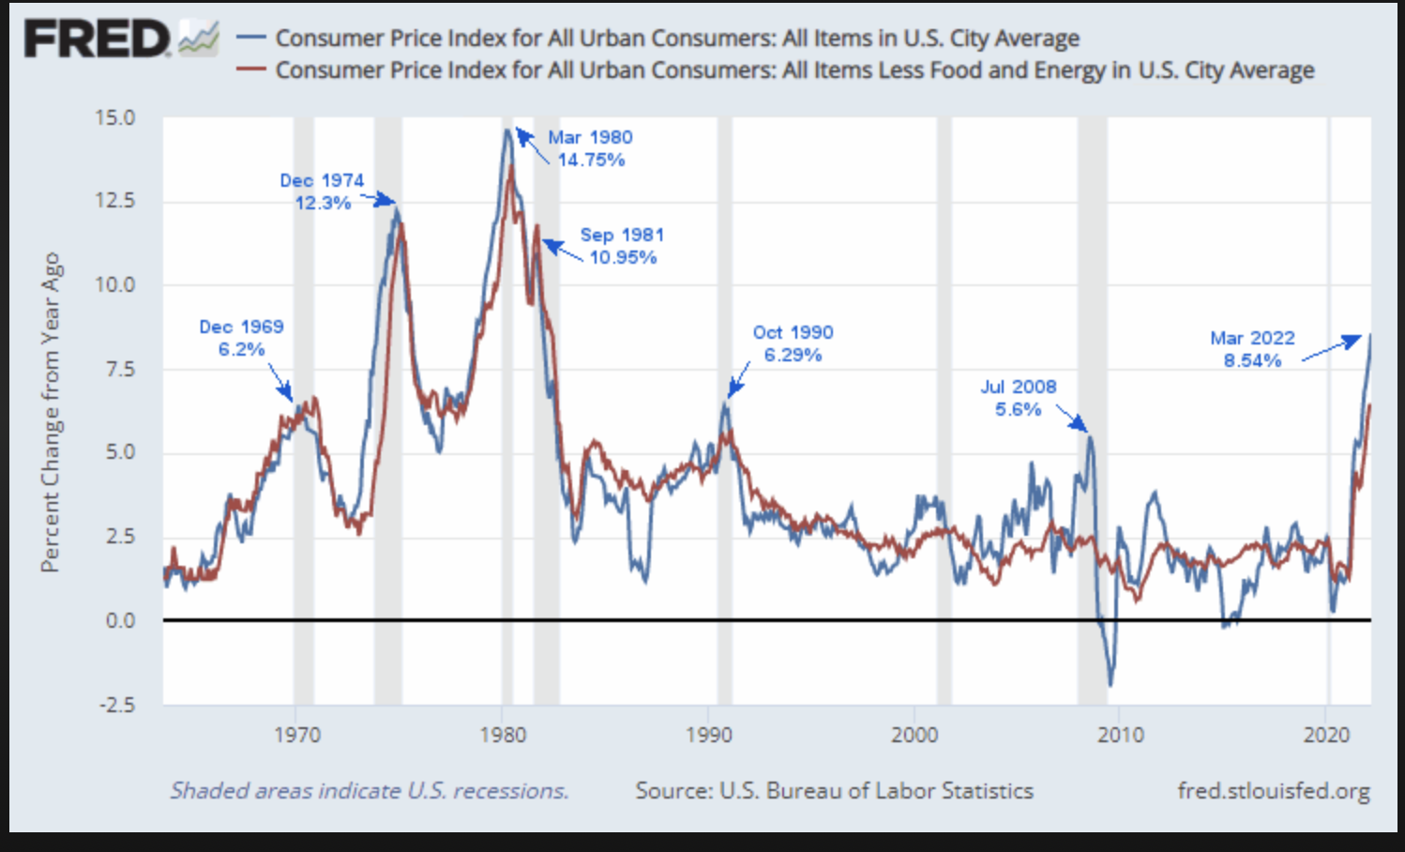
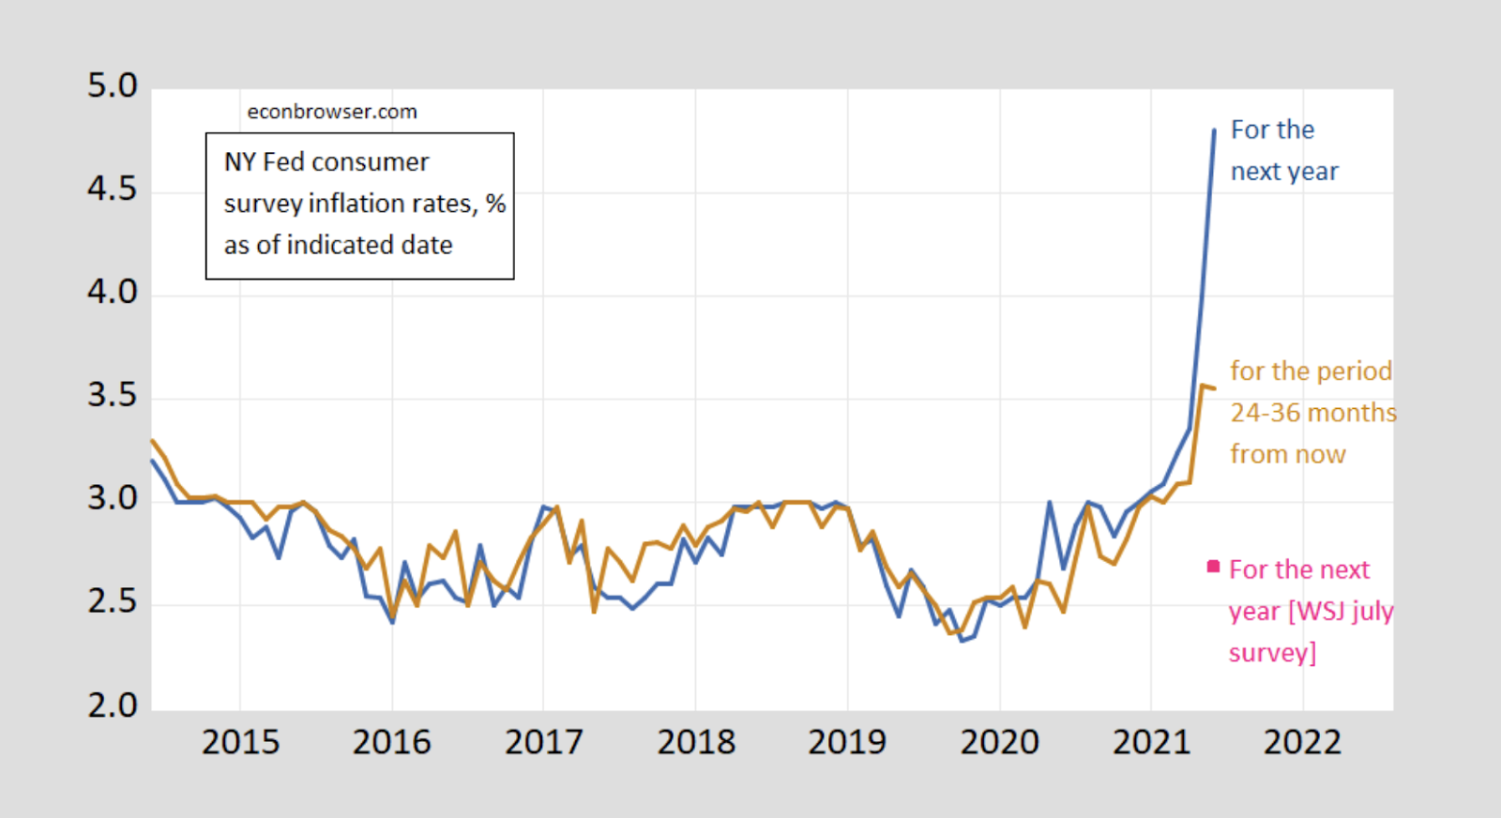
Inflation
Prices are rising at the fastest rate since the early 1980s. In March prices rose an incredible 8.5% compared to the year prior. The main task of the Federal Reserve currently is trying to control this inflation.
Inflation's main cause is due to various factors, such as COVID-19 and supply chain issues, the Energy crisis and fertilizer shortage seen with Russia and Ukraine. With many variables affecting inflation, it is difficult for the Federal Reserve to truly understand what inflation really looks like.

Slide 14
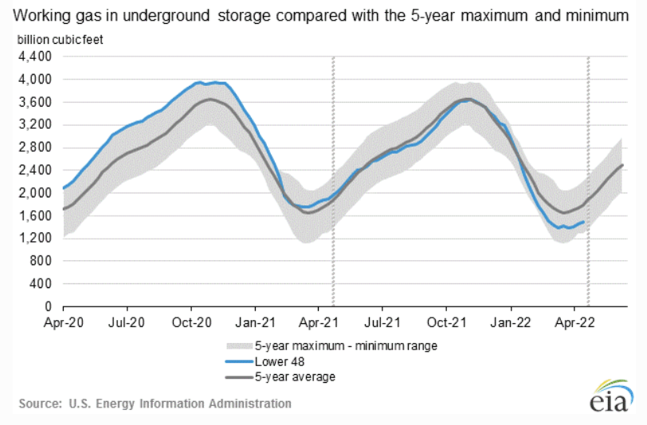
Energy Costs and Supply
The Henry Hub index price for U.S. natural gas dipped below $6.50 per Mmbtu. There was hope for some price relief for fertilizers, plastics, and chemicals, but prices increased to $7.00 due to decreasing domestic storage levels.
Russian/Ukraine conflict is causing high energy prices as it decreases the global supply. The West Texas Intermediate price of a barrel increased from $96 to $105 and the Russian-Ukraine conflict has continued to keep the global oil market under-supplied. AAA reports the average U.S. national price of gas was $4.19 per gallon and the price is expected to rise during the summer months.
Energy costs have been rising as prices for crude oil and gas increase.

Slide 15
Sector Summaries
03

Slide 16

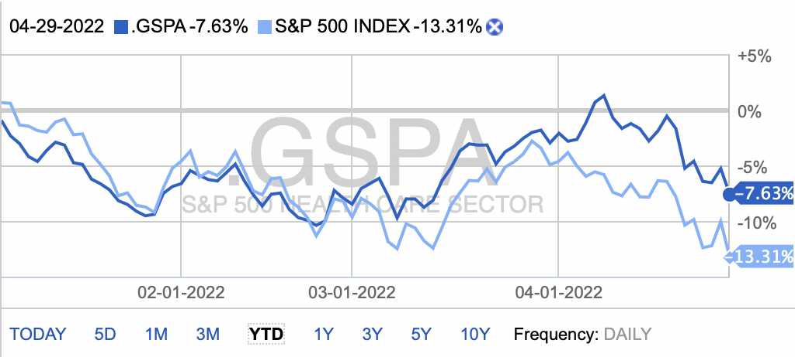
Healthcare
The healthcare sector consists of businesses that provide medical services, manufacture medical equipment of drugs, provide medical insurance, or facilitate the provision of healthcare to patients. The Health Care Sector encompasses two main industry groups. The first includes companies who manufacture health care equipment and supplies or provide health care related services, including distributors of health care products, providers of basic health-care services, and owners and operators of health care facilities and organizations. The second regroups companies primarily involved in the research, development, production and marketing of pharmaceuticals and biotechnology products.
Performance YTD
-7.63%
Portfolio Contribution
20.47%
Stocks Held in Portfolio
Sel Sector: H Care SPDR (ARCX: XLV)
Vertex Pharmaceuticals Incorporated (VRTX)
CVS Health Corporation (CVS)
Medtronic PLC (MDT)
Stocks to Watch
Jupiter Wellness Inc. (JUPW)
Vertex Pharmaceuticals (VRTX)
Teladoc Health (TDOC)

Slide 17
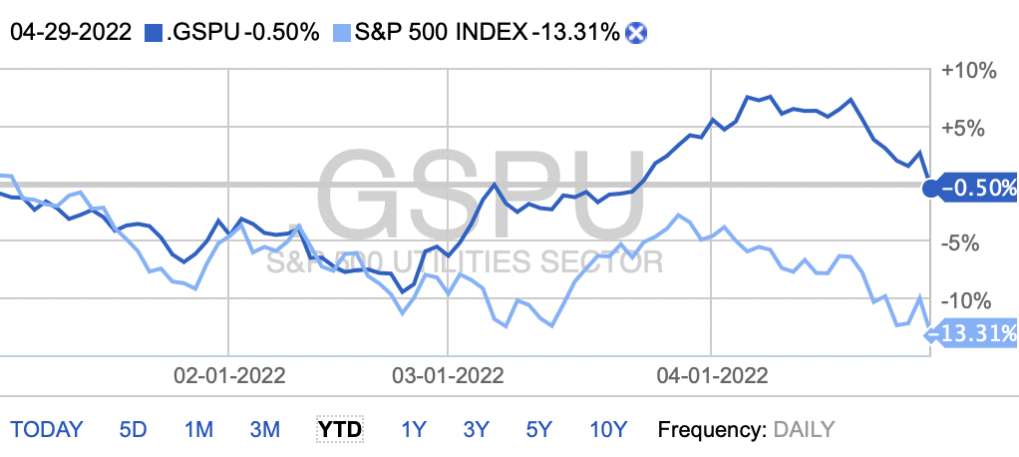
Utilities
The Utilities Sector encompasses those companies considered electric, gas or water utilities, or companies that operate as independent producers and/or distributors of power. It is comprised of establishments engaged in the provision of the following utility services: electric power, natural gas, steam supply, water supply, and sewage removal.
Performance YTD
-0.50%
Portfolio Contribution
0%
Stocks Held in Portfolio
N/A
Stocks to Watch
PG&E (PCG)
Black Hills (BKH)
UGI (UGI)

Slide 18
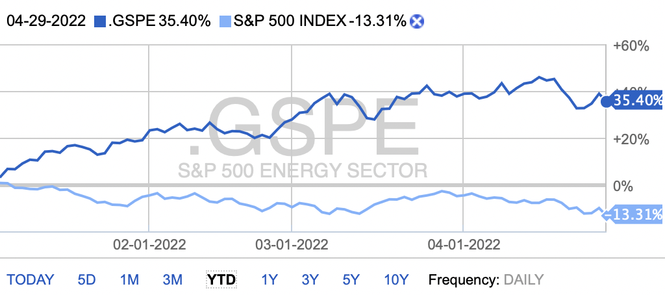
Energy
The Energy Sector comprises companies whose businesses are dominated by either of the following activities: The construction or provision of oil rigs, drilling equipment and other energy related service and equipment, including seismic data collection. Companies engaged in the exploration, production, marketing, refining and/or transportation of oil and gas products, coal and other consumable fuels.
Performance YTD
35.40%
Portfolio Contribution
5.90%
Stocks Held in Portfolio
Diamondback Energy, Inc. (FANG)
Energy Transfer UNT (ET)
Stocks to Watch
Chevron (CVX)
NextEra Energy (NEE)

Slide 19
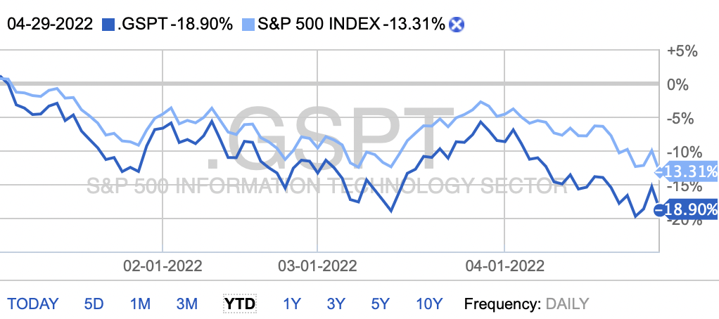
Information Technology
The Information Technology Sector covers the following general areas: firstly, Technology Software & Services, including companies that primarily develop software in various fields such as the Internet, applications, systems, databases management and/or home entertainment, and companies that provide information technology consulting and services, as well as data processing and outsourced services; secondly Technology Hardware & Equipment, including manufacturers and distributors of communications equipment, computers & peripherals, electronic equipment and related instruments; and thirdly, Semiconductors & Semiconductor Equipment Manufacturers.
Performance YTD
-18.90%
Portfolio Contribution
18.00%
Stocks Held in Portfolio
Sel Sector: Tech SPDR (ARCX: XLK)
Alphabet Inc. (GOOGL)
Advanced Micro Devices Inc. (AMD)
Microsoft Corporation (MSFT)
SPDR S&P 500 ETF (ARCX: SPY)
Qualcomm Incorporated (QCOM)
Stocks to Watch
Airbnb (ABNB)
Carvana Co. (CVNA)

Slide 20
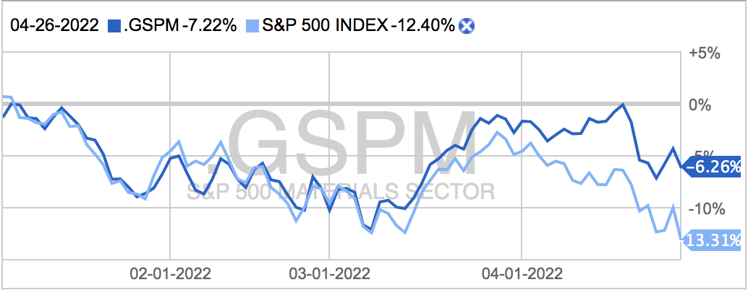
Real Estate
The real estate sector consists of four main categories: Land, Residential, Commercial, and Industrial. Land focuses on undeveloped properties and vacant land or lots and the residential segment focuses on the buying and selling of homes for individuals and families in apartments, townhouses, and all different types of living situations. The commercial segment focuses on properties used for a business-like shopping malls, parking lots, and other places businesses carry out their operations. The Industrial segment focuses on properties used for manufacturing and production such as factories and warehouses.
Performance YTD
-7.22%
Portfolio Contribution
2.98%
Stocks Held in Portfolio
BOSTON PROPERTIES, INC. (XNYS:BXP)
Stocks to Watch
Extra Space Storage Inc. (EXR)
Prologis Inc. (PLD)

Slide 21
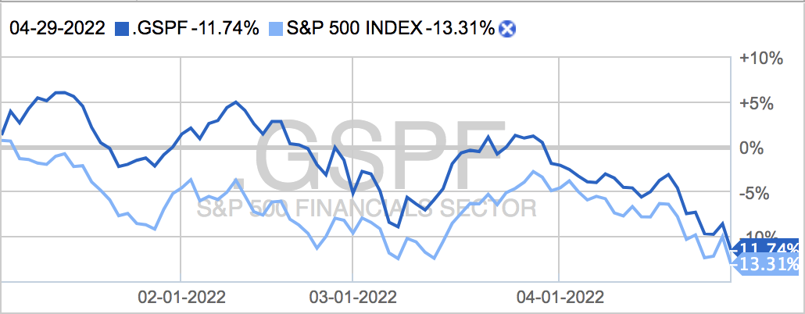
Financials
The financial sector is made up of institutions and firms that provide financial services to commercial and retail customers. The industries comprised within this sector include banks, investment companies, insurance companies, and real estate firms. The financial sector generates a large portion of its revenue from loans and mortgages and thrives in a low-interest-rate environment.
Performance YTD
-11.74%
Portfolio Contribution
18.12%
Stocks Held in Portfolio
Sel Sector: Finl S SPDR (ARCX:XLF)
RAYMOND JAMES FINANCIAL, INC. (XNYS:RJF)
THE CHARLES SCHWAB CORPORATION (XNYS:SCHW)
M&T BANK CORPORATION (XNYS:MTB)
CITIGROUP INC. (XNYS:C)
Stocks to Watch
JPMorgan Chase (JPM)
Visa (V)

Slide 22
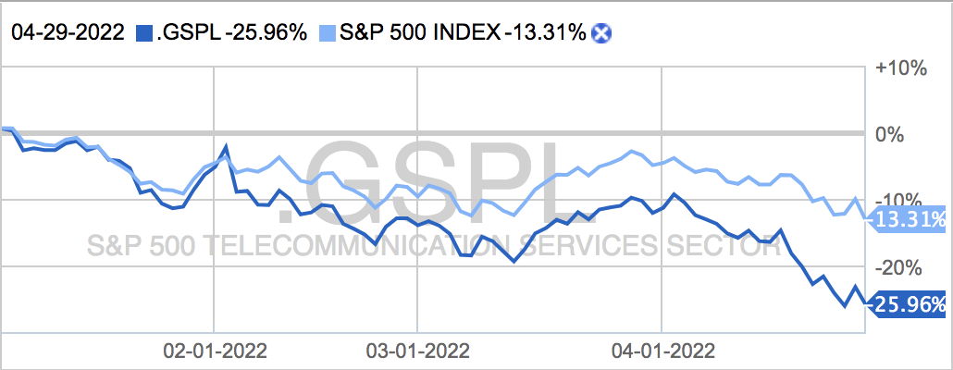
Communication Services
The communication services sector is composed of companies that provide communication services using fixed-line networks or those that provide wireless access and services. This sector also incorporates companies that provide internet services such as access, navigation and internet related software and services.
Performance YTD
-25.96%
Portfolio Contribution
1.61%
Stocks Held in Portfolio
Sel Sector: Comm Svc SPDR (ARCX:XLC)
AT&T INC. (XNYS:T)
Stocks to Watch
Paramount Global (PARA)
Lumen Technologies Inc. (LUMN)

Slide 23
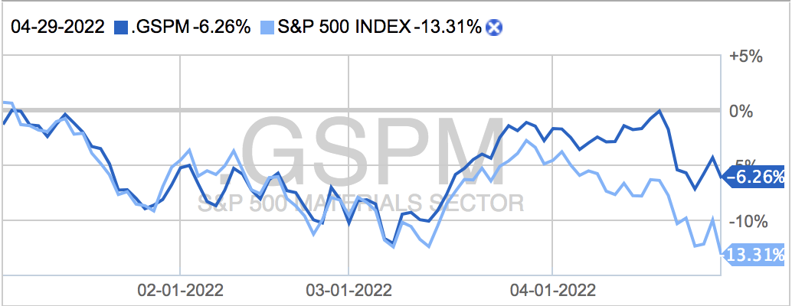
Materials
The basic materials sector includes companies involved in discovery, extraction, and processing of raw materials. This sector incorporates companies that manufacture chemicals, building materials, and paper products. There are a myriad of sub-sectors within basic materials. These include, chemical products, metals and mining, and forestry products. This sector is found to be very sensitive to the US dollar, fluctuations in the global economy, and inflationary pressures.
Performance YTD
-6.26%
Portfolio Contribution
0%
Stocks Held in Portfolio
N/A
Stocks to Watch
United States Steel Corp. (X)
Steel Dynamics Inc. (STLD)

Slide 24
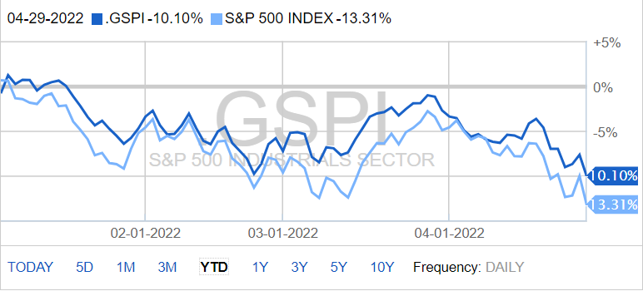
Industrials
The industrials sector includes capital goods (aerospace and defense, building products, electrical equipment, machinery), commercial and professional services, transportation (airlines, railroads)
Performance YTD
-10.10%
Portfolio Contribution
9.83%
Stocks Held in Portfolio
Sel Sec: Indust SPDR (ARCX: XLI)
HUNTINGTON INGALLS INDUSTRIES, INC. (XNYS:HII)
CARLISLE COMPANIES INCORPORATED (XNYS:CSL)
Stocks to Watch
Louisiana-Pacific Corp. (LPX)
Ryder System Inc. (R)

Slide 25
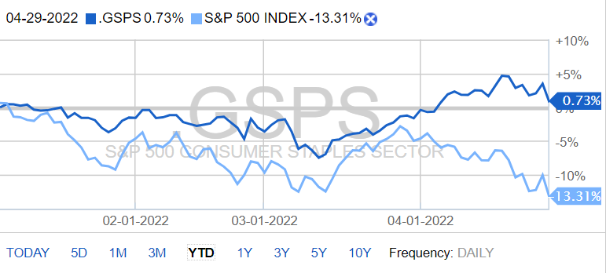
Consumer Staples
The consumer staples sector is deprived of companies that sell essential everyday products. Consumer staple stocks are noncyclical meaning they stay in demand despite market an economic conditions. This is because the sector is made up of products that everyday consumers cannot live without, food, clothing and other personal products.
Performance YTD
.73%
Portfolio Contribution
4.8%
Stocks Held in Portfolio
Sel Sector: C Stp SPDR (ARCX:XLP)
Nutrien Ltd. (XNYS:NTR)
WALMART INC. (XNYS:WMT)
Stocks to Watch
Target Corporation (TCT)
Tyson Foods, Inc (TSN)

Slide 26
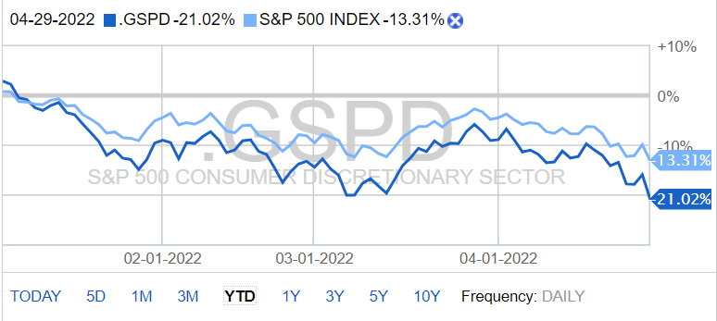
Consumer Discretionary
The consumer discretionary sector is made of companies that sell no essential goods. These are good that consumers may stay away from if the economy isn’t doing well as consumer confidence plays and important role for this sector. Products in this sector include durable good, high-end apparel, leisure activities and auto mobiles.
Performance YTD
-21.02%
Portfolio Contribution
8.65%
Stocks Held in Portfolio
Sel Sector: C Dsc SPDR (ARCX:XLY)
THE TJX COMPANIES, INC. (XNYS:TJX)
Stocks to Watch
AutoZone Inc. (AZO)
Sealed Air Corp. (SEE)

Slide 27
Portfolio Strategy and Composition
04

Slide 28

Value Strategy
A value strategy involves searching for and investing in companies that appear to be undervalued in the market.
In other words, stocks that are trading lower than their intrinsic value.
Value Buy Criteria:
Price/Sales < Industry average
Price/Book Value < Industry average
Dividends > Industry Average
Positive Free Cash Flow
Report Beta

Slide 29
Spring 2022: Value Acquisitions
Acquisitions
AT&T
CVS Health Corp
Walmart
Qualcomm
Boston Properties
Diamondback Energy
Citigroup
Carlisle Companies Incorporated
Energy Transfer UNT
Medtronic Public Limited Company
Conagra Brands, INC.
Stop-Loss Criteria: | 20%

Slide 30
AT&T
Sector: Communication Services
Industry: Telecom Services
Employees: 230,000
CEO: John T. Stankey
AT&T is the third largest wireless carrier in the US connecting over 70 million cell phones
Wireless is AT&T largest business contributing to over 40% of its revenue
Almost 80% of AT&T's revenue in 2020 comes from the communications segment which are a broad range of services and products to businesses and consumers like; wireless service, video and advertising services, and voice and data services
AT&T sells their service of connecting their customers to the Internet and has multiple data plans
Mainly focus on 5G cellular networks and AT&T Fiber
Date Purchased: | 02/1/2022
Ticker | T
Number of Shares: | 400.00
Price/Share at time of purchase: | $24.45
Market Value at Purchase: | $9,780.00

Slide 31
CVS Health Group
Originally founded as Melvin Corporation in 1922
Operates in the Health Care Plans Industry
- Most companies in this industry act as Pharmacy Benefit Managers
CEO: Karen S. Lynch
"Leading health solutions company delivering care like no one else can"
Cooperative M-form organizational structure
Aims to be the most customer-centric health company in the U.S.
Recent Acquisitions:
- Caremark (2007) - pharmacy benefit manager
- Aetna (2018) - insurance provider
CVS Health includes a retail pharmacy, health insurer, and the PBM franchises which creates the potential to improve health outcomes and even bend the healthcare cost curve for its clients
Continue to dive further into healthcare services through its Health Hub strategy and additional plans to acquire or partner its way into more primary-care assets
Recent announcement, that they will focus more of its efforts on digital growth and turning its stores into destinations that offer a range of health-care services
Date Purchased: | 02/15/2022
Ticker: | CVS
Number of Shares: | 120.00
Price/Share at time of purchase: | $103.08
Market Value at Purchase: | $12,369.60

Slide 32
Founded in 1962 by Sam Walton.
President and CEO: C. Douglas McMillon (2014).
The firm employees roughly 2.3 million dedicated employees and experiences 230 million customers per week.
Walmart is America’s largest retailer by sales.
The company operates over 11,400 stores, with most of its business done in the US (78%), followed by Mexico and Central America (6%) and Canada (4%).
Considered a part of the consumer defensive sector, Walmart does roughly 56% of sales from groceries, 32% of sales from general merchandise, and 10% of sales from health and wellness products.
Walmart is competing with Amazon, creating Walmart+ to rival Amazon Prime, a program targeting the nearly 50 million American households not subscribed to Prime.
Walmart+ is a program with a $98 yearly fee, or $12.95 a month, offering several perks like unlimited rapid delivery and product discounts, increasing customer loyalty.
Walmart has a store within 10 miles of 90% of Americans, making them easily accessible.
Walmart Connect, a digital advertising platform, has seen a 130% increase in revenue over the year.
Wholesale Subsidiary: Sam’s Club
Walmart
Date Purchased: | 02/22/2022
Ticker: | WMT
Number of Shares: | 90.33
Price/Share at time of purchase: | $136.65
Market Value at Purchase: | $12,344.14

Slide 33
Boston Properties
Boston Properties is the largest office real estate investment trust in the U.S.
Focus on high quality Class A office properties in dense and space-constrained central business districts
Dispose noncore assets and use the capital to develop high-quality properties from the ground up
Developments were made in the current quarter and are 98% leased and are projected to deliver a stabilized cash yield of more than 8%
They continue to be recognized as an industry leader in sustainability
Date Purchased: | 03/02/2022
Ticker: | BXP
Number of Shares: | 120.00
Price/Share at time of purchase: | $122.38
Market Value at Purchase: | $14,685.60

Slide 34
Qualcomm
Qualcomm, founded in 1985, is a global leader in the development and manufacturing of semiconductors and wireless communication products
Primary business operations include technologies, licensing, and strategic initiatives
Generated $8.65b in Free Cash Flow in 2021, up from $4.41b in 2020
26% of revenue is generated through licensing deals
Increasing market share in self-driving solutions
FQ4 2021 EPS of $2.55, beating estimates by $.29
Partnership with Microsoft for end-to-end, chip-to-cloud solutions for private 5G networks
Recent partnerships announced with Gridspertise and Rexroth
Date Purchased: | 03/02/2022
Ticker: | BXP
Number of Shares: | 120.00
Price/Share at time of purchase: | $122.38
Market Value at Purchase: | $14,685.60

Slide 35
Diamondback Energy
Diamondback is an independent, upstream/midstream, American oil and gas company focused on the acquisition, utilization and development of unconventional, onshore oil and natural gas reserves
Operations are concentrated in the Permian Basin, located in West Texas
Subsidiaries of Diamondback include Rattler Midstream, Viper Energy Partners, and Energen
Dividend has been increased to $2.40 per share, a roughly 20% increase from the previous year.
Generated $772 million of Free Cash Flow in Q4 of 2021
Q4 EPS of $3.63, beat estimate by $.25 dollars a share
Diamondback more than doubled its per share return on capital in 2021.
The firm is looking to maintain oil production at its current levels for 2022, while cutting down debt, increasing FCF, and increasing dividends.
Made significant strides in ESG efforts.
Date Purchased: | 03/17/2022
Ticker: | FANG
Number of Shares: | 120.00
Price/Share at time of purchase: | 132.41
Market Value at Purchase: | $15,889.06

Slide 36
Citigroup
Dates to the founding of the City Bank of New York in 1812 (Citibank) when congress refused to renew the charter of the First Bank of the United States
The first large American bank to open a foreign department
Citigroup includes Citicorp, Citibank, and several international subsidiaries
Revenue comes from three sources: global consumer banking, institutional client’s group, and corporate
Current market Capitalization is $112.3916 billion. Citigroup's growth strategy going forward is to increase presence in the wealth management side
Goal is to be net Zero Emissions by 2050. Executive compensation linked to ESG Performance
Quarterly dividend is $0.51 and their annual Dividend Yield is 3.58%
Date Purchased: | 03/22/2022
Ticker: | C
Number of Shares: | 210.00
Price/Share at time of purchase: | $57.66
Market Value at Purchase: | $12,107.55

Slide 37
Carlisle Companies Incorporated
Carlisle Companies Incorporated, founded in 1917, is a diversified manufacturer of engineered products. The company operated through three segments including construction materials, interconnect technologies, and fluid technologies. The company has key focus areas of energy efficient commercial roofing materials and specialty wiring for power and data transmission.
Operations in the United States, Europe, Asia, Canada, Mexico, the Middle East, and Africa.
Completed over 30+ acquisitions over the last decade and 85 in the last 30 years
Well positioned for growth due to strong market share in green building development
Plans to acquire MBTechnology Inc., a leading manufacturer in energy-efficient roofing materials
FY2021 EPS of $9.44, beating expectations by $.23
Plans to increase EPS to $15.00 as part of their "Vision 2025" initiative
Generated $286.90m in Free Cash Flow in FY2021
Date Purchased: | 03/22/2022
Ticker: | CSL
Number of Shares: | 60.00
Price/Share at time of purchase: | $249.09
Market Value at Purchase: | $14,945.40

Slide 38
Energy Transfer UNT.
Energy Transfer was formed in 1996 then went public in 2004.
Kelcy L. Warren is Executive Chairman and Chairman of the Board of Directors of Energy Transfer, and has been a leader in the energy industry for nearly 40 years
"Energy Transfer is one of the largest and most diversified midstream energy companies in North America with approximately 120,000 miles of pipelines and associated energy infrastructure across 41 states transporting the oil and gas products that make our lives possible"
Extensive portfolio includes, natural gas, crude oil, natural gas liquids, refined products, liquid natural gas.
Projects going forward include Nederland Facility Expansion, Ted collins link, Cushing south project, Gulf run pipeline, Mariner east pipelines.
Date Purchased: | 03/29/2022
Ticker: | ET
Number of Shares: | 1,150.00
Price/Share at time of purchase: | $11.01
Market Value at Purchase: | $12,661.50

Slide 39
Medtronic Public Limited Company
One of the largest medical devices companies
Develops therapeutic medical devices for chronic devices
Markets its products to healthcare institutions and physicians in the U.S. and overseas
Foreign sales almost accounts for 50% of the company's total sales
Historically focused on innovation, designing and manufacturing devices to address cardiac care, neurological and spinal conditions, and diabetes
Slightly shifted its strategy to include partnering more closely with its hospital clients by offering greater range of products and services to help hospitals operate more efficiently
Medtronic's diverse portfolio, allows for certain product lines to be offset by growth in other categories
Date Purchased: | 04/12/2022
Ticker | MDT
Number of Shares: | 108.00
Price/Share at time of purchase: | $110.27
Market Value at Purchase: | $11,909.68

Slide 40
Conagra Brands Inc.
Founded in 1919 as Nebraska Consolidated Mills (4 flour mills).
In 2018, the company acquired Pinnacle Foods.
Brands include, Vlasic, Boom Chika Pop, Hunts, Slim Jim, and many more.
Vision - Conagra Brands has the most energized, highest-impact culture in food. We persistently challenge and disrupt marketplace/business conventions and we are respected for our great brands, great food, great margins and consistent results.
Business strategy is to create plethora of healthy brand options, Non-GMO, and organic. Focus on value, not volume
Their model for growth is to cut underperforming Products. Focus on "Modern and authentic foods", and rely on nutritious frozen dinners for the busy consumers
Looking at the future, Conagra Brands are growing their international business in Mexico and Canada.
Date Purchased: | 04/12/2022
Ticker | CAG
Number of Shares: | 345.00
Price/Share at time of purchase: | $35.09
Market Value at Purchase: | $12,104.39

Slide 41
Growth Strategy
Growth strategies focus on smaller companies with a significant opportunity to grow.
This strategy represents a high-risk/high-reward situation
Buy Criteria:
Conservative Mentality – Expect stock to perform better than Industry
Revenue growth ≈> Industry Average and forecasted to continue to grow
Strong Earnings ~ 5 years of CAGR
ROE ≈ ≥ 15% and > Industry Average
PEG ≈ ≤ 1.2 and < Industry Average
Debt / Equity < 1.5 (or Acceptable Interest Coverage Ratio when D/E >1.0)
Report Beta

Slide 42
Spring 2022: Growth Acquisitions
Acquisitions
PayPal Holdings Inc.
Stop-Loss Criteria: | 20%

Slide 43
PayPal Holdings, Inc.
PayPal was co-founded in 1998 by Peter Thiel, Luke Nosek and Max Levichin originally tokened as “Confinity”
After a switch in business model in 1999, Confinity merged with x.com, led by Elon Musk and eventually turned it into PayPal
Went public in 2002 and IPO at a price of $13 a share
Acquired by eBay later that year and eventually spun it off to its shareholders in 2015
Technology platform company that enables digital and mobile payments on behalf of consumers and merchants.
Offers online payment solutions to customers worldwide.
PayPal enables users to electronically transfer money via numerous methods, with payments originating from a customer's bank account, credit card, or PayPal account.
Revenue comes from fees earned from payment transactions, foreign exchange, withdrawals from foreign accounts, and interest on customer balances and PayPal branded credit cards.
Subsidiaries: Honey Science Corp, iZettle, Braintree, Xoom Corp., Hyperwallet Systems
Date Purchased: | 04/5/2022
Ticker | PYPL
Number of Shares: | 120.00
Price/Share at time of purchase: | $118.10
Market Value at Purchase: | $14,171.88

Slide 44
Dividend Strategy
Dividends occur when a company pays a portion of its profits back to its investors.
Dividends are meant to entice investors as it is another way to see returns.
Not all companies pay dividends/may not always pay dividends every quarter/year.
Dividend Buy Criteria:
Dividend Yield ≥ SPDR S&P Dividend ETF
Quick Ratio ≥ Industry Average
Positive total cash dividends paid annually
Positive total cash from investing activities
Positive total cash from operating activities
Constant dividend
Historical and potential dividend growth
Report Beta

Slide 45
Spring 2022: Dividend Acquisitions
Acquisitions
NA
Stop-Loss Criteria: | 20%

Slide 46
Risk Analysis
05

Slide 47
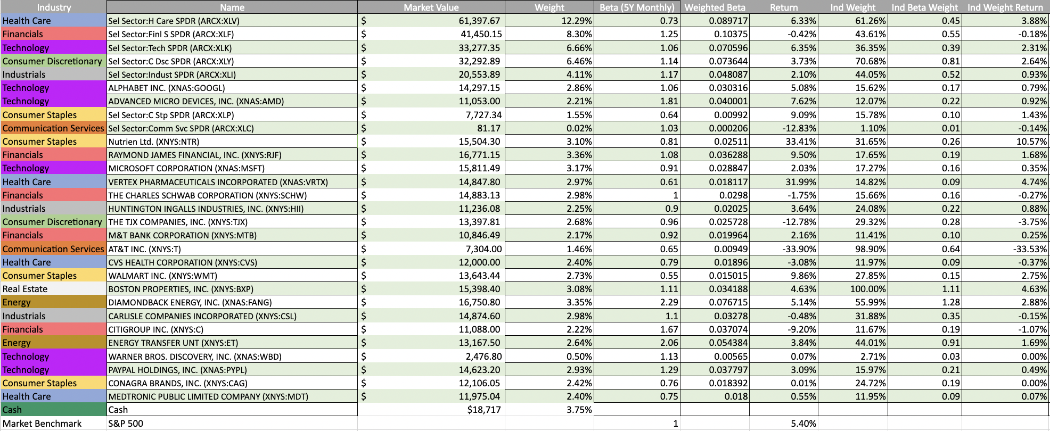
Portfolio Risk Analysis:
Beta Ranking by Industry
ETFs & Betas
A beta of 1 means the stock or ETF mirrors the market's volatility or movements
Current economic conditions affect betas across all industries
If a stock or ETF has a beta less than 1, it is less volatile than the market
Our portfolio's beta is 1.08, a value representing the volatility of our portfolio against the S&P 500 which has a beta of 1

Slide 48
Portfolio Risk Analysis:
Raw Beta
SAP
β1.08
S&P 500
β1.0
VS.
Diamond Back Energy Inc., Energy Transfer UNT, Advanced Micro Devices, Inc.
Highest Betas in the Spring of 2022
Risk Reward
The higher risk stocks in our portfolio did not tend to have higher returns as shown by the negative trend line

Slide 50
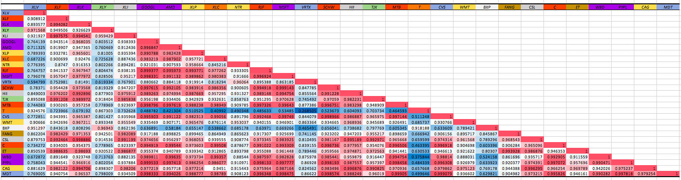
Correlation Matrix

Slide 51
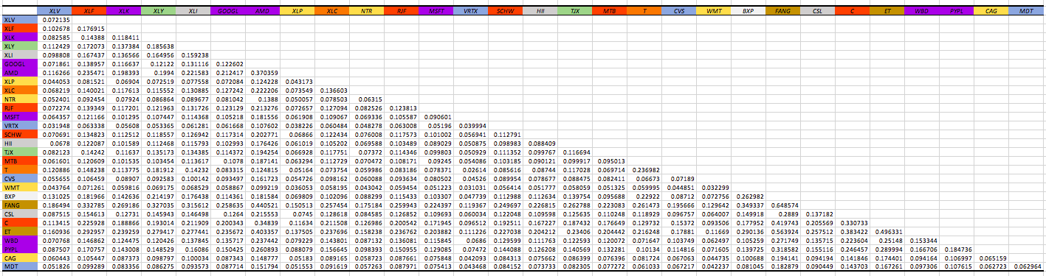
Covariance Matrix

Slide 52
Performance Review
06

Slide 53
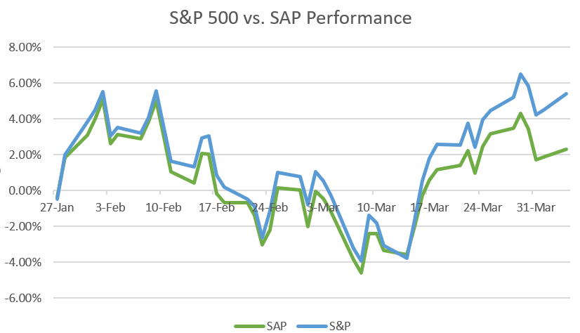
SAP Performance Spring 2022 Compared to S&P 500
 | SAP | S&P 500
Total Return | 2.29% | 5.40%
Risk Free Rate | 2.82% | 2.82%
Standard Deviation | 2.49% | 3.00%
Sharpe Ratio | -0.21 | .93

Slide 54
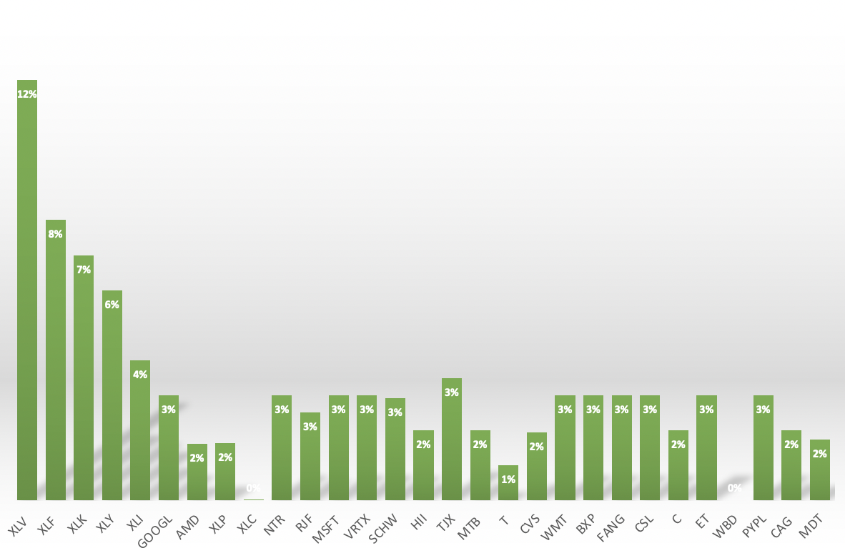
Portfolio Allocation
Largest Holdings:
      XLV, Health Care ETF 12%
  XLF, Financials ETF 8%
XLK, Technology ETF 7%

Slide 55
Sector allocation compared to the benchmark
SAP Sector Weights
Technology | 16.30%
Financials | 18.79%
Health Care | 20.80%
Consumer Discretionary | 8.98%
Communication Services | 1.67%
Industrials | 9.91%
Consumer Staples | 4.93%
Energy | 6.02%
Real Estate | 3.13%
Utilities | 0.00%
Materials | 0.00%

Slide 56
SAP Strategies and Allocation
ETF
Growth
Value
Dividend

Slide 57
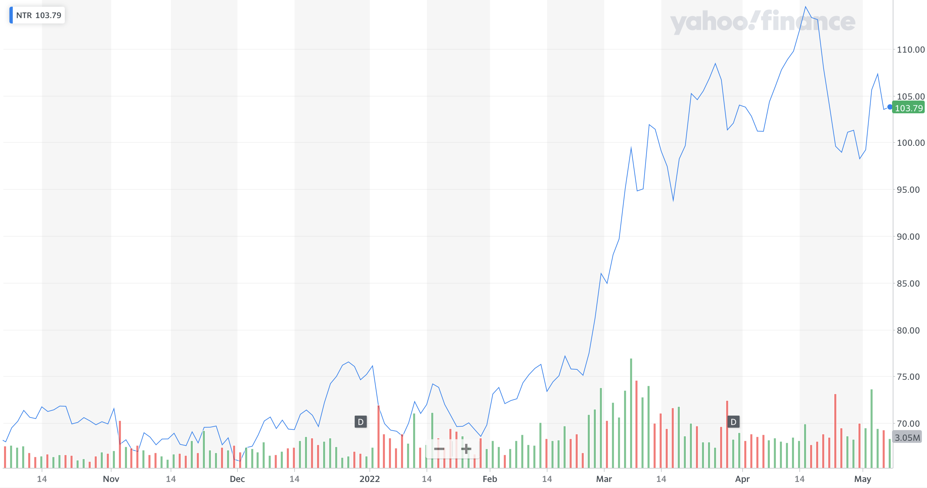
Outperformers:
Nutrien LTD (NTR): 51.92%
Purchased 10/5/2021
150.82 shares @ $68.46
Nutrien provides crop inputs and services such as potash, nitrogen, phosphate and sulfate products
Operates through about 2,000 retail locations in the USA, Canada, South America and Australia
Pitched as a value stock and underwent tremendous growth amidst the Russa-Ukraine

Slide 58
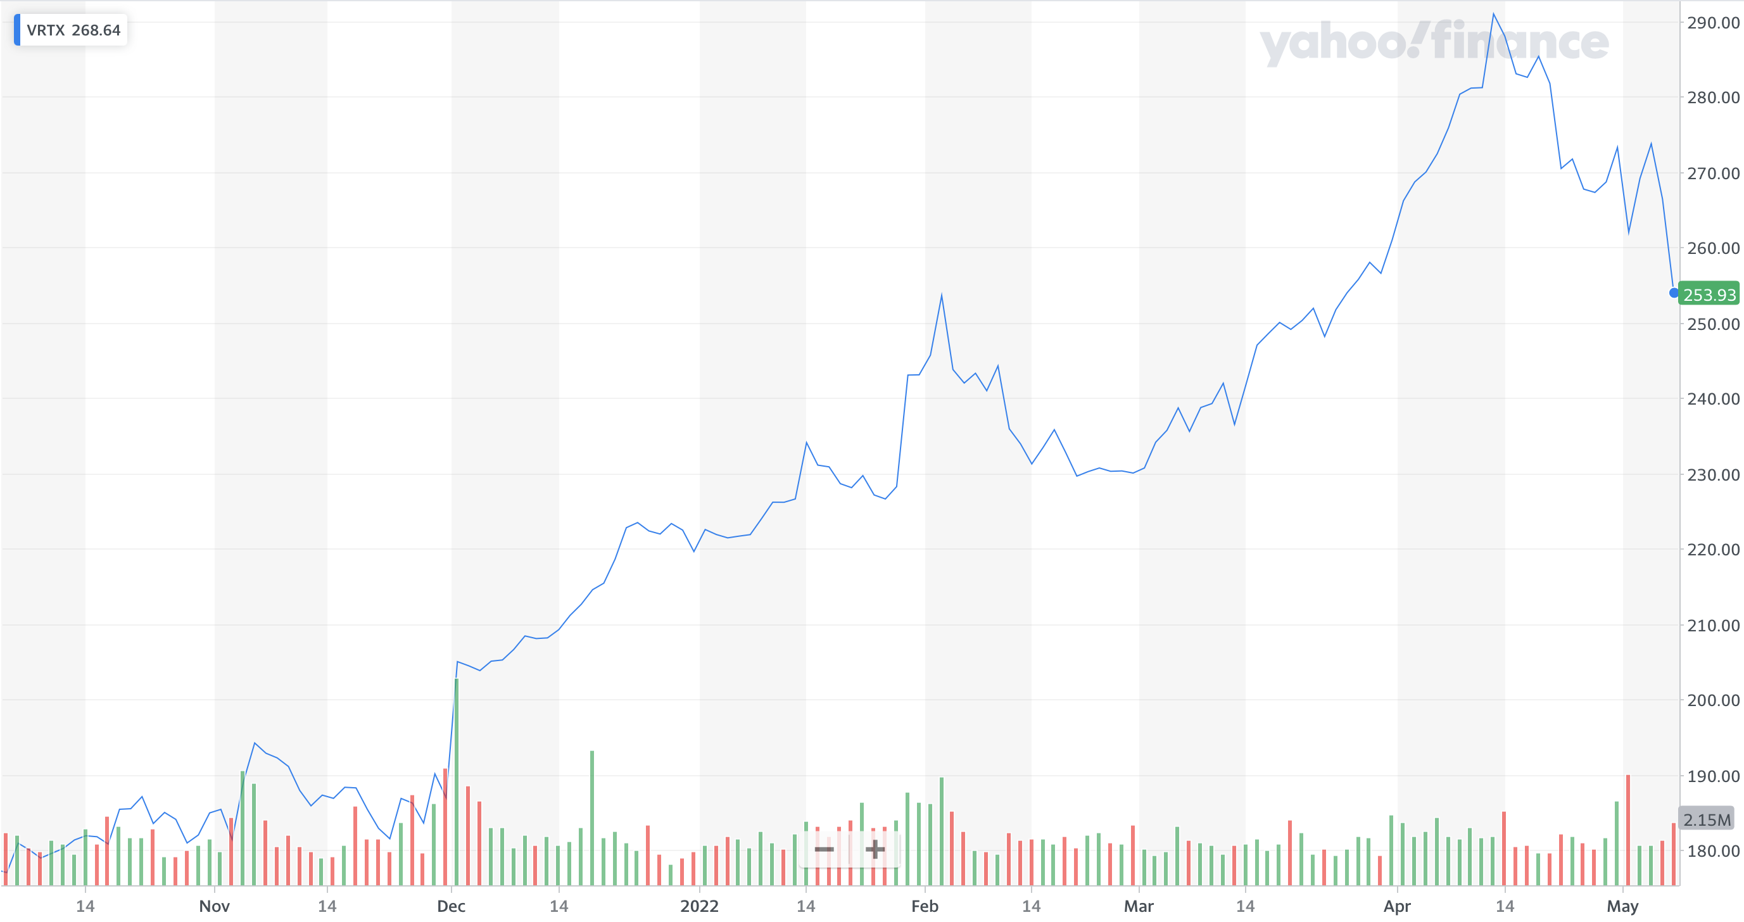
Outperformers:
Vertex Pharmaceuticals Incorporated (VRTX): 43.14%
Purchased 10/9/2021
55 Shares @ $183.61
Has a pipeline of investigational therapies in sickle cell disease, beta thalassemia, type 1 diabetes, and others.
Vertex is a global Biotechnology company focused on developing medicines for the purpose of treating Cystic Fibrosis.
Pitched as a growth strategy and has been leading among the fund’s healthcare sector.

Slide 59
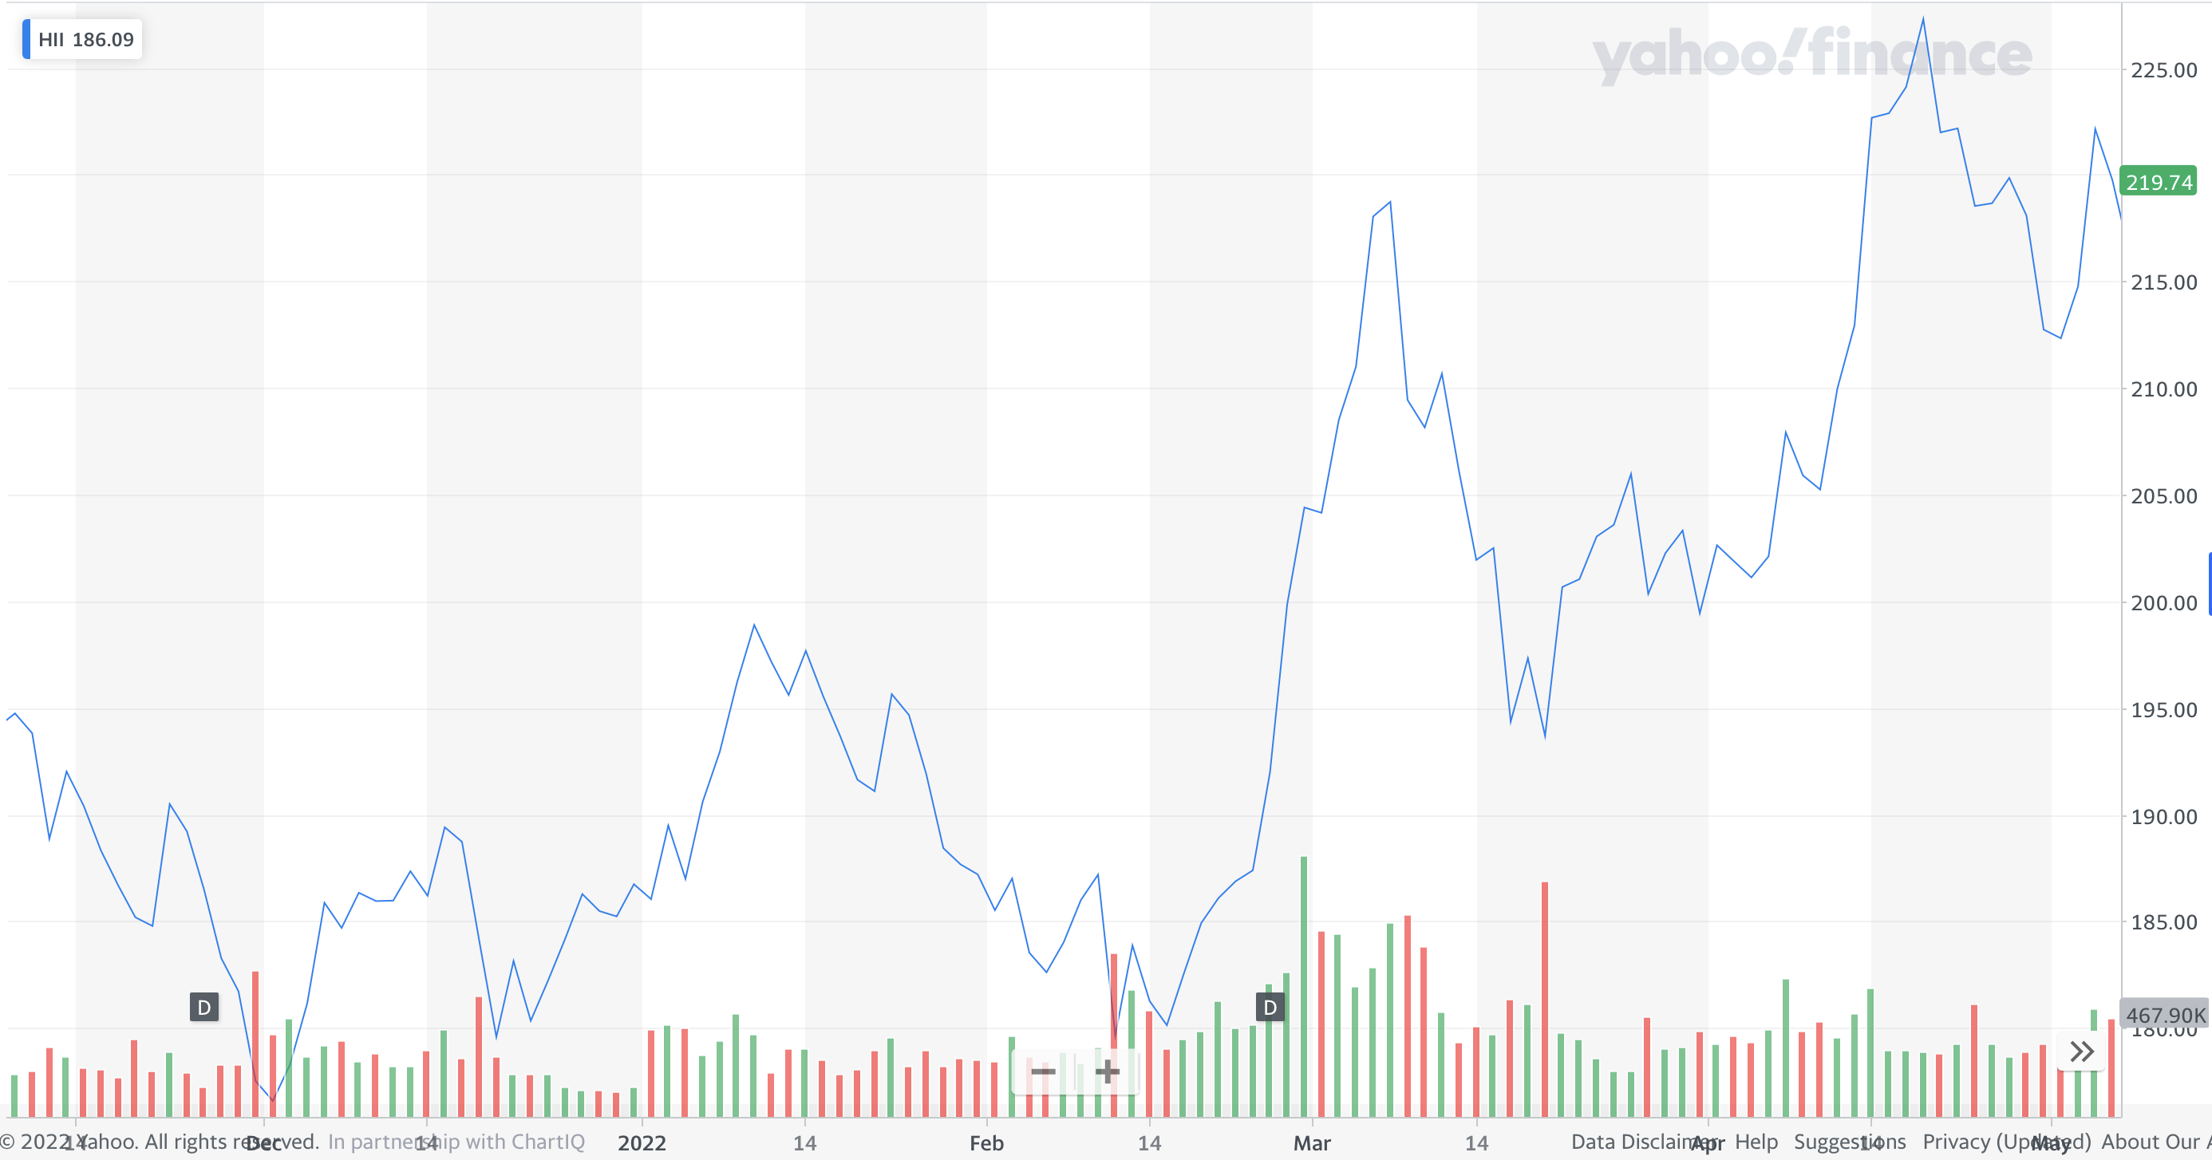
Outperformers:
Huntington Ingalls Industries Inc. (HII): 13.19%
Purchased 11/9/2021
55.66 Shares @ $194.54
Has a 135-year history of trusted partnerships with advancing US National Security and builds naval ships, unmanned systems.
Huntington Ingalls is a global engineering and defense technologies provider
Pitched as a growth strategy in the industrials sector. It’s a staple in its industry and has had tremendous growth over its holding period

Slide 60
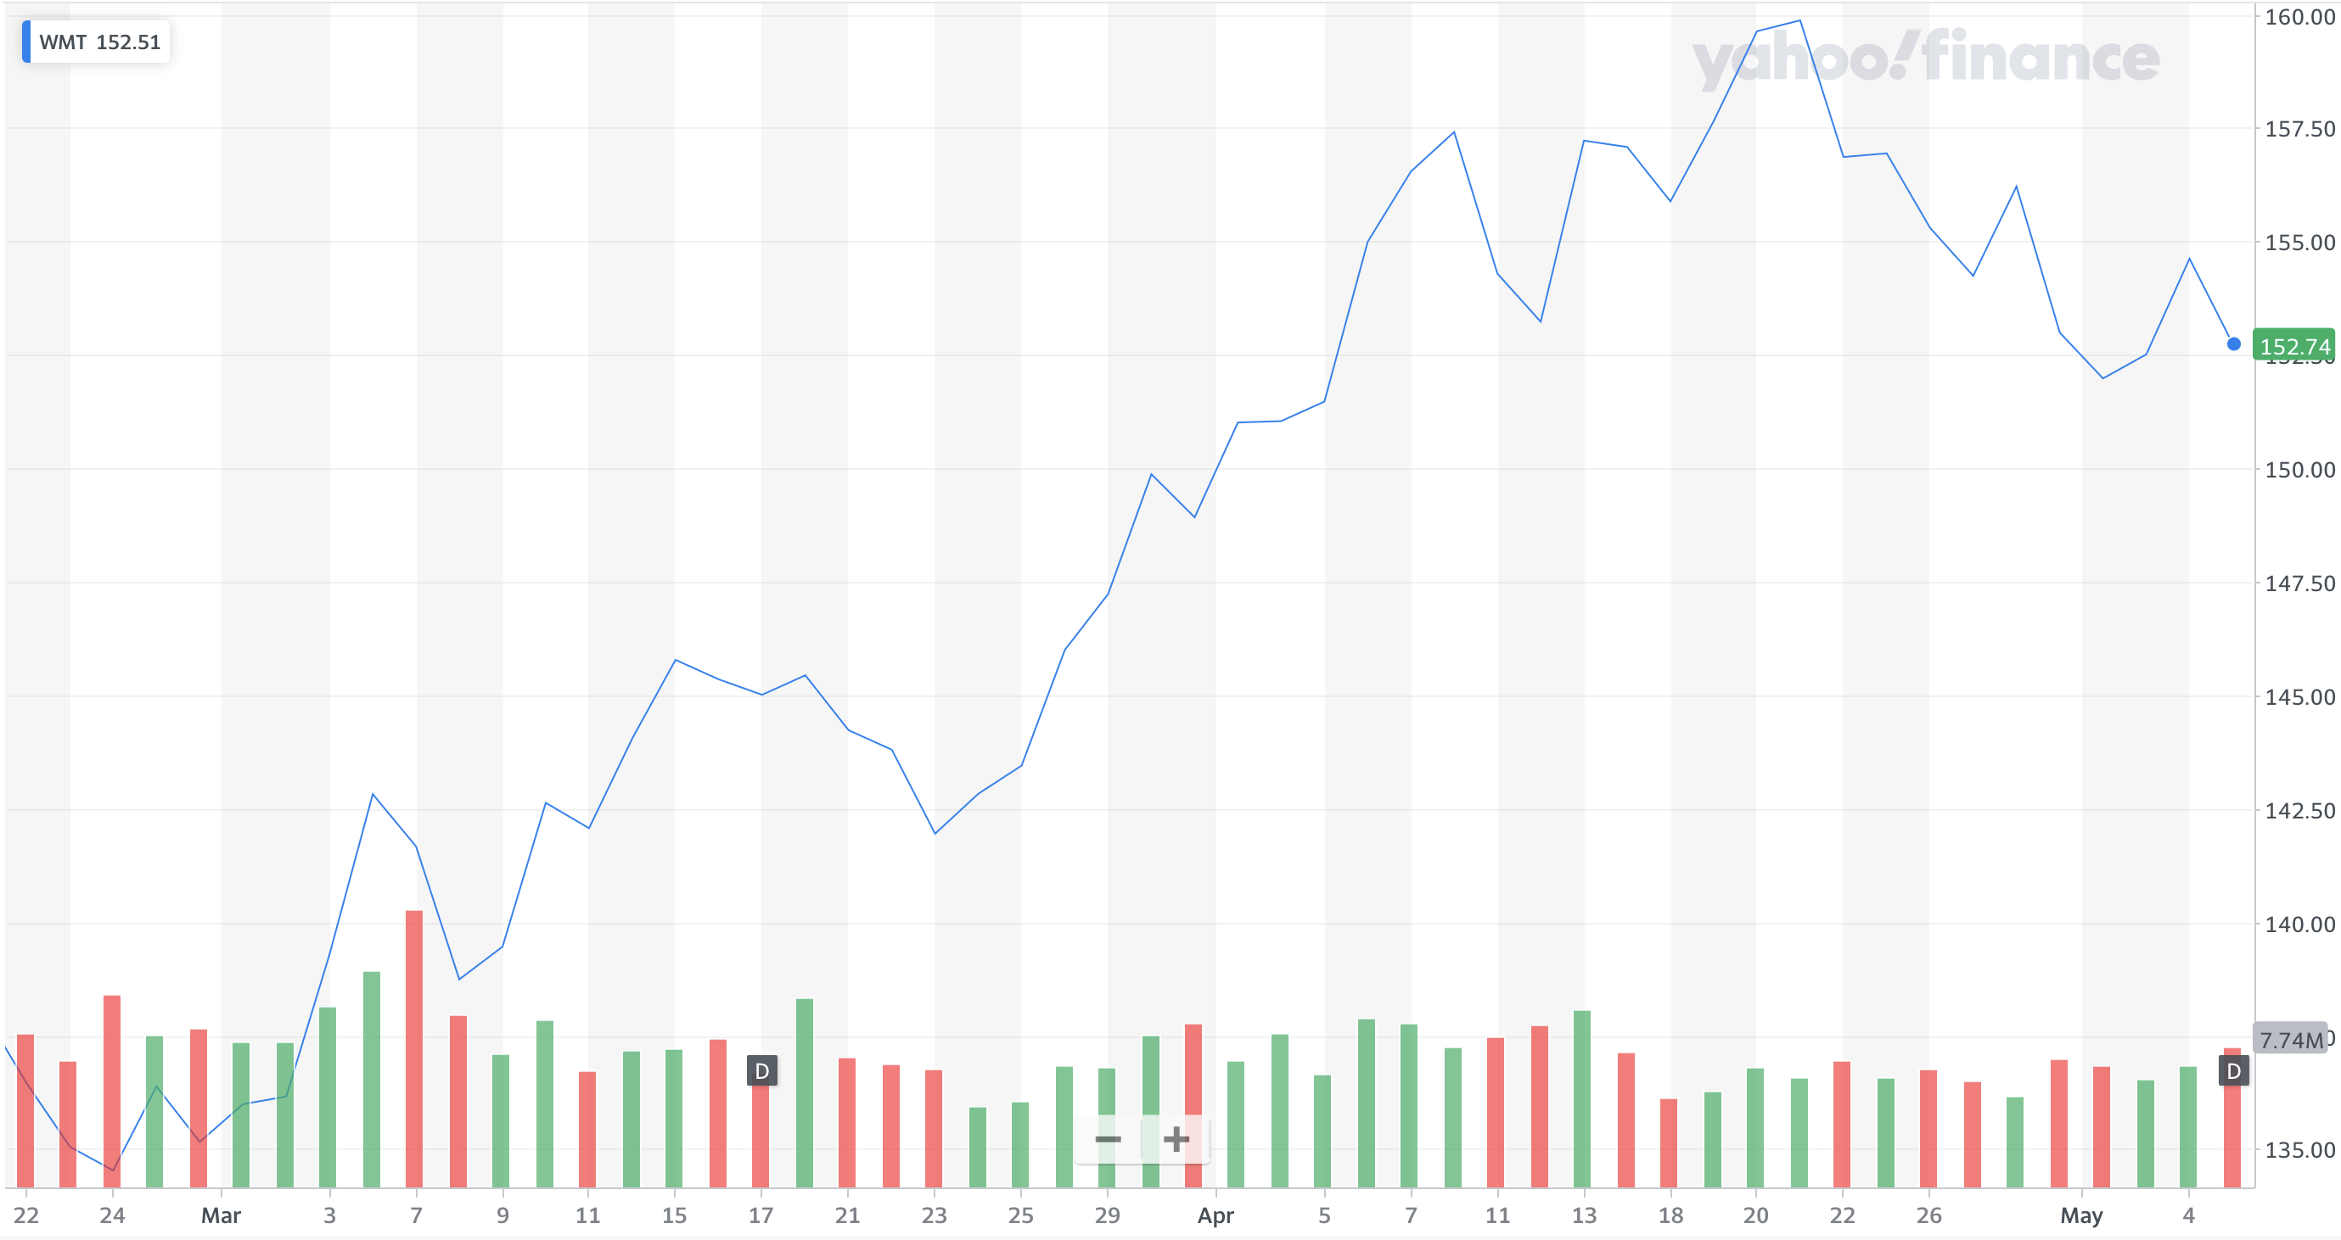
Outperformers:
Walmart Inc. (WMT): 13.96%
Purchased 02/22/2022
90.33 Shares @ $136.65
Founded by Sam Walton in Rogers Arkansas, Walmart has 10,593 stores and clubs in 24 countries.
Walmart is an American Multinational retail corporation that operates supercenters, discount department stores and grocery stores
Pitched to the class as a value stock in the consumer staples sector. We expected growth through covid and inflationary times

Slide 61
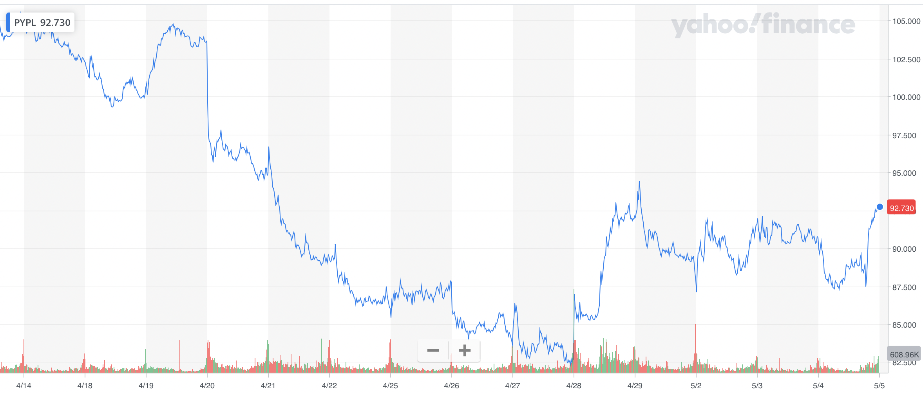
Underperfomers:
Paypal (PYPL): -21.48%
Purchased 04/05/2022
120 Shares @ $118.10
Pitched as a growth stock expecting to come back from its major loss.
PayPal released its forecasted revenue and profits for 2022 which disappointed many investors. This led to a major decline in February.
PayPal has not yet recovered and has gone down since, likely due to the impact of higher inflation on consumer spending
PayPal Holdings, Inc. Is a financial technology company based in California. The company operates an online payment systems in the majority of countries that supports online money transfers

Slide 62
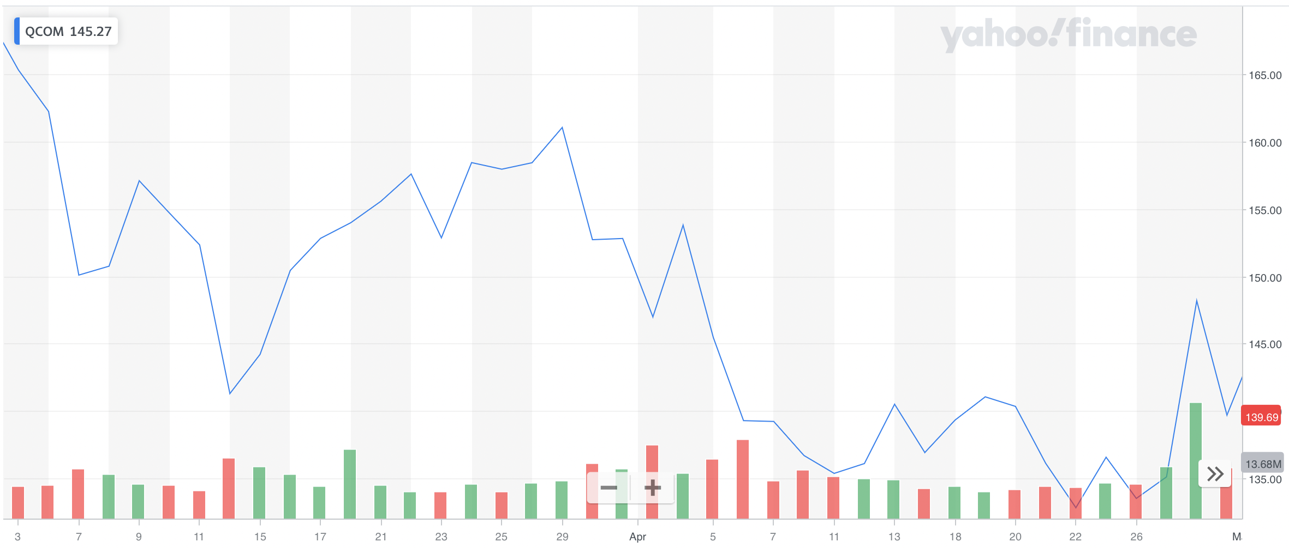
Underperfomers:
Qualcomm (QCOM): -17.59%
Purchased 03/3/2022
88 Shares @ $169.51
The company is headquartered in San Diego and has offices in 40 different countries
Qualcomm is a multinational corporation that designs and manufactures semiconductors and wireless telecommunications products
Qualcomm was pitched as a value strategy stock. Qualcomm was on the decline when it was purchased but the decline was not expected to continue

Slide 63
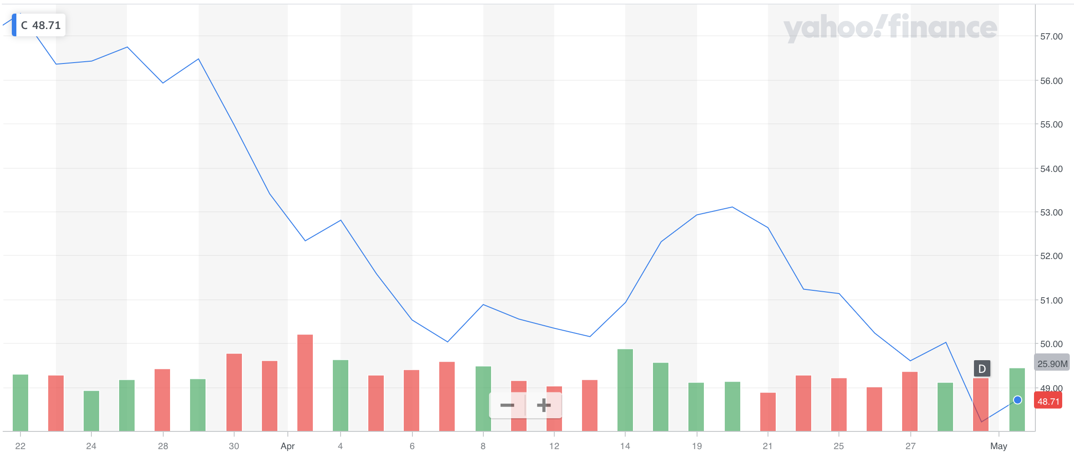
Underperfomers:
Citi Group (C): -15.52%
Purchased 03/22/2022
210 Shares @ $57.66
Citi was pitched under a value strategy.
Citigroup first-quarter profit fell 46%, dragged down by higher expenses and potential losses from its exposure to Russia.
Citi is a US-American multinational investment bank and financial services corporation headquartered in New York City.

Slide 64
The Ones That Got Away
07

Slide 65
Exxon Mobile
NYSE: XOM
Exxon Mobile was pitched to the class as a Value Strategy.
Exxon is an integrated oil and gas company that searches for, refines, and produces oil from around the world and is the world's largest refining company
Total global refining capacity of 4.8 million barrels of oil per day
One of the largest producers of commodities and specialty chemicals.
Experienced tremendous growth as the Russia-Ukraine conflict drove the price of oil up.
Was pitched as a value strategy with its low P/E : 15.1, industry average was 25.15, and its low P/B 2.15 compared to an industry average 4.07.
The class did not vote on Exxon with fears that Oil may be on its way out and replaced by renewables.
Date Proposed: | 02/08/2022
Ticker: | XOM
Proposed number of Shares: | 124.5
Price/Share at time of purchase: | $80.26
Estimated return: | 8.11%

Slide 66
United Healthcare NYSE: UNH
United Healthcare was pitched to the class as a reallocation from the fund’s healthcare ETF holdings.
UNH’s main sources of revenue are from their medical and consulting services, sales of medical products, and their premiums.
United Healthcare grew well over the semester as United Healthcare beat expected earnings and revenue and posted double digit revenue growth in its Optum and United Healthcare segments
Was pitched as a growth strategy boasting a beta of .88, PEG of 1.66, Price to Sales of 1.57 and a way to capture the expected growth of the healthcare sector.
The class decided to not vote the stock through with fears that the healthcare industry’s growth was tied to the COVID-19 pandemic.
Date Proposed: | 02/22/2022
Ticker: | UNH
Proposed number of Shares: | 22
Price/Share at time of purchase: | 467.81
Estimated return: | 9.02%

Slide 67
Enterprise Product Partners: EPD
EPD was pitched to the class as a Value Strategy.
EPD is a midstream natural gas and crude oil pipeline company
EPD is one of the largest players in the NGL market
Their new petrochemical assets create more of a demand pull for Enterprise’s supply of NGLs traveling through its network
Much like other oil companies, great growth was seen in the industry once Russia-Ukraine conflicts began.
It was pitched because their natural gas line assets would be incredibly difficult for competitors to replicate given the strategic location and contracts with every major US producer/refinery
Date Proposed: | 02/08/2022
Ticker: | EPD
Proposed number of Shares: | 500
Price/Share at time of purchase: | $24.16
Estimated return: | 10.18%

Slide 68
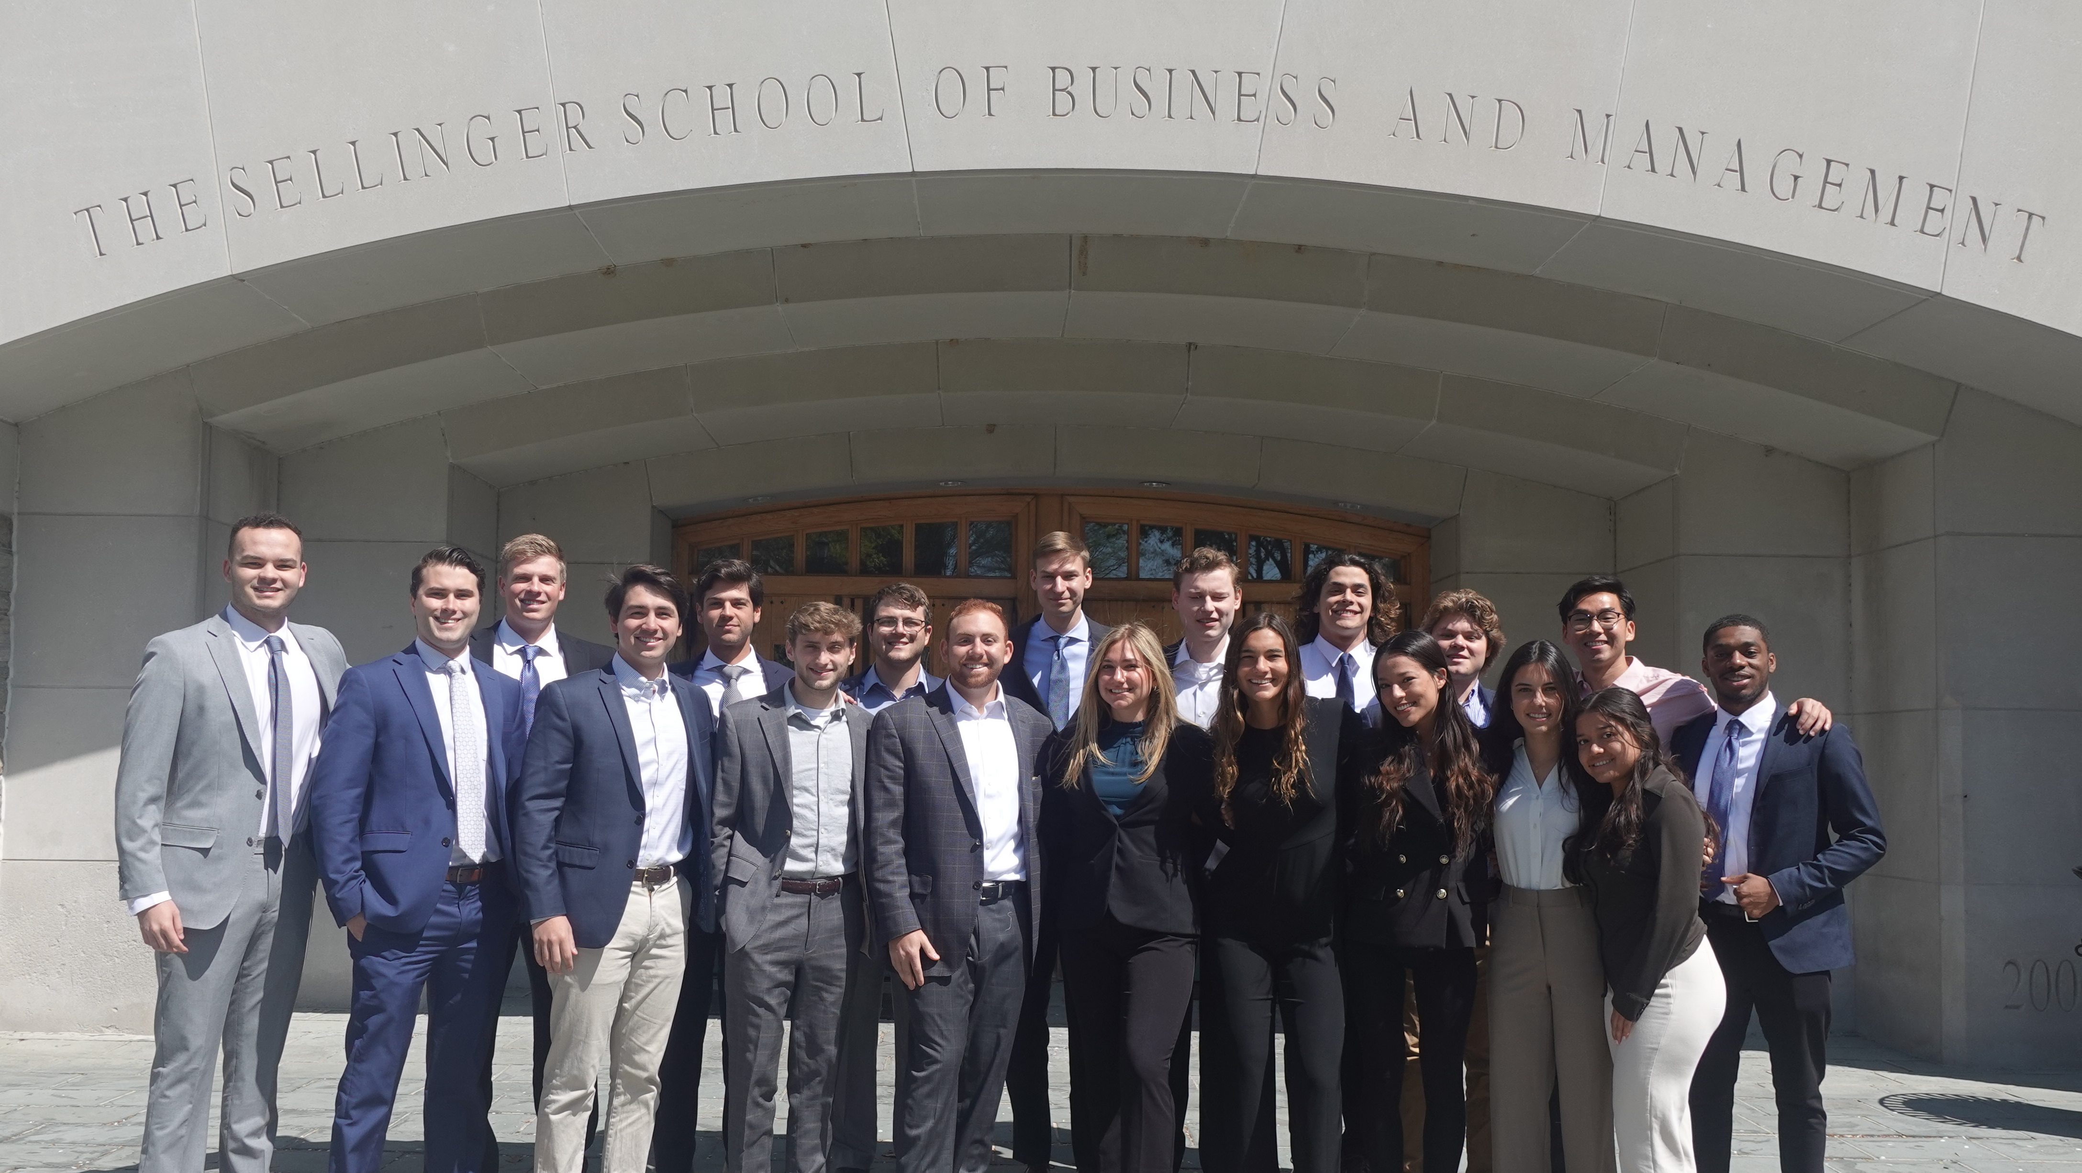
Meet The Class

Slide 69

Sean Apostoli
Sean is an undergraduate student pursuing a Bachelor of Business Administration with a concentration in Finance at Loyola University Maryland. In addition to his studies, Sean is the Captain and President of the Loyola Club Baseball team. He has previously interned for Northwestern Mutual as a Financial Representative Intern and is currently a member of the analytics team for UMBC Baseball. Following graduation, Sean will be pursuing a career in consulting as an Advisory Associate at Baker Tilly in his home state of New York.

Slide 70

Valentina Bastidas
Valentina is an undergraduate student pursuing a Bachelor of Business Administration with a concentration in Finance at Loyola University Maryland. Valentina has previously interned at Morgan Stanley as a Summer Financial Analyst in the Institutional Securities group. Apart from her studies, she is a member of the Financial Management Association at Loyola and mentors first-generation Latinx high school students. Following graduation, she will return to New York City and work at Morgan Stanley as a Full-Time Financial Analyst.

Slide 71

Madison Burns
Madison is an undergraduate student pursuing a B.B.A with a concentration in Finance and a dual minor in Information Systems and Writing. Madison serves as Chair of Recruitment for the professional business fraternity Alpha Kappa Psi and as a member of the Financial Management Association. She spent the past summer as a Business Development intern at Agilis Advisors, an advisory firm operating out of Berlin, Germany. After graduation she will join SC&H Group in Baltimore working in System and Organization Controls to assist clients with cybersecurity assessment, data privacy support, and internal control consulting services.

Slide 72

Giovanna Concalves
Giovanna is an undergraduate student pursuing a Bachelor of Business Administration in Accounting and Bachelor of Business Administration with a concentration in Finance at Loyola University Maryland. In addition to her studies, she is also a member of Beta Alpha Psi and participated in other clubs on campus as well. This past summer she interned at Cornerstone Building Brands, a manufacturing company in New Jersey. Upon graduation, she will be joining Ernst & Young in New York City as an audit associate while working towards obtaining her CPA license.

Slide 73
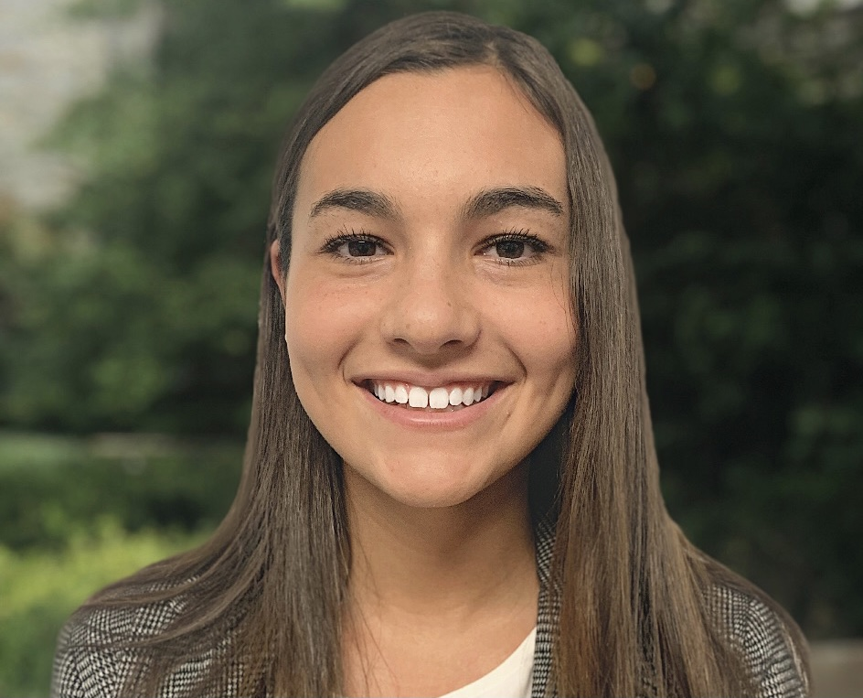
Melina Connolly
Melina is a senior from Massachusetts pursuing an BBA in finance with a minor in information systems. In addition to school, she was a member of the business fraternity at Loyola, Alpha Kappa Psi. She was also a member of FMA, Financial Management Association. Previous internships included being a corporate finance intern at Delta Dental, as well as a corporate financial planning and analysis intern at Hologic. After graduation, she will be going back to Boston, MA, to work at PwC as a deals valuation associate.

Slide 74

Stephen Curiale
Stephen is an undergraduate student pursuing a Bachelor of Business Administration with a concentration in Finance and a minor in Computer Science at Loyola University Maryland. In addition to his academics, Stephen is the Co-President of the Microfinance Club and a member of the Investment Club. He has interned at Oppenheimer & Co as a Summer Analyst for summers 2019, 2020, and 2021. Following graduation, Stephen will explore opportunities in the New York Metropolitan area and work towards earing his CFA.

Slide 75
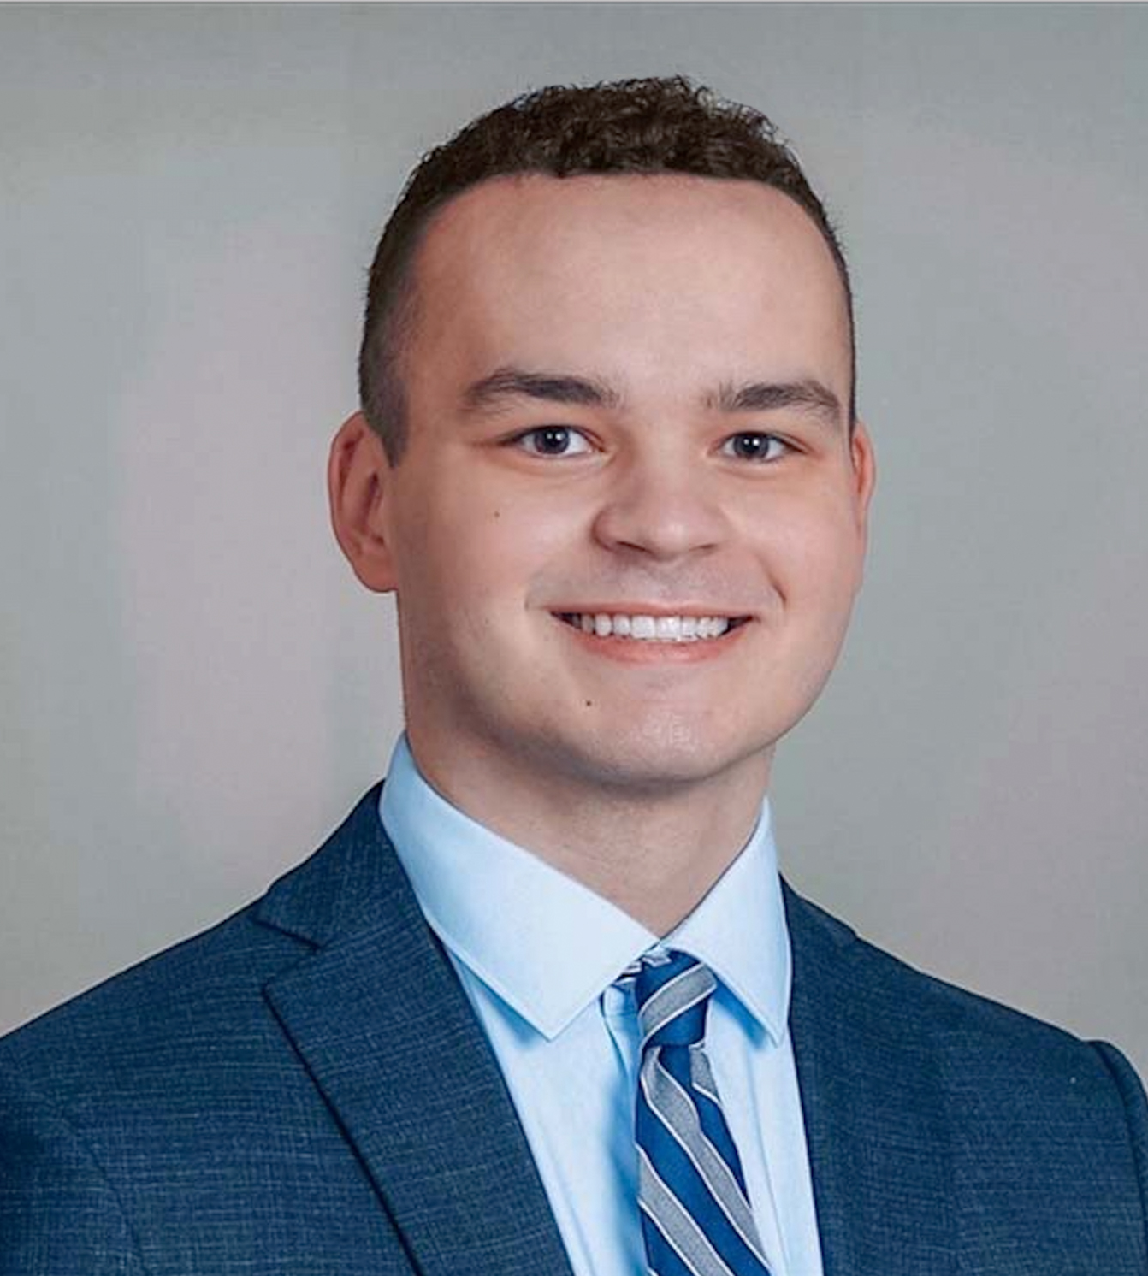
Nicholas Darcy
Nicholas is a senior from Cornwall, New York pursuing a Bachelor’s of Business Administration with a concentration in Finance and a minor in Information Systems. In addition to his studies, Nicholas is a member of the Financial Management Association and a mentor for Student Leadership Corps. He was previously a Member Supervision- Capital Markets intern with FINRA and a Financial Services Intern at Cetera Investors. Upon graduation, Nicholas will be joining KPMG as a Financial Services Regulatory & Compliance Risk associate in New York, NY.

Slide 76

Mark DiPierro
Mark is an undergraduate student pursuing a Bachelors of Business Administration with a concentration in Finance and a minor in Information Systems at Loyola University Maryland. In addition to his studies, Mark is a four-year member and current Vice President of the Club Baseball Team. He as well volunteers with the UMBC Division 1 Baseball Program as Co-Director of Analytics. Following graduation, Mark will return home to New York and will start his career with JPMorgan Chase in the Global Private Bank as a Private Bank Analyst.

Slide 77

Roderick Fernandez
Roderick is an undergraduate student pursuing a Bachelor of Business Administration with a concentration in Finance. In addition to his studies, he also was a part of many on campus extracurricular clubs such as being co-president of the Investments club along with founding and being president of the Loyola Barbell club. While not in class he enjoys spending time with friends and classmates along with lifting weights and giving free training sessions to barbell club members. Upon graduation, Roderick is taking a gap year before returning to Loyola to pursue his master's in Business Administration.

Slide 78

Cameron Hall
Cameron is an undergraduate student pursuing a Bachelor of Business Administration with a concentration in Finance and a minor in Information Systems from Loyola University Maryland. In addition to his studies, he is the co-president of the Investment Club and a member of the Loyola Club Rugby team. Over the past summer, Cameron interned at Crown Castle Fiber in the Credit & Collections Analyst department. While not in class he enjoys spending time with friends, family, and teammates and going to the beach in Maine during the summer. This summer, Cameron will be interning at Bottomline Technologies in the Accounting/Finance department. He will be graduating next December and hopes to pursue his Master's in Business Administration.

Slide 79

Sung Je Lee
Sung Je is an undergraduate student pursuing a Bachelor of Business Administration with a concentration in Finance at Loyola University Maryland. In addition to his studies, Sung has been a four-year member of the Loyola men’s Swim Team. Following graduation, Sung Je will stay in Baltimore and start his career at Transamerica as a GIC Analyst.

Slide 80
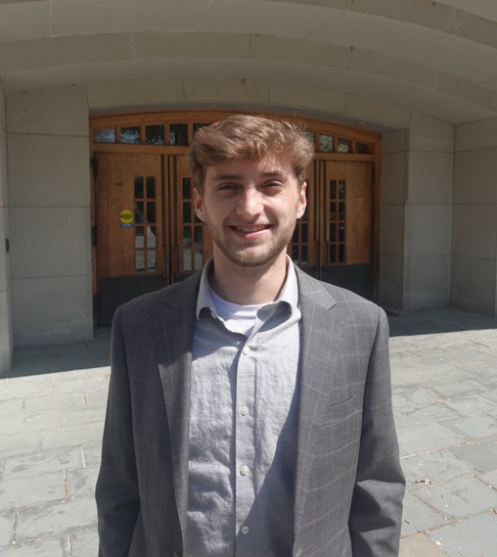
Joshua Long
Josh is an undergraduate student from Boston, MA pursuing his Bachelor’s of Business Administration with a concentration in Finance and Information Systems at Loyola University Maryland. Co-President of the Microfinance Club, Josh has is also a member of the Sellinger Scholars, Alpha Iota Delta, club soccer team, and worked with the Admissions program at Loyola. He has spent his last two years working at Knollwood Investment Advisory as an Investment Analyst Intern where he will transition into a full-time position after graduation.

Slide 81
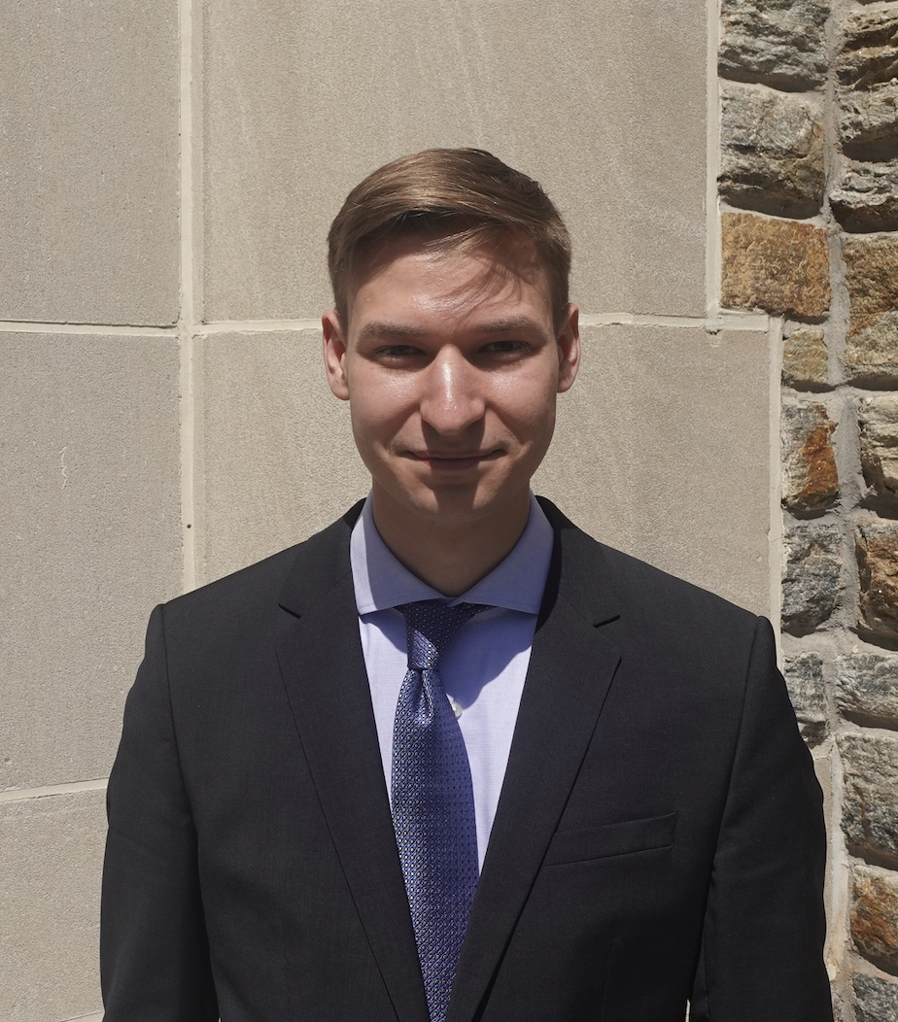
Dominik Pajor
Dominik is an undergraduate student from Westport, CT pursuing a Bachelor of Business Administration with a concentration in Finance at Loyola University Maryland. On campus, he serves as president of the Gearhounds Car Club and member of the Investment Club. He has previously interned with FBN Securities as a Sales & Trading intern, and Dynamic Blockchain Solutions as a Market Research intern. Upon Graduation, Dominik will be working with Northrop Grumman out of Linthicum, MD.

Slide 82

Nicklaus Palmesano
Nicklaus is a senior from Fort Lauderdale Florida pursuing a BBA in Finance with a minor in Communications. In addition to academics, he is a member and treasurer of the Rugby Team and President of the Club Golf Team. Over the summer he had an internship with Northwestern Mutual as a sales associate and has plans after graduation to sit and take the CFA Level 1 exam. After college Nicklaus will be working at Merrill Lynch out of Fort Lauderdale in wealth management.

Slide 83

Christopher Quinn
Christopher is a senior from Wyckoff, NJ pursuing a Bachelor of Business Administration with a concentration in Finance from Loyola. In addition to school, he was a member of the investment club and barbell club while here at Loyola. In his free time, Christopher enjoys playing basketball with his friends, skiing, and watching his favorite sports teams. Following graduation, Christopher will be working in New York City full-time as a risk consulting associate, where he then hopes to further his career in finance.

Slide 84
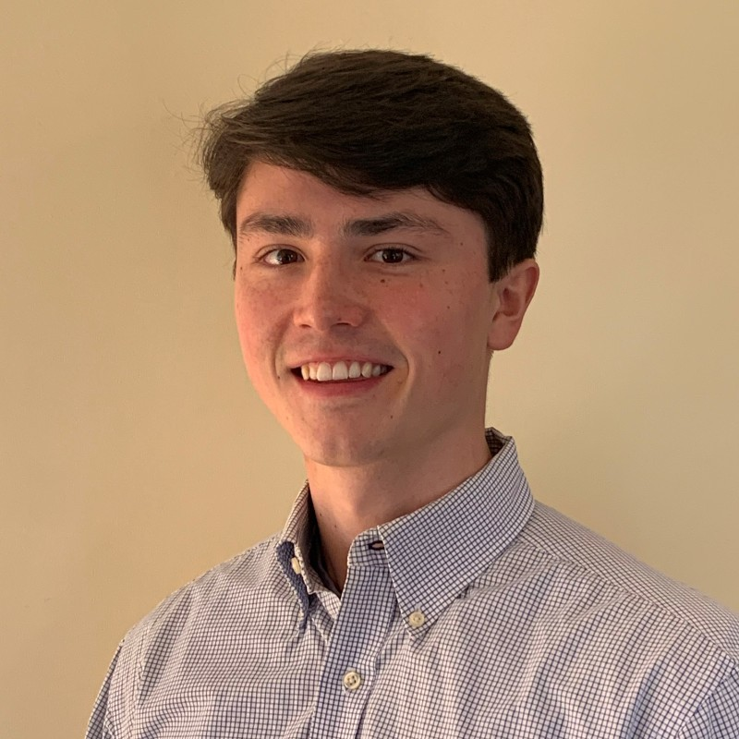
Benjamin Sasse
Benjamin Sasse is a senior from Ridgefield, Connecticut pursing a BBA with a concentration in Finance. In addition to his studies Benjamin is an active member in the Loyola Investment Club. This summer he has a position as a financial services intern at Centennial Bank. Benjamin has one more semester and will graduate in December 2022. Upon graduation he is pursuing a career as a financial planner.

Slide 85

Aidan Serkes
Aidan is an undergraduate student pursuing a Bachelor of Business Administration with a concentration in Finance and a minor in Information Systems from Loyola University Maryland. Aidan is a member of the Micro Finance Club and held an internship at Greenbird Capital last summer. Following graduation, he will be undergoing a training program to be Financial Advisor with UBS in the Baltimore Area.

Slide 86

Ethan Smith
Ethan Smith is a senior from Upper Marlboro, Maryland pursing a BBA with a concentration in Finance and a minor in Information Systems. In addition to his studies Ethan is an active member in the Loyola French Club and Pre-Law Society. Ethan will be graduating in May 2022 but will be remaining at Loyola to pursue his Emerging Leaders MBA. Upon completion of his MBA program, he is pursuing a career in wealth management.

Slide 87
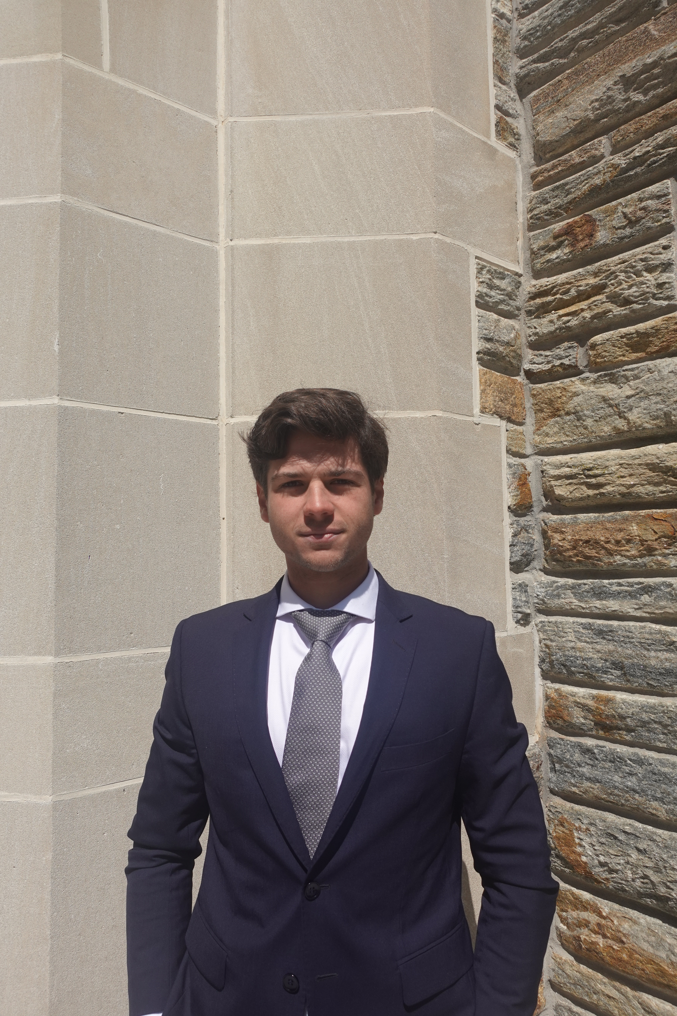
Sasha Sparacino
Sasha is an undergraduate student pursuing dual Bachelors of Business Administrations with concentrations in Finance and Information Systems. In addition to his studies, Sasha has been a four-year member of the Loyola Men’s Golf Team, where he is the team’s first ever international student. Furthermore, Sasha is also the President of the Fixed Income Society. Following graduation, Sasha plans to explore opportunities in Dubai and New York in the fields of Investment Banking and Private Equity. Alongside these endeavors, he looks to fund and cultivate a potential Fin-tech Startup.

Slide 88

Michael Steinrock
Michael Steinrock is a Finance Major and Information Systems Minor from West Chester Pennsylvania. He is a member of Club Baseball at Loyola and is a member of the Sellinger Scholars Business Honors Society. Upon graduation he is planning on working at Bank of America Merrill Lynch as a Financial Advisor.

Slide 89

Tiana Tupac-Yupanqui
Tiana is an undergraduate student pursuing a Bachelor of Business Administration with a double concentration in Finance and Economics. In addition to her studies, she worked at the Alumni Office, International student Services, and as a Desk Assistant. Over the past summer, Tiana interned for Pfizer in their Decision Support of Excellence department. Where they provided comprehensive financial reporting, financial support, and guidance to the commercial finance team. In her free time, she enjoys spending time with family and friends, listening to podcasts, and working out. Upon graduation, Tiana hopes to pursue her Masters in Business Administration after graduation

