Slide 1
Student Biographies

Slide 2
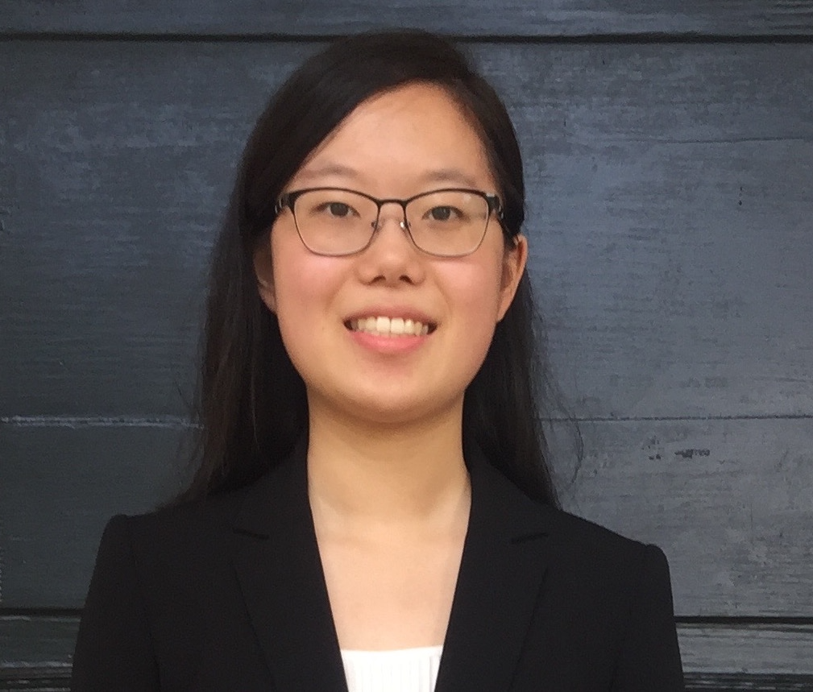
Jenny Huang
Jenny Huang is a financial analyst at Northrop Grumman. She joined the Loyola University PMBA program in 2021 and will be completing her degree in Summer 2024.
Originally from Howard County, Maryland, she obtained her undergraduate degree from UVA with a Bachelors in Commerce, focused on Finance and Information Technology. During her time in university, she was an active member of the investment organization Smart Woman Securities and continues to enjoy learning about personal finance and portfolio management in her free time.

Slide 3
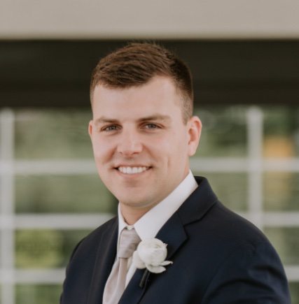
Joseph Carroll
Joseph is set to graduate from the Loyola PMBA program with a specialization in Finance in the Spring of 2025.
He currently works as an Alternatives Onboarding Specialist at Brown Advisory. He was born and raised in Baltimore and attended Towson University as an undergrad.

Slide 4
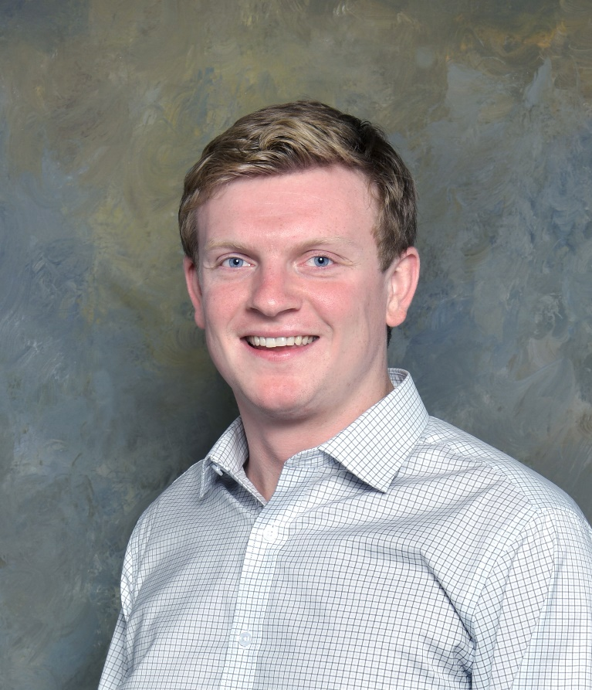
Matt Burke
Hometown: Timonium, Maryland
Employer: Northrop Grumman
Job Title: Financial Analyst
Undergrad: University of Vermont
Major: Community Entrepreneurship

Slide 5
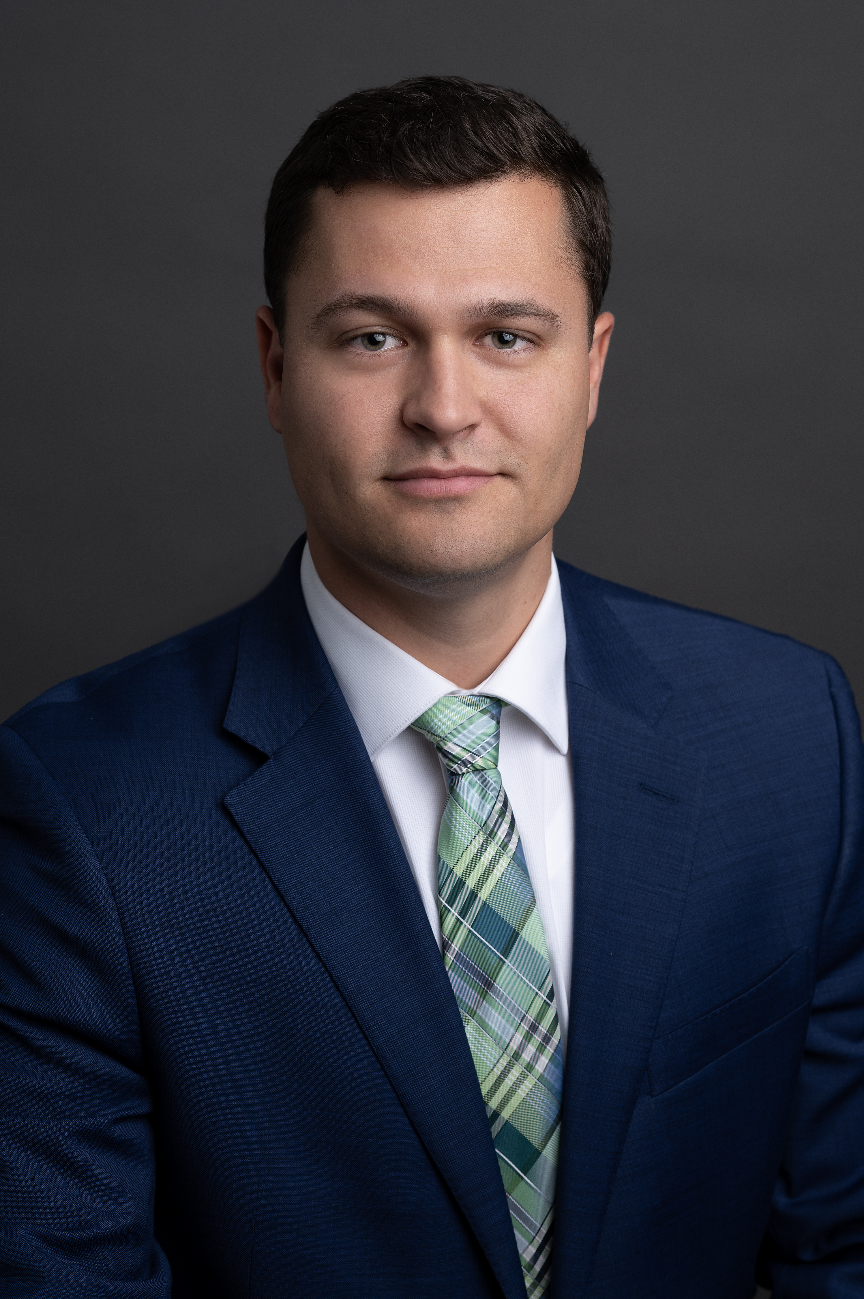
Matthew Gross
Matthew is expected to graduate from the PMBA program at the end of the Summer, 2024 semester with a specialization in Finance. He currently works at T. Rowe Price as a Senior Sales Consultant within the Broker Dealer channel.
He is originally from Columbia, Maryland and attended the University of Maryland for undergraduate with a Bachelor of Arts Degree in Economics with a Minor in Sustainability.

Slide 6
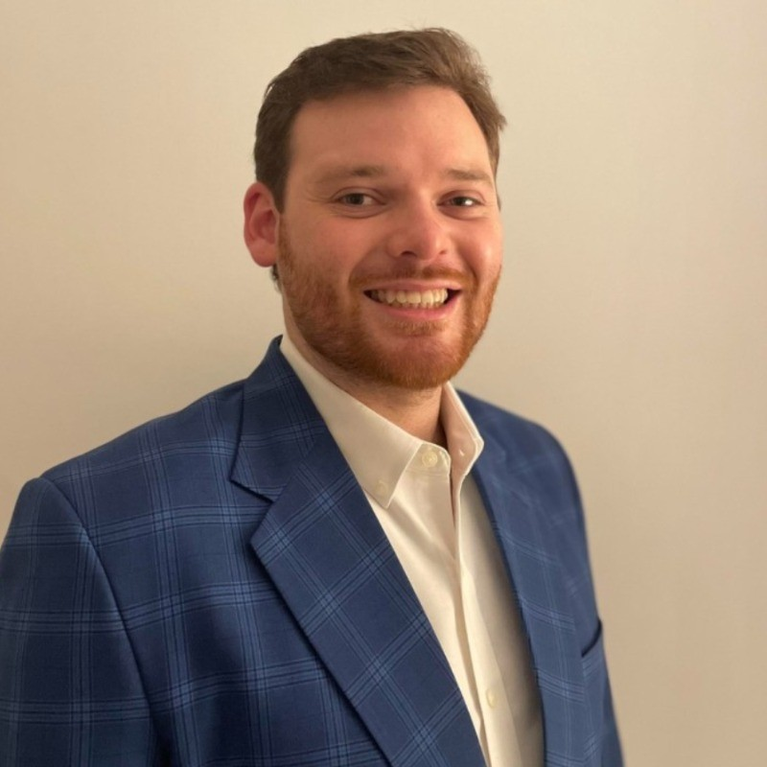
Colin Jansson
Colin currently works as a Financial Analyst at Northrop Grumman.
He received his bachelor’s degree in business from West Virginia University.

Slide 7

Jacob Williams
Hometown: Gambrills, Maryland
Expected Graduation: Spring 2025
Currently working at Brown Advisory as an Asset Transfer Analyst. Previously worked at Morgan Stanley for 2 years in Reference Data and Foreign Currency Trade Support

Slide 8
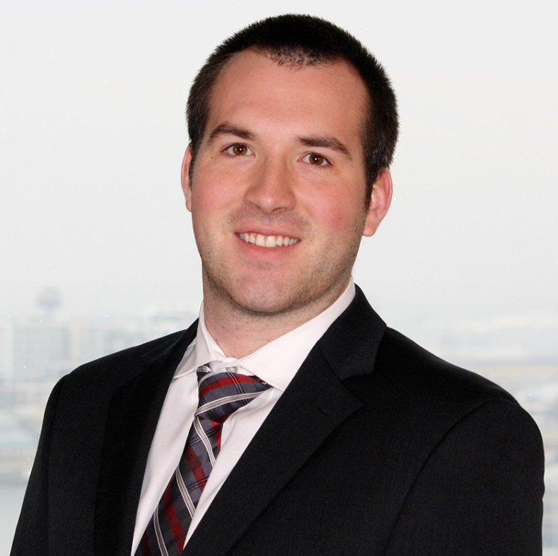
Michael P. Payne
Mr. Payne is an Investment Analyst in US Equity at Raymond James specializing in Semiconductors and the Semiconductor supply chain.
Prior to Raymond James, Mr. Payne worked in Fixed Income at T. Rowe Price supporting the Chief Economist and portfolio managers of corporate and municipal credit strategies.

Slide 9
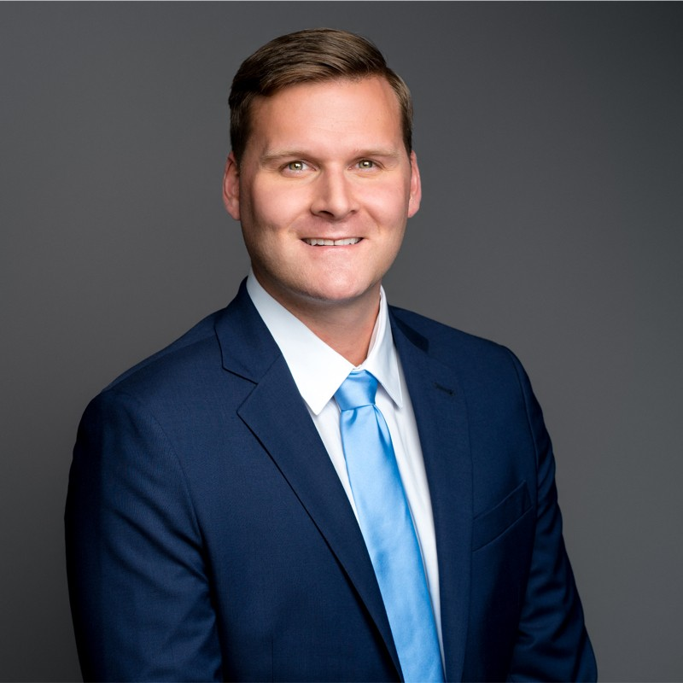
Paul Tegen
Paul currently works as a Financial Systems Analyst at FTI Consulting.
He received his bachelor’s degree in business management from the University of South Carolina.

Slide 10
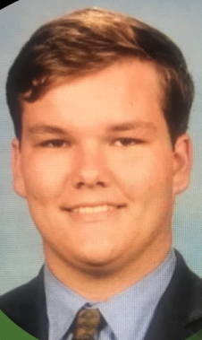
Luke Kelly
Luke is expecting to graduate in 2024 from the PMBA Program with a specialization in Finance.
He received his bachelor’s degree from Loyola in 2023 and is originally from Long Island, NY.

Slide 11
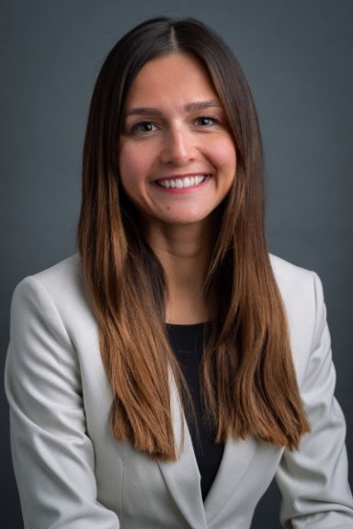
Megan Turlik
Megan is pursuing an MBA at Loyola University of Maryland Sellinger School of Business specializing in Finance and will be graduating after the 2024 summer courses.
In 2017, Megan graduated from Towson University with a bachelor's degree in Business Administration with a concentration in Finance. She has been working at T. Rowe Price for the last seven years and currently supports the Private Asset Management Group maintaining both managerial, operational, and client service responsibilities.

Slide 12
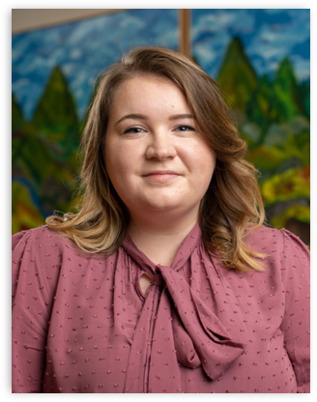
Victoria Wolcott-Guy
Victoria is completing her last semester in Loyola's MBA program. She received her bachelor's degree in Accounting in 2019 at Towson University.
Victoria is currently a Partnership Accounting Manager at Knollwood Investment Advisory, where she has worked for the last 5 years. Her main responsibilities include investment accounting, cash management, and budget forecasting.

Slide 13
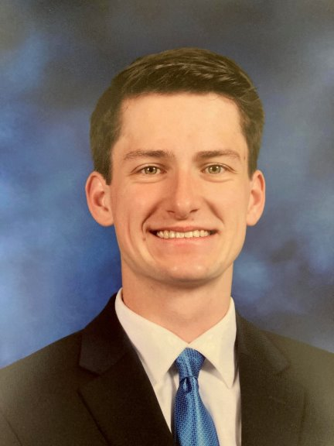
Jimmy Wawrzynski
Jimmy will graduate in 2025 from Loyola University Maryland's Sellinger School of Business with an MBA specializing in Finance. In 2021, Jimmy graduated from McDaniel College with bachelor's degrees in Business Administration and Economics.
He has been working at M&T Bank for the past three years as a Branch Manager, overseeing the bank's operations and performance. His responsibilities include meeting sales targets, managing staff, and supporting business client relationships.

Slide 14
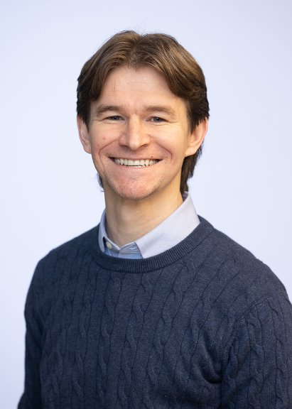
Jeff Uthe
Jeff will be graduating the PMBA program in December 2024. He received his bachelor's degree in 2016 from Millersville University of Pennsylvania, where he majored in business admin. with an accounting focus.
He currently works at Loyola University Maryland as the Senior Investment & Treasury Associate. His primary responsibilities center around the school’s banking, treasury, and investment operations.

Slide 15
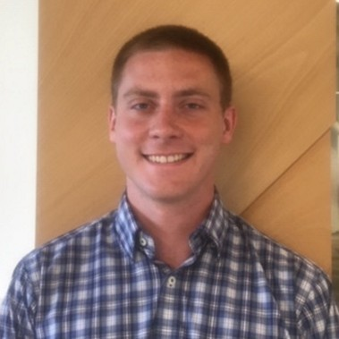
Jonathan Pellatiro
Johnathan is a senior project manager at Baltimore County Public Schools. Prior to this position he worked at the U.S. Department of Veterans Affairs and Glibane Building Company.
He received his bachelor’s degree from Virginia Tech University in 2016.

Slide 16
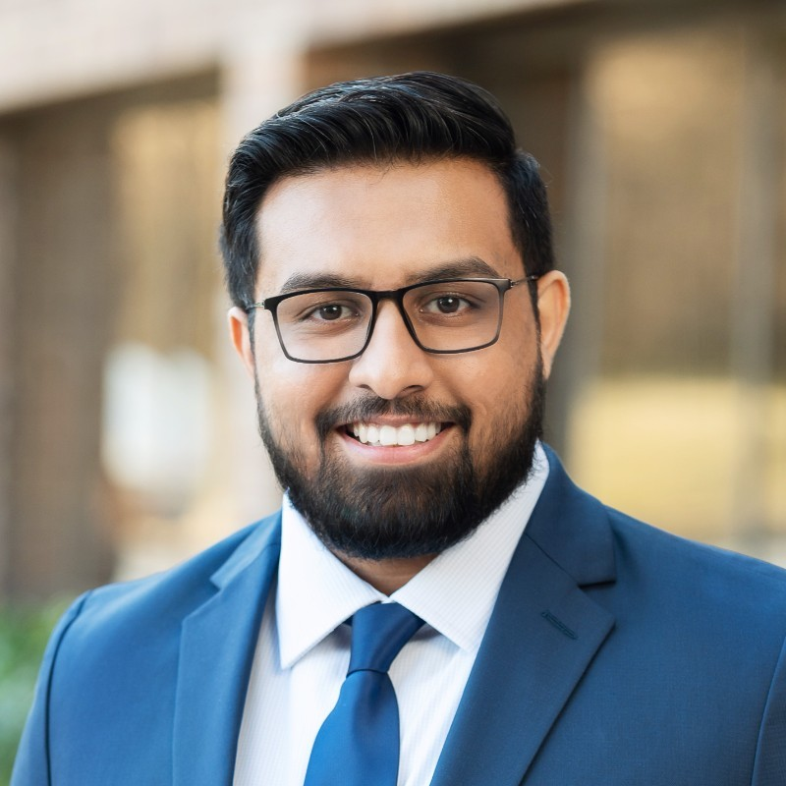
Neel Patel
Neel currently works as a Securities Admin. Services Analyst III at Computershare.
He received his bachelor’s degree in business administration with a concentration in Finance from Towson University.

